Slide 1
CUSTOMER SEGMENTATION RESEARCH
Customer Segmentation Using RFM Analysis
and K-Means Clustering
Evidence from an Online Retail Dataset
Juliana Agyapong
M.S. Marketing Analytics, Illinois Institute of Technology
Independent Research Project 1 — Consumer Behavior Research Portfolio

Slide 2

THE RESEARCH QUESTION
Do purchase frequency and monetary value represent a single dimension of customer behavior — or two distinct dimensions that reveal meaningful customer segments?
Marketing practice often assumes frequent buyers are automatically high-value customers. If that assumption is wrong, businesses risk over-investing in low-value repeat buyers while under-serving a smaller group of infrequent, high-value customers who disproportionately drive revenue.

Slide 3





HOW THE ANALYSIS WAS BUILT
Five-Step Analytical Pipeline
1
2
3
4
5
→
→
→
→
Clean Data
Build RFM
Correlate
Cluster
Validate
541,910 transactions → 397,885 after removing cancellations, invalid prices, missing IDs
Recency, Frequency, and Monetary value computed for 4,338 customers
Spearman correlation tests whether Frequency and Monetary move together
K-means (k=4) groups customers by both dimensions jointly
Silhouette analysis + PCA confirm the segmentation is defensible

Slide 4
FINDING 1
A Strong Overall Relationship—But Not the Whole Story
ρ = 0.807
Customers who purchase more frequently also tend to spend substantially more overall — a strong, statistically significant relationship.
But a strong correlation only shows association — not that frequency and spending measure the same thing. Do meaningful sub-groups exist within that average relationship?
p < .001
Spearman correlation:
Frequency × Monetary Value
That's exactly what clustering was used to test next →

Slide 5


FINDING 2
Four Behaviorally Distinct Customer Segments
Rare / One-Time Buyers
Regular Repeat Customers
2,075 customers
1,939 customers
Avg. Frequency: 1.49 orders
Avg. Monetary: $307 spend
Avg. Frequency: 4.42 orders
Avg. Monetary: $1,768 spend
Loyal High-Value Customers
Extreme High-Value Outliers
316 customers
8 customers
Avg. Frequency: 18.6 orders
Avg. Monetary: $13,301 spend
Avg. Frequency: 122 orders
Avg. Monetary: $80,210 spend

Slide 6
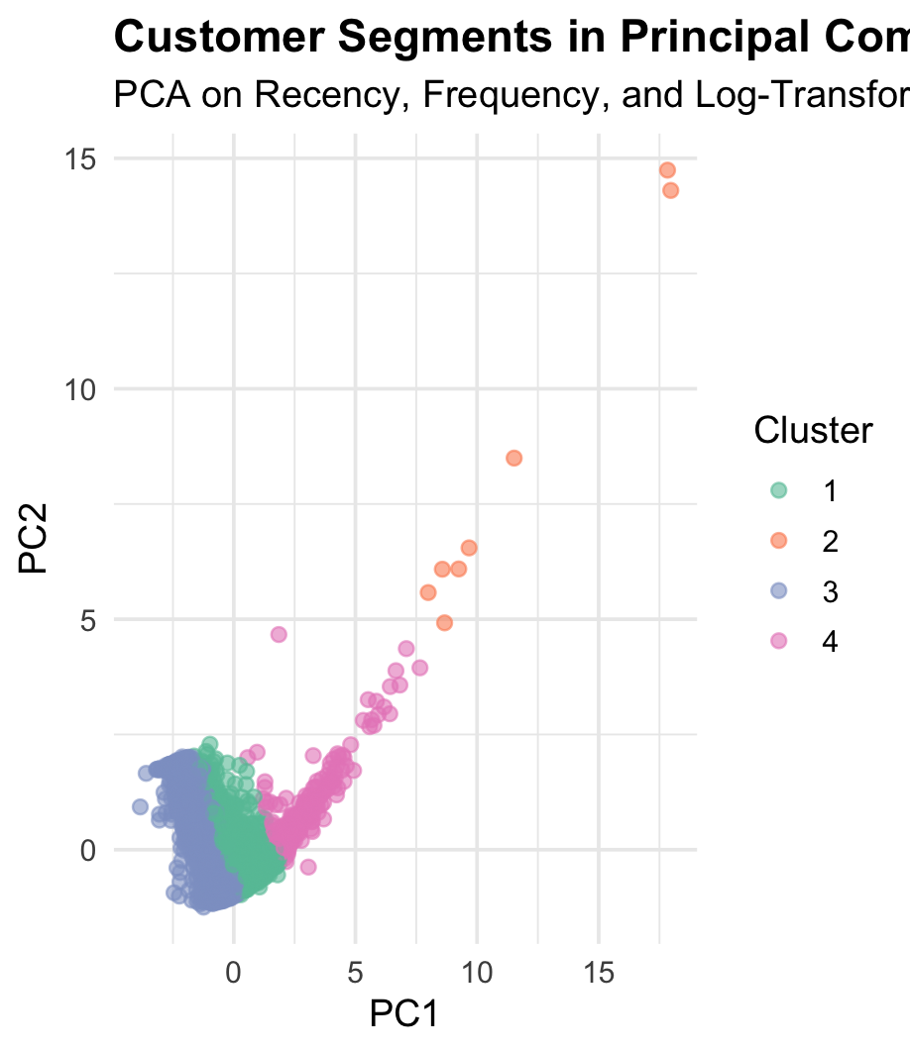
A CONTINUOUS SPECTRUM, NOT SHARP GROUPS
Principal Component Analysis
PC1 and PC2 together explain 86.9% of total variance. Segments separate primarily along PC1 — but the gradient is continuous, not sharply bounded.
This means customer purchasing intensity varies smoothly across the base — the four clusters are useful, interpretable cuts through that spectrum, not naturally occurring, pre-existing groups.

Slide 7
WHY IT MATTERS
Practical Implications for Marketing Strategy
Don't equate frequency with value
A meaningful minority of customers spend disproportionately relative to how often they purchase — frequency alone would miss them entirely.
Target retention resources more precisely
Loyalty incentives and retention efforts benefit from accounting for Frequency and Monetary value jointly, not using either as a stand-in for the other.
Rethink customer lifetime value models
CLV strategies built on frequency alone risk overlooking infrequent purchasers who generate substantial revenue over time.

Slide 8
Read the Full Research Report
Complete methodology, results, discussion, references, and reproducible R code are available on GitHub.
github.com/julia-agyapong/customer-segmentation-rfm
Juliana Agyapong • M.S. Marketing Analytics, Illinois Institute of Technology

