Slide 1
Airline Radiation Project -- Contents
Thinnest atmosphere simulation
High energy biasing method
Simulation Results
Radiation units verification

Slide 2
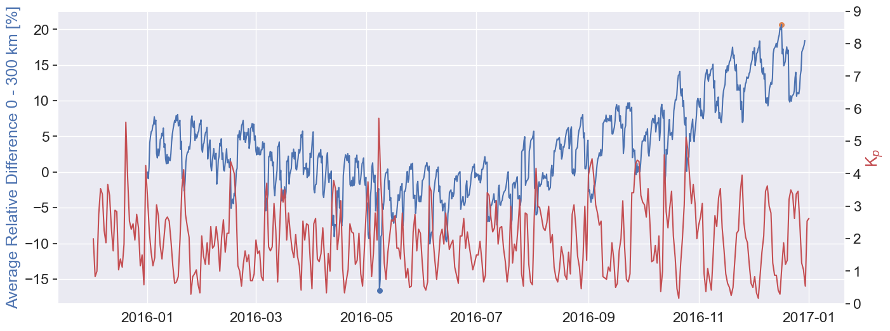
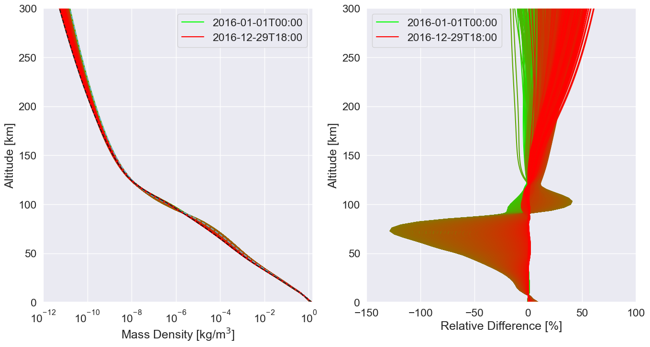
Where is the atmosphere the thinnest?
I perform a grid search of MSIS2.0 spanning the domain:
Time: [2016-Jan-01, 2016-Dec-30], Δ𝑡= 4 hours
Longitude: [-180∘, 180∘], Δ lon = 18∘
Latitude: [60∘, 70∘], Δ lat = 3.3∘
Altitude: [0, 300] km Δalt = 3 km
The atmosphere profile is found by averaging over the latitude and longitude range, then calculating the largest relative difference over the year.
We find that during a high K_{p} event on 2016-05-08 the atmospheric mass density profile between 0 – 300 km is the thinnest. The atmospheric mass density profiles over 2016 are plotted below.
NB: relative difference on the plots to the right calculated with respect to Jan 1 profile

Slide 3
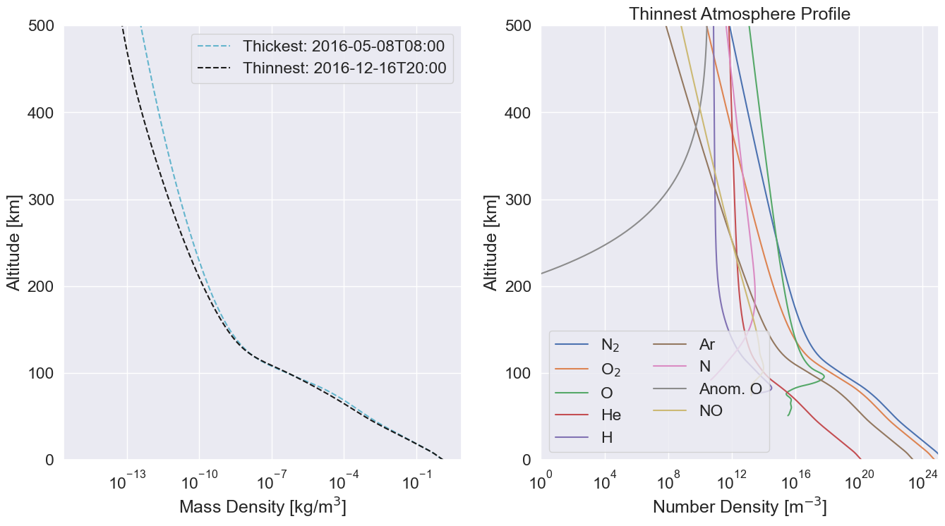
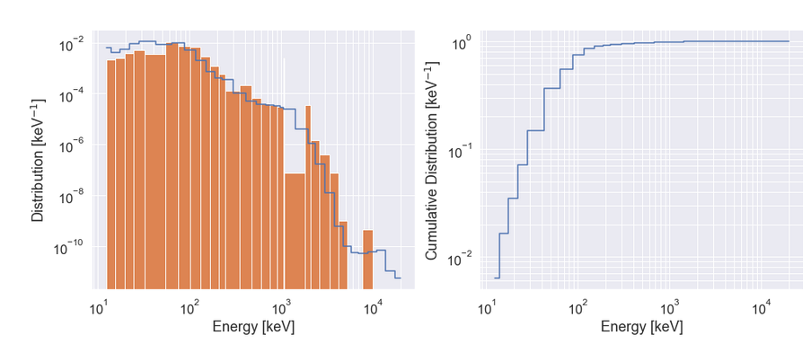
Direct Energy Sampling
Thinnest profile atmospheric constituents, from previous slide
Instead of the Green’s function method which uses the results of weighted mono-energetic electron beams of energies {…, 0.5, 0.71, 1.0, 1.414, 2.0, 3.162, 5.0, 7.071, 10.0} MeV, I simulate the full loss cone electron spectrum >10 keV using inverse CDF transform sampling.
This avoids the discretization errors that can arise from the spacing of the mono-energy beams. An example of this error can be seen in the fact that the 1.0 MeV beam does not transport energy to 11 km, but the 1.4 MeV beam does, which implies there exists some underestimation of the radiation dose rate due to the 1.0 – 1.4 MeV electron flux.
This error is likely a small contribution to the total error, but is nonetheless accounted for by directly simulating the exact electron spectrum.

Slide 4
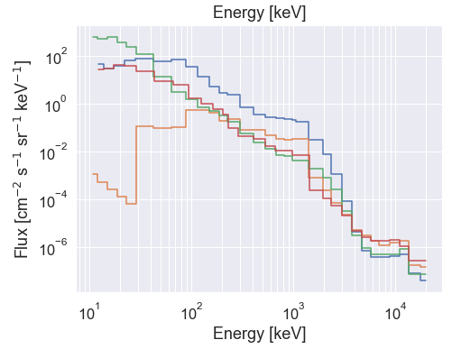
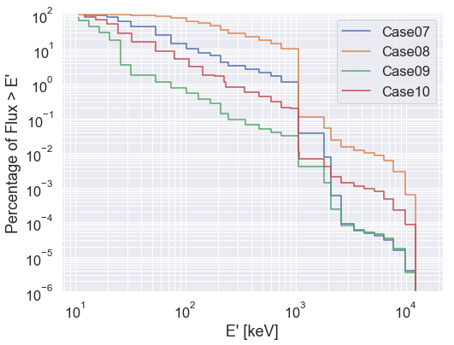
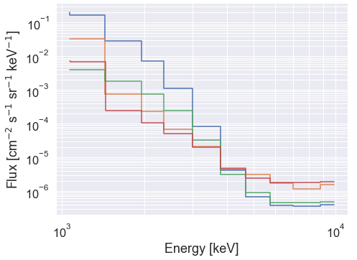
Energy Biasing Method
Flux
With the direct sampling method, the highest energies can be unlikely to be sampled. To fully explore the higher energy region of the domain, the spectra are truncated at some energy E and only energies above E are simulated. The simulation results are then renormalized by the amount of flux > E
Bias energies
E₁ >10 keV , N1 = 6.954 x 10³ cm⁻² s⁻¹ sr⁻¹
E₂ >1 MeV , N2 = 7.970 x 10¹ cm⁻² s⁻¹ sr⁻¹
E₃ >1.8 MeV , N3 = 7.998 x 10⁰ cm⁻² s⁻¹ sr⁻¹
N₃ = ∫_{E3} f(E) dE
Energy
S₁: E > E₁
S₂: E > E₂
S₃: E > E₃
>10 keV
>1 MeV
Representation of renormalization fraction

Slide 5
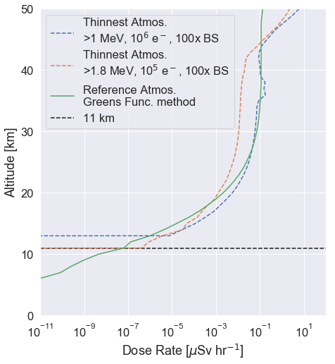
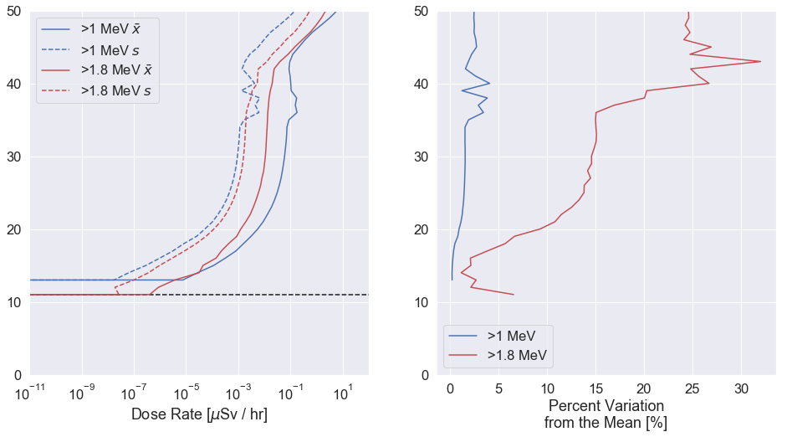
Bias Simulation Results
The following energy bias simulations are run through the thinnest atmosphere profile
>1 MeV, 10⁶ electrons
  Radiation does not reach 11 km
>1.8 MeV, 10⁵ electrons
  Radiation does reach 11 km, ~10⁻⁶ uSv/hr
Standard deviation s calculated between 40 simulation threads of 10⁶/40 and 10⁵/40 particles/thread for both simulations: s < 40% of mean radiation dose value
  I.e., 1.96 * s for a 95% confidence yields
  < 10⁻⁵ uSv/hr
NB: I also implement the bremsstrahlung splitting (BS) biasing method: for each time a bremsstrahlung interaction occurs, the cross section is sampled N times (in our case N = 100) and propagates those photons with weights 1/N. This method was verified by Xu, et al. 2019 as well as Berland, et al. 2023.

Slide 6
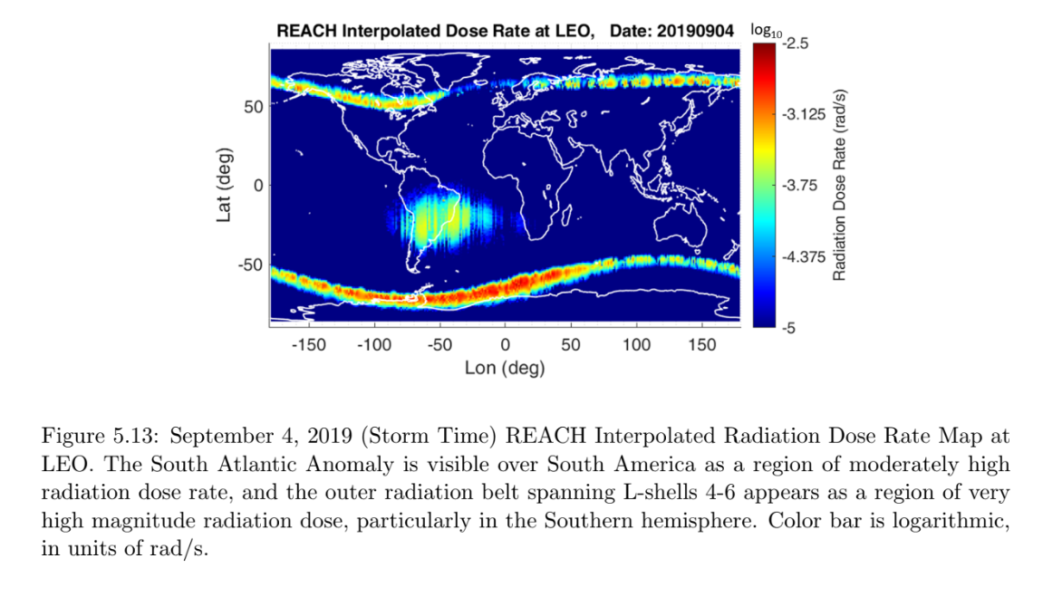
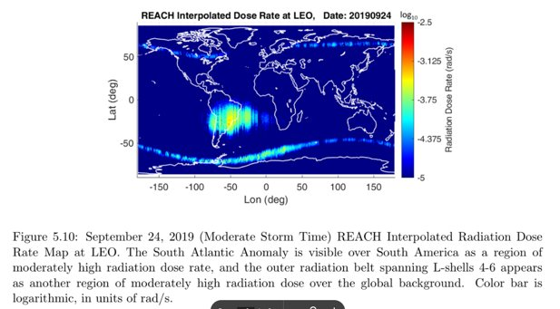
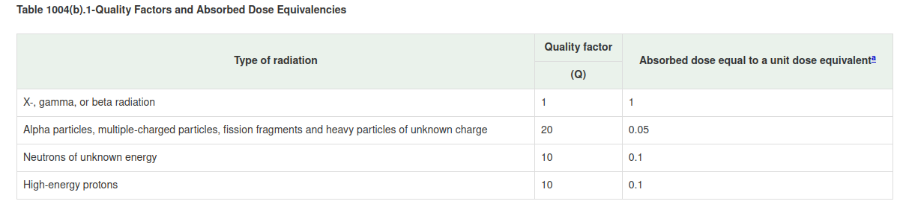
Radiation Units
We would like to verify that, in a well-known region, our radiation dose rate matches a reference. Above the atmosphere before any radiation transport is simulated, we calculate the dose rate and compare to the Teledyne dosimeters onboard the REACH constallation, orbiting at 700 – 800 km.
Range of reasonable dose rates taken from REACH X – W data as presented in McMurchie, 2022
  Max: 10^{-2.5} rad/sec, during storm time
  Min: 10⁻⁵ rad/sec, during moderate storm time
Converting from rad to Sievert (Sv)
  100 rad = 1 Gray (Gy) = 1 J/kg absorbed energy
  (no assumption)
  1 Gy = 1 Sv (*assumption)
*Assumption: US NRC § 20.1004

Slide 7
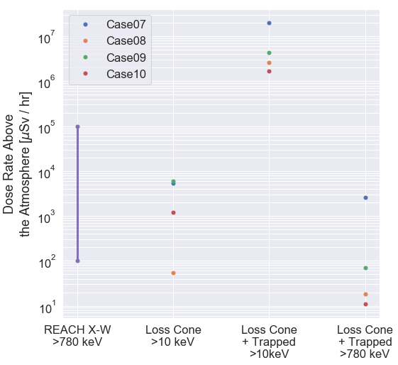
On the Verification of Radiation Units
Continuing from the last slide,
= [10⁻⁵, 10^{-2.5}] rad / sec
= [10⁻⁷, 10^{-4.5}] Gy / sec
= [10⁻⁷, 10^{-4.5}] Sv / sec * 10⁶ uSv / Sv * 3600 sec / hr
= [3.6 x 10², 1.1 x 10⁵] uSv/hr (plotted right)
Caveats:
The REACH X-W dosimeter is only sensitive to >780 keV electrons, but proton dose is excluded
REACH dosimeter is absorbing trapped + loss cone electrons
Best comparison

