Slide 1
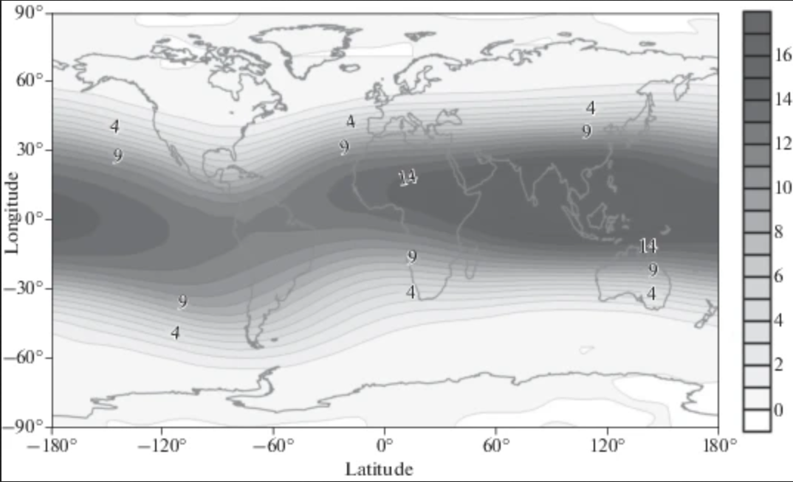
Geomagnetic Cutoff
Rc [GV] -- kinetic energy necessary to penetrate past the inner magnetosphere to the atmosphere
ΔR [GV] -- deviation from model, either derived from perturbation model or measured + derived by ground stations
TS01 Rc map during the Nov. 20, 2003 geomagnetic storm , Danilova, et al. 2019

Slide 2
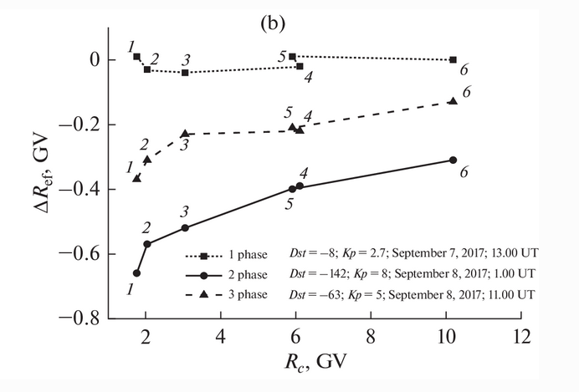
Geomagnetic Cutoff
Kravtsova, et al. 2015 analyzed the Forbush decrease ahead of Nov. 20 CME-induced geomagnetic storm and identified periods of CME interaction and non-interaction with the magnetosphere
Danilova, et al. 2019; Ptitsyna, et al. 2020; Danilova, et al. 2023 analysis of Nov. 20, 2003 geomagnetic storm:
ΔR maximizes at mid-latitudes, around -1.8 GV
Northern hemisphere ΔR is greater than Southern hemisphere ΔR
ΔR strongly correlated (0.7 - 0.98) with Dst through all phases of geomagnetic storms
ΔR correlations with solar wind number density, velocity, Bz, By, |B|
TS01 underrepresents high-latitude ΔR during geomagnetic storms

Slide 3
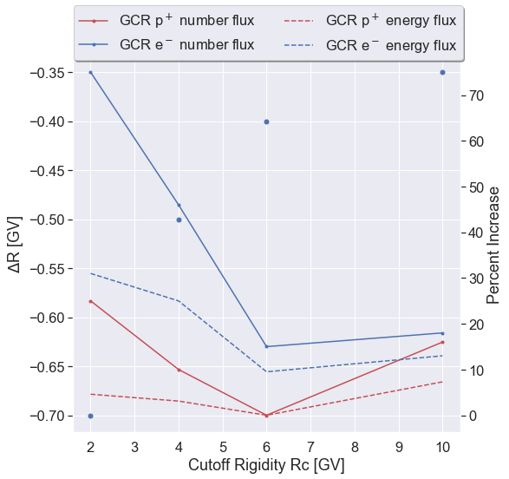
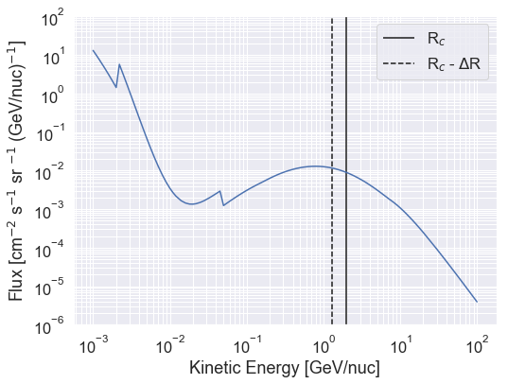
Increase in GCR flux due to ΔR
ΔR from Dst storm phase 2
Higher latitudes
Up to 25% more GCR proton number flux and up to 30% more GCR electron energy flux due to Dst = –140 nT geomagnetic storm

Slide 4
Conclusion
  There exists a strong correlation between ΔR and Dst --> The effect of ring current enhancement plays a role in reducing geomagnetic cutoff rigidity
  A decrease in the cutoff rigidity (ΔR < 0) allowing a larger fraction of the GCR spectrum to access the atmosphere
Open questions
  What relationship exists between ring current enhancement and hiss wave generation that does not exist between EMIC and whistler-mode chorus waves?
  To what extent do Rc decreases occur with Dst perturbation outside of stormtime periods? I.e. was it the storm effects or solely enhancements in Dst that reduce Rc? Kichigin, et al. 2016 says it's the latter but was a pure modeling effort

Slide 5
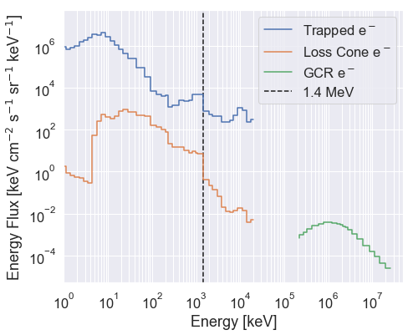
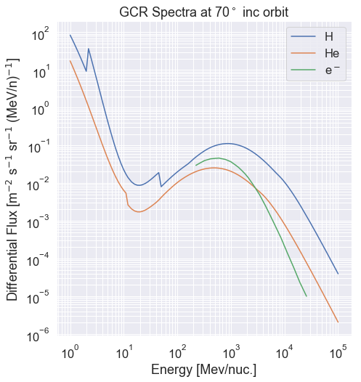
GCR electrons
Magnetospheric electrons
Energy flux >1 MeV: 3.40 x 10³ keV cm⁻² s⁻¹ sr⁻¹
GCR electrons
Energy flux >200 MeV: 1.42 x 10⁴ keV cm⁻² s⁻¹ sr⁻¹
GCR e⁻
Case 10
GCR spectra

Slide 6
Addendum – Cutoff Rigidity Investigation
Summary of motivation and results
  Radiation belt electron precipitation alone is unlikely to cause the ARMAS-observed increased dose rates. Investigations into other possible sources revealed a dose rate sensitivity to cutoff rigidity, and a literature search showed recent work linking enhancements in Dst during all phases of geomagnetic storms to a decrease in cutoff rigidity (slides above). I took the below routes to quantify the decrease in cutoff rigidity to an increase in dose rate at airline altitudes. I would need more time to verify a Geant4 GCR radiation dose model, so an alternate method – deemed a "proxy analysis" -- is performed using the NAIRAS model outputs by shifting to regions of lower cutoff rigidity.
Geant4 GCR forward model
  Did not reach convergence -- not matching NAIRAS radiation dose rates versus altitude without further tuning
  Finding consistent dose rate conversion curves per particle is a messy business – many aspects go into energy deposition & biological effects
NAIRAS analysis
  Can instead use NAIRAS results to perform a proxy analysis of dose rate sensitivity to Rc/ΔRc
  (From previous slides) ΔRc ~ [-0.7, -0.3] GV possible during Dst enhacements

Slide 7
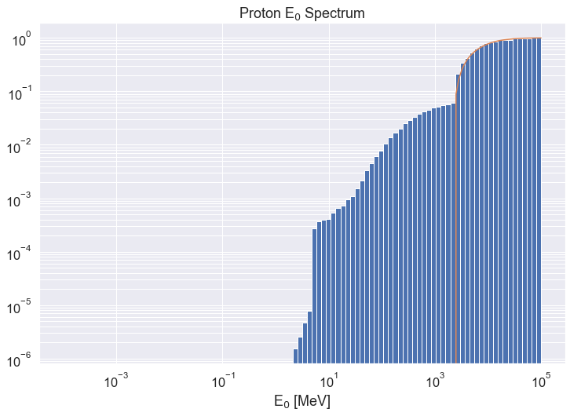
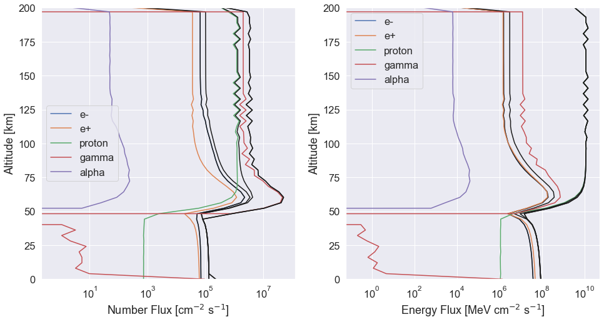
Geant4 GCR Model
GCR proton CDF
GCR proton spectrum being sampled correctly
Occurrence CDF
Input: GCR proton spectrum
X-axis scaling on right figures arbitrary
Computationally expensive
  ~10⁵ secondaries per initial GCR
Large input space
  H – Fe ~ 26 atomic species
  Range of ΔRc versus Rc would need to be simulated
Errors
  Particle transport < 50 km needs smaller step size
  Isotope decay lifetimes and re-emission needs to be handled separately
  Rest of the spectrum, He – Fe, needs to be run
Viable option, I would just need more time to tune the model to replicate the NAIRAS radiation transport code HZETRN results.
  Physics list & secondary propagation likely need tuning – Regener-Pfotzer maximum too high
Secondary proton emissions

Slide 8
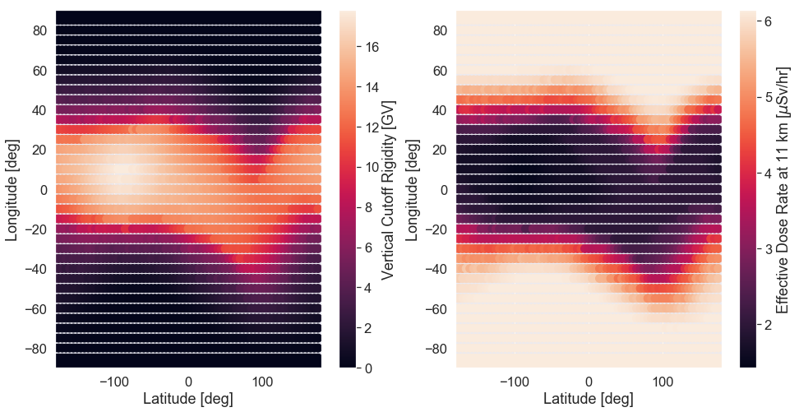
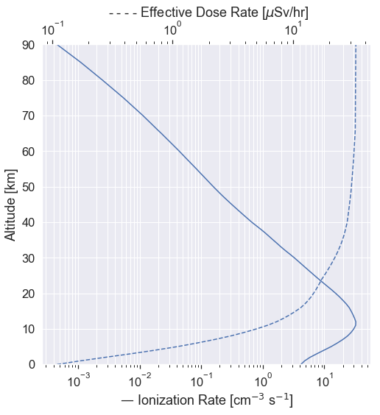
NAIRAS Analysis
NAIRAS run through the CCMC for
Jan 1 – 5, 2016 as an example – 4 GB of output per run!
"Proxy analysis" -- we can utilize the NAIRAS radiation transport code HZETRN in a self-consistent way by searching the global maps for a region that is ΔRc away from our flight path
  We'll need to account for different precipitating populations!
NAIRAS outputs at each (lat, lon, alt)
  Atmospheric ionization rate [cm⁻³ s⁻¹]
  Silicon absorbed dose rate [uGy/hr]
  Tissue absorbed dose rate [uGy/hr]
  Tissue Dose Equivalent rate [uSv/hr]
  Ambient Dose Equivalent Rate [uSv/hr]
  Effective Dose Rate [uSv/hr]
Regener-Pfotzer ionization maximum

Slide 9
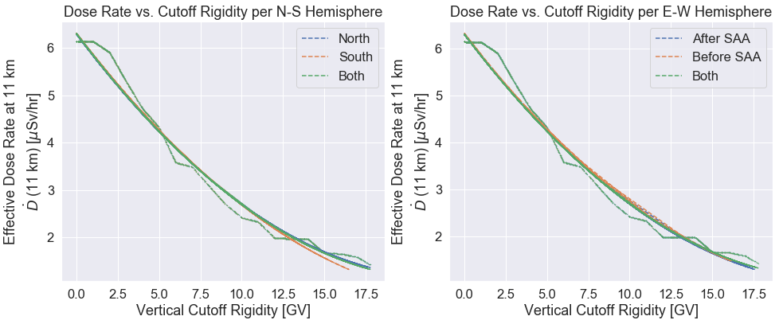
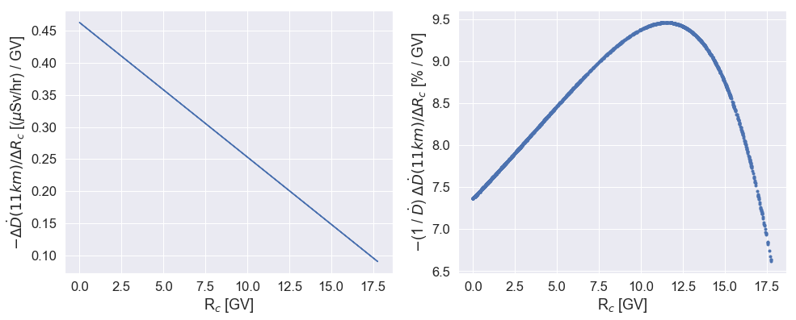
NAIRAS Analysis
Cutoff rigidity Rc and effective dose rate at 11 km Ḋ₁₁ plotted
Ḋ₁₁ vs. Rc segmented by
  northern/southern hemisphere
  before/after SAA
  No significant difference in 2nd degree polynomial fit to data based on geodetic segmentation
Plotted right, bottom row:
  -ΔḊ₁₁ / ΔRc calculated analytically – change in effective dose rate at 11 km versus cutoff rigidity
  -(1 / Ḋ₁₁ ) ΔḊ₁₁ / ΔRc -- percent change in effective dose rate with changing cutoff rigidity versus cutoff rigidity
Non-storm time NAIRAS run – maximum change of ~10% to Ḋ₁₁ with ΔRc ~ 1 GV – not enough to explain enhancement in dose rate signal
40º – 60º
geodetic
latitude

Slide 10
NAIRAS Analysis
Next steps (if this route is to be pursued)
  Re-run NAIRAS or obtain NAIRAS results for ARMAS flight times
  Create global dose rate-cutoff rigidity sensitivity curve
  β = -(1 / Ḋ₁₁ ) ΔḊ₁₁ / ΔRc and compare to observed dose rate increases
  Caveat! We may be convolving the effects of different precipitating populations and cutoff rigidity, which can be ammended by:
  Tuning Geant4 model to obtain β curves directly as a function of (Rc, ΔRc)
Open Question
  Various solar and geomagnetic conditions affect GCR flux incident on the atmosphere, as well as atmospheric scale heights – a more complete "proxy analysis" of NAIRAS conditions are needed to conclude if β curves can explain the observed signals
Conclusion
  The NAIRAS solution on Jan 1, 2016 shows the effect of reasonable ΔRc values are not sufficient to explain enhanced radiation dose
"β curve"

