Slide 1
Airline Radiation Dose Rate -- Inversion Problem
Inversion question: what precipitating electron spectrum will produce the observed results?
Two avenues to evaluate this problem:
  Increase flux
  Increase spectral hardness

Slide 2
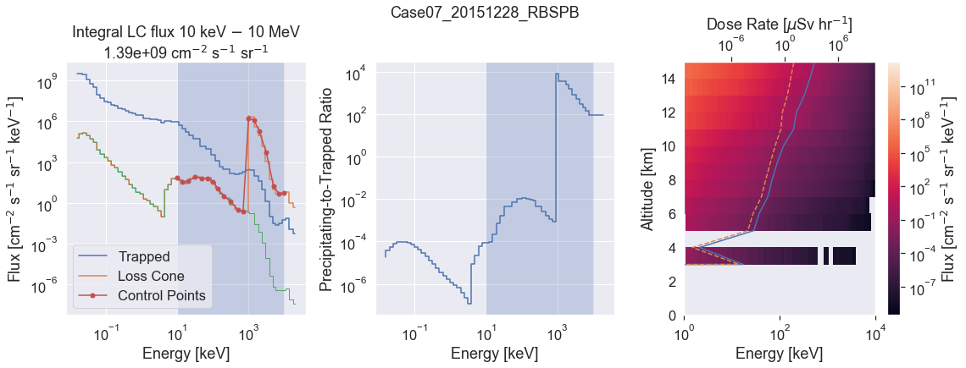
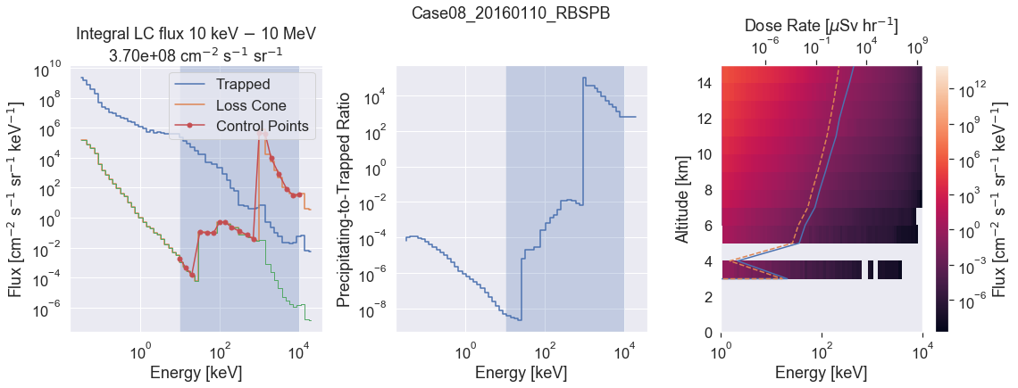
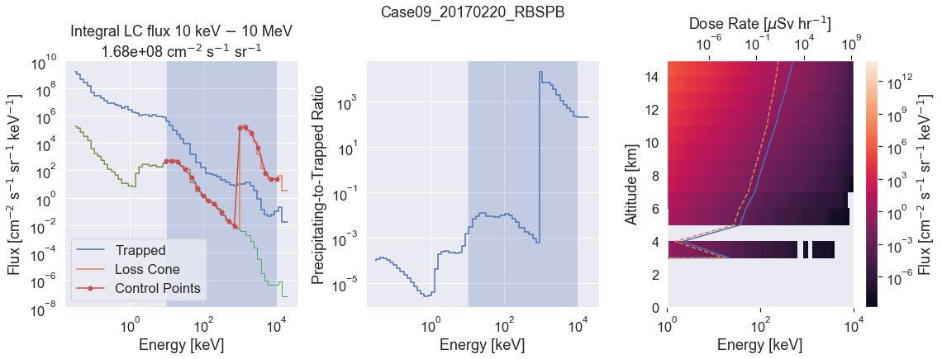
Existing Cases
I artificially inflated the flux of the > 1 MeV portion of the existing Van Allen Probes electron spectra to achieve a goal dose rate, D_{G} = 10¹ uSv/hr at 11 km.
The results of Cases 7, 8, and 9 are shown to the right, where the orange spectra is linearly shifted upwards in flux to achieve the goal dose rate. The original spectra are shown in green, and the trapped population in blue for reference.
These three cases require their integral flux >1 MeV to be 2 – 8 x 10⁷ times higher to achieve 10¹ uSv/hr at 11 km without modifying the spectral distribution.

Slide 3
Dose Rate Calculation Inversion
Input electron spectrum f(E):
f(E) = f₀ * w(E_{i})
Atmospheric transfer function between altitudes h₁ and h₂, H(h₁, h₂, E, E'):
f_{11km}(E) = H(11 km, ∞, E, E') * f∞(E)
  D_{11km} = ∫ f_{11km}(E') C(E') dE' = f₀ ∫ H(11 km, ∞, E, E') w(E) C(E') dE'
  D_{11km} = f₀ w(E_{i}) • d(E_{i})
  Where d(E) are the pre-computed conversion factors per monoenergetic electron with the incorporated atmospheric attenuation effects H(11 km, ∞, E, E'). In the above integral, E' is the electron energy after being operated on by H, which is separate from the input distribution electron energy E, which is why the weights are separable out of the integral.
General problem: find the weight coefficient matrix that produces the desired result
f₀ ( w_{i} • d(E_{i}) ) = D_{G}
Where • is the dot product operation, D_{G} is the goal dose rate (in this case 10¹ uSv/hr), w_{i} is the vector of normalized weights applied to the differential dose rate from monoenergy beam d(E_{i}), and f₀ is the total integrated flux. The vector w_{i} controls the spectral distribution.

Slide 4
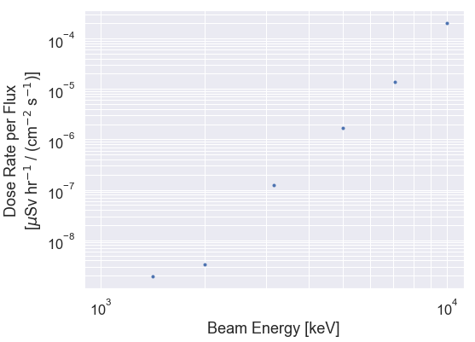
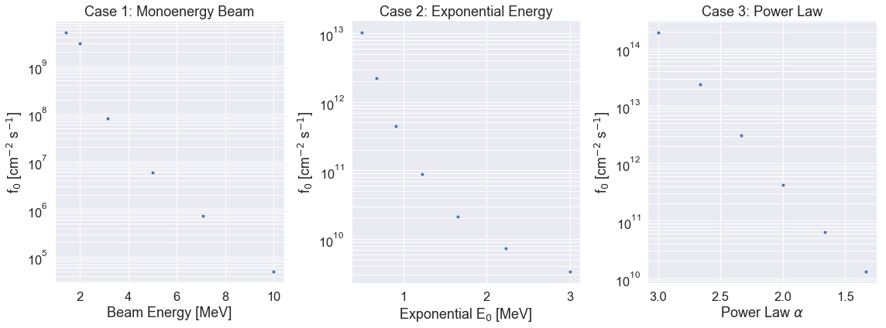
Other Energy Distributions
This is an underconstrained problem, i.e. dose rate
is not uniquely invertible to precipitating spectrum,
so instead let's use some physics constrains to
guess at reasonable spectral distributions.
Case 1: Monoenergy beams f(E) = f₀ E₀
Case 2: Exponential energy f(E) ~ f₀ e^{-E/E0}
Case 3: Power law energy f(E) ~ f₀ E^{-α}
NB: In this case f₀ is integrated over the entire distribution, not the >1 MeV portion.
Conclusion: sufficiently high (>10¹⁰ cm⁻² s⁻¹) precipitating electron fluxes over a variety of spectral distributions are needed to
achieve 10¹ uSv/hr dose rates at 11 km.

