Slide 1
HR data attrition analysis
data modeling with scikit-learn and deep learning

Slide 2
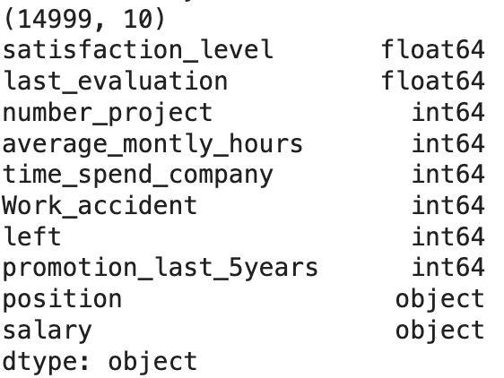
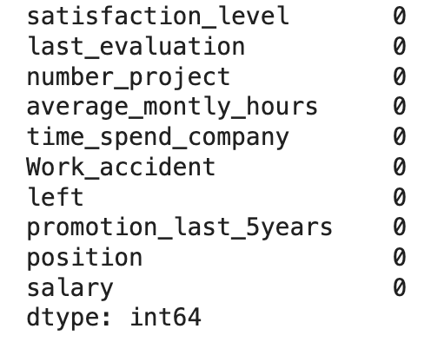
Data inspection
Data type, nulls, total columns and rows
Ten columns with 14999 records.
Eight numerical columns and 2 categorical columns with left as the target column (left the company or not).
No null values in all columns.

Slide 3
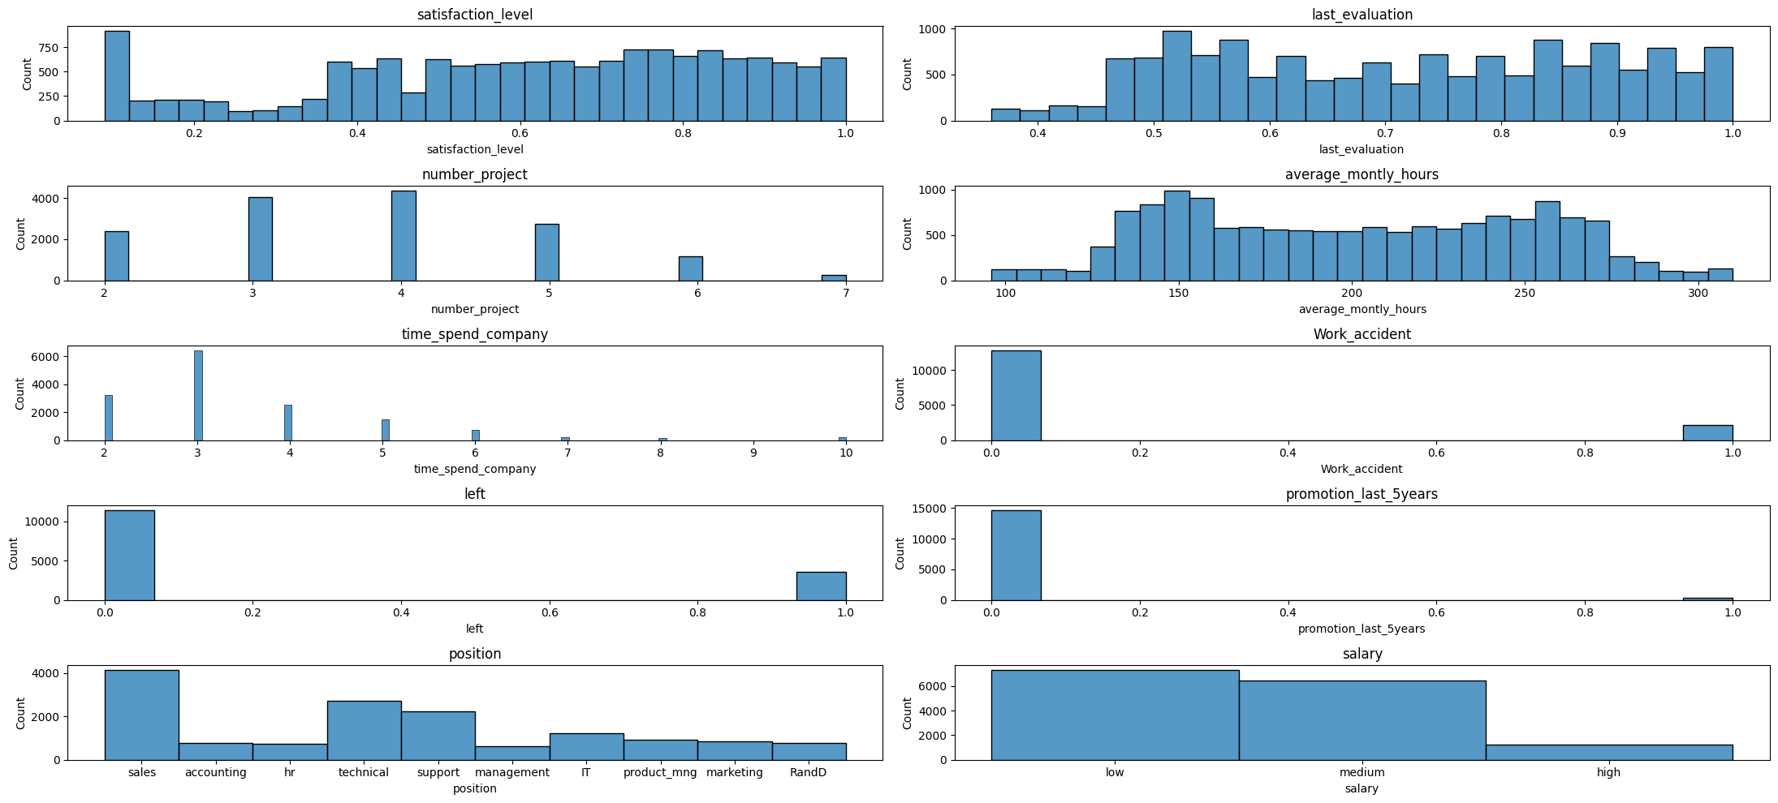
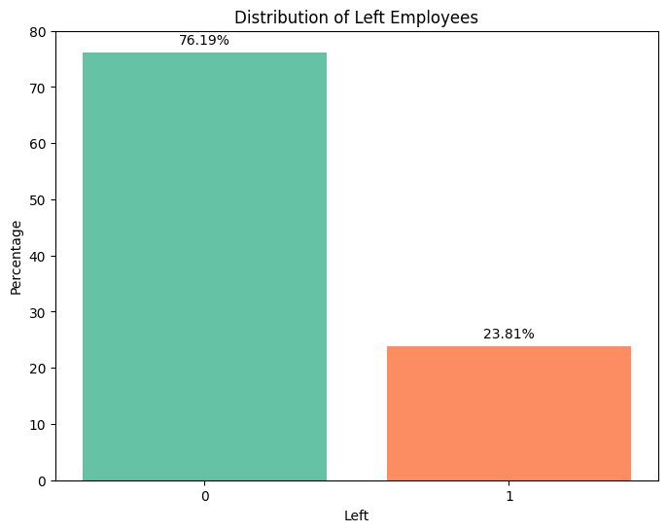
EDA
Columns Distribution pattern
23.81% left records in the total of 14999.
The only category column Salary (besides target column) is categorized as low, medium or high, ordinal encode will be used to transform to numeric variable later.

Slide 4
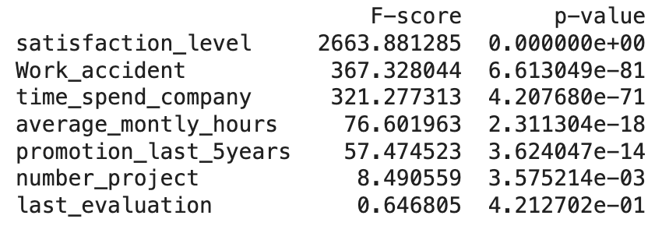
Statistical analysis on correlation between columns and attrition
F score and p value shown in descending order. (numeric columns)
The p value of satisfaction level is an effectively zero, indicating relationship between the satisfaction level and the dependent variable (likely the outcome of employees leaving or staying) is statistically significant.
there is no evidence of a relationship between last evaluation scores and the attrition in this context, thus last evaluation is excluded for data modeling.

Slide 5
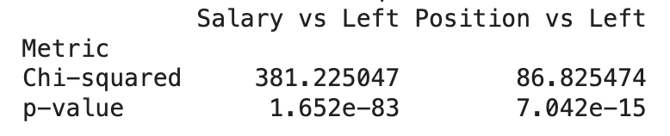
Statistical analysis on correlation between columns and attrition
Transform categorical columns
Salary using ordinal encoder
Position using label encoder
chi-squared, p values
both salary and position have statistically significant associations with employee turnover, with salary being a stronger predictor compared to position

Slide 6
Data preprocessing before modeling
Determine columns to include
Exclude column : 'Last evaluation'
Scaling and split data for training and testing
Standard scaling on columns: 'number_project','average_montly_hours', 'time_spend_company’
Data split: X_train, x_test, y_train, y_test = train_test_split(x, y, test_size=0.25, random_state=42, stratify=y)
Stratify on y to maintaining the same proportion of classes in both the training and test datasets

Slide 7
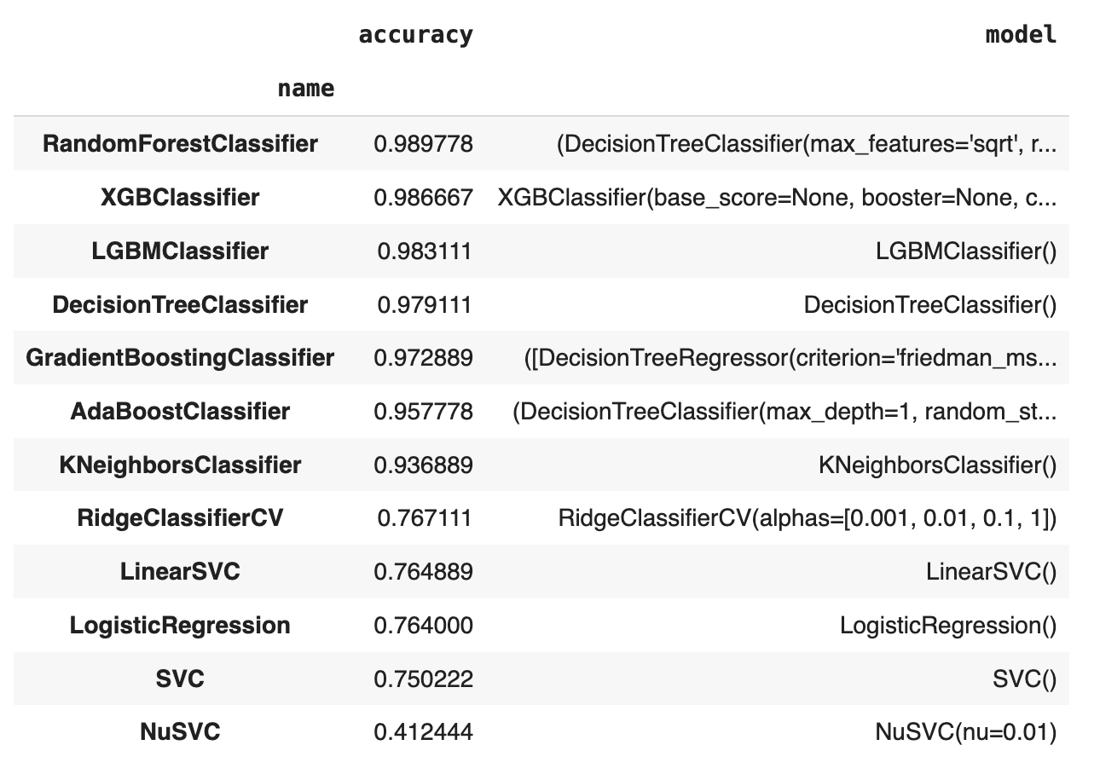
Data modeling with scikit-learn and deep learning algorithms
Random forest is selected and fit in the train data.
Deployed the model to the predication dataset and submitted the prediction attribution.
For code references, please see here: https://colab.research.google.com/drive/1sOOQSA0f2sHtMgZ6g6vE-gY0wo2rWEK_#scrollTo=x5j9kynqKyr-

