Slide 1
YARN is a new package manager for Javascript
a presentation by Julia Dizhak
December 18, 2017
Highly confidential information, not to be shared without the consent from MoneyPark
Notes:
<number>

Slide 2

Yarn build by facebook team
in a collaboration with Exponent, Google and Tilde

Slide 3
YARN > NPM

Slide 4


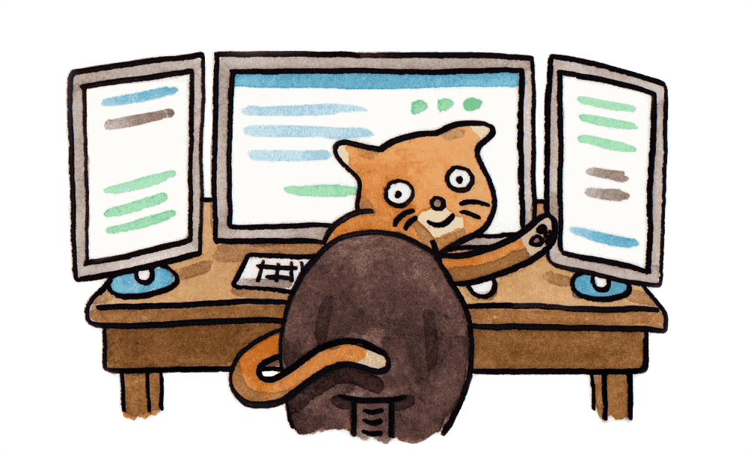
Yarn benefits
Ultra Fast
Mega Secure
Super Reliable

Slide 5
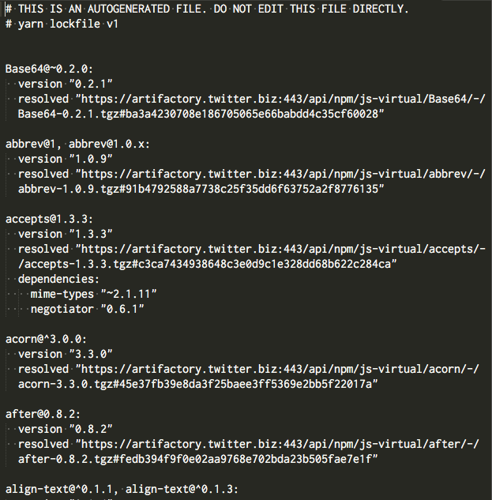
yarn.lock

Slide 6
Yarn usage
https://yarnpkg.com/lang/en/docs/usage/
yarn
yarn add [package]
yarn add [package]@[version]
yarn upgrade [package]
yarn remove [package]

Slide 7

Resources:
https://yarnpkg.com/en/
Yarn: A new package manager for JavaScript (blog article)
https://github.com/yarnpkg/yarn/
Migrating from npm
Yarn: an improvement over npm
Thank you for your time

