Slide 1
Esboço da apresentação

Slide 2
Microcontrollers
Microcontrollers such as the ones that power the Arduinos are designed for embedded applications. Unlike general purpose computers, an embedded processor typically has a well defined task that it must perform reliably and efficiently - and at minimal cost, Microcontroller designs tend to be rather spartan. They forego the luxuries of multi-layer caching and disk-based virtual memory systems and stick to what is essential to the task.
https://learn.adafruit.com/memories-of-an-arduino/arduino-memory-architecture

Slide 3
A completely different Scale
The biggest difference between these microcontrollers and your general purpose computer is the sheer amount of memory available. The Arduino UNO has only 32K bytes of Flash memory and 2K bytes of SRAM. That is more than 100,000 times LESS physical memory than a low-end PC! And that's not even counting the disk drive!
https://learn.adafruit.com/memories-of-an-arduino/arduino-memory-architecture

Slide 4
Memories of an Arduino
There are 3 types of memory in an Arduino:
Flash or Program Memory
SRAM
EEPROM
https://learn.adafruit.com/memories-of-an-arduino/arduino-memories

Slide 5
Memory
There are three pools of memory in the microcontrollers used on Arduino boards (e.g. the ATmega168):
Flash memory (program space), is where the Arduino sketch is stored.
SRAM (static random access memory) is where the sketch creates and manipulates variables when it runs.
EEPROM is memory space that programmers can use to store long-term information.
Flash memory and EEPROM memory are non-volatile (the information persists after the power is turned off). SRAM is volatile and will be lost when the power is cycled.

Slide 6
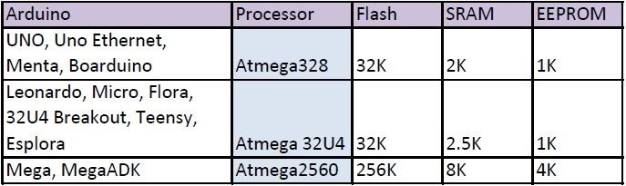
Arduino Memory Comparison
https://learn.adafruit.com/memories-of-an-arduino/arduino-memory-comparision
https://learn.adafruit.com/memories-of-an-arduino/measuring-free-memory
https://learn.adafruit.com/memories-of-an-arduino/optimizing-program-memory

Slide 7
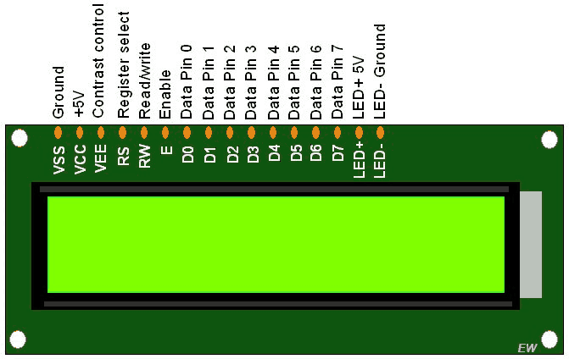
Display lcd
http://www.electronicwings.com/arduino/lcd-16x2-interfacing-with-arduino-uno

