Slide 1
COGNIRUN · BRAIN × BODY PERFORMANCE
Find the pace of
BODY
your best thinking.
×
A voice-first scan compares how you perform sitting, walking, running and recovering.
BRAIN
Provisional · task-specific · baseline-relative · not IQ
113-STUDY SYNTHESIS · SMALL AVERAGE EFFECT · OUTCOMES VARY BY TASK + TIMING
Notes:
Research does not give us one perfect pace. A 2024 synthesis of 113 studies found a small average acute effect, with outcomes varying by task and timing. In one Stanford experiment, walking increased divergent idea generation while a convergent one-answer task dipped slightly. CogniRun turns that nuance into a personal, task-specific scan—not an IQ test or a medical threshold.
[Sources]
- Garrett et al. (2024), https://www.nature.com/articles/s44271-024-00124-2
- Oppezzo & Schwartz (2014), https://aaalab.stanford.edu/assets/papers/2014/Give_your_ideas_some_legs.pdf

Slide 2
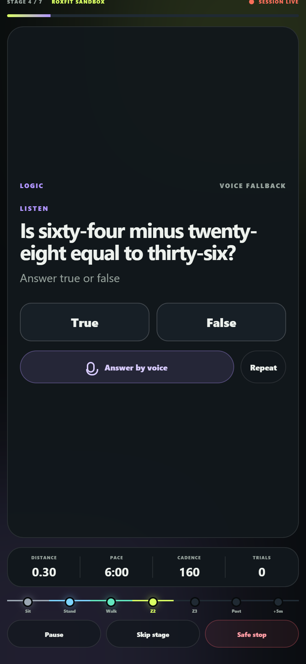
LIVE CHECKPOINT · ZONE 2
The run asks.
You answer.
ZONE 2 · 138 BPM · 6:00 /KM
VOICE PROMPT
“Is 64 − 28
equal to 36?”
YOU SAID
“True.”
COGNIRUN
✓ CORRECT · 2.8 s
NEXT · delayed recall
at +5 min recovery
USER-SUPPLIED RUNNER · GARMIN
Accuracy + response time + heart rate + pace
PROTOTYPE · DEMO DATA
Notes:
Here she is running in Zone 2. A question reaches her headphones; she answers without stopping; and CogniRun checks the task key. At that same moment the app links accuracy and wall-clock response time to heart rate and pace, then schedules the comparable recovery probe. The synchronized Brain × Body record is the product. This prototype screen truthfully labels ROXFIT sandbox and browser voice fallback.
[Sources]
- Runner/Garmin footage supplied by the user: marketing/cognirun-ad/public/video/runner-garmin.mov.
- Current CogniRun live-screen capture generated locally from the repository at 430×932.
- Wohlwend et al. (2017), https://www.frontiersin.org/journals/psychology/articles/10.3389/fpsyg.2017.00406/full

Slide 3
PROPOSED GO-TO-MARKET
Start personal. Scale through participation.
01
02
03
YOU
SCIENTISTS
SPONSORS
Train for interviews, theory tests and memory — under real physical load.
Turn an opt-in cognition-under-exertion protocol into a challenge people can join quickly.
Fund clearly labelled question packs, prizes and themed challenges.
Free scan → premium repeat packs
Study tooling → cohort fees
Sponsored challenges
Runner utility → opt-in challenges → sponsor-funded participation
ROADMAP · NOT CURRENT TRACTION
Notes:
The consumer wedge is immediate utility: prepare for interviews, driving theory or memory tasks under realistic load. If runners repeat because it is useful, scientists can package opt-in protocols as joinable challenges. Only then do clearly labelled sponsor packs and prizes become a funding layer. It is a staged route—consumer utility first, research infrastructure second, sponsorship third—not three businesses we claim are live today.
[Sources]
- Proposed go-to-market model; no current customer, revenue, sponsorship or enrollment claims.

Slide 4

YOUR BRAIN × BODY MAP · ILLUSTRATIVE
Walking was strongest today.
MATCHED LOGIC · SEATED REFERENCE = 100
BEST TODAY
WALKING · 108
+8 vs seated
ZONE 3 · 91
+5 MIN · 105
One scan = an early signal.
SCAN TO TRY
BASELINE-RELATIVE · TASK-SPECIFIC · NOT IQ · ILLUSTRATIVE DATA
Notes:
This is the payoff: for this illustrative matched-logic scan, walking was strongest at 108 relative to a seated reference of 100. Performance dipped in Zone 3 and recovered to 105 after five minutes. That is an early, task-specific signal—not IQ and not a participant finding. Repeat the same protocol to test whether the pattern holds.
[Sources]
- Illustrative deterministic demo values; not participant findings.
- Larson et al. (2024), https://pubmed.ncbi.nlm.nih.gov/38538194/
- Public prototype QR target: https://dreamy-meringue-246d16.netlify.app/

