Slide 1
THINK WHILE YOU RUN
CogniRun
We measure your
cognitive heart-rate threshold
— how sharp you stay as body load changes.
Fastest legs don’t win. Fastest thinking under load does.
🏃
Android prototype · voice questions · live GPS + heart rate
Provisional · task-specific · baseline-relative
Notes:
CogniRun measures a provisional cognitive heart-rate threshold — not a medical threshold, but the point where, on this task today, performance changes as body load changes. Users run with GPS and heart rate, hear questions hands-free, and discover how sharp they stay under pressure.
[Sources]
- Positioning adapted from the user-supplied reference slide 4-Photo-4.jpg.
- Product capability summary is based on the current CogniRun prototype and user-supplied Android screenshots.

Slide 2
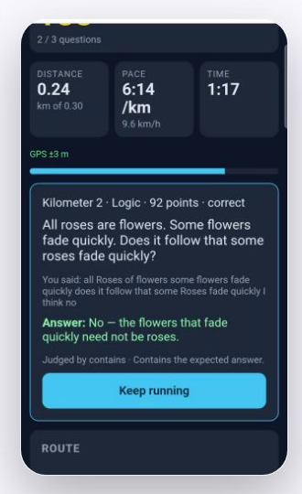
LIVE PRODUCT DEMO
ONE RUN. ONE LIVE COGNITIVE CHECKPOINT.
RUNNER + GARMIN
REAL COGNIRUN APP
1 PROMPT
Hands-free
question
→
2 ANSWER
Speech judged
locally
voice prompt
spoken answer
3 MAP
Result tied to
pace + state
VOICE → ANSWER → LOCAL JUDGEMENT → BODY × BRAIN RESULT
REAL RUNNER + REAL APP SCREEN · DEMO DATA
Notes:
This is the product. On the left, a runner using the watch. On the right, the real live app: distance, pace, GPS, the question, the answer and the local judgement. The prompt comes through voice, the response is captured, and the result is tied back to the runner’s body state. One run becomes a measurable brain-and-body experiment.
[Sources]
- Runner video: user-supplied marketing/cognirun-ad/public/video/runner-garmin.mov.
- Real app screen: user-supplied reference 2-Photo-2.jpg, cropped without altering the interface.
- Demo values are prototype/demo data, not validated participant findings.

Slide 3
WHO IT’S FOR
One platform, three markets
🏃
🔬
💼
You
Scientists
Business
Train body + brain
under real pressure:
interviews, driving
theory, memory.
Cognition-under-
exertion studies at
scale. Enrollment =
joining a challenge.
Sponsored question
packs reach an
engaged audience
mid-run.
Personal packs + subscription
Protocol + participant fees
Sponsored packs + prizes
DISCOVER → REPEAT → CHALLENGE → FUND
Notes:
After the demo, here is how it scales. Individuals train for interviews, driving theory and memory tasks. Scientists convert cognition-under-exertion protocols into joinable challenges; enrollment feels like joining a run. Businesses sponsor question packs, challenge themes and prizes. One platform serves a consumer product, research infrastructure and sponsor revenue.
[Sources]
- Content and visual hierarchy adapted from the user-supplied reference slide 3-Photo-3.jpg.
- These are proposed go-to-market routes, not current customers, revenue or enrollment claims.

Slide 4
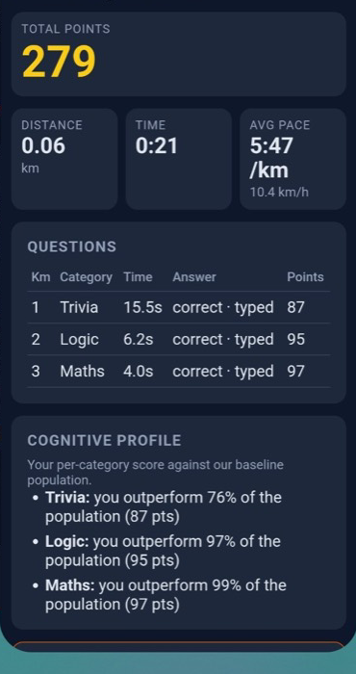

ILLUSTRATIVE PROTOTYPE RESULT
LIVE NOW
Strava for your mind.
A run that measures
thinking under load —
and recruits and funds itself.
TRY THE LIVE PROTOTYPE →
Browser demo + Android prototype
SCAN TO TRY
Category analogy—not Strava affiliation. Prototype result shown for demonstration.
Notes:
The category shorthand is Strava for your mind. Not a promise that running makes you smarter: a platform that measures thinking under load. The loop is simple: runners discover and repeat, researchers publish challenges, and sponsors fund participation. A run that measures; a challenge that recruits; a platform that pays for itself.
[Sources]
- Real result screen: user-supplied reference 1-Photo-1.jpg, cropped without altering the interface.
- Public prototype QR target: https://dreamy-meringue-246d16.netlify.app/
- Commercial analogue: Strava Business Sponsored Challenges, https://business.strava.com/challenges
- No affiliation with or endorsement by Strava is claimed.

