Slide 1
Predictive Modeling with SAS & R
… and other stories from the pit
Presentation by:
Julia E. Barnhart, Lead Business Intelligence HPU/ NU Predictive Analytics Graduate Candidate
June 7, 2017

Slide 2
Agenda
A predictive modeling project using SAS Base, SAS Studio, & SAS Enterprise Miner
An example implementation using R, RStudio, and R Markdown
Data science pipeline automation & reproducible research
Available tools & platforms
Discussion
My project is freely accessible on GitHub: https://github.com/julia-sevenof9/Presentation

Slide 3
Building a Predictive Model
Real-world wine dataset
  ~ 12,795 observations with missing values saved in a csv file
  14 candidate predictor variables (excl. index and target)
  Response variable = the number of wine cases purchased
A Poisson regression model to predict response variable
  Technique often used to model counts
  Multiple variable-selection techniques implemented
  “Best” model is chosen based on:
    Performance on training/tests datasets
    Model parsimony – Occam’s Razor
    Does it make sense? – Causality
    Does it make money for the company?

Slide 4
The Data Science Toolbox
Base SAS (incl. simple macros) using SAS Studio 3.6
  Common procedures include:
    PROC UNIVARIATE, PROC FREQ, PROC MEANS, PROC GENMOD, PROC SQL
SAS Enterprise Miner 14.1, High-Performance Data Mining
  Implemented nodes for:
    Splitting dataset into train/test
    Missing-value imputation using Decision Trees
    Variable Transformation
    Automated variable selection (incl. ANN)
    Implementing models (Poisson, Negative Binomial, ANN, etc.)
    Model comparison and selection (based on AIC, BIC, Deviance, ASE, etc.)
    Deployable score code (using macros)
  Copied SAS code and created macros for each model

Slide 5
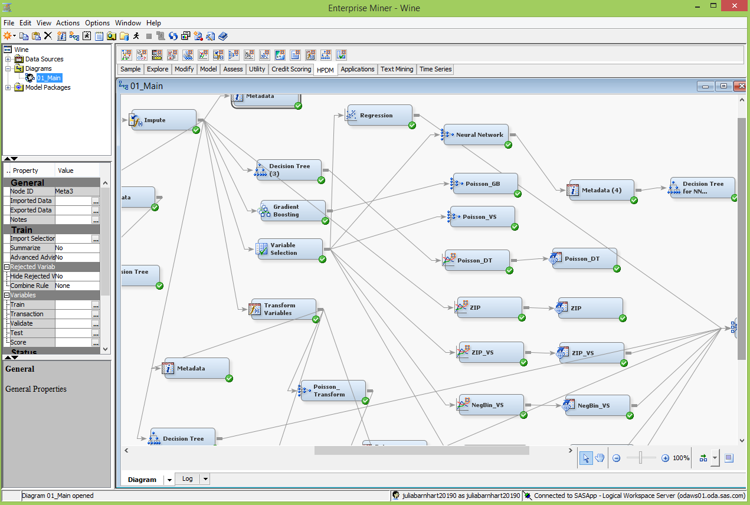
A Predictive Modeler’s Masterpiece
(at 02:13 am)
The obsession with performance, the vice of over-fitting!

Slide 6
Let’s Rock R!
RStudio and R Markdown
An epic battle of package versions and dependencies!
  A quasi-successful local installation of R Rattle and Jupyter
Create reusable function for creating histograms
Missing-value imputation with mice package
Splitting dataset for training/testing with caTools package
Automated variable selection with leaps package
Built Poisson regression model with glm function
Test model performance on test dataset using predict() function

Slide 7
Data Pipeline Automation
A common problem across many industries and teams
Build the capacity to operationalize data science and research
  Create reproducible and publishable research
  Researchers focus on analysis rather than data preparation
  Adaptive to (constant) influx of new techniques and tools
  Transparency and discoverability
People, processes, policies, and goals first
  Then choose the appropriate set of tools and techniques
  Principles of Knowledge Management apply
Within greater context of creating a Learning Organization

Slide 8
A plethora of available tools and platforms
Commercial
Open-source
SAS Enterprise Miner
IBM SPSS
Angoss
Alteryx
Microsoft R Open
Cloudera (Sense)
Salford Systems
Jupyter(Hub)
Tableau integration with R
Rstudio
R Rattle
Weka
R Markdown
GitHub
Microsoft CRAN snapshot repository
Slack
Wolfram Data Science Platform
Anaconda/Spyder Python …
Wikis (Redmine)

Slide 9
Discussion

