Slide 1

Yelp Dataset Sentiment Analysis
Phase 2: Project Plan
Cole Hanrahan and Julia Sober
COSC 5540 — Text Mining & Analysis
Fall 2025

Slide 2
Project Motivation and Goals
Star ratings on Yelp reviews are widely used but can be subjective and inconsistent.
Predicting ratings from review text can help users gauge sentiment efficiently, businesses pinpoint improvement areas, and researchers better understand satisfaction drivers.
We are building on prior work in text-based sentiment and rating prediction, aiming to improve model performance and address gaps in contextual understanding and sentiment analysis.

Slide 3
Insights from Literature Review
Sentiment classification (positive vs. negative) achieves high accuracy (around 90%), but predicting specific star ratings (1–5) is much harder, with accuracy between 60–65%.
Best traditional features are TF-IDF n-grams, and strong classical models include logistic regression and SVM.
Deep models like CNNs and BERT offer nuanced understanding but struggle particularly with middle (2–3 star) reviews due to ambiguity and class imbalance.
Key gaps: limited context understanding, dominance of 4/5-star reviews, and need for better model explainability.

Slide 4
Data Preparation and Baselines
Filtered Yelp restaurant reviews, normalized text (lowercasing, punctuation and stopword removal), and derived auxiliary features like review length.
Output: cleaned, balanced dataset ready for modeling and performance benchmarking.
Built baselines with TF-IDF features and classic models (Logistic Regression, Naive Bayes, SVM, Random Forest, Ordinal Logistic Regression).
“Binary” = positive/negative/neutral
1-5 RRP

Slide 5
Baseline Results (subsample n=500,000)
Features = Unigram + Bigram + TF_IDF w/ max_features = 10,000
Model | Classification Type | Accuracy (%) | Macro-F1
Logistic Regression | 1-5 RRP | 67.66 | 0.5969
Naive Bayes | 1-5 RRP | 64.15 | 0.5187
SVM | 1-5 RRP | 44.70 | 0.4147
Random Forest | 1-5 RRP | 51.96 | 0.2869
Ordinal Logistic Regression | 1-5 RRP | 60.92 | 0.5268
Logistic Regression | Pos. / Neu. / Neg. | 87.43 | 0.7398
Naive Bayes | Pos. / Neu. / Neg. | 84.45 | 0.6494
SVM | Pos. / Neu. / Neg. | 60.63 | 0.5081
Random Forest | Pos. / Neu. / Neg. | 75.83 | 0.4622
Ordinal Logistic Regression | Pos. / Neu. / Neg. | 85.66 | 0.7133

Slide 6
What We Noticed
The Pattern:
Positive vs Negative reviews are very easy to separate (97% accuracy when we took out 3 star ratings).
Neutral (3-star) reviews are ambiguous — they overlap lexically and sentiment-wise with both extremes.
The multi-class (1–5) setup suffers because 3-star reviews blur the boundaries.
The model can almost perfectly identify polarity, but it struggles to map polarity → precise star rating.
This means the information bottleneck isn’t “sentiment detection” — it’s “rating calibration.”

Slide 7
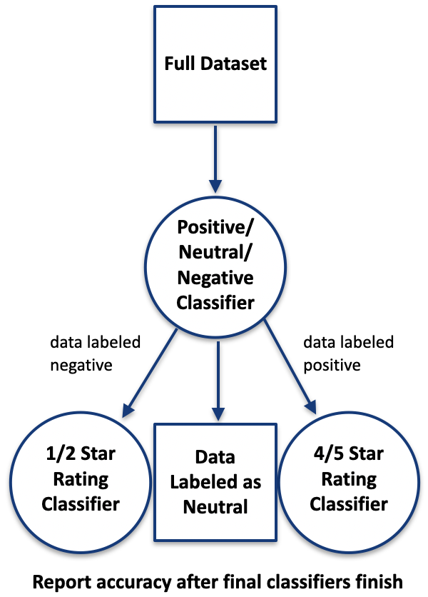
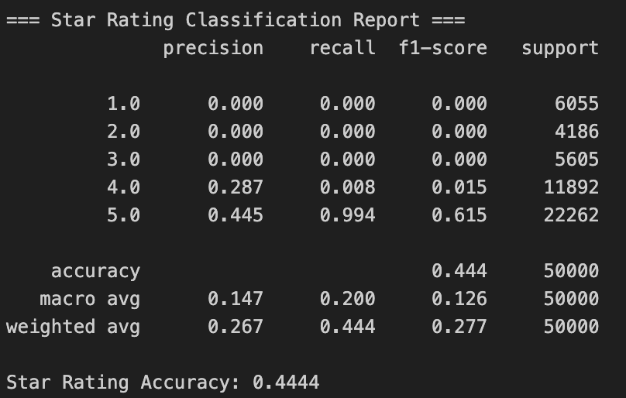
Experimental Tests
Layered/Hierarchical classifier
TF-IDF + n-grams with Logistic Regression
Stage 1: Sentiment classification (negative/neutral/positive)
Stage 2a: Negative reviews → 1 vs 2 stars
Stage 2b: Positive reviews → 4 vs 5 stars
Neutral reviews → automatically assigned 3 stars
Slightly better than baseline in some classes, worse in others, but limited improvement overall (< 0.02%)
Layered classifier with soft probabilities
Passing probabilities from layer 1 classifier
Used pre-trained sentence embeddings (s-BERT) instead of TF-IDF
Worse accuracy for binary (layer 1) classifier than baseline
Layer 2 classifier ended up predicting dominant class (5-star) for every rating
Simple MLP with sBERT
Adam optimizer, 100 epochs, 1 hidden layer (128), ReLU activation, batch size = 64
62% test accuracy

Slide 8
Our Proposal
Best test accuracies:
Logistic Regression (Classifier) w/ TF-IDF & n-grams => 67%
Linear Regression (Regressor) w/ TF-IDF & n-grams => 68% (rounding up to nearest star)
These accuracies are already 5-7 percentage points better than all of the papers we read (we trained on more data than papers).
We can potentially improve these results even more with hyperparameter tuning.

Slide 9
Project Status
Already Completed
Data collection/wrangling
Preprocessing
Model pipelines built + tested:
Baselines with TF-IDF
Baselines with embeddings
Layered classifier with TF-IDF
Layered classifier with embeddings + soft routing (probability-based)
Simple MLP + BERT (2 layers)
Regressors
In Progress
Evaluation & comparison across all models
Hyperparameter tuning and model adjustments
Visualization of results (confusion matrices, metric tables)
Try additional extracted features
Not Started
Report + presentation slides
Additional analysis:
Per-class performance
Error analysis

