Slide 1

Yelp Dataset Sentiment Analysis
Phase 2: Project Plan
Cole Hanrahan and Julia Sober
COSC 5540 — Text Mining & Analysis
Fall 2025

Slide 2
Project Motivation and Goals
Star ratings on Yelp reviews are widely used but can be subjective and inconsistent.
Predicting ratings from review text can help users gauge sentiment efficiently, businesses pinpoint improvement areas, and researchers better understand satisfaction drivers.
We are building on prior work in text-based sentiment and rating prediction, aiming to improve model performance and address gaps in contextual understanding and sentiment analysis.

Slide 3
Insights from Literature Review
Sentiment classification (positive vs. negative) achieves high accuracy (around 90%), but predicting specific star ratings (1–5) is much harder, with accuracy between 60–65%.
Best traditional features are TF-IDF n-grams, and strong classical models include logistic regression and SVM.
Deep models like CNNs and BERT offer nuanced understanding but struggle particularly with middle (2–3 star) reviews due to ambiguity and class imbalance.
Key gaps: limited context understanding, dominance of 4/5-star reviews, and need for better model explainability.

Slide 4
Data Preparation and Baselines
Filtered Yelp restaurant reviews, normalized text (lowercasing, punctuation and stopword removal), and derived auxiliary features like review length.
Output: cleaned, balanced dataset ready for modeling and performance benchmarking.
Built baselines with TF-IDF features and classic models (Logistic Regression, Naive Bayes, SVM, Random Forest, Ordinal Logistic Regression).
“Binary” = positive/negative/neutral
1-5 RRP

Slide 5
Baseline Results (subsample n=500,000)
Features = Unigram + Bigram + TF_IDF w/ max_features = 10,000
Model | Classification Type | Accuracy (%) | Macro-F1
Logistic Regression | 1-5 RRP | 67.66 | 0.5969
Naive Bayes | 1-5 RRP | 64.15 | 0.5187
SVM | 1-5 RRP | 44.70 | 0.4147
Random Forest | 1-5 RRP | 51.96 | 0.2869
Ordinal Logistic Regression | 1-5 RRP | 60.92 | 0.5268
Logistic Regression | Pos. / Neu. / Neg. | 87.43 | 0.7398
Naive Bayes | Pos. / Neu. / Neg. | 84.45 | 0.6494
SVM | Pos. / Neu. / Neg. | 60.63 | 0.5081
Random Forest | Pos. / Neu. / Neg. | 75.83 | 0.4622
Ordinal Logistic Regression | Pos. / Neu. / Neg. | 85.66 | 0.7133

Slide 6
What We Noticed (From Baselines)
Positive/Negative/Neutral classification much easier than 1-5 RRP
Approx. 20% higher accuracy (matches expectation from literature)
The model can identify polarity, but it struggles to map polarity → precise star rating (problem isn’t sentiment detection, it’s rating calibration).
Positive vs negative reviews are very easy to separate (97% accuracy when we took out 3 star ratings)
The multi-class (1–5) setup suffers because 3-star reviews blur the boundaries.
Neutral (3-star) reviews are ambiguous — they overlap lexically and sentiment-wise with both extremes.

Slide 7
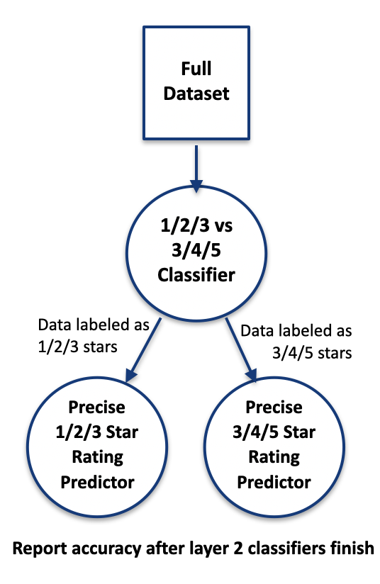
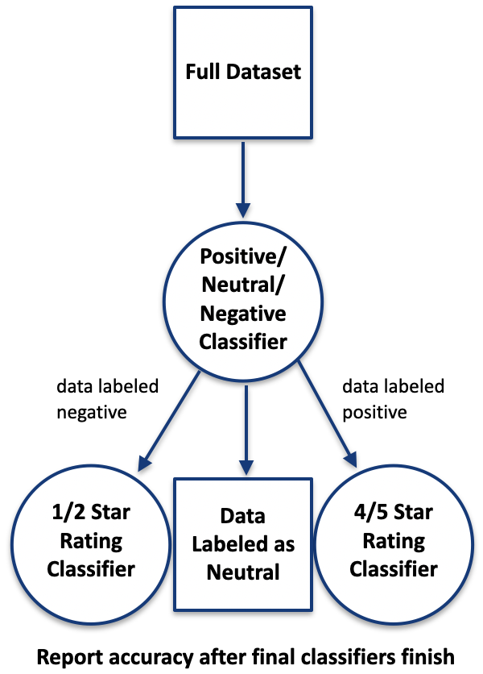
Idea: Layered Classifier
TF-IDF with n-grams (1,2)
Logistic Regression at both levels
First iteration accuracy almost the exact same as baseline (Logistic Regression w/ TF-IDF)
Cascading errors for 3 star classification
Current iteration 1% better (than baseline LR), and we think can be improved further.
Hyperparameter tuning
Soft-er routing (probabilities)
Trying different models at layer 2 (i.e. regressor)
First Test Iteration
Current Architecture

Slide 8
Project Roadmap
9/16 – 10/03 | 10/04 - 10/31 | 11/01 – 11/10 | 11/11 – 12/08
Phase 1
Literature Review
Data Gathering
Cole & Julia
Phase 2
Cole & Julia
Data Cleaning | Preprocessing | Feature Extraction
Json to csv files | Lowercasing | TF-IDF features
Restaurant reviews only | Negation Handling | Unigrams + bigrams
State specific data frames | Removing stopwords, punctuations, urls, numbers
 | Extract review length, capitalizations, exclamation points
Phase 3
Baseline Modeling | Advanced Modeling | Final Evaluations
Linear Regression | Layered classifier + soft routing | Error Analysis
Logistic Regression | Simple MLP + BERT | Per class performance
Naïve Bayes | Multi-Task BERT | Evaluation & Comparison
SVM |  | Confusion matrices & metric tables
Random Forest
Ordinal Logistic Regression | Hyperparameter tuning and model adjustments
Cole
Julia
Julia
Cole & Julia
Cole

