Slide 1

Yelp Review Sentiment Analysis
Phase III: Project Implementation, Experimentation, Evaluation and Discussion/Presentation of the Results
Cole Hanrahan & Julia Sober

Slide 2

Recall: Yelp Review Rating Prediction (RRP)
Project Motivation and Goals (from Proposal)
Star ratings on Yelp reviews are widely used but can be subjective and inconsistent.
Predicting ratings from review text can help users gauge sentiment efficiently, businesses pinpoint improvement areas, and researchers better understand satisfaction drivers.
We stuck to the original plan detailed in our proposal
Source: Columbia University

Slide 3
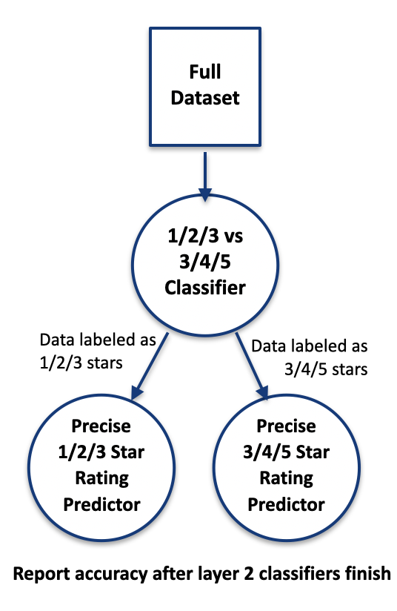
Our Innovation: Layered Classifier
ALL CODE AUTHORED BY OURSELVES (with some help from ChatGPT)
Why layered approach?
Positive/negative/neutral classification much easier than 1-5 RRP
Approx. 20% higher accuracy (matches expectation from literature)
The model can identify polarity, but it struggles to map polarity → precise star rating (problem isn’t sentiment detection, it’s rating calibration).
The multi-class (1–5) setup suffers because 3-star reviews blur the boundaries.
Neutral (3-star) reviews are ambiguous — they overlap lexically and sentiment-wise with both extremes.
Implementation Considerations:
Multiple acceptable labels at layer 1
Routing strategy

Slide 4
Hard Routing:
Use Layer 1’s predicted group to choose exactly one fine classifier.
Highest variance but often highest accuracy when Layer 1 is reliable.
Soft Routing:
Combine outputs of both fine classifiers using fixed blending weights (e.g., 50/50).
More stable but less sharp.
Dynamic Routing:
Use Layer 1’s probabilities (e.g., 70% group 0, 30% group 1) as weights.
Essentially a per-sample attention mechanism.
Ensemble Routing:
Ignore Layer 1 and average the two fine classifiers' outputs.
Testing Different
Routing Strategies
** Note that all strategies require
duplicating 3 star reviews at
layer 1

Slide 5
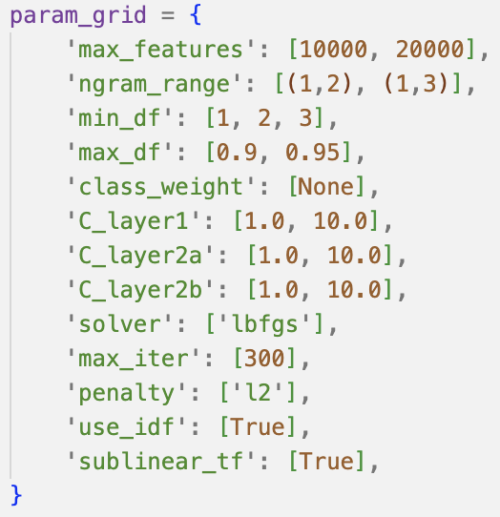
Hyperparameter Tuning
Grid Search
Strategy
scikit-learn ParameterGrid with exhaustive search
Total combinations: 192
Validation approach: 3-way stratified split (200K train / 25K val / 25K test)
Best results retested for comparison with 400K / 50K / 50K
Scoring metric: Macro F1 (balanced across all star ratings)
Hyperparams Tested
Feature Extraction:
max_features
n_gram_range
min_df: minimum document frequency (keep words appearing ≥ n documents)
max_df: maximum document frequency (keep words appearing ≤ n proportion of documents)
Logistic Regression (per layer):
C: regularization strength
Fixed Hyperparams:
class_weight = None (balanced training sample)
Best Hyperparam Combination
{'C_layer1': 1.0, 'C_layer2a': 1.0, 'C_layer2b': 1.0, 'class_weight': None, 'max_df': 0.9, 'max_features': 10000, 'max_iter': 300, 'min_df': 3, 'ngram_range': (1, 3), 'penalty': 'l2', 'solver': 'lbfgs', 'sublinear_tf': True, 'use_idf': True}

Slide 6
Final Results
Training set: 400,000 reviews | Validation: 50,000 | Test: 50,000
Model | Accuracy (%) Unequal Class Sampling | (Macro) F1-Score Unequal Class Sampling | Accuracy (%) Equal Class Sampling | (Macro) F1-Score Equal Class Sampling
Logistic Regression (best baseline) | 67.66 | 0.5969 | 62.12 | 0.6190
Layered Classifier (default hyperparams) | 65.55 | 0.6050 | 65.28 | 0.6022
Layered Classifier (after hyperparam grid search) | 71.79 | 0.6551 | 66.71 | 0.6656
ChatGPT 5.0 Nano* | 71.86 | 0.6500 | 64.28 | 0.6322
* only run on 5,000 samples (cost saving measure)

Slide 7
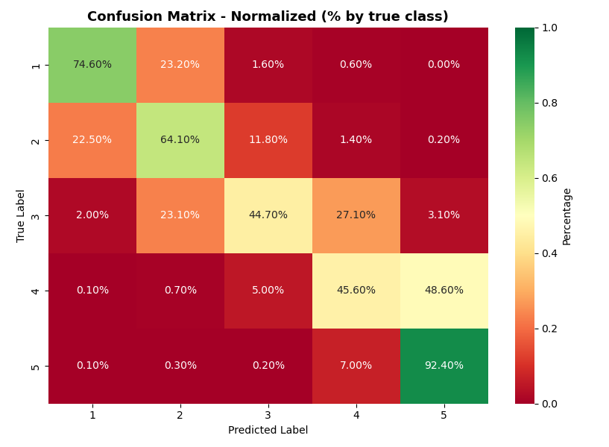
Error Analysis
Layered Classifier
ChatGPT

Slide 8
Error Analysis
What a treat this Japanese-all-you-can-eat-sushi-bar was.
A friend told me that the sushi was good in Reno, but I didn't know that Reno sushi could get that good, especially since this place is no where near any form of water. I guess such modern advancements as refrigeration really come in helpful here.
Either way, any dish that I ordered, you could tell that the chefs put that much extra effort to make the dish even better.
If you're curious why I docked it 1 star, it's because it's the only place I've visited in Reno without a slot machine. I went into the night thinking about how nice it would be to eat sushi and gamble, but my dreams came up real short. Thanks Sushi Pier, but NO THANKS.
ChatGPT Prediction:
Layered Prediction:
Actual Star Rating:
Had the soup and salad lunch combo. Broccoli asiago soup is super yummy!! Love the homemade chips on the side.
ChatGPT Prediction:
Layered Prediction:
Actual Star Rating:
Examples
Looked like a nice place so we thought we would try it. Upon walking in, the strong odor of sewage hit you in the face. We were told it was from outside. However, there was not smell outside. It's a shame. Beautiful decor. Just couldn't eat with the smell of sewage all around. Clean your drains and we may be back.
ChatGPT Prediction:
Layered Prediction:
Actual Star Rating:
Local small town hangout. The place had a weird smell of old rags used for wiping the bar down or something. It smells musty from mold or mildew hiding out. The food is okay.
ChatGPT Prediction:
Layered Prediction:
Actual Star Rating:

Slide 9
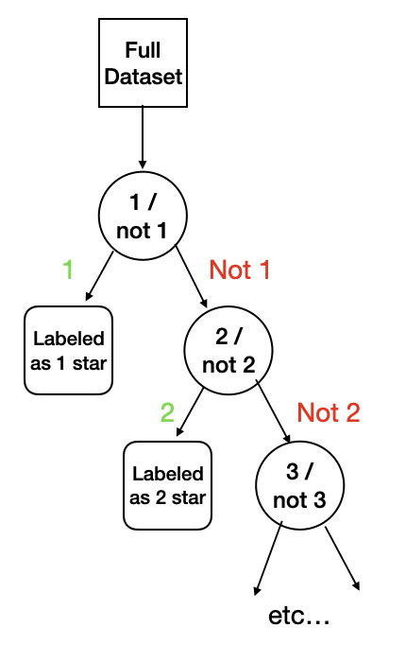
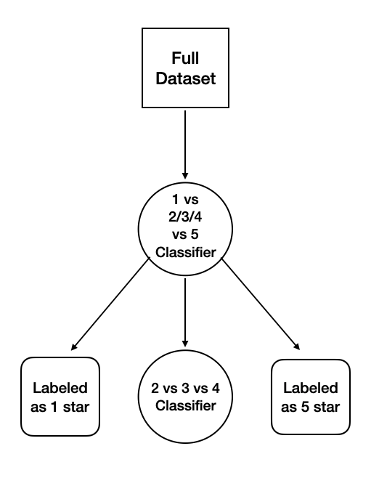
Conclusion and Comments
What we’d try given more time
** suggestions
from classmates
Data cleaning/regularization strategies:
Weighting by user/restaurant average review **
Further data exploration, eliminating outliers
ChatGPT API for outlier removal
Model architecture:
Splitting by 1 / (2 & 3 & 4) / 5 at layer 1 → layer 2 classifier for 2/3/4 star ratings
Avoids routing problem
Could also try 1 & 2 / (2 & 3 & 4) / 4 & 5
Testing different models at each layer e.g., SVM, Random Forest, MLP
1 v all structure (i.e., 1 or not 1, 2 or not 2,… etc.) **

Slide 10
Conclusion and Comments
Final Takeaways
Simplicity Outperformed Complexity: Our fine-tuned Layered Logistic Regression beat both the standard baselines and the ChatGPT 5.0 Nano model.
Traditional Methods Still Work: We achieved best-available results for this specific dataset using TF-IDF and n-grams, proving you don't always need heavy DL for text classification.
The Balancing Paradox: We discovered that unequal class sampling actually yielded higher accuracy than perfectly balanced data, suggesting the model benefits from the natural distribution of real-world reviews.

