Slide 1

Yelp Dataset Sentiment Analysis
Literature Review Survey
Cole Hanrahan and Julia Sober
COSC 5540 — Text Mining & Analysis
Fall 2025

Slide 2
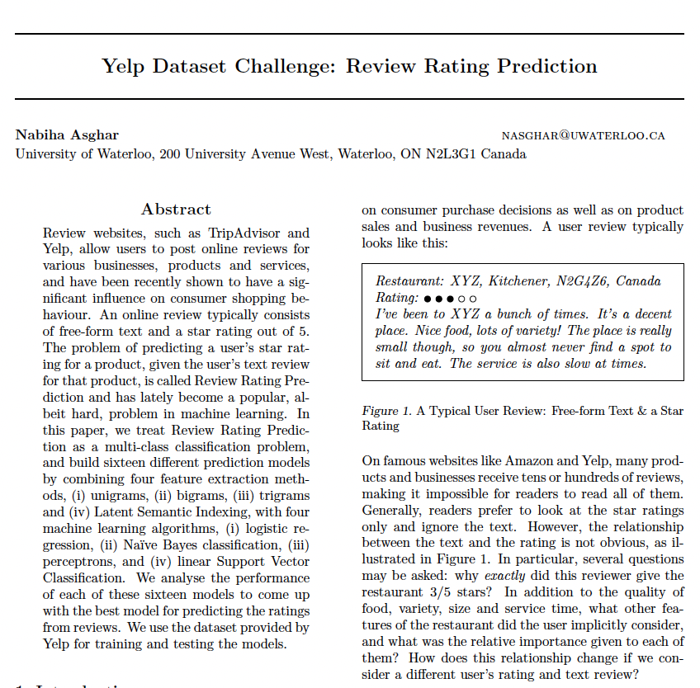
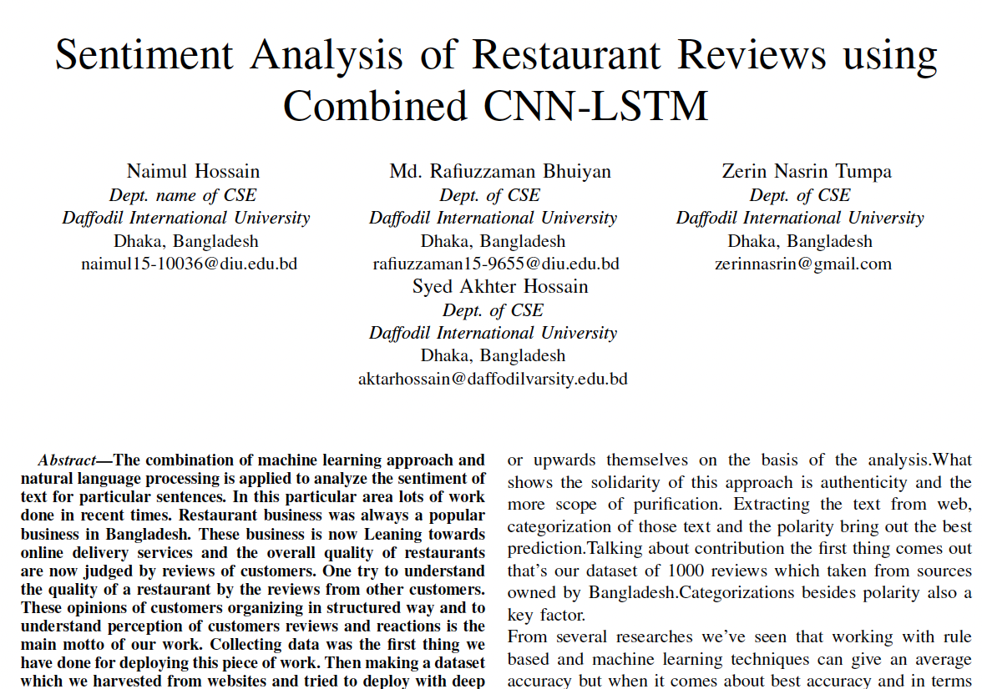
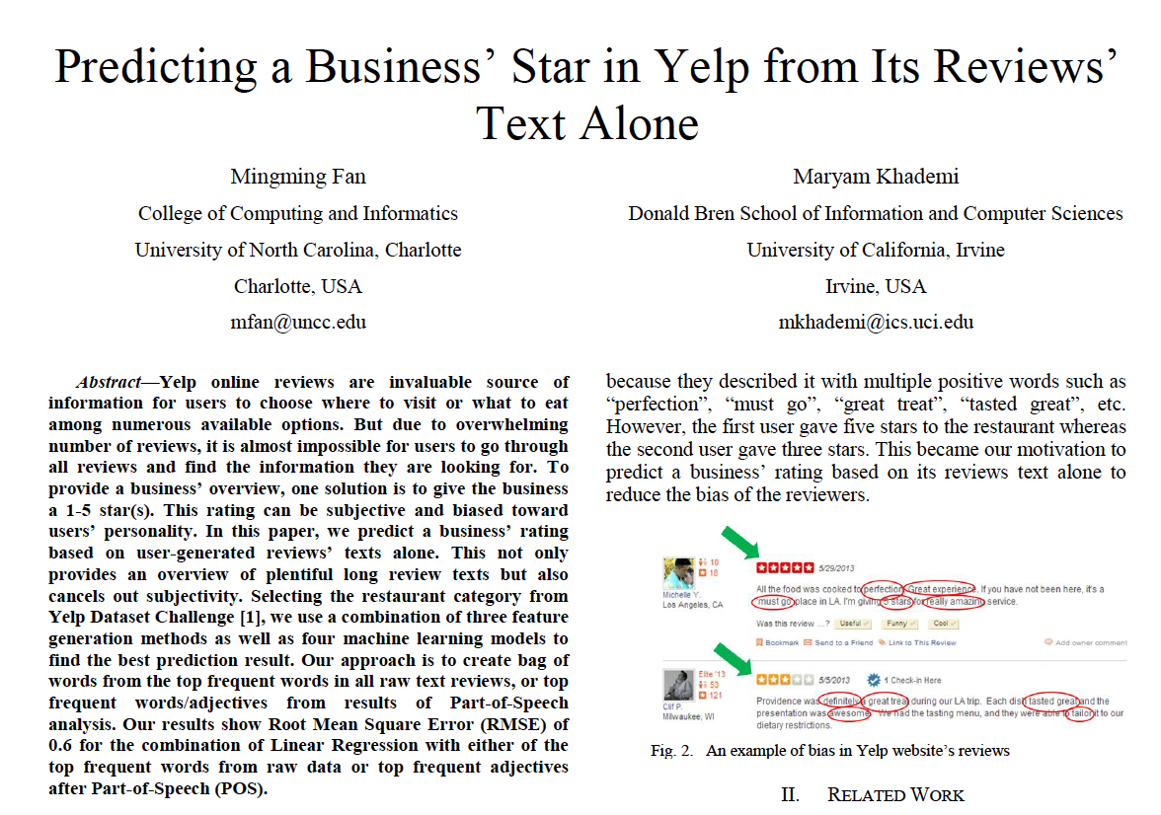
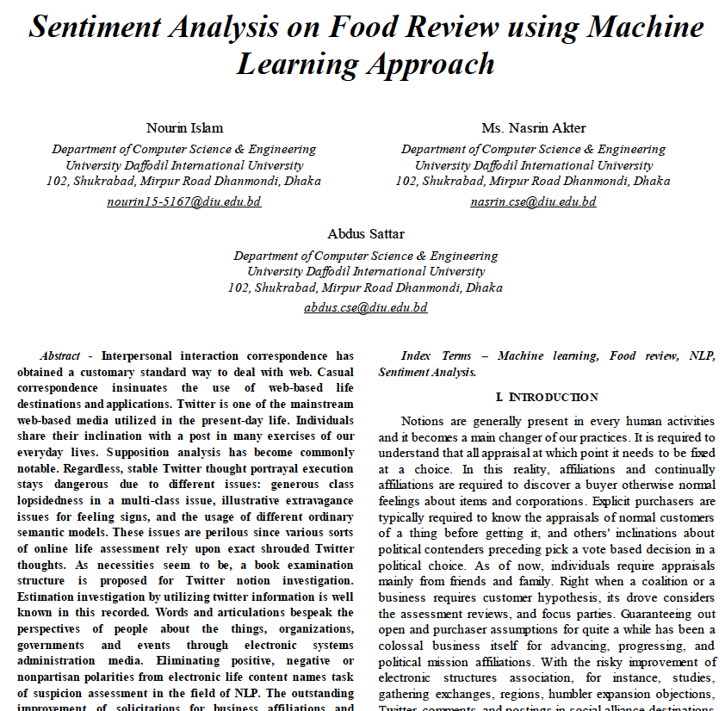
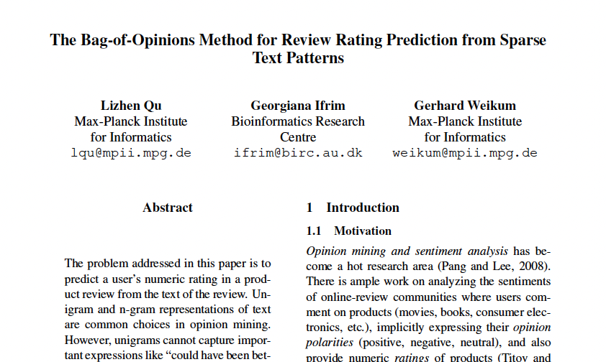
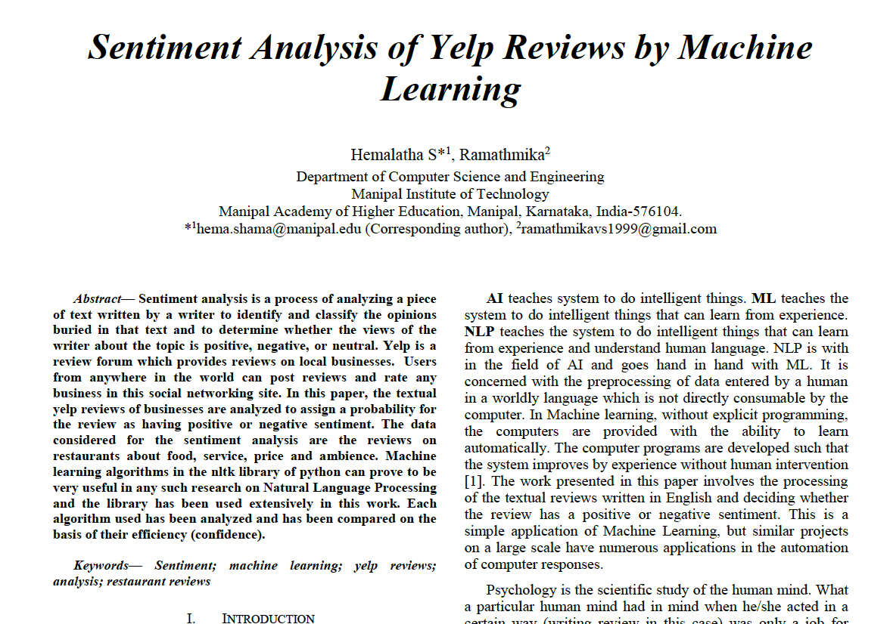
Outline
Background
Research Directions
Dataset
Approaches
Selected Papers
Overall Summary

Slide 3
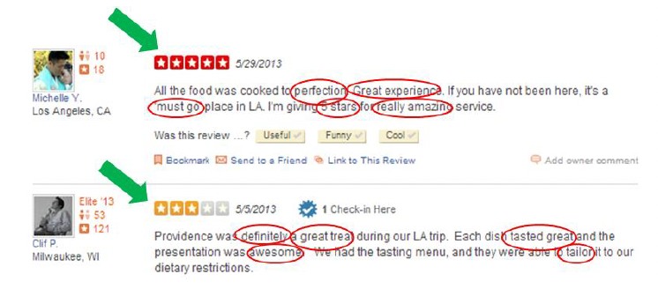
Background and Motivation
Online platforms like Yelp contain millions of reviews, but the link between text and star ratings is not straightforward.
Automating star prediction helps users and businesses understand sentiment quickly
Literature shows high accuracy for binary sentiment, but more nuanced star prediction is difficult due to imbalanced data, reviewer subjectivity, and noisy language.
Source: Fan & Khademi

Slide 4
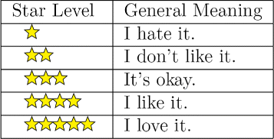
Research Directions in Literature
Binary Sentiment Classification – positive vs. negative reviews.
Star Rating Prediction – predict 1–5 stars from text.
Bias Analysis – explore inconsistencies between text and rating.
Source: Journal of Big Data

Slide 5

Dataset
Yelp Dataset Challenge (~7–8 million reviews).
Each review includes text and star rating (+ many more features); known imbalance with most ratings ≥4 stars.
Similar datasets in research: Amazon, Twitter, IMDB for method comparison.
Some papers used these
Source: Columbia University

Slide 6
Preprocessing Methods
Lowercase conversion, punctuation/special character removal, stop word elimination.
Extract features (length, punctuation) before cleaning.
Negation handling (“not good” → “not_good”), optional stemming.
Part of Speech tagging
Before: If you decide to eat here, just be aware it is going to take about 2 hours from beginning to end. We have tried it multiple times, because I want to like it! I have been to it's other locations in NJ and never had a bad experience. The food is good, but it takes a very long time to come out. The waitstaff is very young, but usually pleasant. We have just had too many experiences where we spent way too long waiting. We usually opt for another diner or restaurant on the weekends, in order to be done quicker.
After: decide eat aware going take hours beginning end tried multiple times want like locations nj never bad experience food good takes long time come waitstaff young usually pleasant many experiences spent way long waiting usually opt another diner restaurant weekends order done quicker

Slide 7
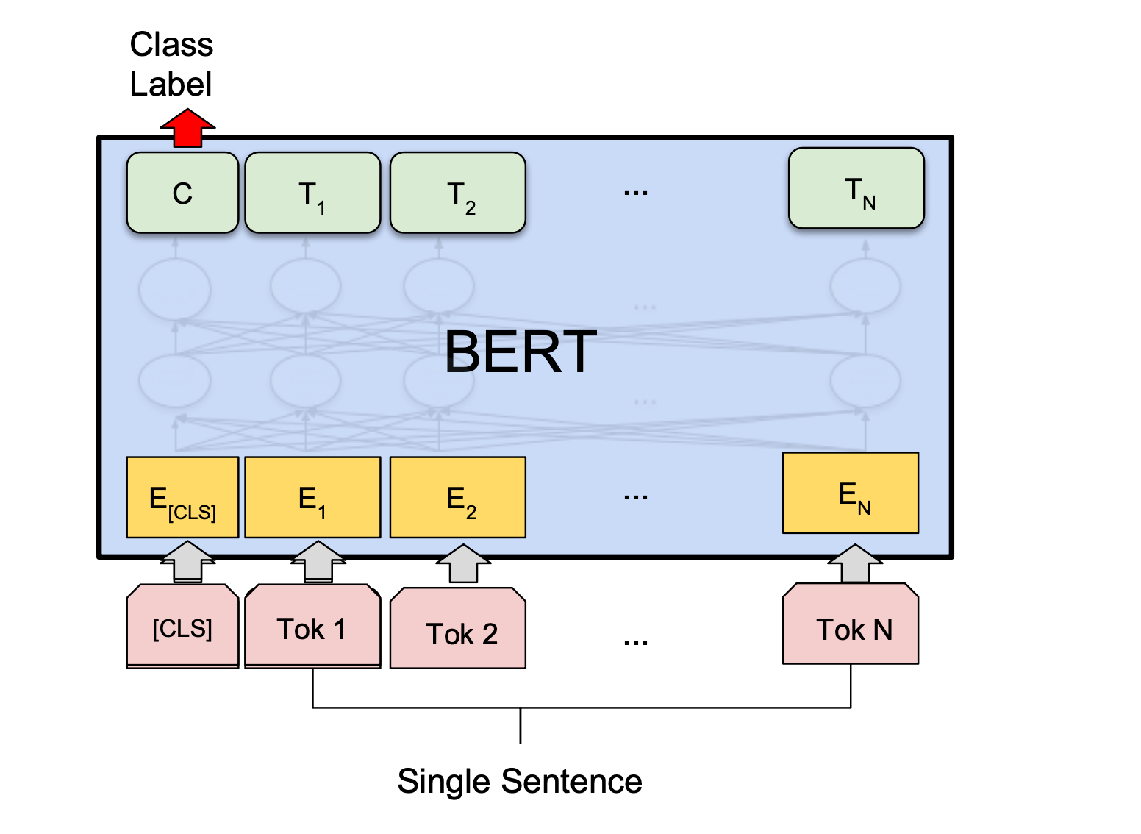
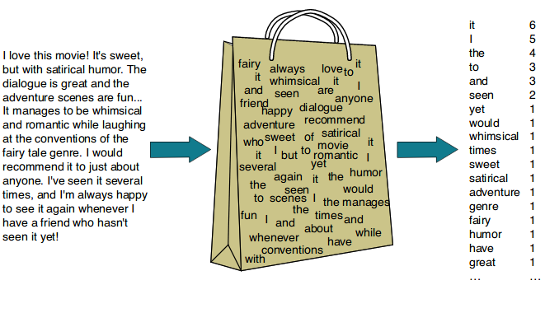
Feature Engineering Approaches
Source: Wandb
Bag of Words (BoW):
Baseline—simple but effective
TF-IDF and n-grams (unigrams, bigrams, trigrams):
Define rare/meaningful words/phrases
Sentiment Lexicons:
Compare text with predefined word lists (e.g., Bing Liu)
Struggle with slang/typos
Part-of-Speech Tagging:
e.g. use only adjectives
Could improve interpretability and model performance
Contextual Embeddings:
e.g. BERT
Supplement with extracted features like review length, positivity/negativity scores, user votes if feasible
Source: Medium

Slide 8
Modeling Approaches
Baseline classifiers: Logistic Regression, Naive Bayes, SVM (linear/non-linear), Passive-Aggressive (similar to SVM).
Tree-based ensembles: Random Forest, AdaBoost.
Shallow/deep Multi-Layer Perceptrons with contextual embeddings.
Ensemble methods: weighted voting, stacking.
Ordinal models (ordered logistic regression) to honor rating order (i.e. 1 is closer to 2 than 4).
Regressors (RandomForest, SVM, etc.), layered strategies (classify sentiment then regress rating).

Slide 9

Binary Classification

Slide 10
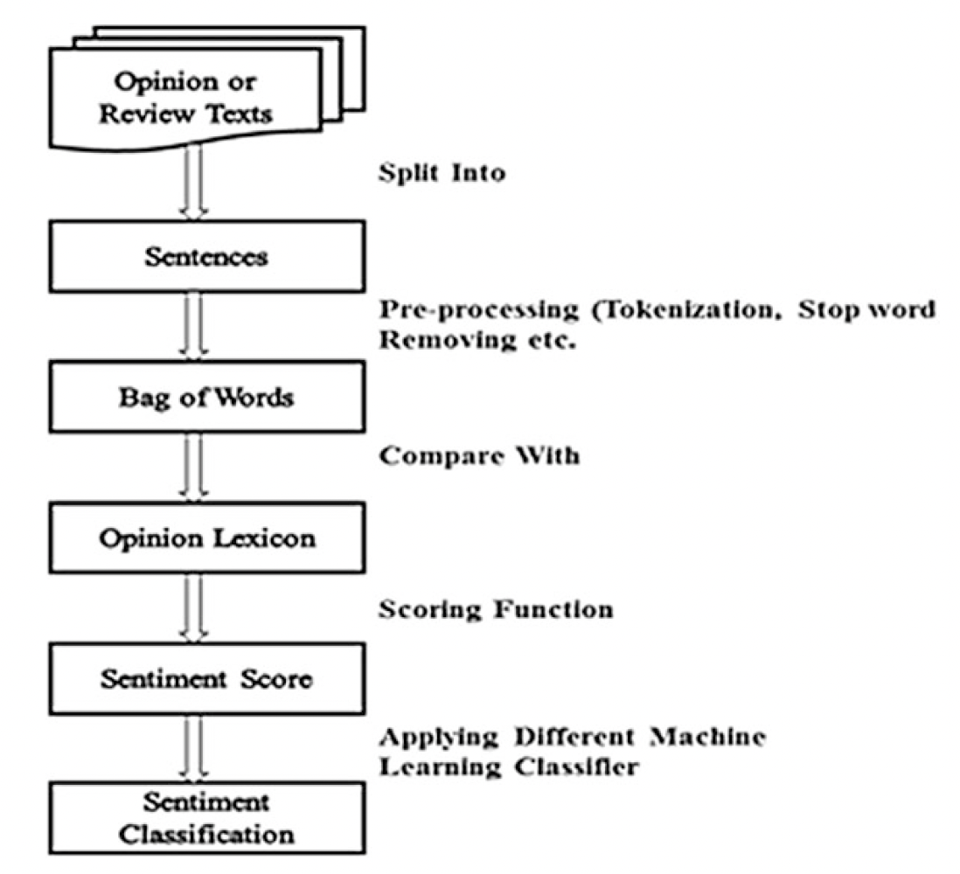
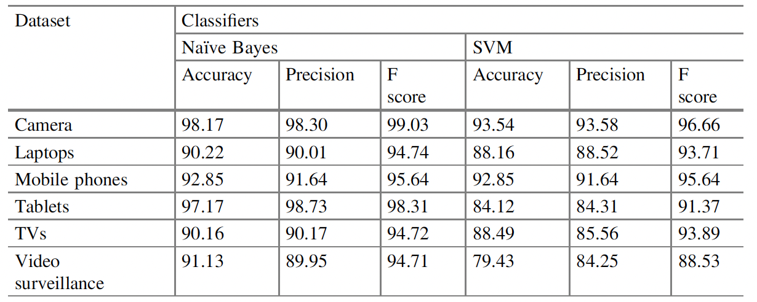
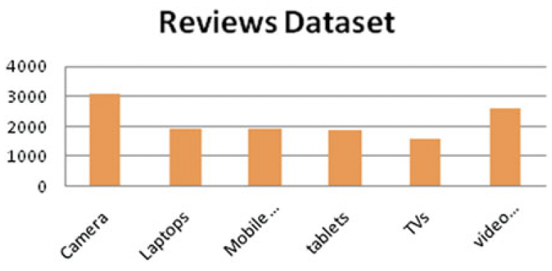
Sentiment Analysis on Product Reviews Using Machine Learning Techniques; Jagdale et al. (2019)
Amazon product reviews: Camera, Laptops, Mobile phones, tablets, TVs, video surveillance (approx 13k total reviews)
Binary classification
Future work: aspect level analysis could improve (e.g. Camera’s quality, megapixel, picture size, structure, lens, picture quality, etc.)

Slide 11
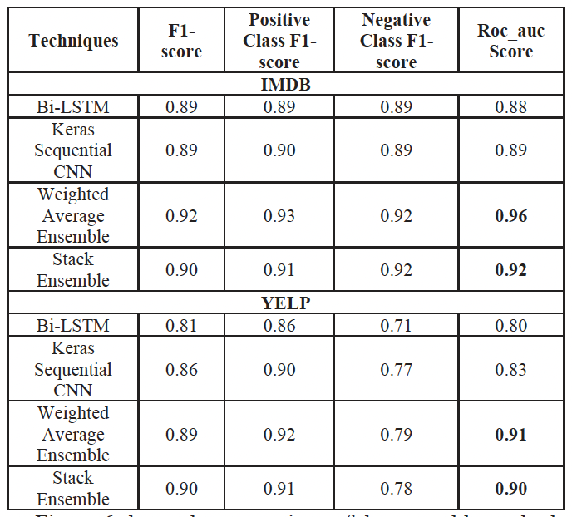
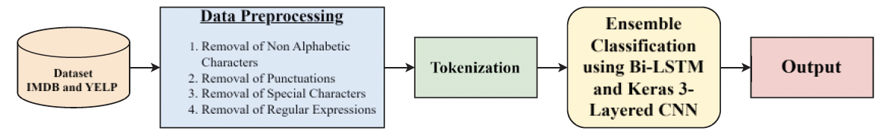
Ensemble Sentiment Analysis Using Bi-LSTM and CNN; Puneet Singh Lamba et al. (2024)
Dataset: IMDB movie reviews and Yelp (separate models)
Binary classification
Tokenization: NLTK library's word_tokenize()
Hybrid of two techniques (Keras Sequential CNN and Bi-LSTM):
Built/saved model with Bi-LSTM
Built/saved CNN with Bert Tokenizer and Keras Module
Ensemble of both models
Weighted average
Stacking

Slide 12

1-5 Star Rating Prediction

Slide 13
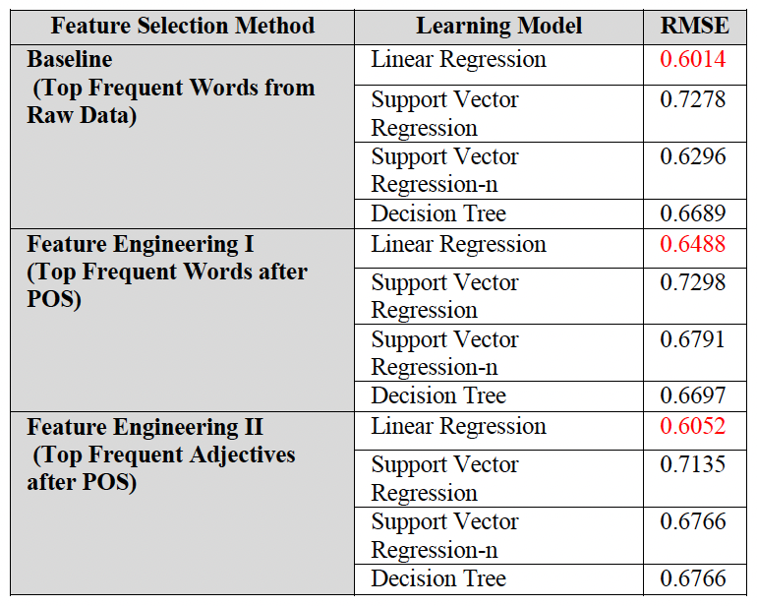
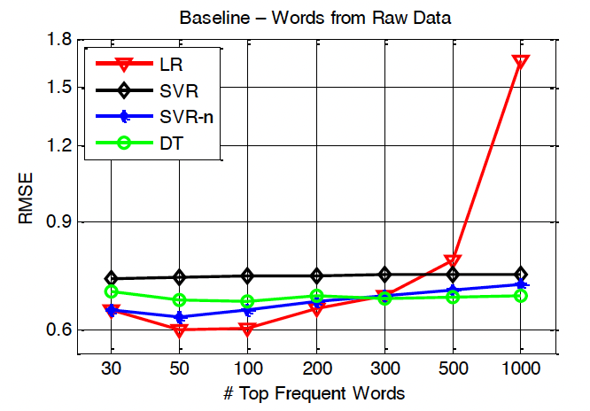
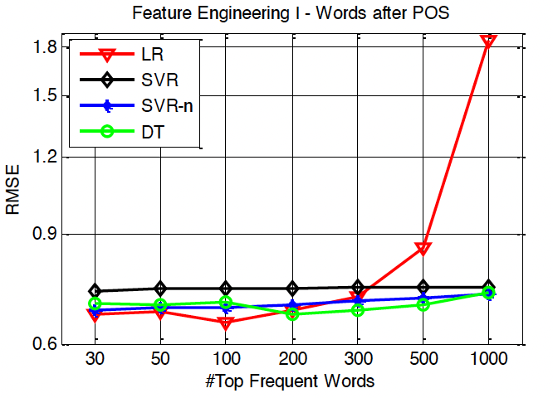
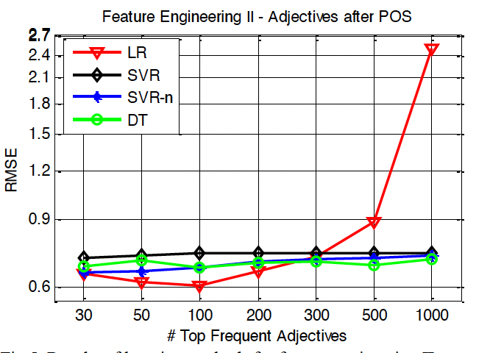
Predicting a Business’ Star in Yelp from Its Reviews’ Text Alone; Mingming Fan & Maryam Khademi (2014)
Feature Selection:
BOW — top K frequency words
3 feature vectors:
baseline: raw data of the top K frequent words in all the reviews
feature engineering I: POS analysis per sentence, top K words
feature engineering II: K frequent adjectives
Predicting star rating as a regression task
Would try to generalize the model in the future by using other business categories (e.g., fashion, beauty) that are not restaurants.

Slide 14
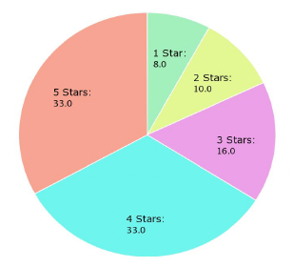
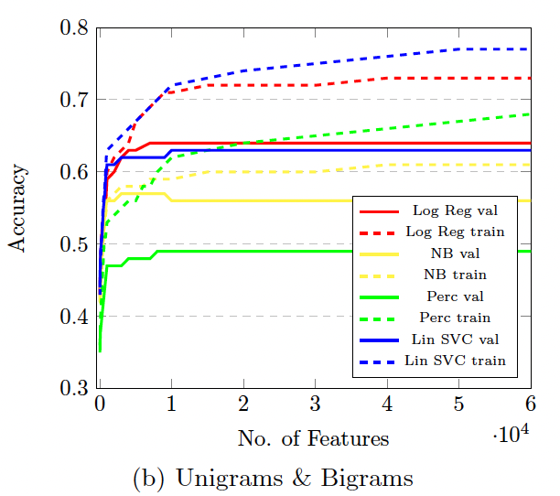
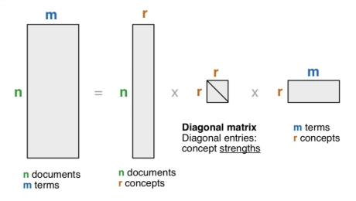
Yelp Dataset Challenge: Review Rating Prediction; Nabiha Asghar (2016)
Preprocessing: removed capitalizations, stop words and punctuations
Feature Extraction: feature vector for each review from four different methods:
Unigrams (BOW)
Unigrams & Bigrams
Unigrams, Bigrams, & Trigrams
LSI
By default, t = the size of vocabulary
first t* topics can be chosen as the most important ones, and thus the top t* rows of V can be used as the feature matrix
ML Models:
Logistic Regression
Multinomial Naive Bayes
Perceptron (n_iterations = 50)
SVM (linear, tolerance = 0.001)
Results: Logistic Regression achieved the highest accuracy of 64% using the top 10,000 Unigrams & Bigrams as features, followed very closely by Linear SVC which achieved 63% accuracy using the top 10,000 Unigrams & Bigrams.

Slide 15
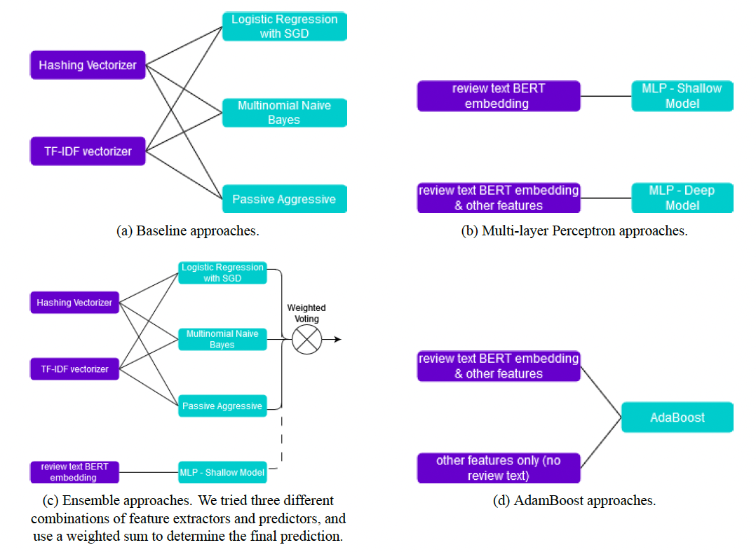
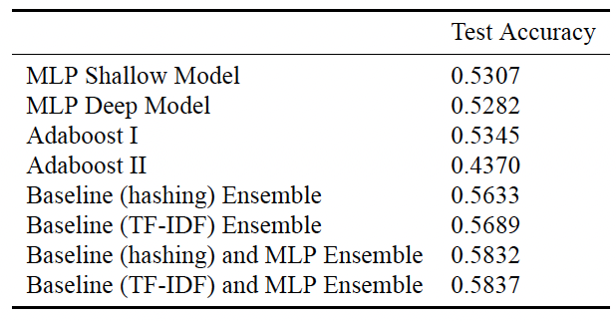
Sentiment Analysis: A Systematic Case Study with Yelp Scores; Wenping Wang et al. (2023)
Feature Extraction/Engineering:
Hashing Vectorizer (sklearn)
TF-IDF
ML Models:
Logistic Regression with SGD I and SGD II
Multinomial Naive Bayes
Passive Aggressive
Similar to SVM (maximizing the margin of the separating planes between the data points)
(Shallow) Multi-Layer Perceptron (MLP) with BERT
7 fully connected layers (768, 1024, 512, 512, 256, 64, 32, 5)
(Deep) MLP with BERT (+ other features)
Useful, funny, cool, positive, negative, nchars, nwords, sentiment score
Heterogeneous (ensemble) classifiers (combined using weighted voting):
Baseline models ensemble
Baseline models and shallow MLP
Baseline models and deep MLP
AdaBoost
For star rating of 5, best model is able to correctly classify 79.57% of the test data points, but it could only correctly classify 32.30% of the data that has ratings of 2.
Shallow > deep

Slide 16
Review of Findings
Binary sentiment models (Naive Bayes, Random Forest) good at positive/negative
Multi-class and regression models (Logistic/SVM, Linear Regression) weaker for all 5 star ratings (accuracy ≤ 65%).
TF-IDF and n-gram features are standard; context-sensitive embeddings (BERT) have emerged for fine-grained results.
Lexicons help but struggle with slang, typos, noisy data; sarcasm and nuanced language largely unsolved.
Ensemble methods sometimes improve results; deep learning gaining ground, especially for multi-aspect analysis and context.
Trends observed:
More features ≠ better performance (can cause overfitting).
Simple > Complex Models

Slide 17
Interesting Findings
Standard preprocessing and Bag of Words are still strong baselines.
Too many features can hurt linear regression results; keep it simple when possible.
Context-aware models (e.g., BERT) for sarcasm, multi-aspect sentiment are promising.
Aspect-Based Sentiment Analysis worth trying.

Slide 18
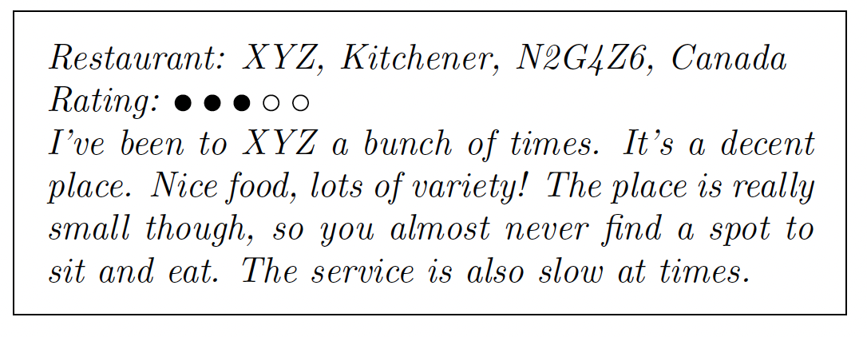
Challenges and Gaps
Context & Sarcasm: “Great job burning my pizza!” — an unsolved problem
Lexicon mismatch: limited by real-world data noise, slang, and sarcasm
***Imbalanced data***: most reviews are 4 or 5 stars
Explaining middle ratings: very difficult to discern between 2 & 3 star ratings
Source: Asghar et al.

Slide 19
Papers Read
Sentiment Analysis on Product Reviews Using Machine Learning Techniques; Rajkumar S. Jagdale, Vishal S. Shirsat and Sachin N. Deshmuk
Yelp Dataset Challenge: Review Rating Prediction; Nabiha Asghar
Sentiment Analysis: A Systematic Case Study with Yelp Scores; Wenping Wang Et al.
Ensemble Sentiment Analysis Using Bi-LSTM and CNN; Puneet Singh Lamba Et al.
Sentiment Analysis of Restaurant Reviews using Combined CNN-LSTM; Naimul Hossain Et al.
Sentiment Analysis of Yelp Reviews by Machine Learning; Hemalatha S, Ramathmika
Sentiment Analysis on Food Review using Machine Learning Approach; Nourin Islam, Ms. Nasrin Akter, Abdus Sattar
Sentiment Analysis using Machine Learning Techniques on Python; Ratheee Et al.
Sentiment Analysis of Yelp‘s Ratings Based on Text Reviews; Xu Et al.
Predicting a Business’ Star in Yelp from Its Reviews’ Text Alone; Fan, Khademi

