Slide 1
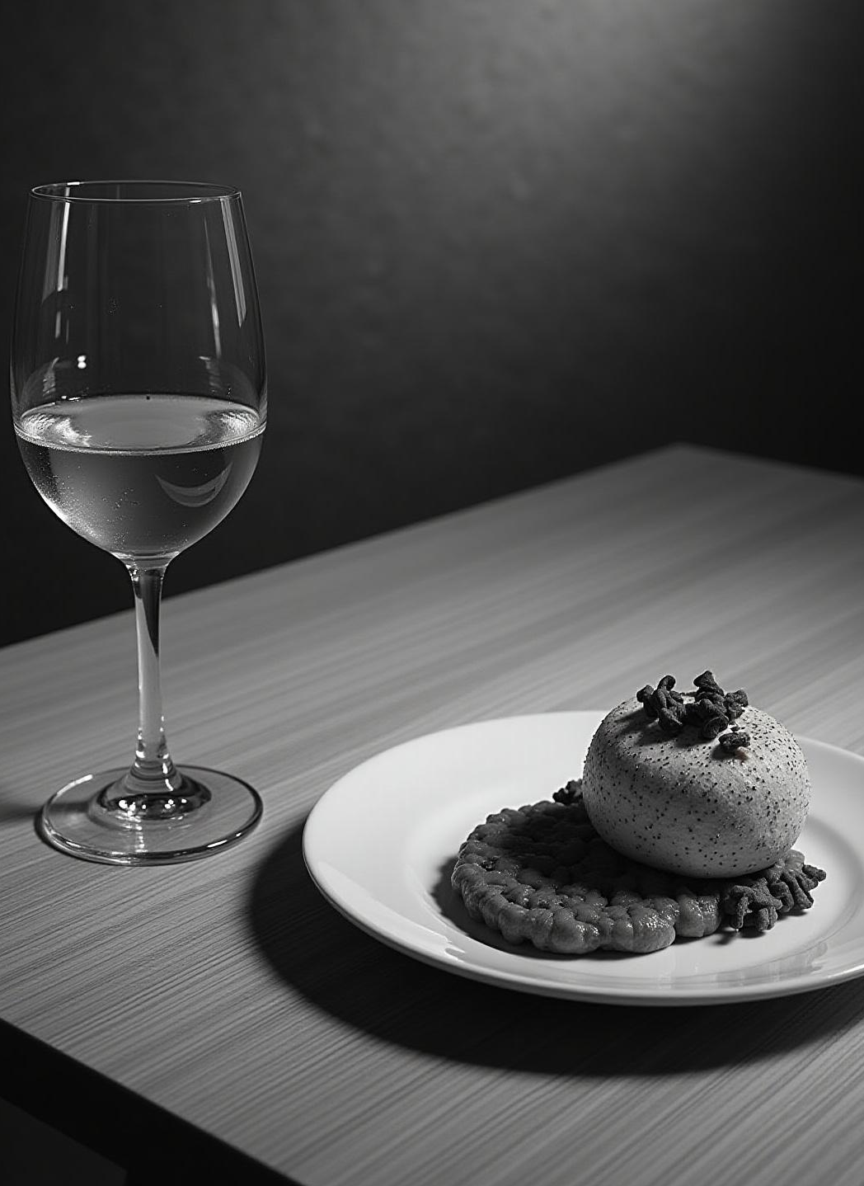
PairVino
Wine & Food
Pairing Recommender
Julia Ribeiro
Ironhack Data Analytics Bootcamp - Final Project

Slide 2
WHY?
Better Taste, Backed by Science
Sensory research shows that good food–wine pairings significantly enhance flavor perception.
Two-thirds of wine drinkers strongly feel that wine and food naturally complement each other, according to Colangelo & Partners — but most lack the confidence to choose the right pairing.
Marketing studies show that providing pairing recommendations can boost wine sales by ~15%.
Wine knowledge is complex, options are overwhelming, and most consumers do not have sommelier expertise.
Wine Intelligence Global Trends in Wine report shows that the global wine knowledge index declined between 2015 and 2019 — from ~43.8 to ~40.1 (out of 100).
A data-driven, user-friendly tool can make expert pairing accessible to everyone, enhancing meals, improving buying decisions, and increasing engagement across the wine experience.
What Consumers Already Believe:
Clear Business Impact:
The Gap:
The Opportunity:
Introducing: PairVino
A smart, ML-powered wine–food pairing assistant designed to bring sommelier-level recommendations to every table.

Slide 3
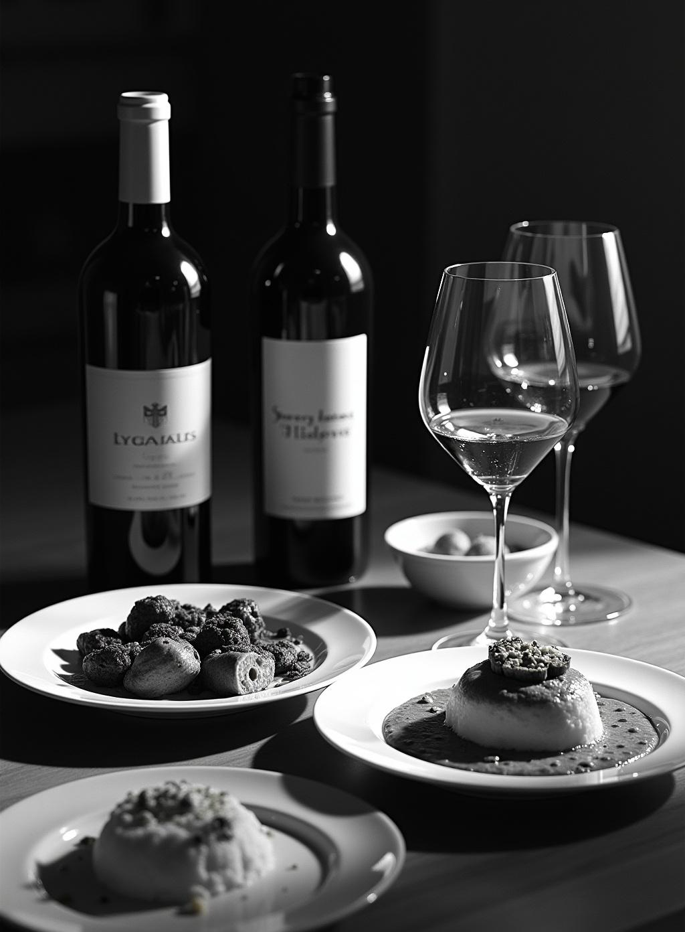
Project Overview
This project aims to build a wine recommender that suggests the best wine for a given food item, category, or cuisine and type of wine preference.
Dataset: Kaggle Wine & Food Pairing - a synthetic dataset with over 34,000 wine-food pairings ratings
The pipeline covers exploratory data analysis, feature engineering, machine learning modeling, and app deployment for real-time recommendations.

Slide 4
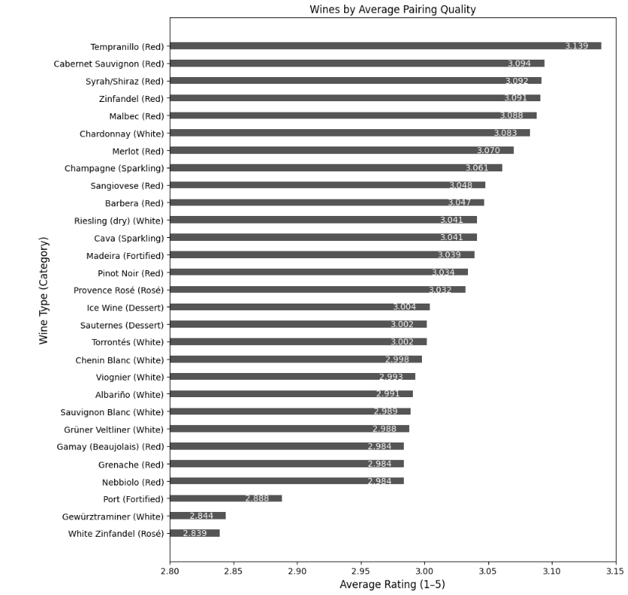
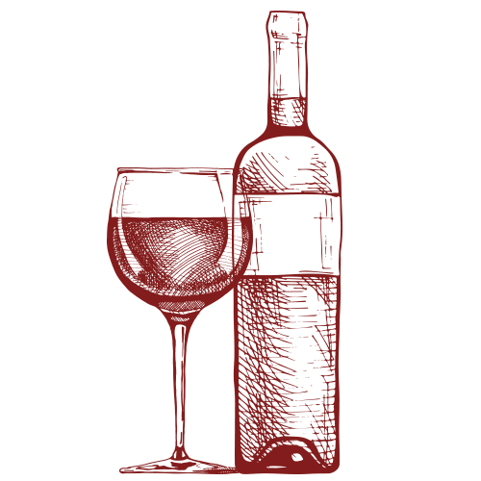
Exploratory
Data Analysis

Slide 5
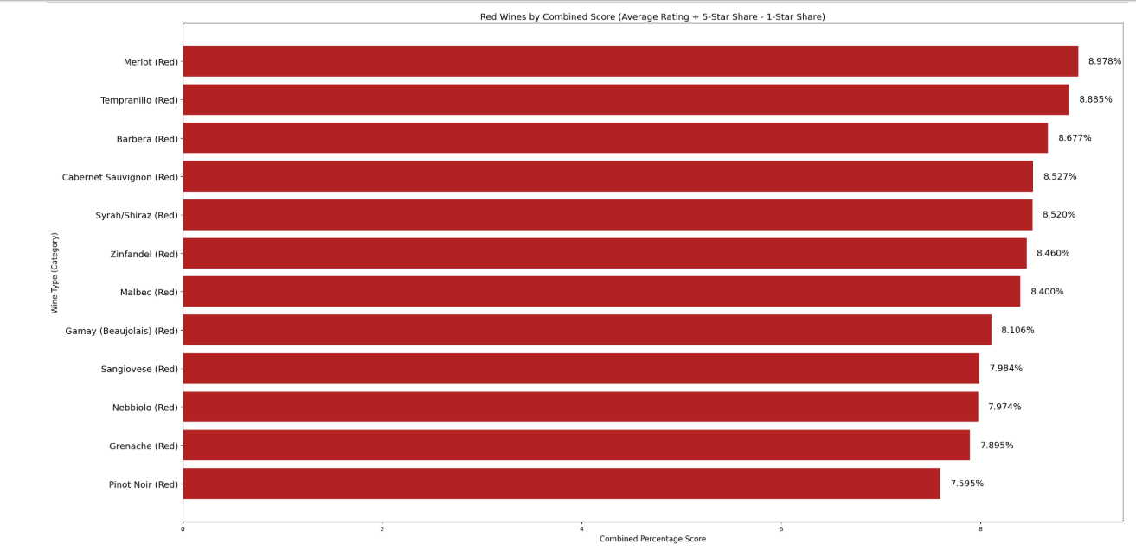
Exploratory Data Analysis
RED WINE

Slide 6
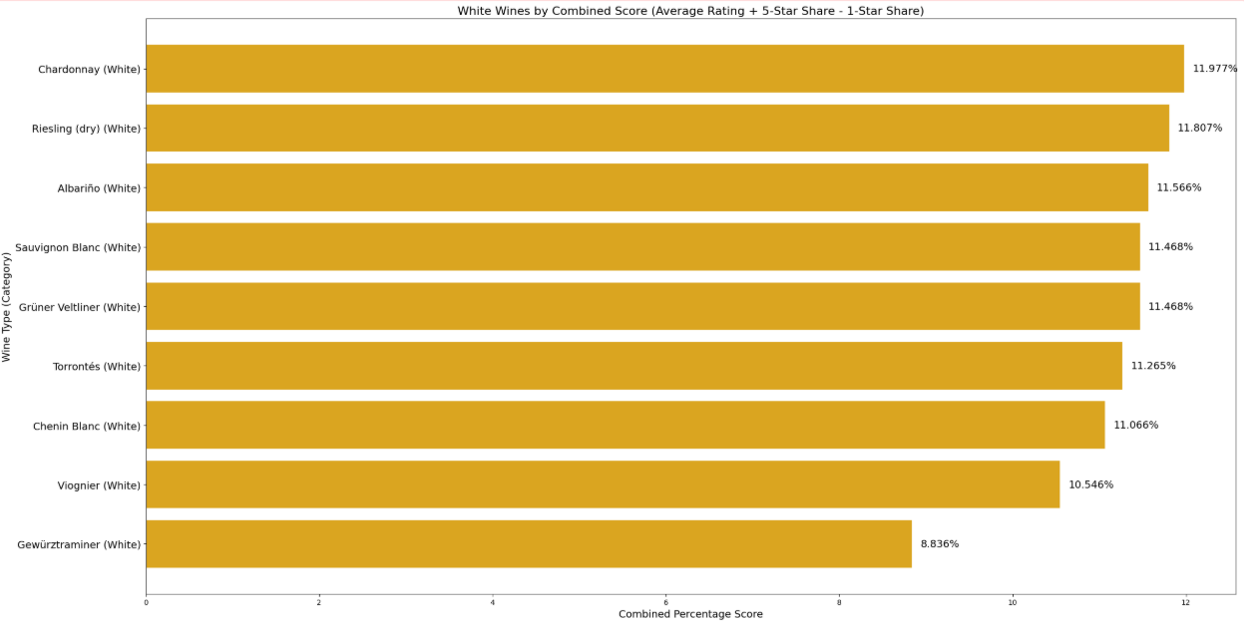
Exploratory Data Analysis
WHITE WINE

Slide 7
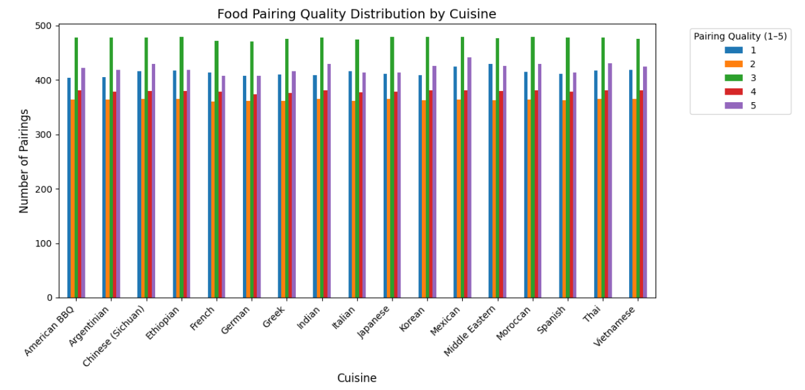
Exploratory Data Analysis
Cuisine

Slide 8
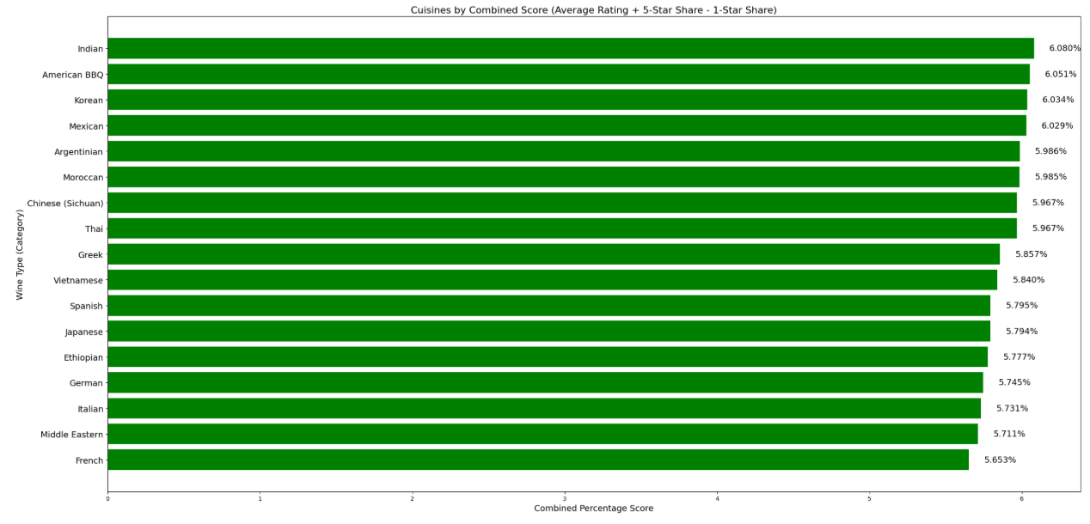
Exploratory Data Analysis
Cuisine

Slide 9

Machine Learning
Recommender System
Collaborative Filtering
Gradient Boosting
XG Boost
LightGBM

Slide 10
Machine Learning
Recommender System
LightGBM
LightGBM is a machine learning algorithm based on gradient boosting, designed to make accurate predictions using decision trees.
It builds many small decision trees one after another.
Each new tree focuses on correcting the errors made by the previous ones.
RMSE ≈ 0.28
MAE ≈ 0.16

Slide 11
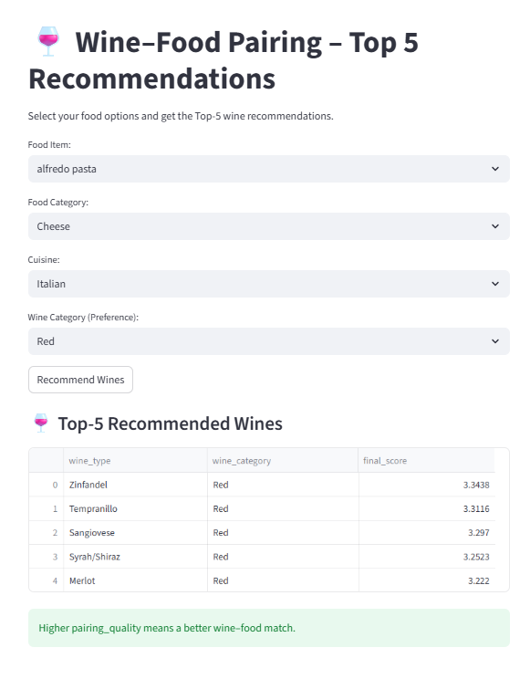
PairVino
Streamlit App

Slide 12
Practical Application & Future Improvements
The app lets users choose food, category, cuisine, and wine preference, displaying the top 5 recommended wines by predicted pairing quality.
Future improvements:
  Adapt this to reality, collecting real data
  With real data, adapt the buttons on the app to only include combinations that make sense in reality
  Include pictures and improve UI

Slide 13

Conclusions
EDA showed that the synthetic dataset was very well balanced and well distributed among the different types of wines and foods, but did not express reality.
LightGBM provided fast, reliable wine-food recommendations.
The Streamlit app offers an intuitive user experience with scope for expansion through advanced models and richer interfaces.

Slide 14
Thank you!

