Slide 1
Create MTG Trading Card Database by API
Big Data Practical Exam | 5. Dezember 2022 | Julia Bai

Slide 2
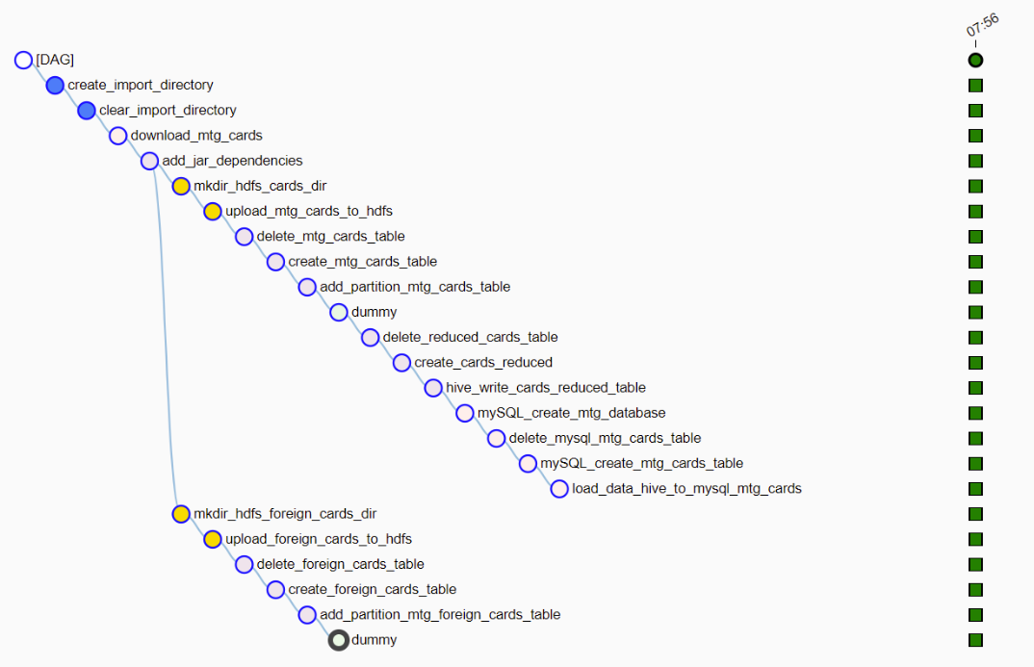
1. Start ETL Workflow

Slide 3
2. Data Source
Magic: The Gathering API
API endpoint: https://api.magicthegathering.io/v1/cards?pageSize=[PAGESIZE]&page=[PAGENR]
Download of all mtg cards:
Send HTTP GET request to endpoint
PAGESIZE=150, PAGENR=[0, 709]
Data Structure
Hadoop Container
Airflow Container:
Magic.py -- contains all relevant tasks of the workflow
big-data – contains ssh private key
MySQL Container
Databases:
HIVE:
mtg_foreign_cards
mtg_cards
cards_reduced
MySQL:
mtg_cards

Slide 4
3. ETL Workflow
Init & download
operations for mtg_cards
operations for
cards reduced
Operations
for enduser db
operations for mtg_foreign_cards

Slide 5
3. External Ressources
Die verschiedenen Docker Container
Pip installs
SSH-connection
sshtunnel
mysql-connector
paramiko
hiveSQL Queries
pyhive
sasl
thrift-sasl
thrift
mySQL Queries
pymysql

Slide 6

4. Data Model
Airflow
Hadoop File System
/home/airflow/mtg/
mtg_cards_[ds].json
/user/hadoop/mtg/raw/[year]/[month]/[day]/
mtg_cards_[ds].json
MTG API
/home/airflow/mtg/
mtg_foreign_cards_[ds].json
/user/hadoop/mtg/raw/[year]/[month]/[day]/
mtg_foreign_cards_[ds].json

Slide 7

4. Data Model
Hadoop File System
/user/hadoop/mtg/raw/[year]/[month]/[day]/
mtg_cards_[ds].json
SELECT: HiveSQL
INSERT: MySQL
JOIN
/user/hadoop/final/cards
/user/hadoop/mtg/raw/[year]/[month]/[day]/
mtg_foreign_cards_[ds].json
Enhanced data
name
multiverseid
imageurl
! only German cards

Slide 8
4. Data Model
Backend
Frontend
AXIOS
Express
NodeJS
localhost:3001/mtg
localhost:3000
Notes:
- Über Express wird eine Rest API erstellt, der mit der MySQL Datenbank kommuniziert
Über den Link erhalten wir dann den ganzen Inhalt der Datanbanktabelle der mtg_cards
Im Frontend kann dann auf den Inhalt zugegriffen warden über einen HTTP GET Request mittels Axios

Slide 9
5. Frontend: Live Demo

Slide 10
Create MTG Trading Card Database by API
Big Data Practical Exam | 5. Dezember 2022 | Julia Bai

