Slide 1
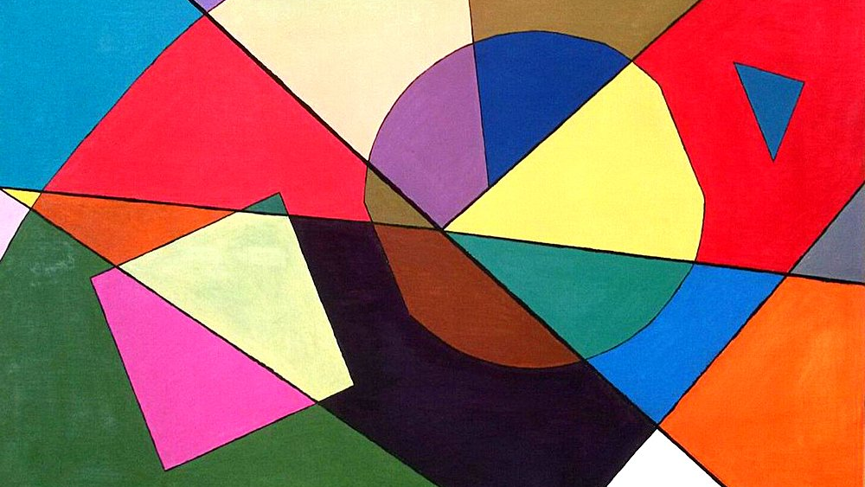
Figure recognition

Slide 2
1 Step. Feature extraction
KEY features:
Solidity - Measures how dense/convex an object is, helping distinguish shapes with indentations (Bridge)
Aspect Ratio - Compares width to height, separating squares (≈1) from rectangles (≠1) or elongated shapes.
Extent - Ratio of object area to its bounding box area, identifying "fullness" (e.g., triangles have lower values than squares).
Eccentricity - Quantifies elongation

Slide 3
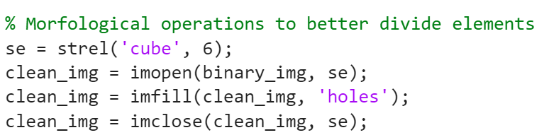
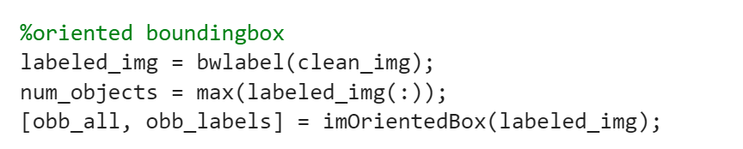
1 Step. Feature extraction

Slide 4
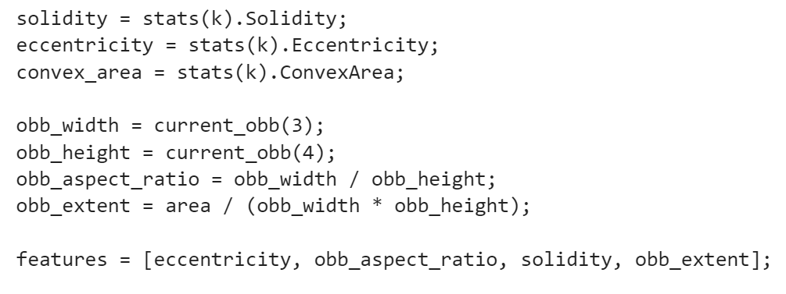
1 Step. Feature extraction

Slide 5
Oriented Bounding Box
For computing bounding box we used an external function that finds minimum-area oriented bounding box of particles in image
function [rect labels] = imOrientedBox(img, varargin)
% Author: David Legland

Slide 6
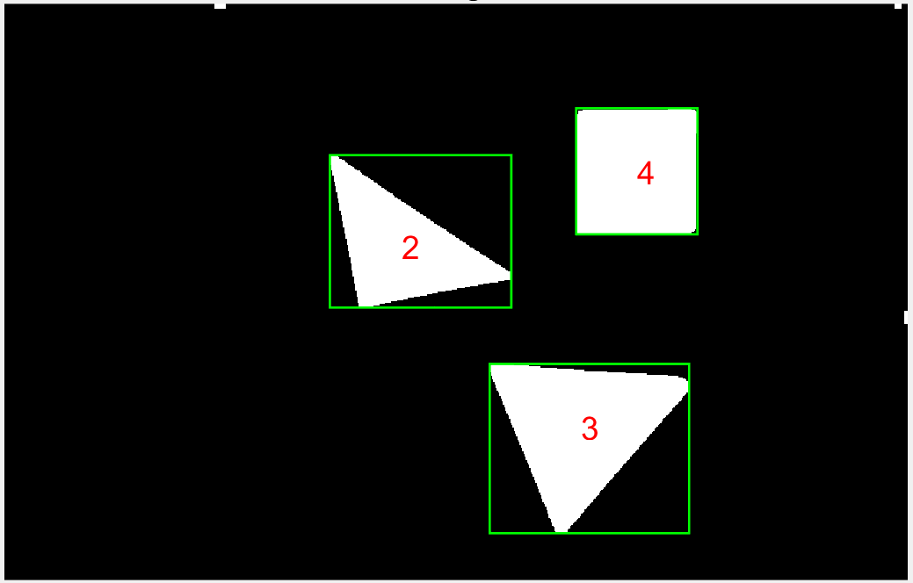
Example of output features
Object 2: eccentricity=0.8182, obb_aspect_ratio=1.0007, solidity=0.9561, obb_extent=0.5176
Object 3: eccentricity=0.4840, obb_aspect_ratio=1.2098, solidity=0.9739, obb_extent=0.5456
Object 4: eccentricity=0.2919, obb_aspect_ratio=1.0396, solidity=0.9840, obb_extent=0.9727

Slide 7
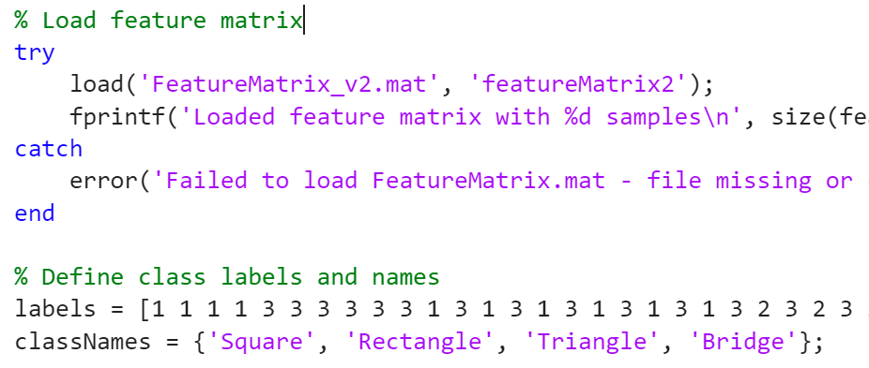
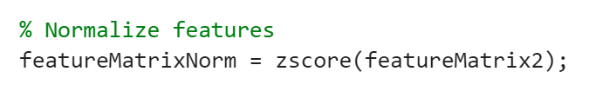
Step 2. Training Models

Slide 8
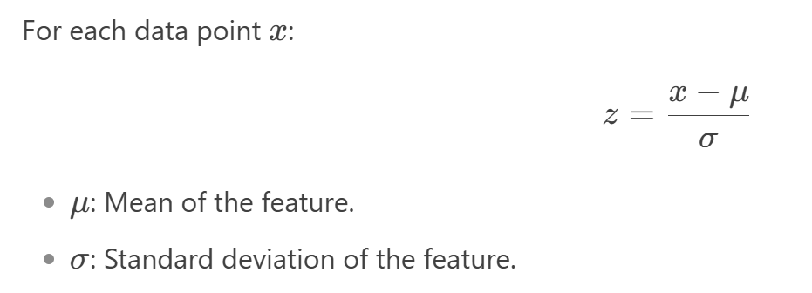
Step 2. Training Models
zscore standardizes data by transforming each value to show how many standard deviations it lies from the mean.
Balances Feature Influence
Improves Classifier Performance

Slide 9
Step 2. Training Models
For training models we used:
Statistics and Machine Learning Toolbox
Classifiers: Random Forest, Decision Tree, k-NN
Cross-validation (KFold)
Data normalization (zscore)
Deep Learning Toolbox Neural network architecture: Input layer → Fully connected layers → Softmax → Classification Adam optimizer

Slide 10
Step 2. Training Models
Machine Learning Methods
Ensemble Methods: Random Forest (100 trees)
Nearest Neighbor Method: k-NN with parameter optimization
Neural Network: Batch Normalization, ReLU, L2 regularization
Model Evaluation: Confusion Matrix, Accuracy

Slide 11
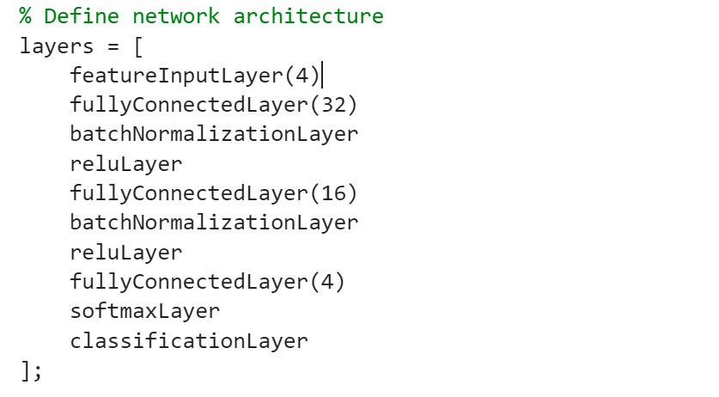
Step 2. Training Models

Slide 12
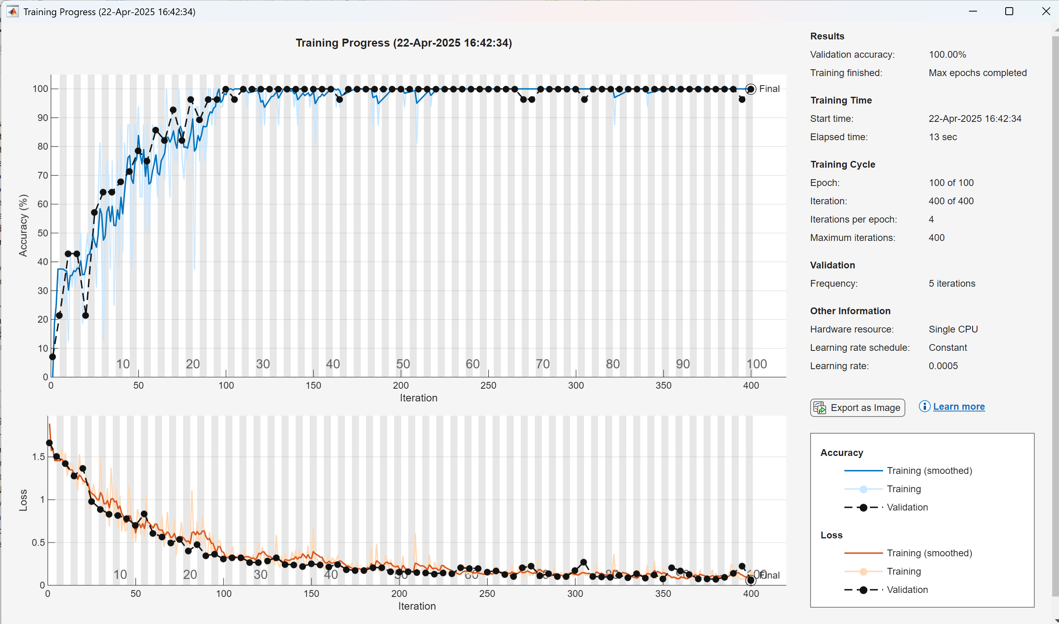

Slide 13
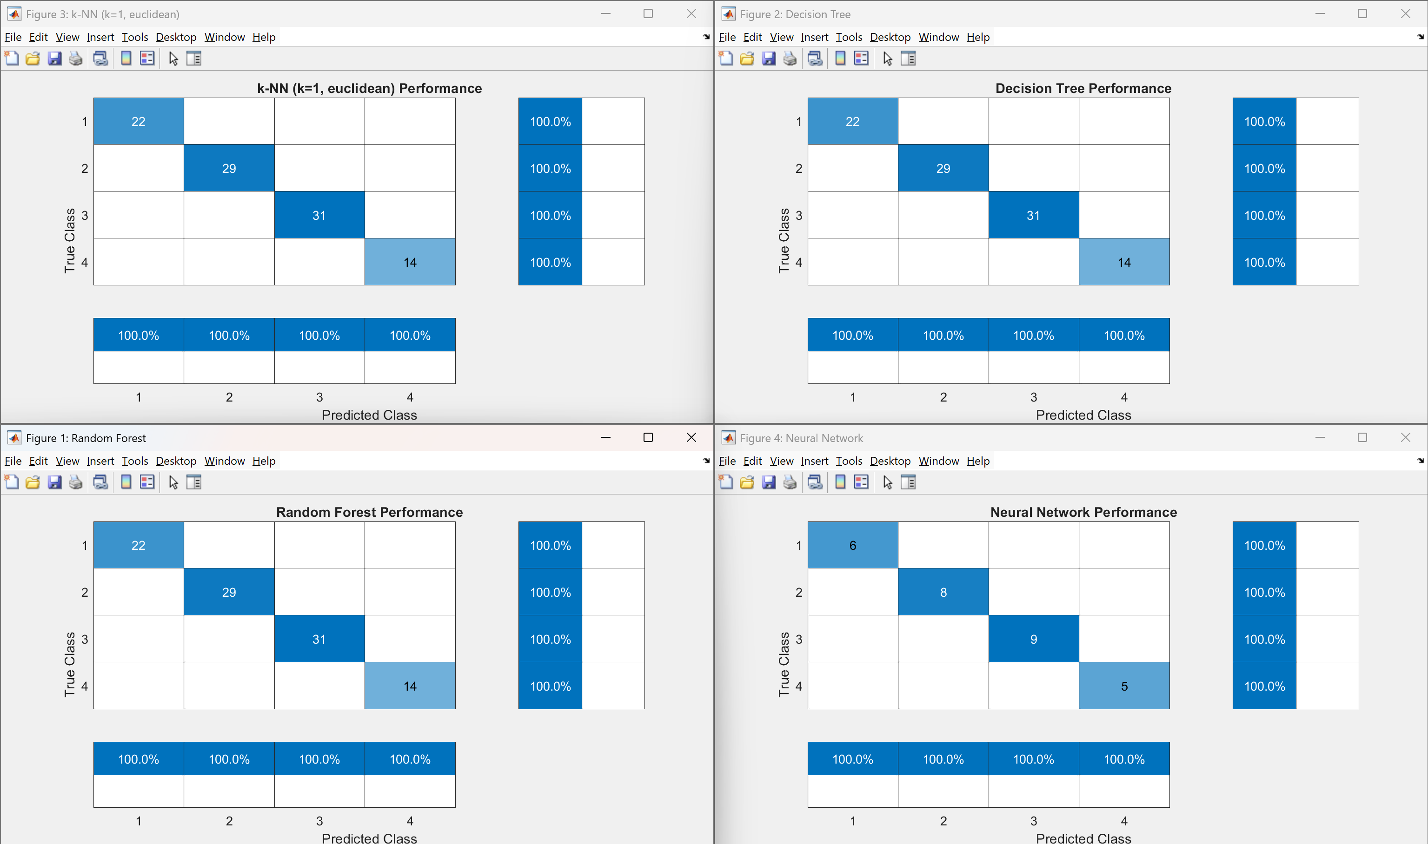

Slide 14
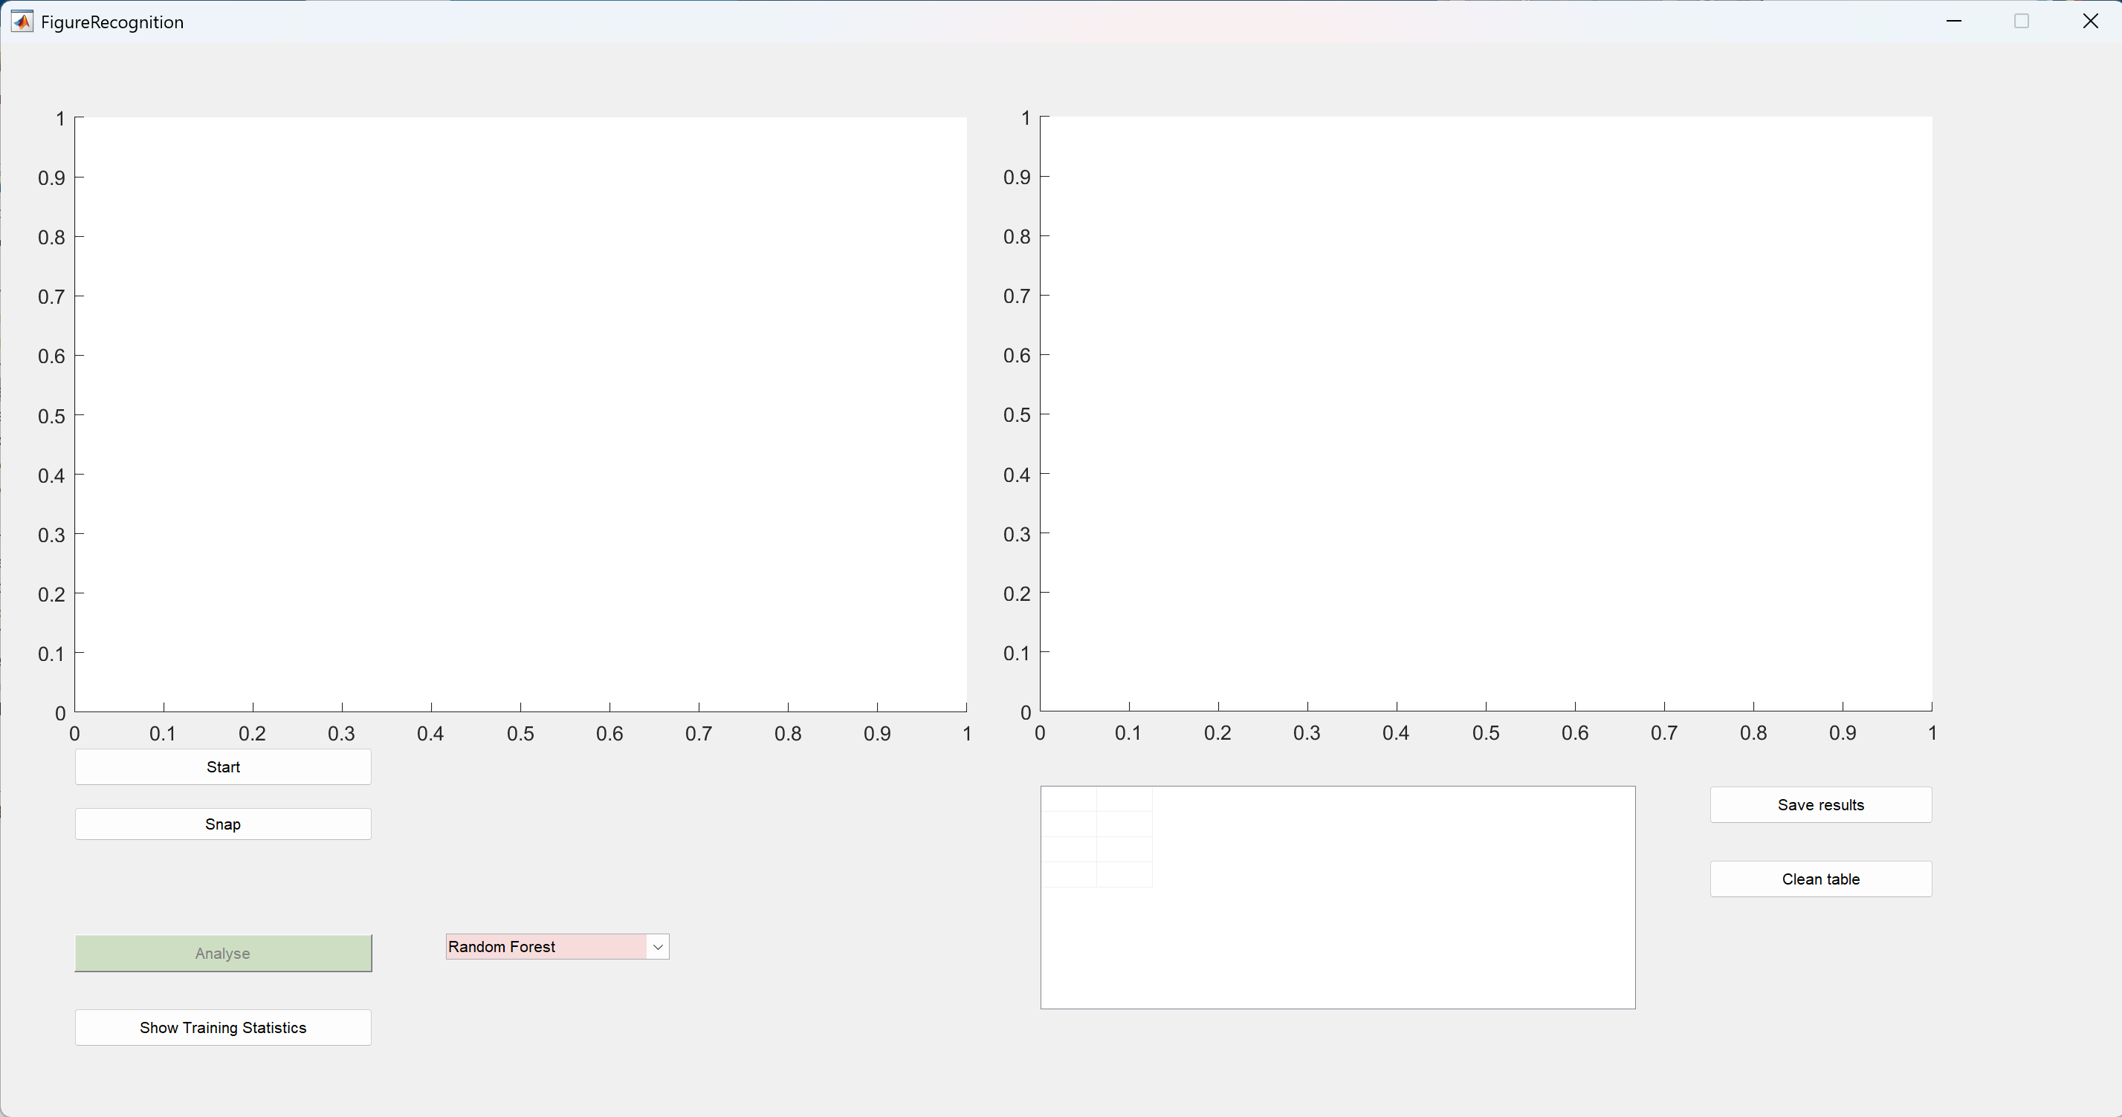
Step 3. GUIDE

Slide 15
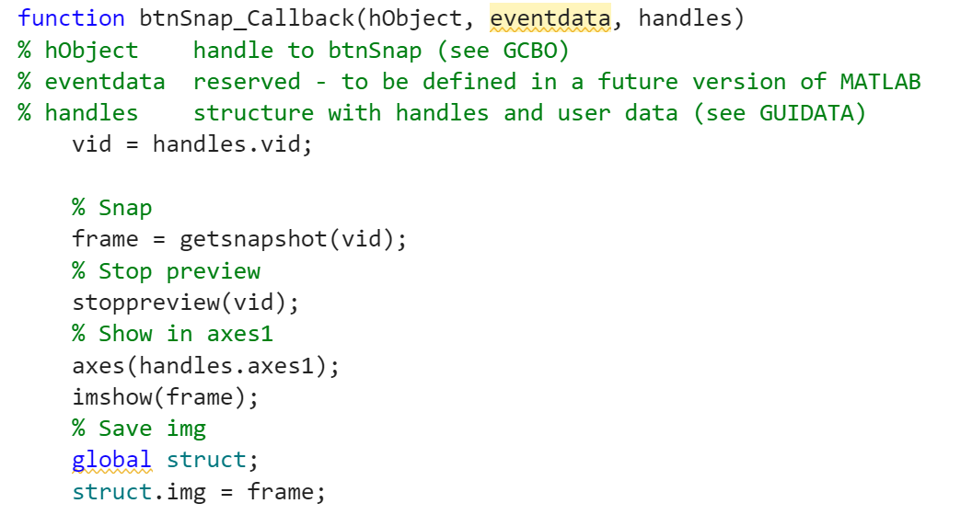
Getting an image

Slide 16
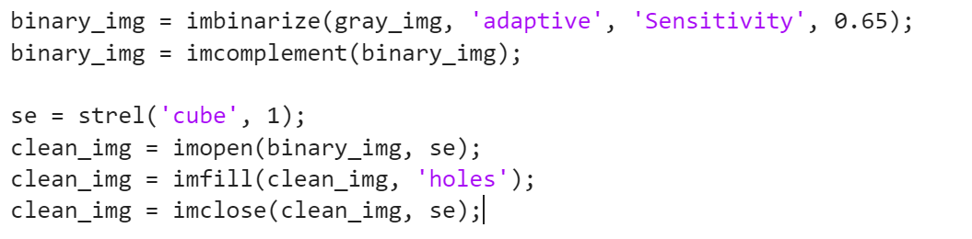
Morphological image processing
Adaptive binarization (sensitivity=0.65)
Inversion flips black/white pixels (imcomplement)
Morphological opening removes small noise
Hole filling closes dark regions within white objects
Morphological closing smoothes edges and fills small gaps

Slide 17
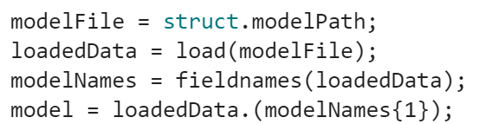
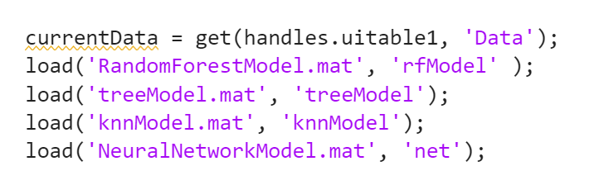
Loading models

Slide 18

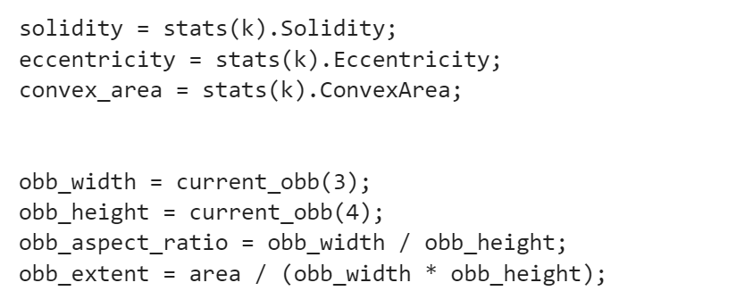
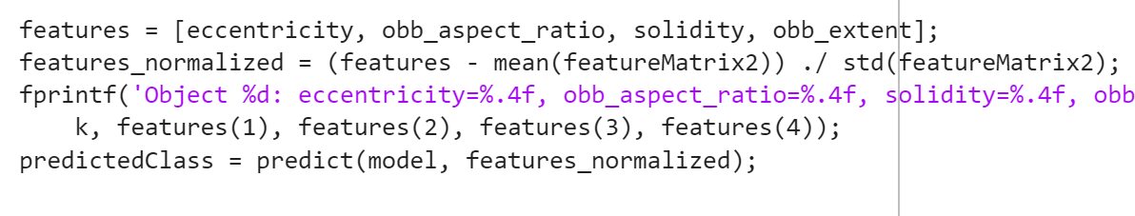
Getting features for figures in loop

Slide 19
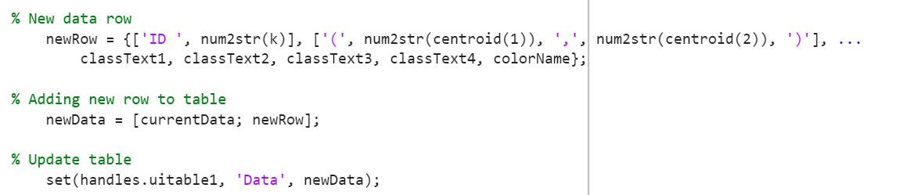
Comparing models via table

Slide 20
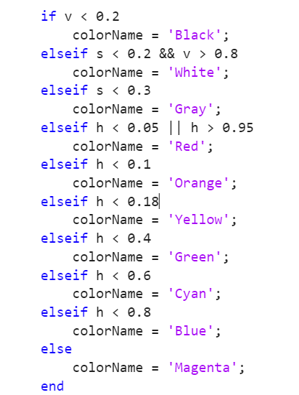
Getting color name
Averages the RGB Color. Takes an RGB image region (rgbRegion) and calculates the mean R, G, and B values across all pixels, converting them to the range [0, 1].
Converts RGB to HSV. Transforms the averaged RGB color into HSV (Hue, Saturation, Value) for easier color classification.
Classifies Color Based on HSV Values.

