Slide 1

Bacchus Winery Case Study

Slide 2
Green Team
We are the green team, we worked on the Bacchus wine case and our members include the following:
Kendrick Baker
Julia Delightly
Elizabeth Fung
Christopher Morales
Abigail Sabelhaus

Slide 3
Case Study
For this case study in association with Bacchus Winery, our team was tasked with looking through the records of the company and making an analysis of the delivery, distribution, sales, cost, hours of labor and inventory using databases to discover discrepancies, gaps in time, over abundance of hours and anything else that could be making them less efficient and profitable. The steps that were taken to discover and remedy their financial hardships were as follows.
ORD- to create a layout and plan for the elements and values that are to be looked at and inputted into an algorithm.
Databases- Tables using the information given by the company to input into the layout of the ORD as database tables are made to show in a comprehensive and easy to visually analyze how the company is run and what resources are being used at what rate.
Generate Reports- Reports are made to show the important information that would be beneficial to discovering where the companies losses are coming from using the databases as they generate specific requested information and analysis's.

Slide 4
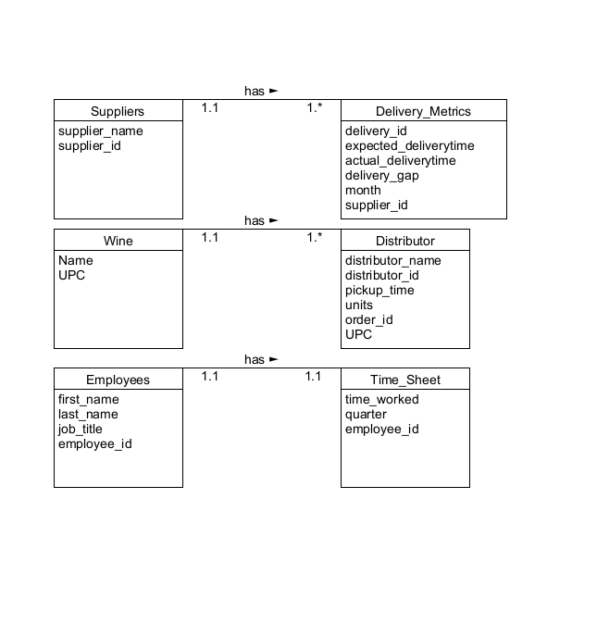
ORD
An ORD was created to breakdown and layout the Relationships between the embedded documents.
The ORD relations consisted of a one-to-many relationship between suppliers and delivery metrics as well as with the Wine to Distributors for suppliers and wine each possesses multiple distributors and delivery variables each.
The Employees and the Time sheets on the other hand were made up of one-to-one relationships meaning that each employee possessed only one time sheet each.
then these variables and relationships were each plugged into a database code with the proper inserting of each of the needed items. These databases would use the variables within to calculate and show the expenditures as well as profits and time gaps and losses posed by each of the tables by generating Reports.

Slide 5
Generated Reports
Report concepts based on case study needs were created to show comprehensively what the overarching costs and expenditures that would affect the company the most are.
Create a month-to-month report of delivery times to see where there are gaps
Create a sales report to see which wine is selling the most
Create a timesheet report that totals number of hours each employee worked

Slide 6
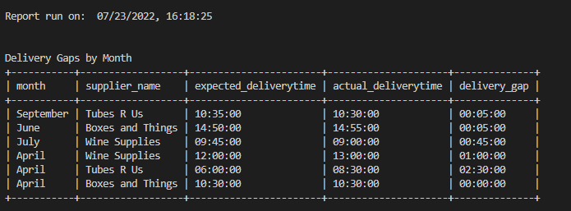
REPORT #1
The purpose of this report is to gather all of the data for delivery times and see how frequently the deliveries deviated from the expected time and average the total amount of time month-to-month to check for problem areas or an overall issue with the supplier’s performance.
The Results from Report #1 were that Tubes R Us was the supplier who was late the most in April by 2 and a half hours. As far as best delivery record that would go to Boxes and Things, they were late by 5 minutes in June and the only supplier to deliver on time in April.

Slide 7
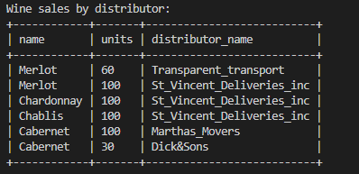
REPORT #2
This report observes which wine is selling the most based on sales records kept for each individual wine. Each of the wine’s records will be compared to the others to see which wine is the most popular and which distributor carries it.
The results for the wine sales were that the Merlot sold the most units, followed by the Cabernet, and followed then Chardonnay and Chablis which sold the same amount of units. These results show that while there is a clear preference for the Merlot, there is not one wine that sticks out as performing poorly compared to the rest. However, both of the lowest performing wines are being handled by the same distributor, which may be important to note moving forward.

Slide 8
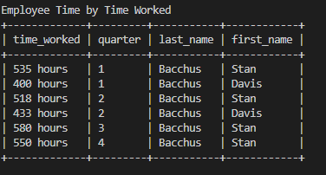
REPORT #3
In order to determine how many hours each employee has worked within each quarter, this report will generate a table of employee records that keeps track of the hours clocked. Therefore, the employers may see if the work has been unequally shared amongst their employees.
The results for the time each employee worked was that Davis worked for far less time than Stan had. In order to even the spread of hours Davis will need to take over some of the hours Stan typically works. This will provide better time worked equality among staff.

Slide 9
Assumptions
A large amount of financial strain would come from the overstocking of specific brands that didn't sell as well as anticipated by the size of the orders.
Each order from the distributor was only for one kind of wine. If they order different wines they have to make a separate order per wine type.
The uneven spread of hours for each employee could lead to employee burnout if not corrected. Which could lead to a higher turnover rate.
Distributors purchase wine by cases, or units, as opposed to individual bottles
A unit of wine contains the standard US amount of 12 bottles
The amount of hours an employee works is calculated over the entire quarter, as opposed to a monthly time frame
The expected supplier minimum on-time delivery performance should be no lower than 80%
Shipments are able to be tracked by Maria using wine order_id.
Stan and Davis can keep track of deliveries using delivery_id.
A Stock Keeping Unit or SKU is the typical number that retailers will use to differentiate products
Time clocks or time sheets are one of the more common methods to monitor employees time
Each order is only for one kind of wine
We made the assumption that there are established delivery days (Mondays and Fridays). Delivery times are established according to availability.

