Slide 1
Game Idea

Slide 2
Summary
Two players play as balls, and race to the finish line, both start from opposite, identical sides of the level
The finish line will be in the middle of the level

Slide 3
Player Movement
Players can
-move/ rotate their platforms
-make the ball jump
-make their ball charge (which can break objects in the way)
One player uses the arrow keys, the other uses WASD

Slide 4
Obstacles
If players drop or hit an obstacle they have to start from the beginning
The levels will be short

Slide 5
Levels
The levels will fit on one screen
Some levels will have rotating platforms, and some will be sliding, either way the arrows and A and D will move them
Some levels will have simple enemies that the players must dodge, players must use timing to get through the level while going as fast as they can

Slide 6
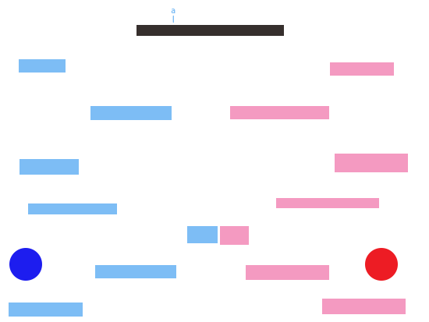
Example level

Slide 7
Winning
At the end of each level, the winner will get a point
Each level will lead directly into the next level
The levels will get increasingly complicated

Slide 8
Extra Things
The players can collect boosts
Some platforms will be different, some will be slippery/bouncier/makes ball faster
A platform that will make a level switch gravity
Customizable/choosing players

Slide 9
Tasks
Creating a scene in Unity
Creating both players
Creating both platforms for both players and colliders
Creating platforms movement and rotation
Test speed of player movement and platform movement
Colliding with an obstacle should restart the ball
Make points

