Slide 1
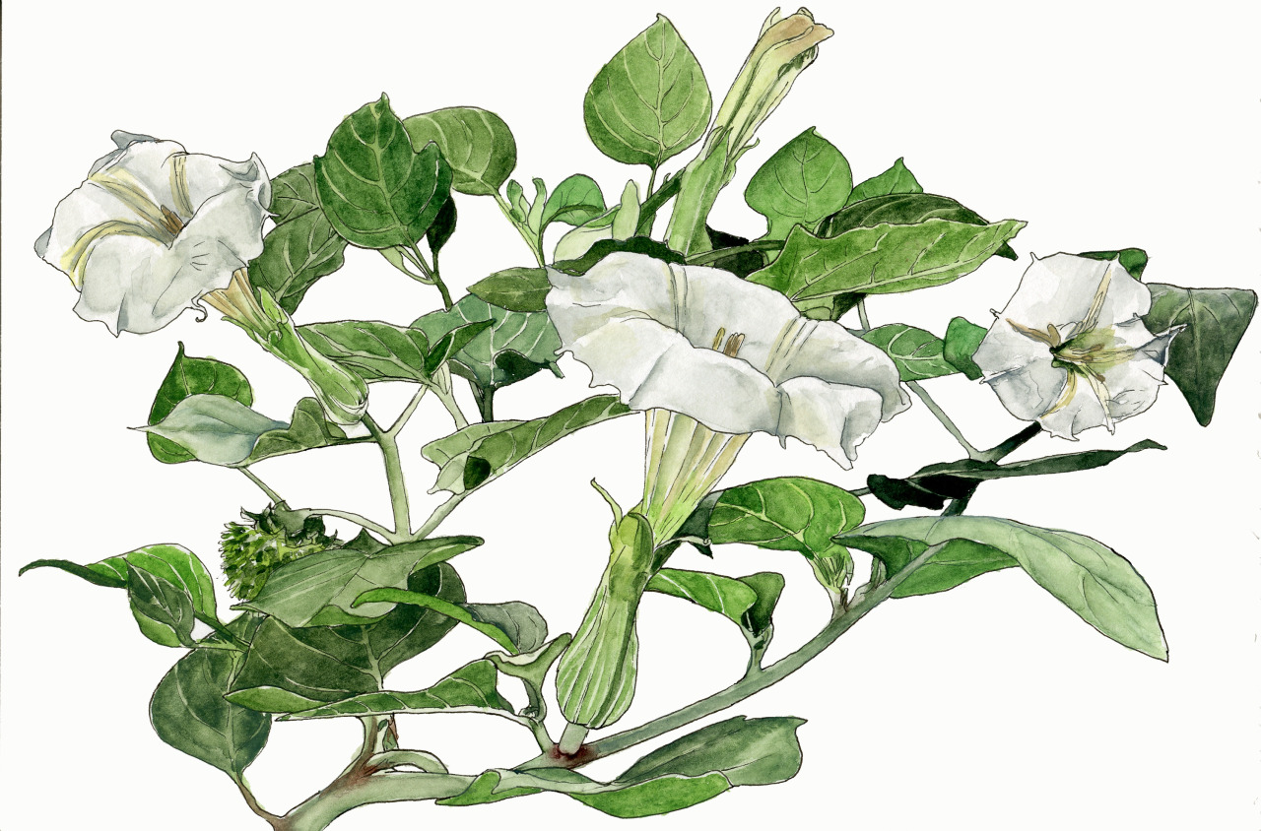
Phylogenetics and Biogeography of the Datureae clade (Solanaceae)
Julia Dupin, University of Colorado Boulder
The California Botanical Society, 25th Graduate Student Meeting - April 11, 2015
hallierosetaylor.tumblr.com

Slide 2







Notes:
3rd year PhD student
Smith lab

Slide 3
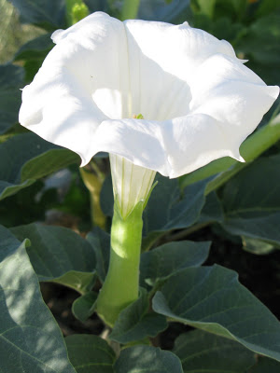
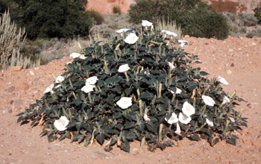
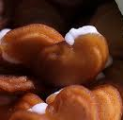
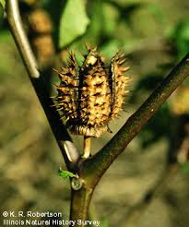
Datureae – Datura L.
Notes:
12 species

Slide 4
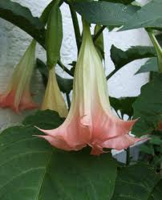
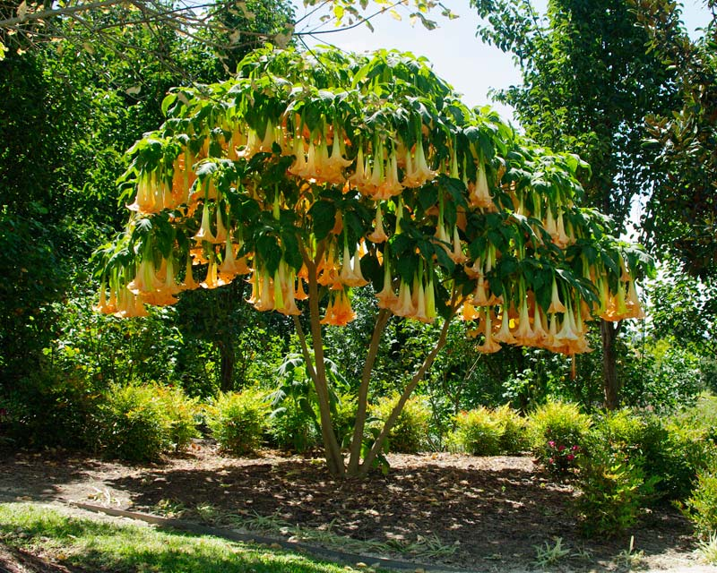
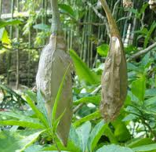
Datureae – Brugmansia Pers.
Notes:
Tree-like shrubs
10 feet tall
Biggest flowers in the family

Slide 5
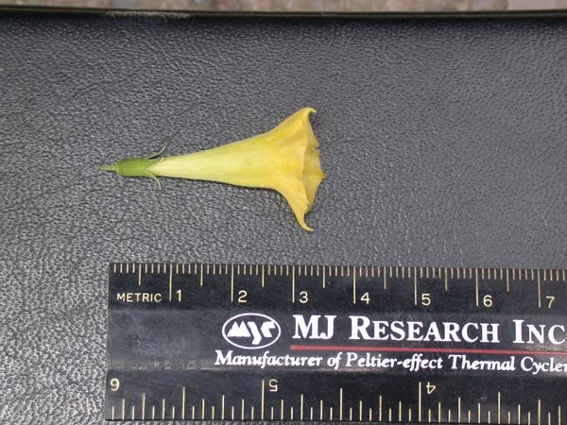
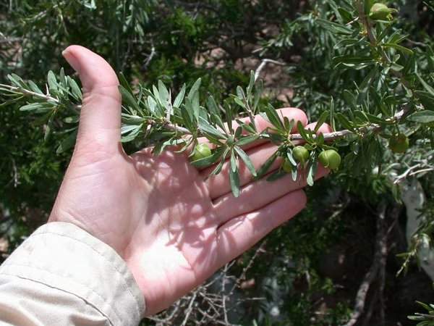
Datureae – Iochroma cardenasianum Hunz.
Notes:
misplaced

Slide 6
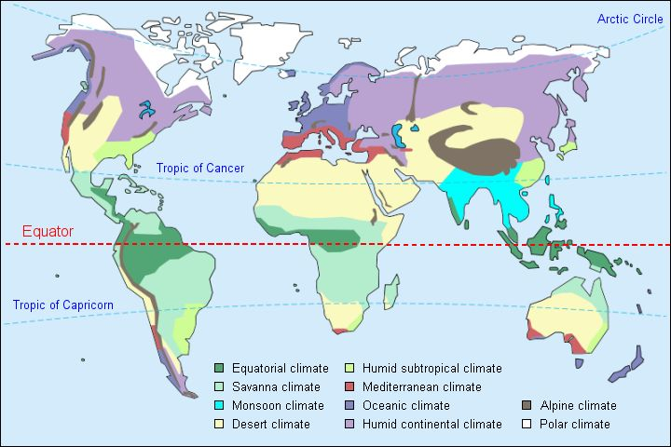
Datureae distribution
Datura
Brugmansia
Iochroma
cardenasianum

Slide 7
What is the Datureae biogeographical history?

Slide 8
To answer the question:
Calibrated phylogeny
Species distribution
Ecological niches

Slide 9
Datureae phylogeny
Relationship between species in Datureae
Outgroup?
Divergence time between outgroup, Datura, Brugmansia, I cardenasianum
Notes:
Know what are the relationships between the species in Datureae
Know who is the outgroup

Slide 10
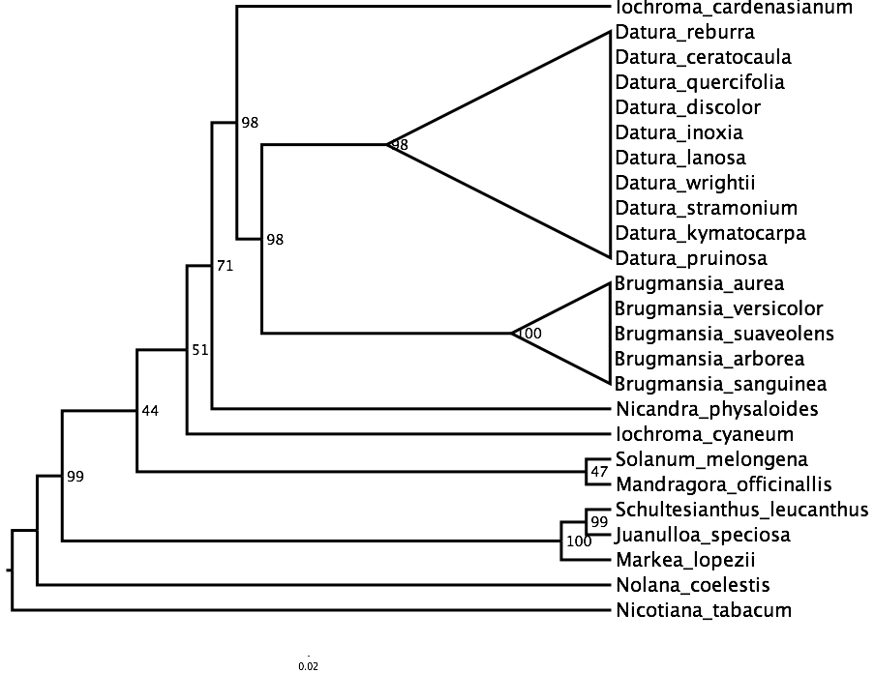
Datureae phylogeny – Preliminary results
~ 8 m.y.
~ 7 m.y.
Notes:
Objectives 3 and 4 – no sense except in the light of Datureae phylogey

Slide 11
Datureae distribution
Datura
Brugmansia
Iochroma
cardenasianum

Slide 12
Datureae distribution
The range expansion hypothesis
Niche reconstruction in CAm
Datura
Brugmansia
Iochroma
cardenasianum
Notes:
Considering periods of glaciation – variations in temperature

Slide 13
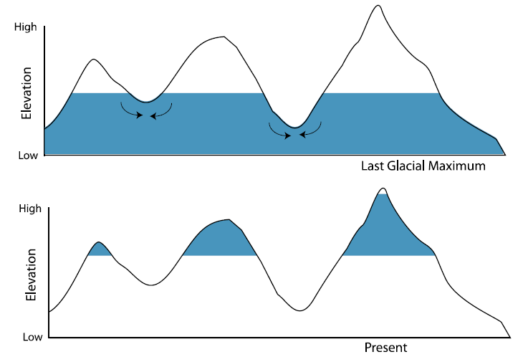
Datureae distribution
The range expansion hypothesis
Niche reconstruction in CAm
Datura
Brugmansia
Iochroma
cardenasianum
Notes:
Considering periods of glaciation – variations in temperature

Slide 14
Datureae distribution
The long-distance dispersal hypothesis
Ancestral range reconstruction where long-distance dispersal events can be estimated
Datura
Brugmansia
Iochroma
cardenasianum

Slide 15
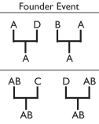
Datureae distribution
The long-distance dispersal hypothesis
Ancestral range reconstruction where long-distance dispersal events can be estimated
Datura
Brugmansia
Iochroma
cardenasianum

Slide 16
Datureae distribution
Datura
Brugmansia
Iochroma
cardenasianum

