Slide 1
A very brief Introduction to OpenCV

Slide 2
Introduction
Open Source Computer Vision (OpenCV) library aims at real time computer vision applications.
  Object Identification
  Segmentation
  Face Recognition
  Motion Tracking
  Mobile Robotics

Slide 3
Download and Setup
Download
  You can download the library from the homepage: http://opencv.org/
  The latest version is 4.1.1, but you may choose any version > 2.1 to do the homework.
Setup
  We will demonstrate how to set up OpenCV 3.0 in Visual Studio.
  For users of other OSs, please refer to:
    Linux: http://docs.opencv.org/doc/tutorials/introduction/linux_install/linux_install.html
    Ubuntu: http://milq.github.io/install-opencv-ubuntu-debian/
    Mac OS X: http://blogs.wcode.org/2014/10/howto-install-build-and-use-opencv-macosx-10-10/

Slide 4
Resources
Tutorial
  http://docs.opencv.org/doc/tutorials/tutorials.html
  http://docs.opencv.org/master/d9/df8/tutorial_root.html
  http://www.cs.iit.edu/~agam/cs512/lect-notes/opencv-intro/index.html
Documents
  http://docs.opencv.org
  http://docs.opencv.org/master/index.html
  $OpencvDirectory/sources/doc/tutorials/tutorials.markdown

Slide 5
Useful Functions: Image reading
cv::Mat
  Matrix structure for the OpenCV
  Mat Mat::clone()
    Duplicate a image of itself and return it.
cv::Mat cv::imread(filename, color_flag=1)
  Load a image by the filename. Color_flag specifies the color type of the image.
bool cv::imwrite(filename, img_mat)
  Save a image with the filename.

Slide 6
Useful Functions: User Interface
void cv::namedWindow(window_name, flags=WINDOW_AUTOSIZE )
  Create a window with the window_name.
void cv::imshow(window_name, img_mat)
  Show the img_mat in the window with that window_name.
int cv::waitKey(delay=0)
  delay(ms): how long the window will be shown. 0 means forever.
void cv::destroyWindow(window_name)
  Destroy the window with the window_name.

Slide 7
Useful Functions: Image Processing
void GaussianBlur(src, dst, ksize, sigmaX, sigmaY)
  Blurs an image using a Gaussian filter.
double threshold(src, dst, thresh, maxval, type)
  Applies a fixed-level threshold to each array element.
void erode(src, dst, kernel)
  Erodes an image by using a specific kernel.
void dilate(src, dst, kernel)
  Dilates an image by using a specific kernel.

Slide 8
Useful Functions
If you’re familiar with OpenCV, you should try the following functions:
cvFindContours()
cvMoments()
cvGetCentralMoment()

Slide 9
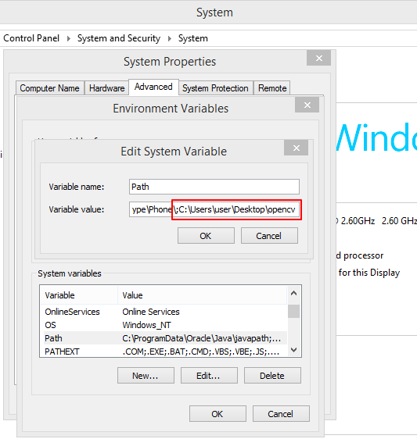
System Configurations
Environment Variables
OpenCV directory path

Slide 10
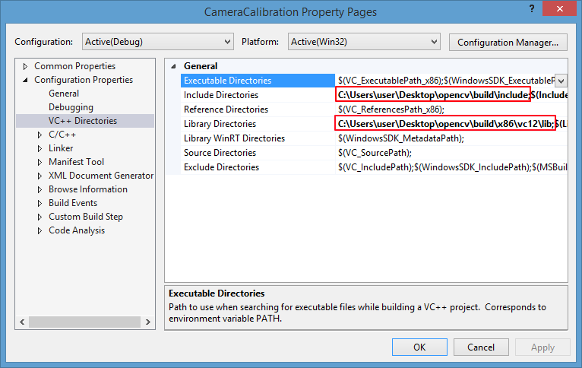
Visual Studio Configurations
Directory Path
Include Directories: <OpenCVDirectory>\build\include
Library Directories: <OpenCVDirectory>\build\<x86>\<vc12>\lib
Change <> part if your using different setting.

Slide 11
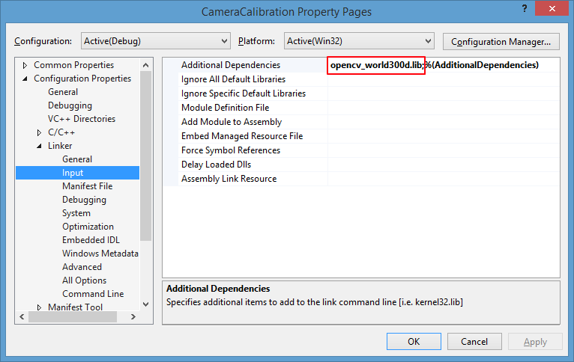
Visual Studio Configurations
Linker->Input: opencv_world300d.lib (debug)
opencv_world300.lib (release)

