Slide 1
Musical Spork
A project by David, Derek, Julia, and Peter
Notes:
Derek introduces

Slide 2
Mission
GitHub
Earworm
Find song
View YouTube videos
Notes:
Derek Mission

Slide 3
Design process
Looked at music APIs
YouTube
MusixMatch
Spotify
Materialize for CSS
Jumbotron → Card
Split into FE & BE teams
Notes:
Peter

Slide 4
Roles
David
The Diabolical
Derek
The Delightful
Julia
The Just
Peter
The Proud
Notes:
To each their own

Slide 5
Challenges
Git
CORS
YouTube Docs
… [next slide]
Notes:
CORS – Julia
YouTube Docs – David and Derek

Slide 6
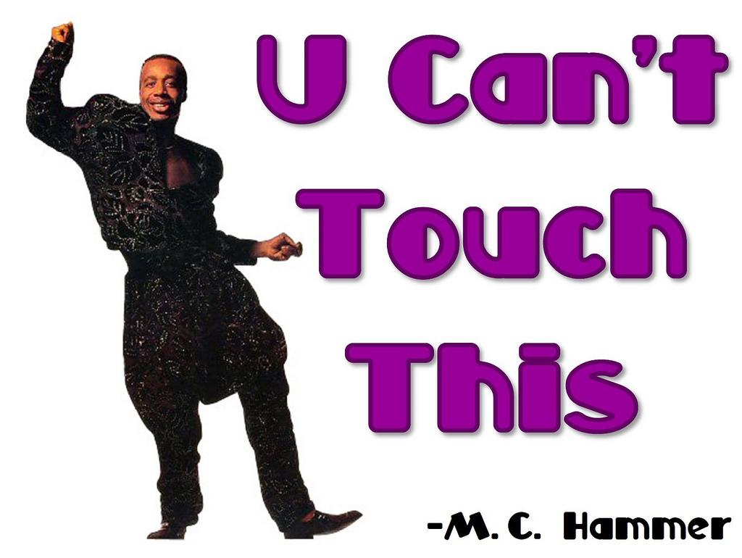
Hammer Demo Time!
This Photo by Unknown Author is licensed under CC BY-NC

Slide 7
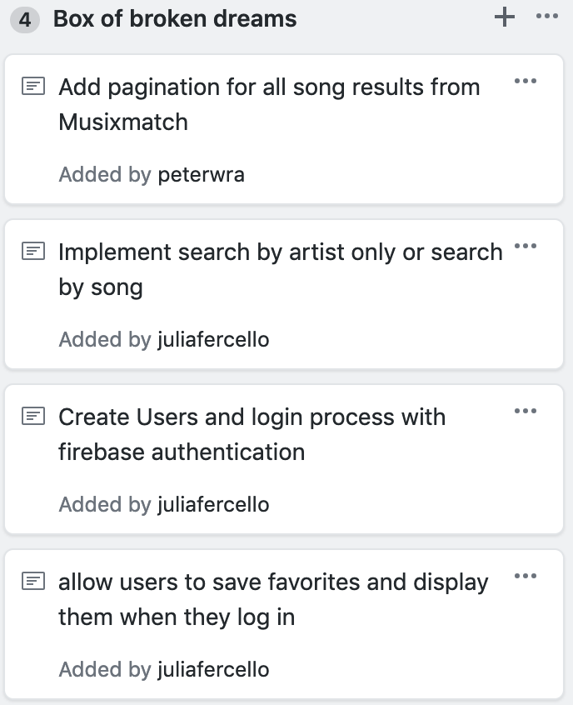
Future Dev
Licensure issues from YouTube proved prohibitive to effective use of web app.
After careful consideration, resources dedicated to this project will be redirected to other initiatives. We encourage you to follow our organization and stay tuned for our upcoming announcements.

