Slide 1
Clustering
Julia Gallucci HB.Sc, M.Sc, Ph.D. (c)
Campbell Family Mental Health Research Institute, CAMH
Institute of Medical Science | University of Toronto
Notes:
Hi everyone, I’m Julia — a PhD candidate at the Institute of Medical Science here at the University of Toronto.
Before I begin, I want to briefly share how I’ve chosen to approach these teaching demonstrations.
My goal was to strike a balance between how to run an analysis and why we use particular methods. To do that, I’ve structured each lesson around short, concept-to-code examples that move from theoretical understanding to practical implementation.
Today, you’ll see two mini-modules that could easily fit within courses offered at the Faculty of Information: – The first explores unsupervised learning through K-means clustering, and – The second focuses on supervised learning through simple linear regression.
For timing today, I’ve streamlined the code walkthroughs a bit. In a real class, students would follow along hands-on in Jupyter or R Markdown notebooks and work through short exercises in pairs. Here, I’ll focus on the key instructional steps and flow.
Normally, I’d include a few brief check-in points for questions during the session, but today we’ll hold all questions until the end of the demonstration.
Ok, so let’s begin.
This lesson would fit within INF2190: Introduction to Data Analytics, taught after students have learned about data pre-processing and methods like classification.

Slide 2
Learning objectives
Why clustering?
How K-means works
Try it in Python!
Notes:
Just to orient everyone, here are our learning objectives for today’s session.
By the end of this demonstration, you’ll understand why clustering is useful, how the K-means algorithm works, and see how we can implement it in Python with a real data set.

Slide 3
The clustering problem
Clustering involves grouping a set of data objects (or observations) into multiple groups so that objects within the same group are highly similar, while those in different groups are very dissimilar.
Examples of clustering applications:
Grouping documents by topics
Segmenting customers by purchasing behaviors
Clustering is often used for exploratory data analysis to uncover hidden patterns and structures in large datasets.
Notes:
Clustering is about finding structure or natural groupings within our data.
Think of situations where we don’t know the categories ahead of time — like grouping customers by their shopping habits, or grouping documents by themes.
The idea is to group observations so that things in the same group are as similar as possible, and things in different groups are as different as possible
So, how can we actually do that? That brings us to unsupervised learning.

Slide 4
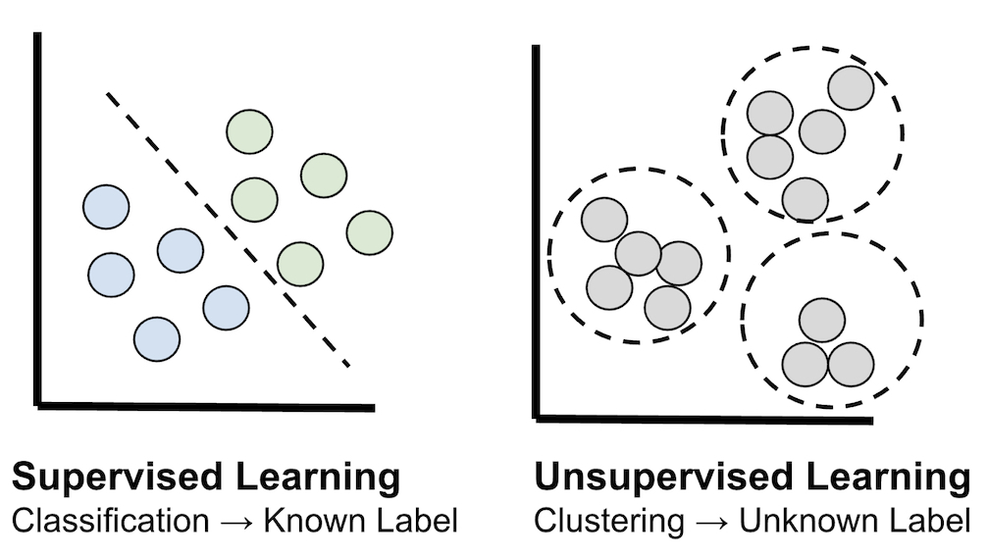
Clustering is unsupervised learning
Unsupervised (e.g., Clustering) | Supervised (e.g., Classification)
No labels or known outcomes Finds natural groupings in data. → Learning by observation | Uses past labels or known outcomes to make predictions. Learning by example
Notes:
Clustering is what we call an unsupervised learning task — meaning there’s no predefined response variable or labels guiding the process.
In contrast, supervised learning tasks aim to predict a specific response variable, whether that’s a categorical label like “disease” vs. “no disease,” or a numeric value such as blood pressure or income. These models learn from examples — that is, labeled data — to make accurate predictions about new, unseen data.
One key advantage of clustering is that it requires no labeled data. This is especially valuable when obtaining labels is expensive, time-consuming, or perhaps simply just not possible.

Slide 5
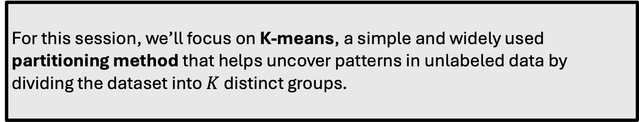
Clustering approaches
There are many ways for grouping data — depending on how we define “similarity”.
Two main clustering approaches:
Partitioning-based: pick number of groups → assign points
Hierarchical-based: build a nested tree of clusters
For this session, we’ll focus on K-means, a simple and widely used partitioning method that helps uncover patterns in unlabeled data by dividing the dataset into $K$ distinct groups.
Notes:
There are actually many different ways to group data, and the method you choose really depends on how you define similarity.
Two of the most common approaches include:
Partitioning methods, where we pick a set number of groups and assign each data point to the one it fits best.
Hierarchical methods, which build a kind of ‘family tree’ of clusters — showing how smaller clusters are gradually merged (or split) based on their similarity.
Each of these methods has its strengths, but to keep things focused today, this demonstration will be looking at one of the simplest and most widely used approaches — K-means clustering.
K-means is a partitioning method that helps uncover patterns in data by dividing it into K distinct groups based on similarity. We’ll go into more detail about how K-means accomplishes this in the next few slides.

Slide 6
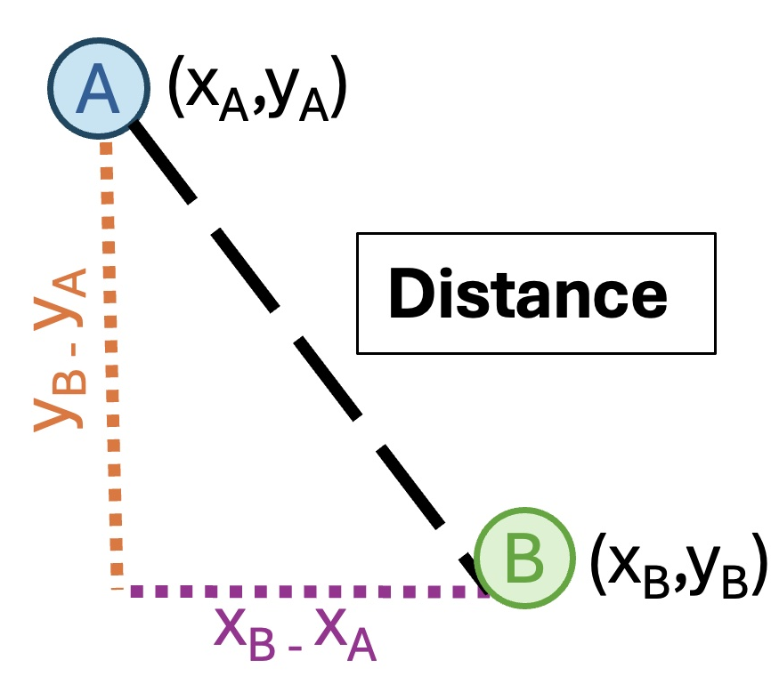
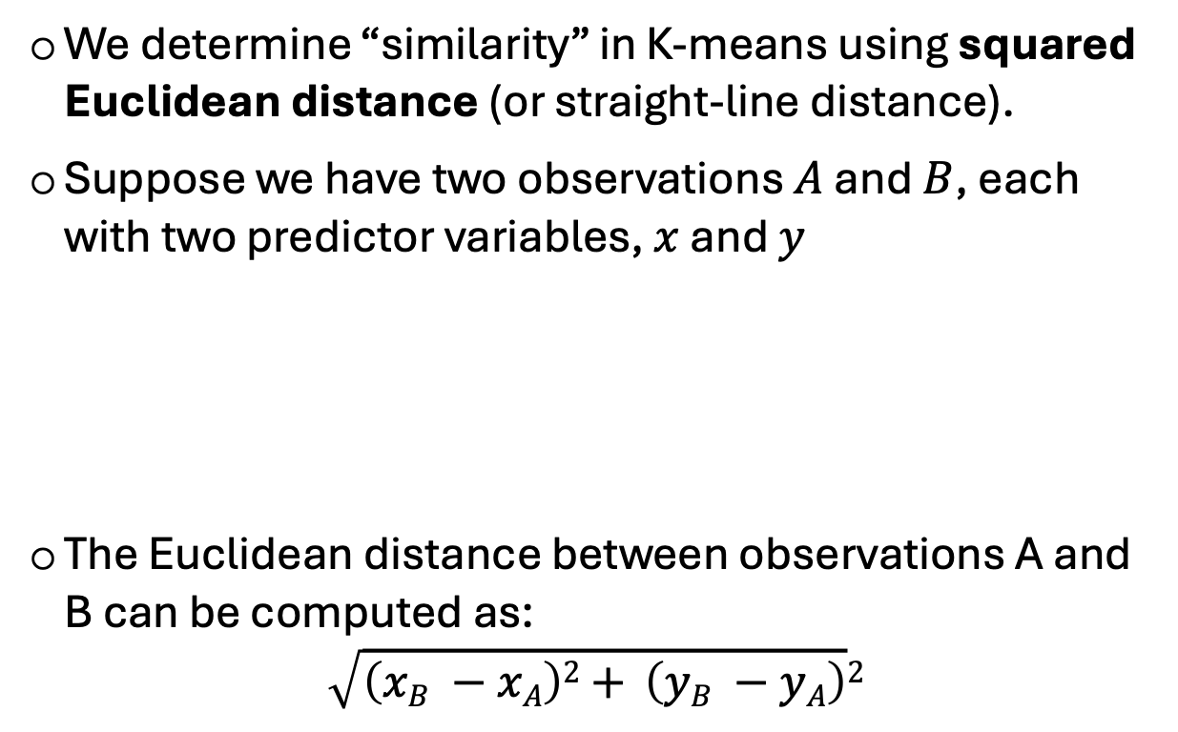
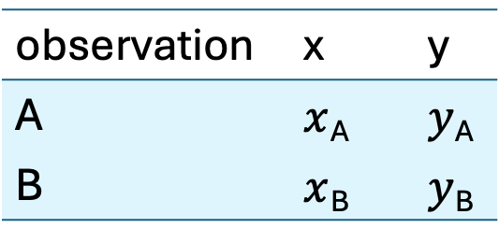
Measuring similarity in K-means
We determine “similarity” in K-means using squared Euclidean distance (or straight-line distance).
Suppose we have two observations $A$ and $B$, each with two predictor variables, $x$ and $y$
The Euclidean distance between observations A and B can be computed as:
$$\sqrt{\left(xB −xA\right)2+ \left(yB −yA\right)}2$$
observation | x | y
A | $x$_{A} | $y$_{A}
B | $x$_{B} | $y$_{B}
Note. Squared Euclidean distance cancels out the square root!
Notes:
First, To understand how K-means works, we need to talk about what it means for two observations to be ‘similar.’
We determine “similarity” in K-means using the straight-line distance, also known as Euclidean distance.
Let's consider two observations, A and B, each with two predictor variables, x and y.
So in this table,
xA​ and xB​ are the horizontal positions on the x axis. (ANIMATION)
yA​ and yB​ are the vertical positions on the y axis. (ANIMATION)
To find the distance between A and B, we:
Find the difference between their horizontal positions (subtract the x-values). (ANIMATION)
Find the difference between their vertical positions (subtract the y-values). (ANIMATION)
Square both of these differences to get rid of negative numbers and make larger differences more important.
Add these squared differences together.
Finally, we take the square root of the result, which gives us the straight-line distance between the two points.
Basically what we are doing is We're finding the shortest distance between two points based on their coordinates.

Slide 7
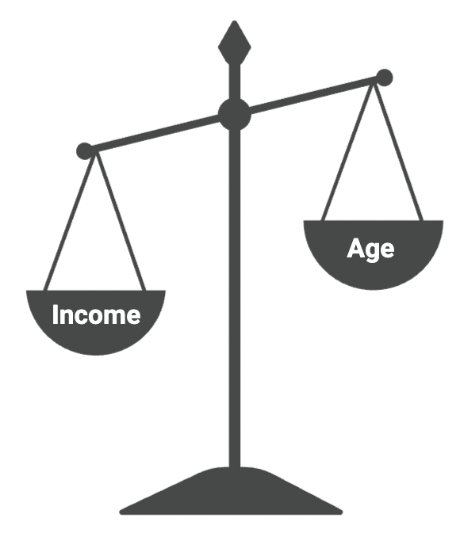
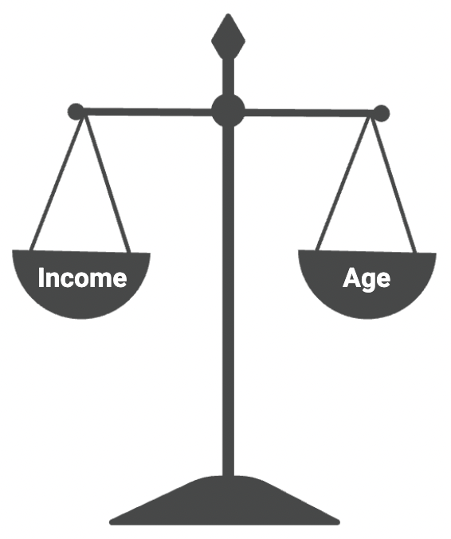
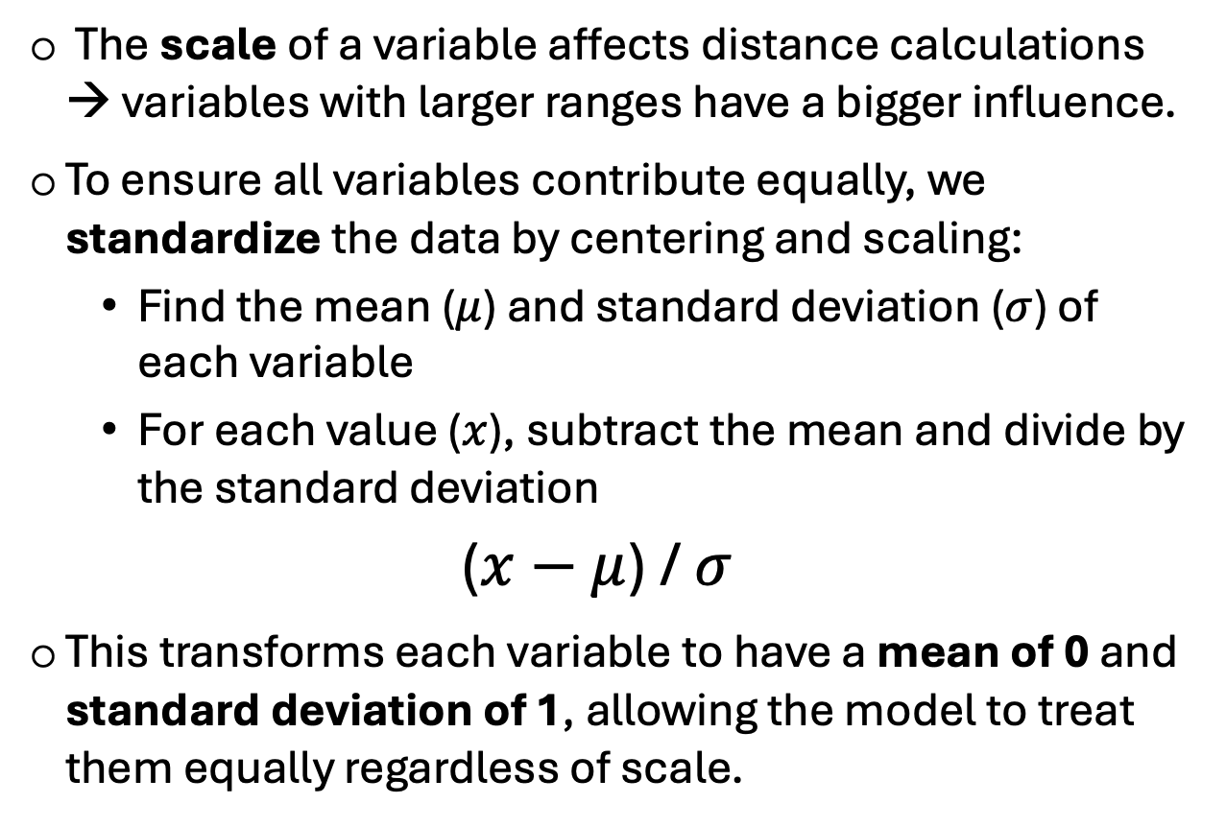
Variable standardization
The scale of a variable affects distance calculations → variables with larger ranges have a bigger influence.
To ensure all variables contribute equally, we standardize the data by centering and scaling:
Find the mean ($μ$) and standard deviation ($σ$) of each variable
For each value ($x$), subtract the mean and divide by the standard deviation
($x−$ $μ$) / $σ$
This transforms each variable to have a mean of 0 and standard deviation of 1, allowing the model to treat them equally regardless of scale.
age
Before standardization
After standardization
Notes:
Now that we know how similarity is measured, we need to make sure all variables contribute fairly to that calculation.
If one variable has a much larger range than another — say, income in thousands of dollars versus age in years — that variable can end up dominating the clustering process, even if it’s not more meaningful to the grouping.
To prevent this, we scale and center the variables. This means we adjust the data so that each variable is measured on a similar scale.
Typically, this is done by transforming each variable to have a mean of 0 and a standard deviation of 1.
In practice, that means we take each value, subtract the variable’s mean, and divide by its standard deviation.

Slide 8

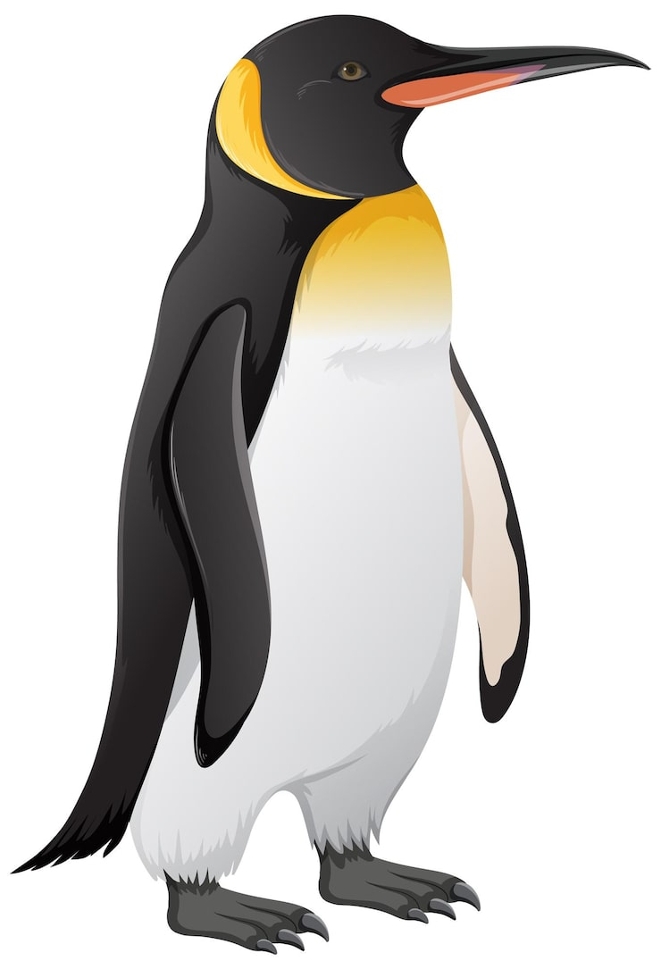
Example data set
Palmer penguins is the dataset we will be using, specifically to determine whether there are distinct types of penguins in our data.
Key features:
Penguin (rows)
Two variables (bill and flipper length)
Bill
Flipper
Notes:
Let’s see what this looks like in a simple dataset.
We’ll be using the Palmer Penguins dataset to see how the K-means algorithm works.
Ok, so in this dataset, each data point represents a single penguin.
We’ll be focusing on two main features:
Bill length, which measures the length of the penguin’s beak, and
Flipper length, which measures the length of its flipper.
Our goal is to apply K-means clustering to this dataset and see whether the algorithm can identify distinct types of penguins based on these two features.

Slide 9
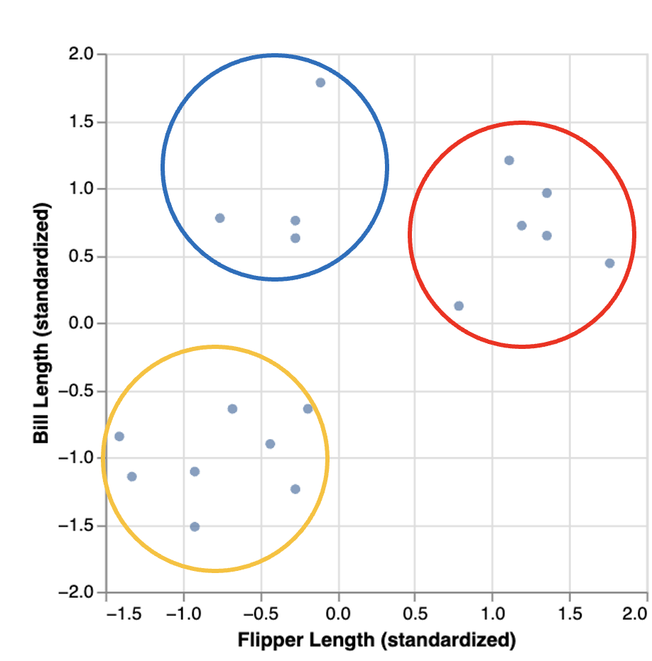
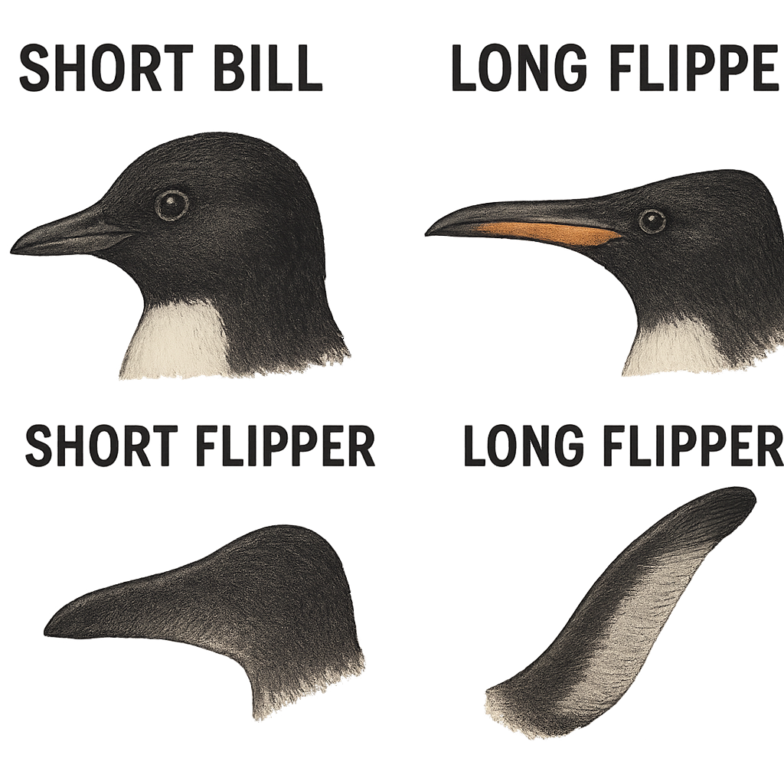
Data visualization
Visualizing the relationship between flipper length and bill length, we can observe what appear to be three distinct subtypes of penguins in the dataset:
A group with small flipper length and small bill length
A group with small flipper length and large bill length
A group with large flipper length and large bill length
Notes:
Data visualization is an incredibly useful tool for understanding our data, especially when we’re working with a small number of variables. For instance, here we already started to see some groups emerging visually.
From the plot, it seems that there are three possible subtypes of penguins in our dataset:
The first group in yellow has small flipper lengths and small bill lengths.
The second group in blue has small flipper lengths but larger bill lengths.
The third group in red has larger flipper lengths and larger bill lengths.

Slide 10
Data visualization
Visualizing the relationship between flipper length and bill length, we can observe what appear to be three distinct subtypes of penguins in the dataset:
As the number of variables grows, patterns become harder to see! To group data objectively and reproducibly, we can use an automated approach like K-means clustering.
A group with small flipper length and small bill length
A group with small flipper length and large bill length
A group with large flipper length and large bill length
Notes:
However, visualization becomes less effective as the number of variables increases. Imagine trying to plot more than two or three variables on a graph — it gets tricky quite fast! The more dimensions we have, the harder it is to spot clear patterns with just visualization.
So, to more rigorously group data and determine the optimal number of groups, we need clustering algorithms like K-means that handle this task in a more systematic and reproducible way.

Slide 11
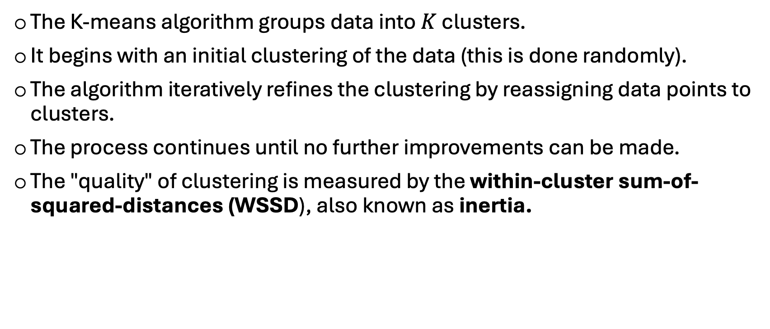
Cluster quality
The K-means algorithm groups data into $K$ clusters.
It begins with an initial clustering of the data (this is done randomly).
The algorithm iteratively refines the clustering by reassigning data points to clusters.
The process continues until no further improvements can be made.
The "quality" of clustering is measured by the within-cluster sum-of-squared-distances (WSSD), also known as inertia.
Notes:
So what does K-means actually do? Essentially, you choose how many groups you want (that’s the “K” parameter), and the algorithm starts by guessing which group the observation belongs to, checks how good those guesses are, and keeps improving them until the groups make sense.
To see how "good" the grouping is, K-means looks at within cluster sum of squared distances or inertia,— how close each data point is to its group’s average. The smaller the inertia, the better the clustering.

Slide 12


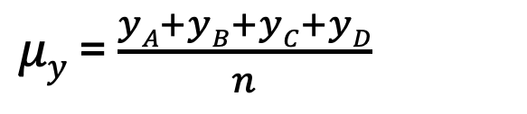
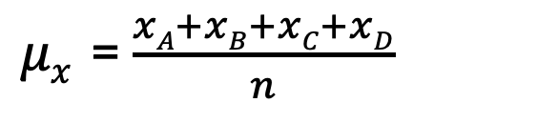
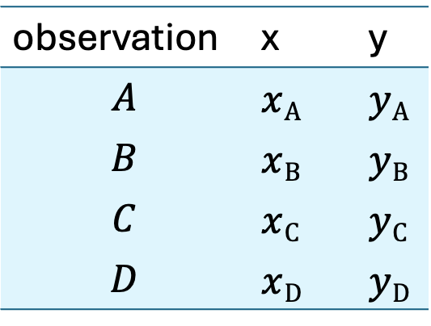
Evaluating Cluster Quality
1. Calculate the cluster centers by taking the mean of each variable for all data points in a cluster.
For example, suppose we have a cluster containing 4 observations, and we are using two variables, $x$ and $y$ , to cluster the data. Then we would compute the coordinates, $μx$ and $μy$ of the cluster center by:
observation | x | y
$$A$$ | $x$_{A} | $y$_{A}
$$B$$ | $x$_{B} | $y$_{B}
$$C$$ | $x$_{C} | $y$_{C}
$$D$$ | $x$_{D} | $y$_{D}
$μx$ = $\frac{xA+xB+xC+xD}{n}$
$μy$ = $\frac{yA+yB+yC+yD}{n}$
$n =$Number of observations
Notes:
To calculate the group's average, or the cluster centers otherwise known as the “centroids”, you follow these steps:
In this example, there are 4 observations A to D that all belong to a cluster and each observation has two or more features (e.g., x variable and y variable).
For each feature (e.g., x and y), you calculate its average based on all the data points in the cluster.
This gives you the coordinates of the cluster center (centroid) in the two-dimensional space defined by the mean of the x and the mean of the y

Slide 13
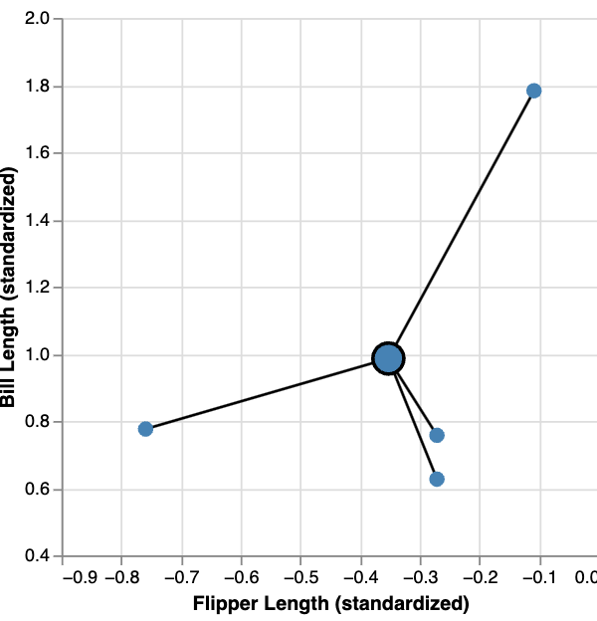





Evaluating Cluster Quality
$$D$$
2. Measure the sum of squared distances between each data point and its cluster center.
WSSD is computed by summing the squared Euclidean distances between each data point and the cluster center.
$$μ$$
$$WSSD= \left(\left(xA −μx\right)2+ \left(yA −μy\right)2\right)+$$
$$\left(\left(xB −μx\right)2+ \left(yB −μy\right)2\right)+$$
$$\left(\left(xC −μx\right)2+ \left(yC −μy\right)2\right)+$$
$\left(\left(xD −μx\right)2+ \left(yD −μy\right)2\right)+$
Distance of $A$to Centroid
Distance of $B$to Centroid
$$C$$
$$A$$
Distance of $C$to Centroid
$$B$$
Distance of $D$to Centroid
Notes:
Once you have your centroid, you need to measure how far each data point is from it. This step is important because it tells you how tightly grouped the data points are around the centroid!
In the penguin example, as shown in the figure here, we have a cluster of penguins, and each penguin has a flipper length and bill length. The centroid represents the "typical" or average flipper and bill length for the penguins in that cluster.
The lines in the figure represent the distance between each individual penguin and the centroid. In other words, how far apart each penguin's characteristics are from the average characteristics of the group.
If a penguin's flipper and bill lengths are very close to the centroid, the line will be short, like observation C. This means that the penguin is similar to the "average" penguin in the cluster.
If the penguin is far from the centroid, the line will be long, like observation D indicating that this penguin is different from the average penguin in the cluster.
The distance between each data point (or penguin) and the centroid is important because it helps us understand how "well" the data has been grouped. The closer the penguins are to the centroid, the more "tight" and meaningful the cluster is. If many penguins have long lines, the cluster might not be a good fit, and the algorithm might need to adjust the groupings to improve them.
As we talked about, in K-means clustering, distance is typically defined using squared Euclidean distance formula, which is the straight-line distance between two points in feature space. In this case between each data point and the centroid (ANIMATION)
This process is known as the Within-Cluster Sum of Squared Distances (WSSD), or inertia.

Slide 14
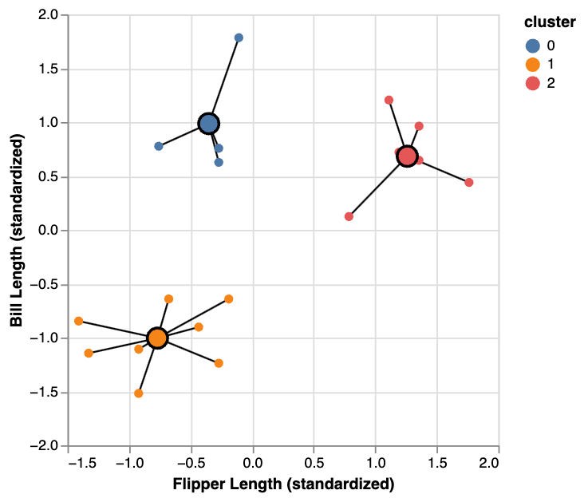
Evaluating Cluster Quality
To obtain the total WSSD, sum the WSSD values for all clusters, which involves adding up all squared distances for all observations.
Goal: We’re trying to make each penguin as close as possible to the average penguin in its group.
Notes:
To get the total Within-Cluster Sum of Squared Distances , you simply sum the within cluster sum of squared distacne values across all clusters.
The goal is to minimize this total value to ensure that the data points are as close as possible to their respective centroids.
In other words, we are trying to make each penguin as close as possible to the average penguin in its group.

Slide 15
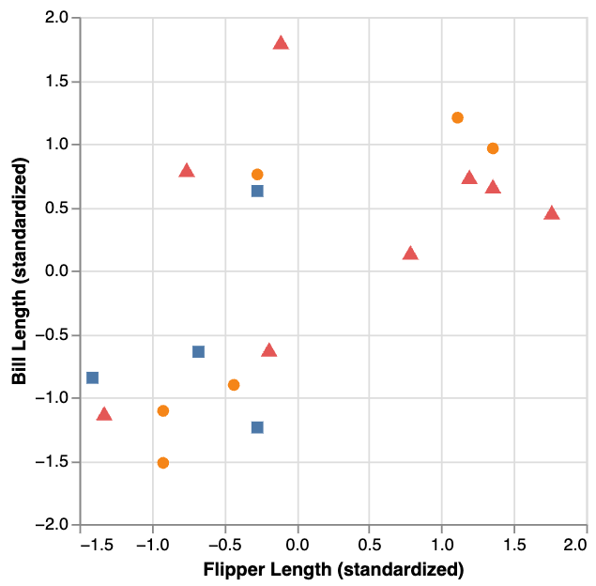
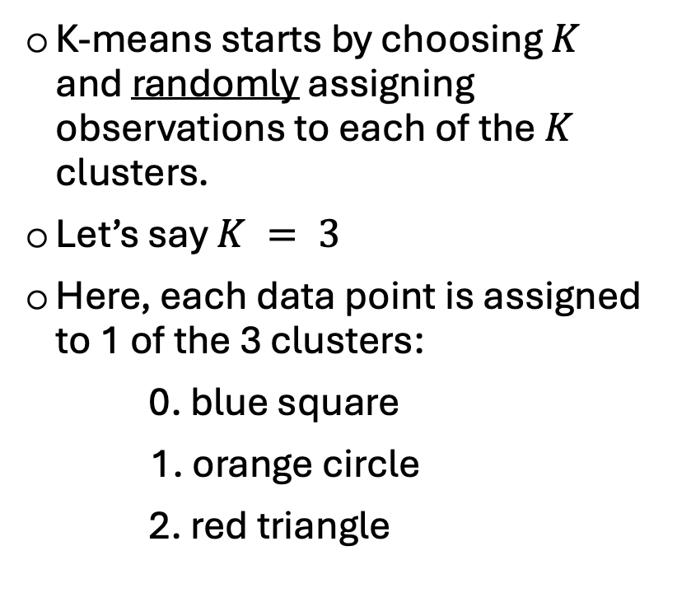
K-means algorithm
K-means starts by choosing $K$ and randomly assigning observations to each of the $K$ clusters.
Let’s say $K = 3$
Here, each data point is assigned to 1 of the 3 clusters:
0. blue square
1. orange circle
2. red triangle
Notes:
The K-means algorithm starts by choosing the number of clusters, denoted as K.
For this example, let’s assume we want to divide our data into 3 clusters. so K = 3 This is a key decision because K , once again, determines how many groups the data will be split into.
To begin, the algorithm randomly assigns each data point to one of these 3 clusters. At this stage, these initial assignments don’t necessarily reflect anything meaningful. They're simply a starting point for the next steps in the algorithm.
So, for our example:
And the blue square represents data points randomly assigned to the first cluster.
The orange circle represents data points randomly assigned to the second cluster.
The red triangle represents data points randomly assigned to the third cluster.

Slide 16
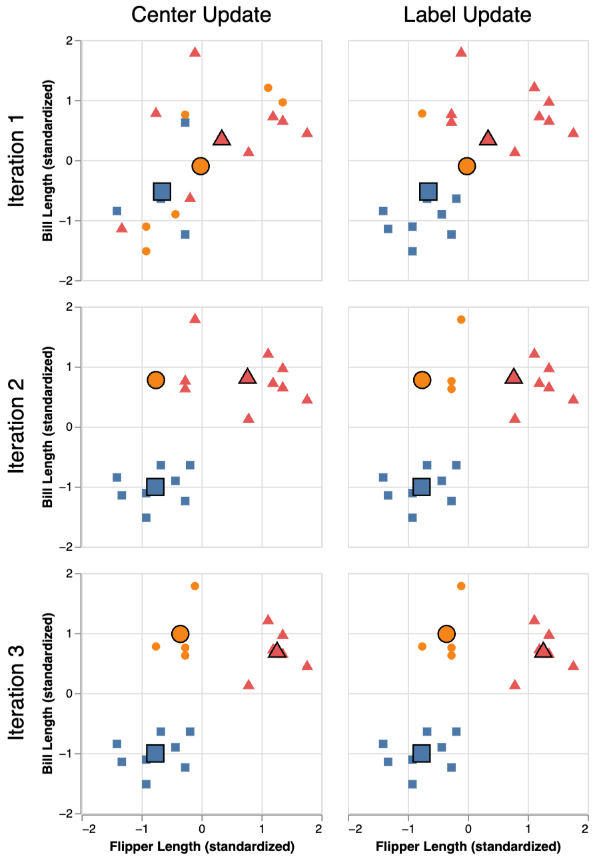
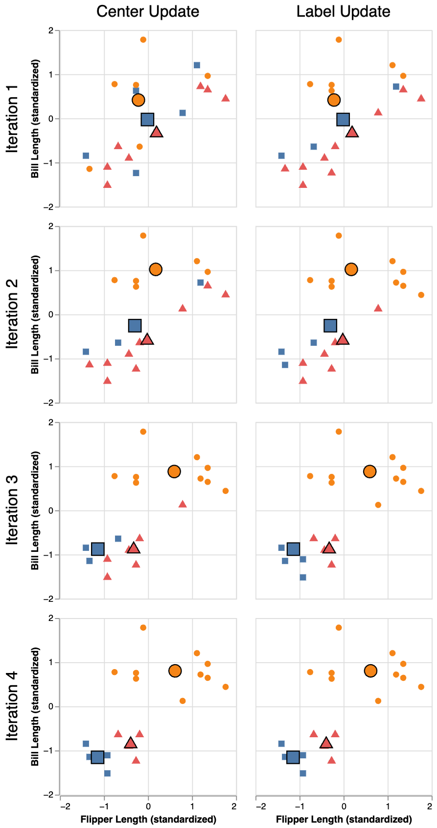
K-means algorithm
K-means involves two iterative steps to minimize the total WSSD:
Center update: Compute the centroid of each cluster.
Label update: Reassign each data point to the cluster with the nearest center.
These steps are repeated until cluster assignments stabilize.
The total WSSD will eventually stop decreasing!
Centroids
0. blue square
orange circle
red triangle
Notes:
Now that we've randomly assigned data points to clusters, the K-means algorithm enters its iterative process to improve these initial groupings.
The algorithm involves two key steps, which are repeated until the cluster assignments no longer change.
Step 1: Center Update (ANIMATION)
In this step, we compute the center, or the centroid, of each cluster. So, we find the 'mean' of the x and y coordinates for all the points in a particular cluster, and this becomes the new center of that group.
For our example, there are 3 centroids that that represents the "average" flipper length and bil length for all the data points in each cluster.
Once we have the updated centroids, we move to the second step which is label update, (ANIMATION) meaning we reassigning each data point to the cluster with the nearest centroid.
The data points will be reasigned from one cluster to another if they are closer to a different centroid, helping refine the groupings. So in this example here (ANIMATION), this data point is actually closer to the Blue Square centroid than the red triangle centroid, so the label was updated accordingly.
These two steps—center update and label update—are repeated over and over until the labels no longer change, and the centroids stop moving.
This iterative process is what helps the algorithm find the most meaningful grouping of the data.
Here, we can see that by the third iteration, both the cluster centers and the labels remain the same. This tells us that the clustering process has stabilized. Essentially, the algorithm has converged and no more changes need to be made.
Another key indicator is the total Within-Cluster Sum of Squared Distances. Over time, this value will continue to decrease as the algorithm refines the clusters. However, once it reaches its minimum, it will stop decreasing. This means the data points are as close as possible to their respective centroids, and no further improvements can be made.

Slide 17
Random restarts
K-means can get “stuck” in a suboptimal solution due to poor initializations.
To address this issue, we can:
Randomly reinitialize the cluster labels multiple times.
Run K-means for each initialization.
Select the clustering result with the lowest total WSSD.
Centroids
0. blue square
orange circle
red triangle
Notes:
It's worth noting that sometimes K-means starts off with bad random guesses.
This typically happens due to poor initializations. Remember that K-means begins by randomly assigning data points to a cluster, which generates our initial cluster centers. If these centers are poorly placed, the algorithm may converge to a suboptimal or less-than-ideal solution that doesn't reflect the best possible clustering.
In the figure here, you can see how the K-means algorithm evolves over the first 4 iterations, starting from a poor initialization. With each iteration, the algorithm adjusts the cluster centers and reassigns the data points just as we've seen before. But because of the poor starting points, the algorithm still doesn’t reach the most optimal clusters by the end of the process. You can see that it sort of subdivided the bottom cluster into two groups, and treated the two top clusters as one.
So, how can we deal with this issue? One common strategy is to use random restarts. This means running the K-means algorithm multiple times with different initializations, and then choosing the solution with the lowest total Within-Cluster Sum of Squared Distances. This helps us avoid getting stuck in a suboptimal solution.

Slide 18
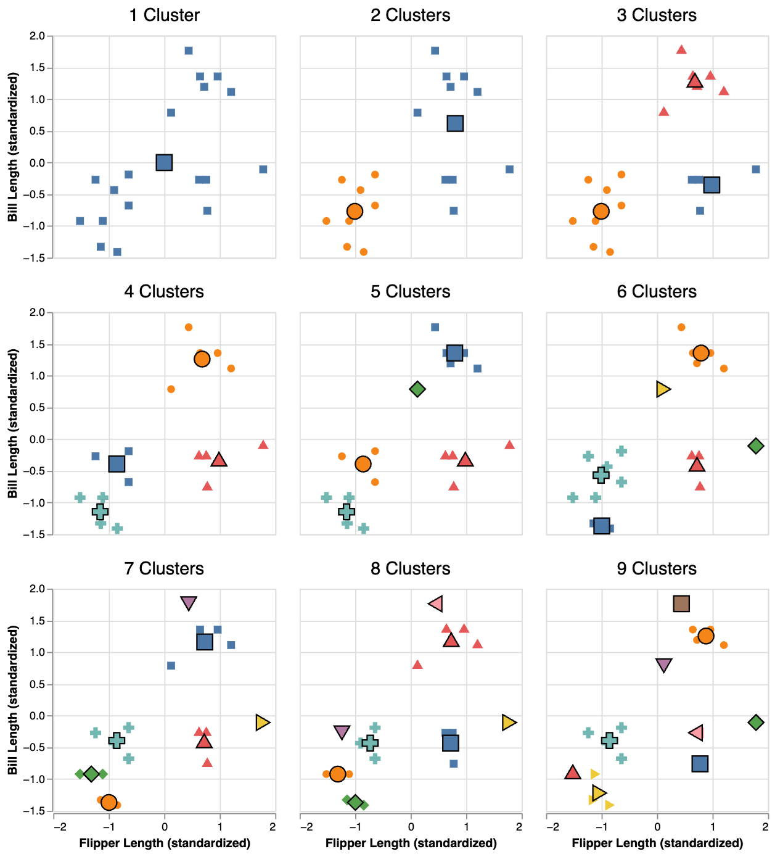
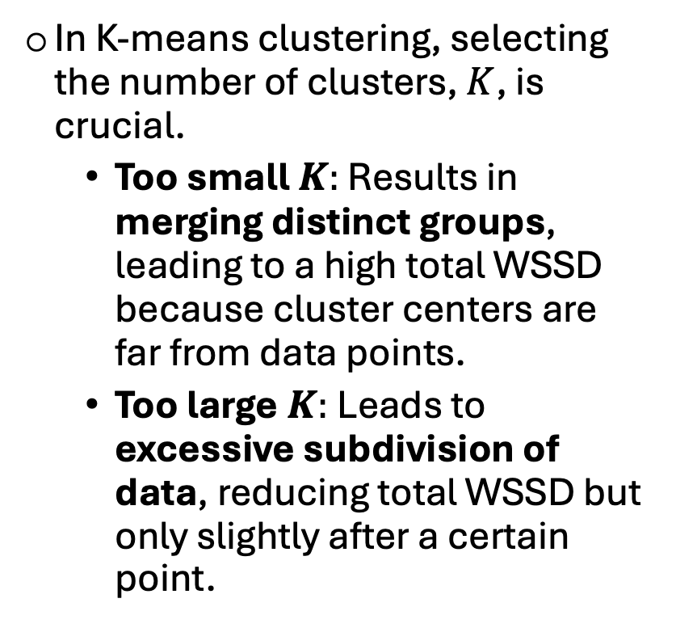
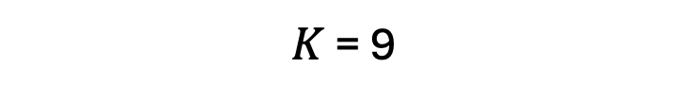
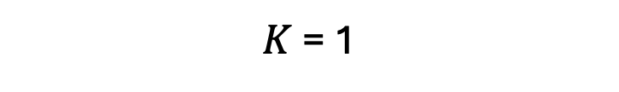
Choosing K
$K$ = 1
$K$ = 9
2
1.5
1
0.5
0
-0.5
-1
-1.5
In K-means clustering, selecting the number of clusters, $K$, is crucial.
Too small $K:$ Results in merging distinct groups, leading to a high total WSSD because cluster centers are far from data points.
Too large$K:$Leads to excessive subdivision of data, reducing total WSSD but only slightly after a certain point.
Bill Length
-2 -1 0 1 2
Flipper Length
Notes:
We talked about this K parameter which is something we can choose. And so far, the examples we've been going through, we arbitratily chose K is equal to 3, meaning 3 clusters. But how do we know what value of K is the right choice?
When K is too small, for example K = 1, we may force distinct groups to merge into a single cluster.
The result? The data isn’t grouped meaningfully, and our clusters don’t reflect the true structure of the data.
On the other hand, when K is too large, for example K = 9, we overcomplicate our clustering.The data becomes subdivided into very small clusters, which might not actually add much meaningful insight to our data
The goal is to find a value of K that balances these issues: too small and we lose meaningful groupings, too large and we overcomplicate the structure of our data.

Slide 19
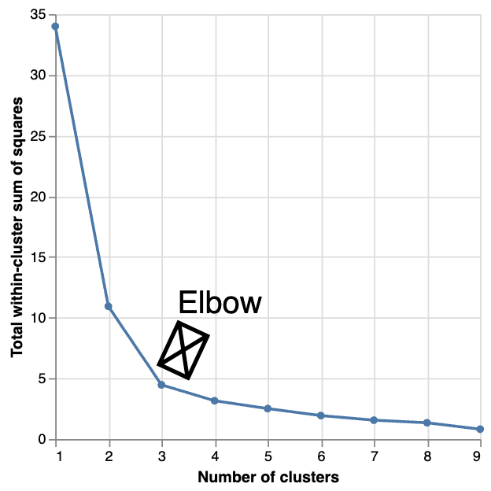
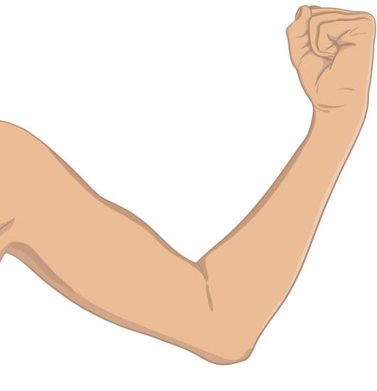
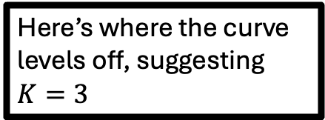
Choosing K
The total WSSD versus the number of clusters, often showing an "elbow" shape indicating the optimal number of clusters where the WSSD decrease levels off.
Here’s where the curve levels off, suggesting $K=3$
Notes:
As we increase the number of clusters, the Total Within-Cluster Sum of Squared Distances typically decreases because the data points are more tightly grouped.
However, beyond a certain point, adding more clusters doesn’t significantly improve the grouping. This is where the elbow occurs — it's the point where the reduction in total within cluster sum of squared distances starts to slow down.
The optimal K is at the elbow point, where we achieve a good balance between the number of clusters and how well the data is grouped.
######EXTRA
Before the elbow: Adding more clusters leads to a noticeable decrease in Within-Cluster Sum of Squared Distances, meaning the clusters are becoming more accurate.
After the elbow: Adding more clusters results in only small improvements in Within-Cluster Sum of Squared Distances. This indicates that the clusters are already well-defined, and further subdivisions aren't necessary.

Slide 20
Putting it all together
K-means in Python
Notes:
Now that we know the steps of Kmean clustering conceptually, let’s see what this looks like in Python.

Slide 21
Load in packages
import pandas as pd
import matplotlib.pyplot as plt
from sklearn import set_config
from sklearn.preprocessing import StandardScaler
from sklearn.cluster import Kmeans
# Output DataFrames
set_config(transform_output="pandas")
Notes:
Let’s start by importing the libraries for our analysis.
I won't spend too much time going over the details of each of these packages,
But very briefly we’ll use pandas as we are going to import it as PD to handle and explore our data — think of it as a faster, more flexible version of Excel.
Next, matplotlib which we are importing as PLT, which will allow us to creating visualizations, like scatter plots of our cluster groupings and the elbow curve we’ll use to find the best number of clusters.
Then, from scikit-learn, we’ll import three tools: set_config to adjust global settings, StandardScaler to put all variables on the same scale, and KMeans, the algorithm we'll use to cluster our data points.
First, we’ll configure scikit-learn to output results as pandas DataFrames by using the set_config function with the argument transform_output="pandas". What this is doing is asking scikit learn to to keep our results in a DataFrame format, which makes it easier to inspect, index, or add new columns to our data later on.

Slide 22
Load and preview dataset
penguins = pd.read_csv('penguins.csv’)
penguins.head() # View first few rows
 | bill_length_mm | flipper_length_mm
0 | 39.1 | 181
1 | 39.5 | 186
2 | 40.3 | 195
3 | 36.7 | 193
4 | 39.3 | 190
Notes:
Now that we’ve imported our libraries, let’s load in our dataset.
Here, we’re using pandas read csv function to load in the file and store it in a DataFrame called penguins.
To get a quick look at the data, we call pandas method head() which displays the first few rows of the dataset.
And we get this really nice structured data frame where each row represents a penguin(ANIMATION), and each column is a variable like bill length (ANIMATION), or flipper length (ANIMATION).
So just quickly looking at our data, we can see flipper length is on a much larger scale than bill length.

Slide 23
Standardize variables
# Initialize the scaler
scaler = StandardScaler()
# Fit and transform the data; mean 0 sd 1
penguins_scaled = scaler.fit_transform(penguins)
penguins_scaled.head()
 | bill_length_mm | flipper_length_mm
0 | -0.884499 | -1.418347
1 | -0.811126 | -1.062250
2 | -0.664380 | -0.421277
3 | -1.324737 | -0.563715
...
Notes:
And we talked about how K-means measures distance between points. So if one variable, like flipper length, has much larger numeric values than another, such as bill length, it will dominate the distance calculation even if that variable isnt necessarily more meaningful to the grouping of the penguins.
First we’re initializing something called a scaler, using the StandardScaler function.
Next we use our scaler in combination with the fit_transform method on our data.
This does two things:
first it learns the average and standard deviation of each variable (that’s the “fit” part), and then uses those values to ‘transform’ the data so each variable now has a mean of 0 and a standard deviation of 1.
To avoid overriding our original data, we're going to save this transformation as a new dataframe called penguins_scaled.
Now,
We check the first few rows of the processed data, we see that our variables are on similar scales which is exactly what we want!

Slide 24
Perform K-means clustering
# Initialize model then fit to data
kmeans = KMeans(n_clusters=3,random_state=0,n_init=10)
kmeans.fit(penguins_scaled)
# Add cluster label to the dataset
penguins_scaled['Cluster'] = kmeans.labels_
Notes:
Now that our data are standardized, we’re ready to run K-means.
We’ll start by initializing our model using the KMeans() function.
Here, we include a few key arguments:
n_clusters=3 — we want the algorithm to find three groups in our data.
random_state — this controls the random starting points K-means uses. Setting it to a specific number, it can be any integer, this is just going to ensure reproducibility, making sure we get the same results each time we run the model.
n_init=10 — that means K-means will try ten different random initalizations and keep the best result — the one with the lowest total within-cluster sum of squared distance. 10 is the default value for this argument
Next, we fit the model to our scaled data. This is where K-means does all the heavy lifting that we talked about in the backgorund— it goes through that iterative two-step process of center update and label update, and repeating those steps until no further improvements to the clustering could be made.
Once it’s done, we can add the cluster labels back to our dataset. K-means has this attribute called labels_, which tells us which cluster each data point ended up belonging to.
By adding this to our dataframe, we create a new column called Cluster.

Slide 25
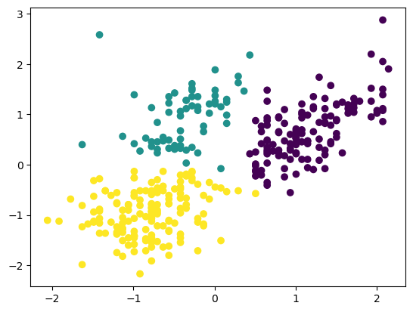
Scatter plot colored by cluster
plt.scatter(penguins_scaled['flipper_length_mm'], # X axis
penguins_scaled['bill_length_mm'], # Y axis
c=penguins_scaled['Cluster’]) # Color points
Bill length
Flipper length
Notes:
Finally, let’s take a quick look at how K-means grouped similar penguins using a scatter plot.
We’ll use matplotlib to create it — specifying “scatter” where each point here represents a single penguin.
On the x-axis, we're indexing flipper length, and on the y-axis we're indexing, bill length.
We’re setting the argument c to the new column we created earlier, called ‘Cluster’.
That tells matplotlib to color each point based on its cluster label — so penguins that fall into the same group appear in the same color.
We see that clusters are fairly well separated, which suggests that K = 3 was a good choice and that flipper length and bill length do a nice job distinguishing between penguin subtypes.
There’s still a bit of overlap at the boundaries — that’s expected in real data, since biological traits often vary along a continuum and rarely ever form perfectly distinct groups.

Slide 26
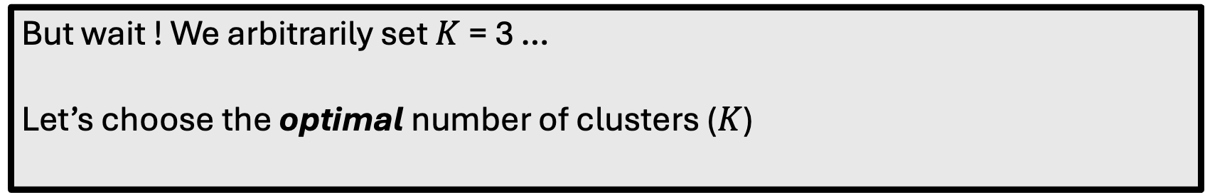
Evaluate cluster quality: WSSD
# Total WSSD is stored in the inertia_ attribute
kmeans.inertia_
157.8153218752378
But wait ! We arbitrarily set $K$ = 3 …
Let’s choose the optimal number of clusters ($K$)
Notes:
Once we’ve fit our K-means model, we can take a look at how well it grouped our data. The model contains an attribute called inertia, also known as total within cluster sum of squared distances, which if you recall, measures how close each point is to its cluster center — in other words, how tight the clusters are.
A smaller inertia means the clusters are more compact, which is generally what we want.
But the big question is — how do we know if this is a good inertia value?
On its own, inertia doesn’t tell us much, because it naturally gets smaller as we increase the number of clusters.
So, instead, we can compare it across different values of K. Let’s run K-means several times with different numbers of clusters, or K, and compare their inertia values to find the optimal number.
We can accomplish this using a simple for loop!

Slide 27
Determine the optimal K
# Compute total WSSD for k = 1–10
total_wssd = []
for k in range(1, 11): # Start at 1, stop before 11
km = KMeans(n_clusters=k, random_state=0, n_init=10)
km.fit(penguins_scaled)
total_wssd.append(km.inertia_)
Notes:
We start by creating an empty list to store the total within-cluster sum of squared distance values for each number of k that we are testing.
Next, we use a for loop that runs K-means ten times, testing different numbers of clusters — from 1 up to 10.
Inside the loop, we create a K-means model for each value of k and fit it to our data.
Then we save the total WSSD from that run by appending it to our list we defined above.
By the end of our loop, our list contains 10 WSSD values, one for each possible number of clusters or k.

Slide 28
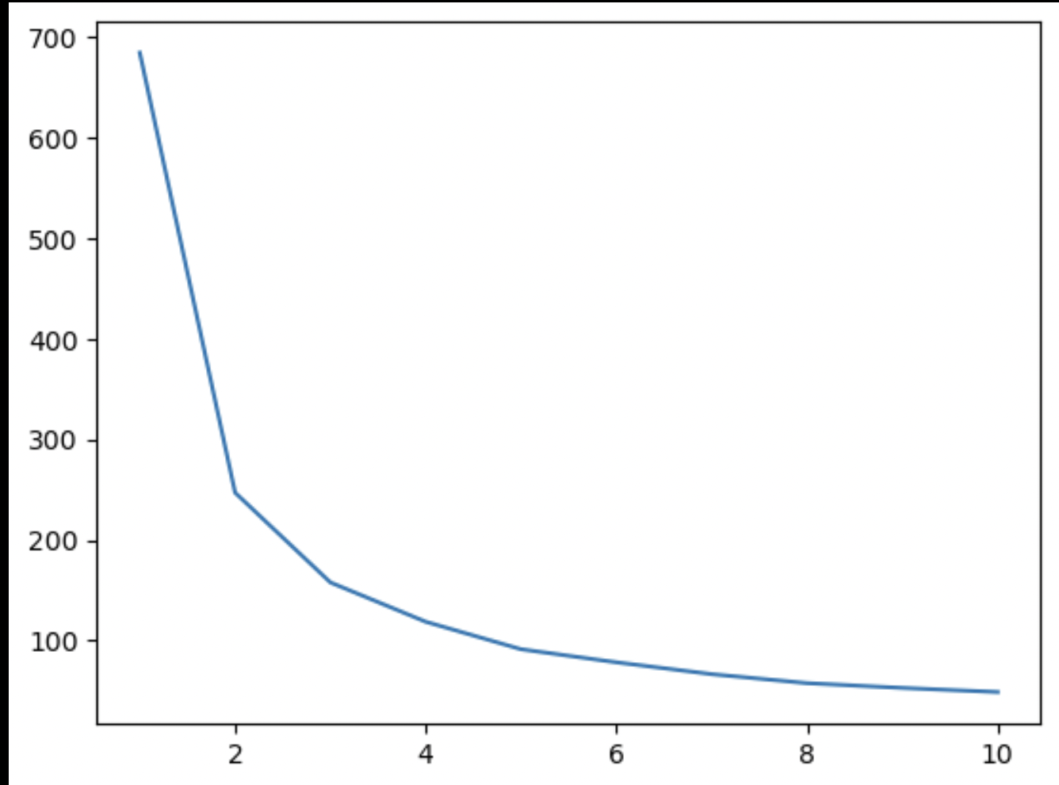
Elbow plot
plt.plot(range(1, 11), total_wssd) # k vs Total WSSD
Total WSSD
Number of clusters (k)
Notes:
Once we’ve done that, we can use matplot lib to create a line plot with K on the x-axis and the WSSD on the y-axis — so we get this elbow curve.
At first, as we increase K, the total WSSD drops sharply — because adding more clusters naturally makes the groups tighter. But after a certain point, those improvements level off — the curve starts to flatten — and that’s where we find our elbow point.
That elbow tells us the optimal number of clusters — the point where adding more groups doesn’t meaningfully improve the model.
The elbow looks to appear around K = 3, which matches what we saw visually earlier!

Slide 29
Concept map
how tightly observations in a cluster are grouped
no response variable (y)
Unsupervised Learning
Within-cluster sum of squared-distance (WSSD)
predictor variables (x)
evaluation
use information about
K-means
Clustering
Elbow method
K
Partition data into K clusters based on similarity
to find the optimal
Hyper-parameter
Notes:
Let’s quickly reviewing a concept map of the key ideas we’ve covered in this demonstration.
We talked about K-means clustering, which is a method that partitions data into K clusters based on how similar the observations are to one another.
Importantly, this is an unsupervised learning technique — meaning it looks only at the predictor variables and doesn’t rely on any predefined labels or categories.
We also discussed how K-means models are evaluated using inertia, or the within-cluster sum of squared distances. This tells us how tightly grouped the points are within each cluster — the lower the value, the better the clustering fit.
Finally, we looked at how K itself is a parameter we can change.
We can test different values of K and plot K against total within cluster sum of squared distances to find the point where adding more clusters doesn’t improve the model much — this is often called the elbow method, and it helps us identify the optimal number of clusters for our data.

Slide 30

Thank you!
Scan me!
Questions?
Acknowledgements: The content in this demonstration was adapted from material I’ve previously developed at the Data Science Institute
Notes:
To end off, I always emphasize data transparency and reproducibility in my teaching. All of the materials for this demo — including the slides, code, and dataset — are publicly available on my GitHub repository.
You can scan the QR code on the slide if you’d like to explore them later.
Thank you so much for your time — I’d be happy to take any questions!

Slide 31
Appendix

Slide 32

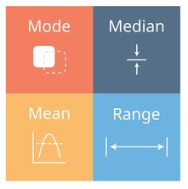
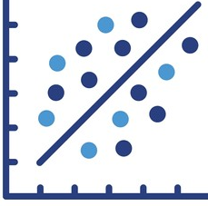
Exploratory data analysis
Before any analysis or modeling, it’s essential to explore your data to understand its structure and quality.
EDA helps reveal distributions, relationships, outliers, missing values, and guides model building.
3 main steps
1. Inspect the raw data → get a feel for what’s in the dataset.
2. Compute summary statistics → e.g., mean, median, interquartile range.
3. Visualize the data → use plots to spot patterns and anomalies.
Notes:
Before we jump into any analysis or modeling, it’s really important to take some time to explore our data.
This step helps us understand what we’re working with — things like how our variables are distributed, how features relate to one another, and whether there are any missing or unusual values that could affect our results later on.
There are three main steps in this process:
Inspect the raw data — to get a quick sense of what’s included and how it’s structured.
Compute summary statistics — measures like the mean, median, and interquartile range give us a snapshot of our variables.
Visualize the data — by creating plots, we can identify patterns, trends, and potential anomalies that might not stand out in a table.
By exploring the data first, we build a solid foundation for modeling and make sure that any insights we draw later are both accurate and meaningful.

Slide 33
Python code
# 1. Inspect the data by viewing the first few rows
penguins.info()
<class 'pandas.core.frame.DataFrame'>
RangeIndex: 342 entries, 0 to 341
Data columns (total 2 columns):
# Column Non-Null Count Dtype
--- ------ -------------- -----
0 bill_length_mm 342 non-null float64
1 flipper_length_mm 342 non-null int64
dtypes: float64(1), int64(1)
memory usage: 5.5 KB
Notes:
Now that we’ve loaded our dataset, it’s time to take a closer look at what we’re working with. In pandas, we can use the info() method on our DataFrame.
When you run penguins.info(), you get a concise summary of the dataset, including:
Column names
Data types for each column
Number of non-null values
This is incredibly helpful for understanding the structure of your dataset and spotting missing data right away!

Slide 34
Python code
# 2. Summarise data by computing summary statistics
penguins.describe()
 | bill_length_mm | flipper_length_mm
count | 342.000000 | 342.000000
mean | 43.921930 | 200.915205
std | 5.459584 | 14.061714
min | 32.100000 | 172.000000
25% | 39.225000 | 190.000000
50% | 44.450000 | 197.000000
…
Notes:
Next, let’s pull out some summary statistics for our variables.
We can do this easily using the describe() method in pandas.
This function gives us a quick overview of key statistics — like the mean, standard deviation, minimum and maximum values, and different percentiles for each numeric variable.
We can see from this summary that bill length and flipper length are measured on very different scales.
We can see flipper length is in the hundreds, while bill length is much smaller.
This difference in scale is important because it can affect how our algorithm interprets the data — where as we talked about variables with larger ranges can dominate the analysis.

Slide 35
Python code
# 3. Visualize data: Scatter plot for bill_length_mm vs flipper_length_mm
plt.scatter(standardized_penguins['flipper_length_mm'], standardized_penguins['bill_length_mm'])
# Adding labels
plt.ylabel('Bill Length (standardized)')
plt.xlabel('Flipper Length (standardized)')
# Display the plot
plt.show()
Notes:
Now that we’ve standardized our data, let’s visualize the relationship between our two variables — bill length and flipper length — to see if we can spot any patterns or possible groups in the data.
In this code, we’re using matplotlib to create a scatter plot.
Each point represents a single penguin:
The x-axis shows the flipper length (standardized),
and the y-axis shows the bill length (standardized).

Slide 36
Python code
# Elbow plot for k vs WSSD
plt.plot(penguin_clust_ks['k'],penguin_clust_ks['wssd'])
# Add labels
plt.xlabel('Number of clusters')
plt.ylabel('Total within-cluster sum of squares')
# Display the plot
plt.show()
Notes:
To choose the best number of clusters, we can plot the total Within-Cluster Sum of Squared Distances for each K value.
A line plot can help us identify the "elbow" point, where the rate of total Within-Cluster Sum of Squared Distances reduction slows down as k increases

