Slide 1
Correlation & Simple Linear Regression
Julia Gallucci HB.Sc, M.Sc, Ph.D. (c)
Campbell Family Mental Health Research Institute, CAMH
Institute of Medical Science | University of Toronto
Notes:
Now that we’ve seen how to discover underlying patterns in unlabeled data, the focus of this second demonstration will be how we can make predictions when we do have a response variable.
This lesson would fit within INF1344: Introduction to Statistics for Data Science, taught after students have learned about basic data types and distributions.
At this stage, the goal is to move from describing relationships to modeling them — we'll progress from correlation to regression to make predictions and assess how well the model fits.
Students in this course come from a variety of backgrounds — including information science, psychology, and sociology — so I focus on clarity and interpretation, emphasizing the why behind each step before we move to code.
And as before, for timing today, I’ve streamlined the code walkthroughs a bit, to mainly focus on the key steps.
Normally, I’d include a few brief check-in points for questions during the session, but today we’ll hold all questions until the end of the demonstration.
Ok, let's begin!

Slide 2
Learning objectives
Why correlation and regression?
How regression works
Try it in R!
Notes:
By the end of this demonstration, you should be able to do three main things.
First, you’ll be able to identify what correlation and regression are — and understand when each is useful.
Second, we’ll focus in on simple linear regression, exploring how this method fits a straight line through our data to model relationships and make predictions for new observations.
And finally, we’ll apply what we’ve learned in R, walking through a real dataset example.

Slide 3
How are 2 sets of numbers related?
Correlation | Simple Linear Regression
Tells us how strongly two things move together Shows direction: Positive, both go up. Example: Height ↔ Weight Negative, one goes up, the other goes down. Example: Stress levels ↔ Hours of sleep | Allows us to predict one value from another Builds a line of best fit through the data Gives us an equation to make those predictions Example: Predicting weight based on height, or predicting stress levels based on hours of sleep
Notes:
Let’s start with the big question: How are two sets of numbers related?
First, correlation tells us how strongly two things move together — and in what direction.
If the relationship is positive, that means both variables increase together. For example, as height increases, weight tends to increase too.
If it’s negative, one goes up while the other goes down. For example, as stress levels increase, we tend to be able to sleep less

Slide 4
How are 2 sets of numbers related?
Correlation | Simple Linear Regression
Tells us how strongly two things move together Shows direction: Positive, both go up. Example: Height ↔ Weight Negative, one goes up, the other goes down. Example: Stress levels ↔ Hours of sleep | Allows us to predict one value from another Builds a line of best fit through the data Gives us an equation to make those predictions Example: Predicting weight based on height, or predicting stress levels based on hours of sleep
Key take-away: Correlation = how strong is the link? Regression = can we predict one from the other?
Notes:
Now, simple linear regression takes this one step further. Instead of just describing the relationship, it lets us predict one value from another.
It does this by creating a line that best summarizes the pattern we see. We'll go more into detail with regards to what this actually means and how this line is defined in a bit!
For example, we could use height to predict someone’s weight, or use stress levels to predict how much sleep someone gets
So to summarize (ANIMATION), Correlation answers the question, “How strong is the link between two variables?” It tells us about strength and direction, but it doesn’t let us make predictions.
On the other hand, Regression, answers the question, “Can we predict one variable from the other?” It not only describes the relationship but also builds an equation we can use to make those predictions.

Slide 5
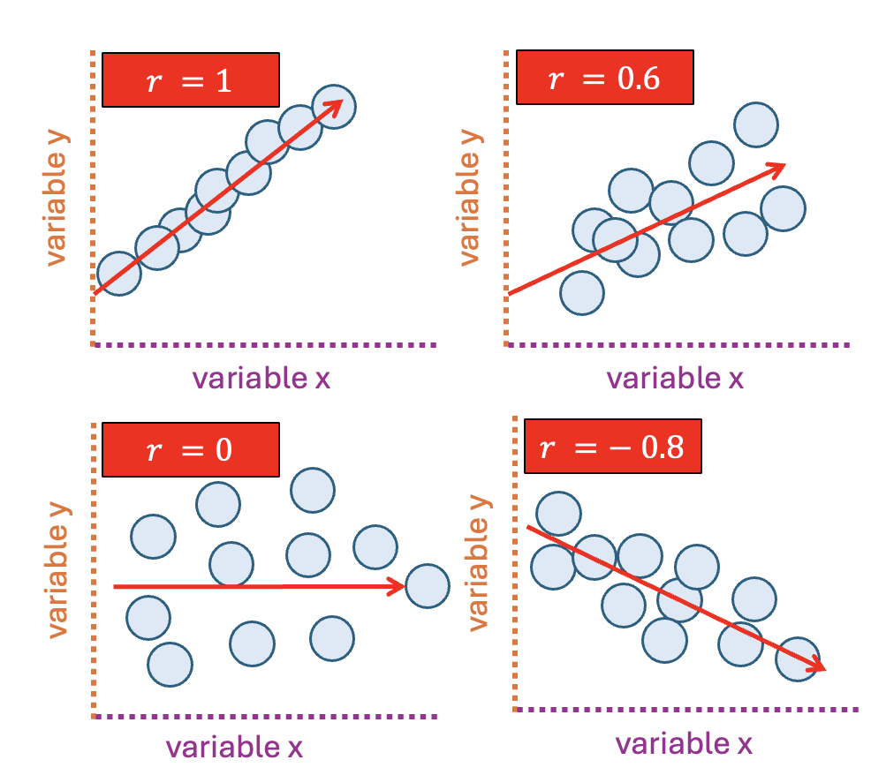

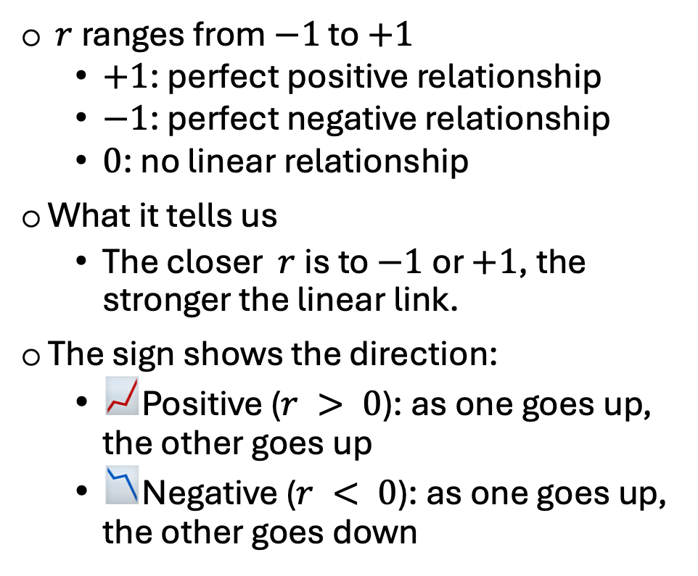
The Pearson’s correlation coefficient ($r$)
$r$ranges from $−1$ to $+1$
$+1$: perfect positive relationship
$−1$: perfect negative relationship
$0$: no linear relationship
What it tells us
The closer $r$is to $−1$or $+1$, the stronger the linear link.
The sign shows the direction:
📈Positive ($r > 0$): as one goes up, the other goes up
📉Negative ($r < 0$): as one goes up, the other goes down
The closer $r$is to $±1$, the stronger the relationship
Notes:
First, let’s talk about Pearson’s correlation coefficient, often just called r.
This value measures how strongly two numeric variables move together, and it ranges from –1 to +1:
+1 indicates a perfect positive relationship — as one variable increases, the other increases in perfect sync.
–1 indicates a perfect negative relationship — as one goes up, the other goes down in a perfectly predictable way.
0 means no linear relationship — changes in one variable don’t relate to changes in the other.
The closer r is to –1 or +1, the stronger the linear link. The sign of r tells us the direction:
- When r is positive, both variables move in the same direction - When r is negative, they move in opposite directions.
These plots show different strengths and directions of correlation: • Top left (r = 1): A perfect positive correlation — as one variable increases, so does the other, in a perfectly consistent pattern. • Top right (r = 0.6): A moderate positive correlation — the general trend is upward, but the points are more spread out. • Bottom left (r = 0): No linear relationship — the points are scattered with no clear pattern. • Bottom right (r = –0.8): A strong negative correlation — as one variable increases, the other tends to decrease.

Slide 6
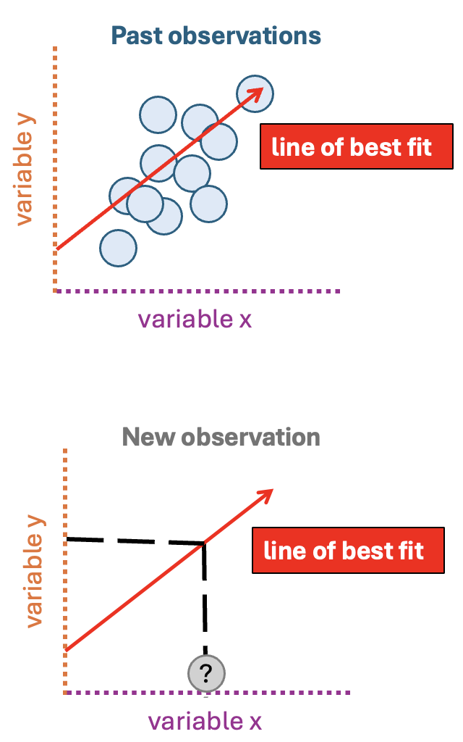
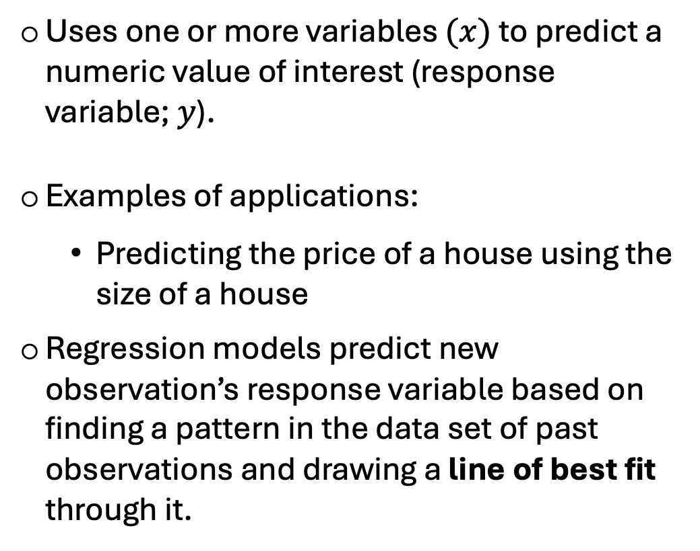
The regression problem: Finding the line of best fit
Uses one or more variables $(x)$ to predict a numeric value of interest (response variable; $y$).
Examples of applications:
Predicting the price of a house using the size of a house
Regression models predict new observation’s response variable based on finding a pattern in the data set of past observations and drawing a line of best fit through it.
Notes:
In a regression problem, we're trying to predict a numeric value of interest based on one or more input variables/ or features.
For example, imagine we want to predict the sale price of a house (so this would be our Y variable). One predictor or x variable we could use is the size of the house. Intuitively, larger houses might generally sell for higher prices. Regression allows us to quantify this relationship
A regression model works by examining a dataset of past observations to identify patterns in the relationship between predictors and the response variable. Using these patterns, the model essentially 'draws' a line of best fit—we’ll talk more about what defines “best fit” in the next few slides.
This best-fit line then becomes the tool for making predictions. For any new observation, such as a house with a size we haven't seen before, the model uses the established relationship to estimate the expected sale price.

Slide 7
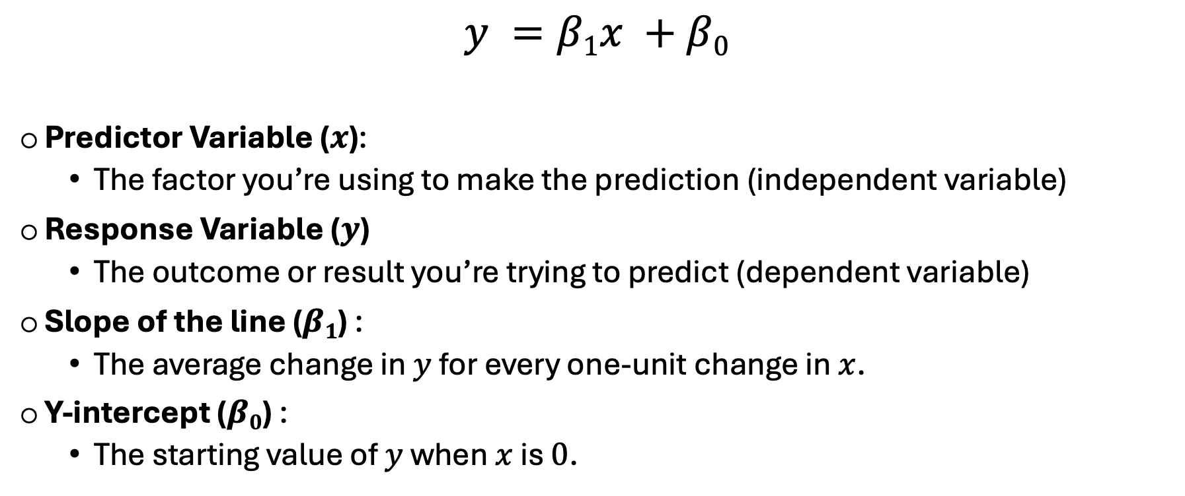
The regression problem: Finding the line of best fit
$$y =β1x +β0$$
Predictor Variable ($x$):
The factor you’re using to make the prediction (independent variable)
Response Variable ($y$)
The outcome or result you’re trying to predict (dependent variable)
Slope of the line ($β1$) :
The average change in $y$ for every one-unit change in $x$.
Y-intercept ($β0$) :
The starting value of $y$ when $x$ is $0$.
Notes:
Let’s talk about simple linear regression — one of the most fundamental algorithms in predictive modeling.
At its core, simple linear regression helps us understand the relationship between two variables by fitting a straight line through the data.
The formula is probably one you’ve seen before in high school math: y = mx + b, or in statistical terms, y = b₁x + b₀.
Let’s break down what each part means:
Predictor Variable (x): This is the independent variable — the factor you use to make predictions. For example, you might use a person’s age to predict their income.
Response Variable (y): This is the dependent variable — the outcome you’re trying to predict. In our example, that would be income.
Slope (b₁): The slope tells us how much y changes for every one-unit increase in x. A steeper slope means a stronger relationship between the two variables.
Y-intercept (b₀): This is the value of y when x is zero — essentially the starting point of the line on the y-axis.
So, together, these elements define a line that best fits our data, helping us quantify and predict how one variable changes with another.

Slide 8

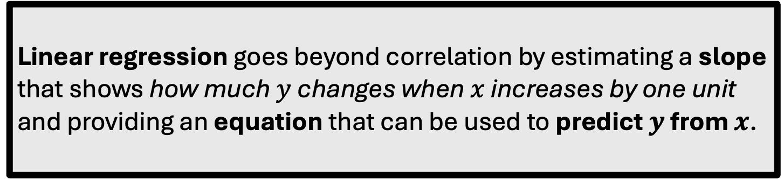
From correlation to prediction
$$y =β1x +β0$$
Predictor Variable ($x$):
The factor you’re using to make the prediction (independent variable)
Response Variable ($y$)
The outcome or result you’re trying to predict (dependent variable)
Slope of the line ($β1$) :
The average change in $y$ for every one-unit change in $x$.
Y-intercept ($β0$) :
The starting value of $y$ when $x$ is $0$.
Linear regression goes beyond correlation by estimating a slope that shows how much $y$ changes when $x$ increases by one unit and providing an equation that can be used to predict $y$ from $x$.
Notes:
Linear regression goes one step beyond correlation.
While correlation only tells us that two variables are related, regression actually quantifies that relationship.
It estimates a slope, showing how much y changes when x increases by one unit — and, importantly, it gives us an equation we can use to predict y from x.
So rather than just knowing two variables move together, regression lets us model how much and in what direction one affects the other.

Slide 9


Example data set
We’ll use housing data from Sacramento to see if we can predict sale price from house size.
Key features:
Houses (rows)
A single predictor or explanatory variable (house size, in square feet)
Numeric response variable or outcome (house sale price, in USD)
Notes:
Let’s walk through an example to illustrate how regression modeling can be applied in practice.
Here, we’re focusing on whether the size of a house—measured in square feet—can be used to predict its sale price. This type of analysis has real-world applications in real estate, where understanding the relationship between house size and price can provide valuable insights for buyers, sellers, and investors!

Slide 10
Data visualization
Visualizing the relationship between house size (predictor) and sale price (response) suggests a positive correlation→ as house size increases, sale price tends to rise.
This pattern also indicates that we could potentially predict a home’s sale price based on its size, even if it hasn’t been sold yet.
Notes:
When we look at the scatter plot, we notice a clear trend—as the size of a house increases, its sale price generally rises as well. This positive correlation suggests that larger homes tend to sell for more, which aligns with our intuition about the real estate market.
This observation is important because it implies that we could potentially use the size of a house to predict its sale price. In other words, even if a house hasn't been sold yet, its size could help us estimate a reasonable selling price based on the patterns observed in our dataset.

Slide 11
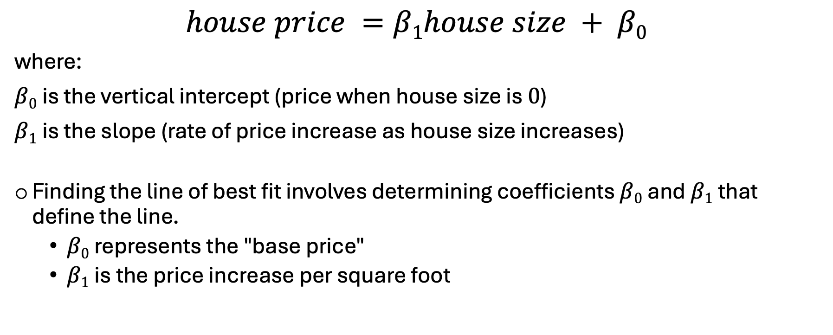
Simple linear regression
The equation for the straight line in simple linear regression is:
$$house price =β1house size + β0$$
where:
$β0$is the vertical intercept (price when house size is $0$)
$β1$is the slope (rate of price increase as house size increases)
Finding the line of best fit involves determining coefficients $β0$and $β1$that define the line.
$β0$represents the "base price"
$β1$is the price increase per square foot
Notes:
So far, we’ve seen that house size and price are strongly positively correlated — but correlation only tells us how strong the link is.
Now, let’s take the next step: Can we actually predict house price based on square footage?
To do that, we use simple linear regression.
The equation for our model would look like this:
House Sale Price = β₀ + β₁ × (House Size)
where:
β₀, or the intercept, represents the estimated base price of a house with zero square feet. Now, that doesn’t make much practical sense — since no house is truly 0 square feet — but it’s an essential part of the equation because it defines the starting point of our regression line.
β₁, or the slope, tells us how much the price changes for each additional square foot of house size. For example, if β₁ = 150, that means for every extra square foot, the predicted price increases by 150 dollars
Together, β₀ and β₁ define the line of best fit — the straight line that minimizes the difference, or error, in other words between our predicted prices and the actual price.

Slide 12
To decide whether the $350,000 asking price for the 2,000 square-foot house is fair, we can use our existing data to predict its likely sale price.
However, since there are no exact observations for a 2,000 square-foot house in our dataset, we need a method to estimate the price.
Using simple linear regression, we can use the data to draw a straight line of best fit through our existing data points.
Notes:
This line summarizes the overall pattern in the data — as square footage increases, price generally increases as well.
You can also see that the points don’t fall perfectly on the line — there’s some spread, or residual error — which reflects the real-world variation that our model doesn’t fully explain. We’ll talk more about that soon!
Now, let’s take this one step further. Suppose we want to know whether a $350,000 asking price for a 2,000 square-foot house in Sacramento is fair.
In our dataset, we don’t have a house that’s exactly 2,000 square feet — so how can we estimate what it should sell for?
That’s exactly where our line of best fit becomes useful. It gives us a mathematical equation we can use to predict the expected price for any given house size — even if that specific value doesn’t appear in our data.

Slide 13
Once we have the coefficients, we can use the equation to estimate the predicted sale price given the value we have for the predictor variable—e.g. 2,000 square feet.
For every additional square foot, price increases by approximately $135 on average.
This gives us a simple way to estimate price for any home size within our data range; extrapolate only when logically justified.
2,000 square feet
$285,477
$$house price =(134.6408)2000 + 16195.5456$$
Notes:
Once we have the coefficients—base price beta_0 and slope; beta_1 —we can use this regression equation to predict the sale price of a house based on its size.
For example, let’s say:
The base price (beta_0​) is roughly $16 thousand 196
The slope (beta_1​) is roughly $135 per square foot
Using the equation:
Sale Price = 135×(House Size) + 16 thousand, 196
So, if we plug our x into the equation, 2,000 square-foot house, the predicted sale price is approx. $285,000.
However, I do want to point out that linear regression models can make predictions for any value of x, even for extreme or unrealistic values, such as:
A 6-million-square-foot house, which would produce an unusually high price,
A -2,000 square-foot house, which would result in an illogical negative price.
These predictions are unreliable because they fall outside the range of the data we used to make the model.
So, while linear regression can extrapolate (predict beyond the data range), it’s important to make predictions only within the original data range. Extrapolating outside of that range should be done only when logically justified.

Slide 14
Choosing the line of best fit
Many different lines could be drawn through the data points; how do we choose the line of best fit?
Simple linear regression finds the line of best fit by making the predicted values as close as possible to the actual data points.
Notes:
When plotting data points on a graph, we can see that there are many possible lines that could be drawn through the points. So, you may be asking yourself how do we choose the line of best fit?
In simple terms, the line of best fit is the straight line that comes closest to all the points on a scatter plot. The line is “best” because it’s drawn in a way that makes the predicted values from the line as close as possible to the actual data points. In other words, it tries to keep the gaps between the real points and the line (the errors) as small as possible on average.

Slide 15
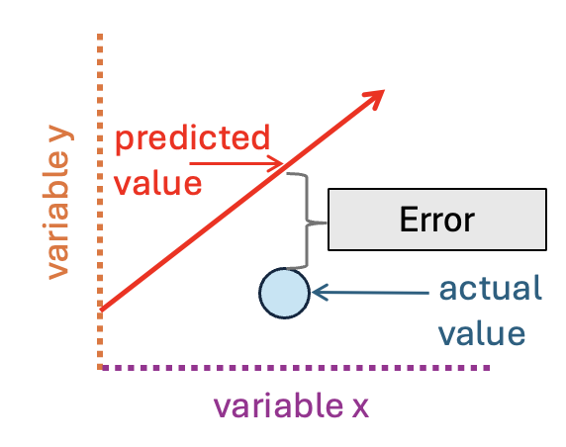
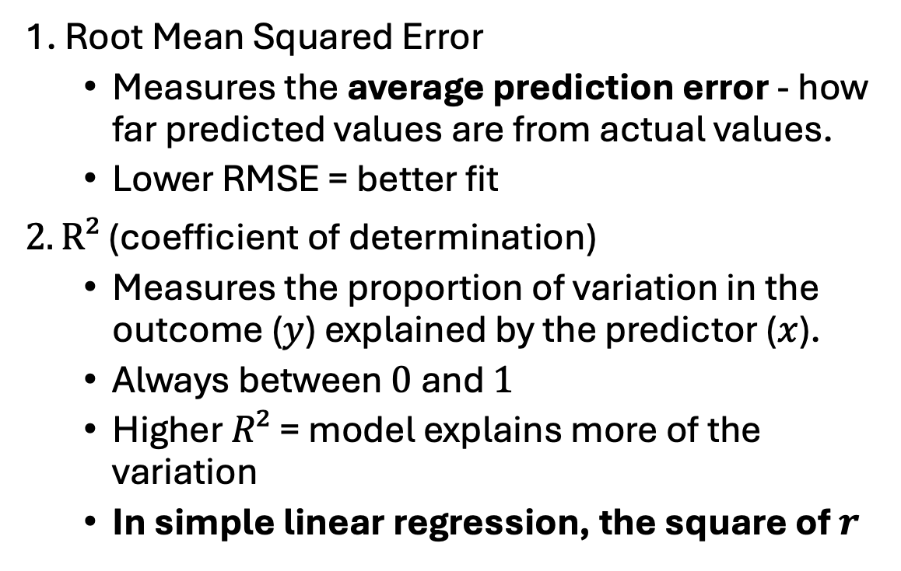
Evaluating model fit: RMSE and R²
1. Root Mean Squared Error
Measures the average prediction error - how far predicted values are from actual values.
Lower RMSE = better fit
$2. R²$ (coefficient of determination)
Measures the proportion of variation in the outcome ($y$) explained by the predictor ($x$).
Always between $0$and $1$
Higher $R²$ = model explains more of the variation
In simple linear regression, the square of $r$
Error, or residuals, measure how far each data point is from the regression line
Notes:
Once we’ve fit our regression line, we need to check how well it predicts the data. To do that, we evaluate the model using two key metrics: the Root Mean Square Error (RMSE) and R², the coefficient of determination.
RMSE tells us, on average, how far our predictions are from the actual values, using the same units as our response variable. A smaller RMSE means our predictions are closer to reality — in other words, the model is more accurate.
While RMSE tells us about accuracy in the original units, R² tells us how well our model explains the variation in the response variable — or how much of the change in y can be explained by x. It ranges from 0 to 1:
An R² close to 1 means the model explains most of the variation — the line fits the data well.
An R² close to 0 means it explains very little — the line doesn’t capture the pattern effectively.
In simple linear regression, R² is the square of the correlation coefficient (r), meaning it represents the strength of the linear relationship between our predictor and response, but in terms of explained variance.
Together, R² and RMSE give us a complete picture of model performance:
R² shows how well the model fits the data overall.
RMSE tells us how accurate the predictions are, on average.

Slide 16
Simple linear regression is just the start!
Some extensions allow us to model more complex patterns in our data:
Include categorical predictors (e.g., type of home — Residential, Multi-family, Condo)
Add multiple predictors (e.g., house size + number of bedrooms)
Model non-linear relationships (e.g., curved trends captured using polynomial terms)
Notes:
Everything we’ve covered today — correlation, simple linear regression, and evaluation metrics like RMSE and R² — forms the foundation of how we understand and model relationships between numeric variables.
It’s worth noting that there are also extensions that allow us to model more complex patterns in data. These are beyond the scope of today’s session, but here’s a quick preview:
We can include categorical predictors, such as the type of home — for instance, Residential, Multi-family, or Condo.
We can add multiple predictors, also known as multivariable linear regression, so combining house size and maybe number of bedrooms to improve our predictions.
And we can model non-linear relationships, where the trend curves rather than forms a straight line — often captured using polynomial terms.
These techniques build on the same core ideas we explored in this demonstration — just extended to capture more complex real-world relationships.

Slide 17
Putting it all together
Correlation & simple linear regression in R
Notes:
Now that we know the steps conceptually, let’s see what this looks like in R.

Slide 18
Load in packages
library(ggplot2)
Notes:
Let’s start by importing the libraries we’ll need for our analysis. The good news is that most of the packages we need are already built into R, so we don’t have to install or load very much.
The main one we’ll be using here is ggplot2, which allows us to easily visualize our data — including the line of best fit from our regression model.

Slide 19
Load and preview dataset
sacramento = read.csv(”sacramento.csv")
head(sacramento) # View first few rows
street | city | zip | … | sq_ft | … | price
1005 MORENO WAY | SACRAMENTO | 95838 |  | 1410 |  | 180000
10105 MONTE VALLO CT | SACRAMENTO | 95827 |  | 1578 |  | 190000
10133 NEBBIOLO CT | ELK GROVE | 95624 |  | 2096 |  | 289000
10165 LOFTON WAY | ELK GROVE | 95834 |  | 1540 |  | 266510
10254 JULIANA WAY | SACRAMENTO | 95827 |  | 2258 |  | 331200
Notes:
Let’s start by loading and previewing our dataset.
“Here, We’ll use read.csv() to load the file called sacramento.csv and assign it to a variable called sacramento. Next, we use the head() function to preview the first few rows of the dataset. This helps us quickly confirm that the file loaded correctly and lets us see what variables we’re working with.
We can spot the key columns we’ll be using today — square footage as our predictor, and price as our response variable

Slide 20
Perform Pearson’s correlation
# Syntax = cor(data$x, data$y)
cor(sacramento$sq_ft, sacramento$price)
0.728642
# This indicates a strong positive correlation between house size and house price!
Notes:
Now that we’ve looked at our data, let’s quantify the relationship between house size and sale price.
Here, we’re using the cor() function to calculate Pearson’s correlation coefficient between the variables sq__ft and price. This gives us a single number that tells us both the strength and direction of the relationship between these two variables.
When we run this, we get a correlation of 0.73.
That’s a strong positive correlation, meaning that as house size increases, sale price tends to increase as well, which aligns with what we saw in the plot.
It’s important to note that correlation doesn’t imply causation — it just tells us that the two variables move together in a consistent pattern.

Slide 21
Perform simple linear regression
# Syntax = lm(y ~ x, data)
lin_reg = lm(price ~ sq_ft, data = sacramento)
# Fitted model components (e.g. coefficients, residuals) are stored in lin_reg
lin_reg$coefficients
(Intercept) sq_ft
16195.5456 134.6408
Notes:
Since we’ve found a strong positive correlation between house size and price, the next step is to build a model that lets us predict price based on size.
We can do that using simple linear regression.
In R, the function lm() stands for linear model. The syntax follows the form y ~ x, which reads as ‘predict y from x.’
Here, we’re predicting price from square footage.
When we run this code, R creates a model object called lin_reg.
It automatically calculates several key components — things like coefficients, residuals — and stores them inside this object.
If we check the coefficients component by indexing it, we can see the two main numbers that define our line of best fit:
The intercept, about 16,195, and
The slope, about 134.6.
This means that for every additional square foot of living space, the model predicts the price will increase by roughly $135.”
So, we’ve moved beyond describing a relationship — now we can actually use that line to make predictions.

Slide 22
Plot the line of best fit
ggplot(data = sacramento, aes(x = sq_ft, y = price)) +
geom_point() + # Add scatter plot
geom_smooth(method = ‘lm’) # Add the line of best fit
price
sq_ft
Notes:
Now that we’ve built our regression model, let’s take a look at what that relationship actually looks like.
Here, we’re plotting house size on the x-axis and house price on the y-axis, where each point represents a single home in our dataset.
We start by adding a layer to specify a scatter plot using geom_point().
Then, we add another layer for our regression line using geom_smooth(), with the argument method = "lm" — that tells R to fit a linear model.
This line of best fit captures the trend our model we just estimated — how price tends to increase as house size gets larger.

Slide 23
Evaluate model fit: RMSE
# Step 1. Get the residuals
residuals <- lin_reg$residuals
# Step 2. Square the residuals
residuals_squared <- residuals**2
# Step 3. Find the average
avg_residuals_squared <- mean(residuals_squared)
# Step 4. Take the square root
RMSE <- sqrt(avg_residuals_squared)
RMSE
81885.64
# On average predictions are about $82,000 off from the true sale prices.
Notes:
Once we’ve fit our regression model, we can evaluate how accurate our predictions are on average.
We can measure that using the Root Mean Squared Error, or RMSE.”
Here’s how it works:
First, we take the residuals, which are the differences between our predicted prices and the actual sale prices.
Then we square those residuals — this makes all the errors positive and gives more weight to larger mistakes.
Next, we find the average of those squared errors using the mean function
And finally, we take the square root using the square root function to bring the number back to the original units — in this case, dollars.
When we do that, we get an RMSE of about $81,885.”
That means, on average, our model’s predictions are about $82,000 off from the true sale prices.
So while the model captures the overall trend well — bigger houses cost more — there’s still quite a bit of variability that house size alone can’t explain.
In a real-world setting, we could reduce that error by including more predictors — just like we discussed earlier when talking about extensions beyond simple linear regression.

Slide 24
Evaluate model fit: R²
# Metrics such as R² are derived statistics that are calculated only when you call summary()
summary(lin_reg)$r.squared
0.5309191
cor(sacramento$sq_ft, sacramento$price)**2
0.5309191
# R² tells us how much of the variation in price we can explain using size — here, about half!
Notes:
Now let’s look at R2 to see we know how much variation in house price our model explains
We can access it by calling the summary function on our model — which calculates several derived statistics, including this R squared component that we could index.” Here, R² is 0.53, meaning our model explains about 53% of the variation in house prices using size alone.
We can actually verify that value — if we square our correlation coefficient from earlier, we get the same result. That’s because in simple linear regression, R² is literally the square of the correlation coefficient between the observed and predicted values.”
So, what does 0.53 mean in practical terms? It tells us that about half of the differences in house prices can be explained by house size , which is a strong relationship for a single variable!

Slide 25
Concept map
numeric response variable (y)
average prediction error
to make predictions for
how much variance explained
predictor variable (x)
use information about
Root mean squared error (RMSE)
Linear
Regression
R²
fits a straight line to model relationship between x and y
evaluation
Pearson’s correlation (r)
Notes:
Let’s end off by quickly reviewing a concept map of the key ideas we covered in today’s demonstration.
We started with the idea of linear regression, which fits a straight line to model the relationship between two numeric variables — an x (predictor) and a y (response).
Specifically, linear regression uses information about the predictor variable to make predictions for the numeric response variable.
We then looked at how to evaluate our model’s performance in two main ways:
First, using the Root Mean Squared Error (RMSE), which tells us the average prediction error — how far off our predictions are, on average, from the true values.
And second, using the Coefficient of Determination (R²), which tells us how much of the variation in our response variable is explained by our model.
Importantly, in simple linear regression, R² is directly related to Pearson’s correlation coefficient — it’s actually the square of r.
So together, these concepts help us understand both how well two variables are related and how accurately we can use one to predict the other.

Slide 26

Thank you!
Scan me!
Questions?
Acknowledgements: The content in this demonstration was adapted from material I’ve previously developed at the Data Science Institute
Notes:
Once again, if you’d like to explore these materials later, I’ve shared everything in my GitHub repository. You can scan the QR code on the slide to access it directly!
Thank you so much and id be happy to take any questions

Slide 27
Appendix

Slide 28

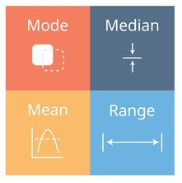
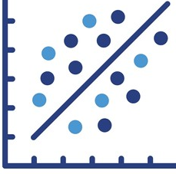
Exploratory data analysis
Before any analysis or modeling, it’s essential to explore your data to understand its structure and quality.
EDA helps reveal distributions, relationships, outliers, missing values, and guides model building.
3 main steps
1. Inspect the raw data → get a feel for what’s in the dataset.
2. Compute summary statistics → e.g., mean, median, interquartile range.
3. Visualize the data → use plots to spot patterns and anomalies.
Notes:
Like in our clustering demonstration, before we jump into any analysis or modeling, it’s really important to take time to explore our data.

Slide 29
R code
# 1. Inspect the data by viewing the first few rows
str(sacramento)
'data.frame’: 813 obs. of 12 variables:
...
$ sq_ft: int 1410 1578 2096 1540 2484 2258 1720 1410 1623 …
...
$ price: int 180000 190000 289000 266510 331200 232500 290000…
# Note. In this slide only relevant columns are shown
Notes:
Now that we’ve loaded our dataset, let’s take a closer look. we can use the structure() function on our DataFrame.
When you run str(sacramento), you get a concise summary of the dataset, including:
Column names
Data types for each column i.e., whether its an integer o
The first few observations in that column
This is incredibly helpful for understanding the structure of your dataset!

Slide 30
R code
# 2. Summarise data by computing summary statistics
summary(sacramento)
sq_ft ... price
Min. : 484 Min. : 30000
1st Qu.:1144 1st Qu.:148750
Median :1418 Median :208000
Mean :1586 Mean :229728
3rd Qu.:1851 3rd Qu.:285000
Max. :4400 Max. :884790
# Note. In this slide only relevant columns are shown
Notes:
Next, let’s pull out some summary statistics for our variables to get a better sense of what we’re working with.
We can do this easily using the summary() function.
This function gives us a quick overview of key statistics — like the mean, minimum and maximum values, median, the 25th, and 75th percentiles for each numeric variable.

Slide 31
R code
# 3. Visualize data: Scatter plot for sq_ft vs price
ggplot(data = sacramento, aes(x = sq_ft, y = price)) +
geom_point() + # Adding scatter plot
labs(x = ‘Square Feet’, y = ‘Price’) + # Adding label
theme_classic () # Format background and font
Notes:
Lastly, let’s visualize the relationship between our two variables –house size and house price— to see if we can spot any trends in the data.
In this code, we’re using ggplot to create a scatter plot, which is specified by the geom_point layer.
Here, Each point represents a house listing where
The x-axis shows the house size and the y-axis shows the house price

