Slide 1
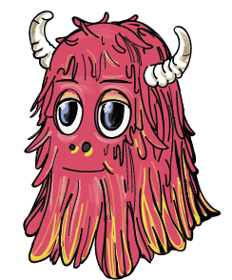
Notes:
This is Klaptoo! (CLICK SPACEBAR) He is our alien friend from another planet. Recently Klaptoo bumped his head and forgot the words of his alien language. He needs to your help to find them!

Slide 2

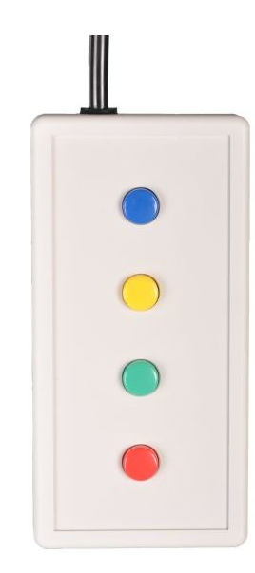

Notes:
To help him, listen for his favorite word. This is his favorite word (play clip x3). When you hear it, press a button on the button box (CLICK SPACE BAR) so he can find it too!

Slide 3
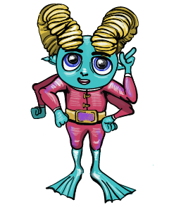
Notes:
Sometimes though his troublemaker friend Judoon will interrupt by singing a song with sounds like this (PLAY CLIP), don’t let him confuse you!

Slide 4
Notes:
Just focus on listening for Klaptoo’s favorite word, which is (PLAY CLIP) and press the button when you hear it. We will do this for 5 minutes and then take a break!

