Slide 1
Investigating the NFL 4th Down
Presented by Julia Griese
CMSE 201 SS26

Slide 2
Context
I obtained the NFL Team Stats 2002 - Feb. 2026 (ESPN) dataset through Kaggle. It includes over 60 variables including date, team matchups, score, first downs, second downs, third downs, fourth downs, sacks, rushing yards, penalty yards, and many more football statistics!
Dataset Inefficiencies:
  Incomplete statistics are all listed as a “0”
  Only includes team data, does not include individual player data, team locations, or notes on extreme circumstance games
  Includes large amounts of data, requiring timely and careful manipulation
Assumptions
  A 4th down is the offensive team's last attempt to try and gain the necessary yards. Failing to do so results in the opposing team getting the football at that mark. This means the offensive team must make the decision to either punt it further away for the opposing team to receive, try to kick a field goal for 3 points, or risk losing the ball by going for the remaining yards
  I am assuming that each attempt comes from a full-time, officiated game

Slide 3
questions
  As the game and play styles have changed, have 4th down attempts generally increased or decreased?
  What other teams or factors are associated with higher 4th down attempts?

Slide 4
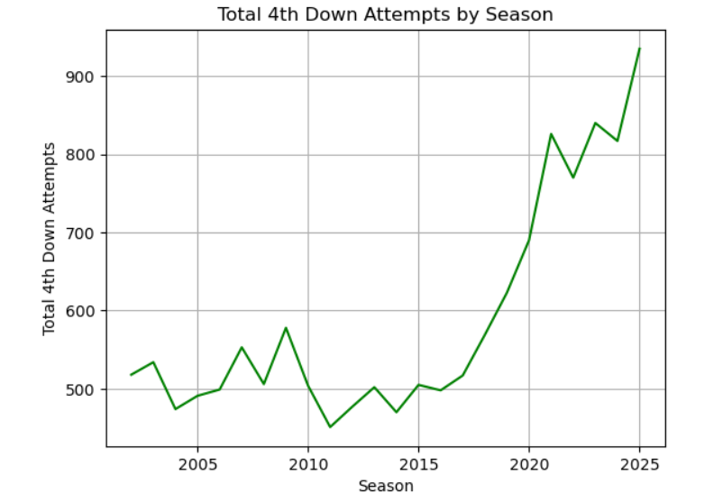
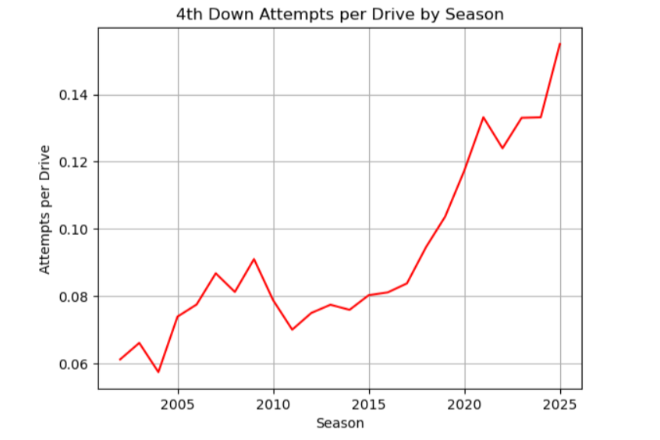
Results
To analyze the 4th down most closely, I looked at averages by season, game, and even drive. I found that the average attempts per drive was the most accurate in determining 4th down aggression. Using curve_fit, I made an approximate line of best fit for these two plots.
Inflated by increase in regular season games! (16 to 17)
Slope of best fit line = 15.4
Slope of best fit line = 0.0032

Slide 5
Results
In considering factors that affect 4th down attempts, I analyzed the 4th down attempt average per game of home versus away teams using numpy calculations.
Average 4th down attempts by home team per game: 1.045
Average 4th down attempts by away team per game: 1.132
2025 Season Average 4th down attempts by home team per game: 1.674
2025 Season Average 4th down attempts by away team per game: 1.607
Home average 4th down completion %: 51.406
Away average 4th down completion %: 50.109
Home 2025 season average 4th down completion %: 54.927
Away 2025 season average 4th down completion %: 55.022
Both home and away teams attempted more 4th downs per game in 2025 on average and completed them more efficiently than historical trends.

Slide 6
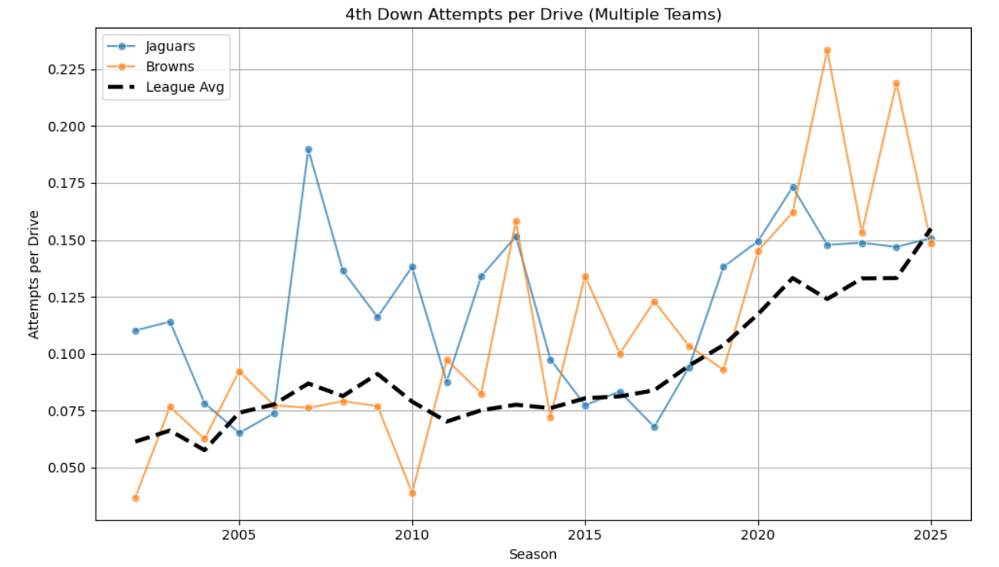
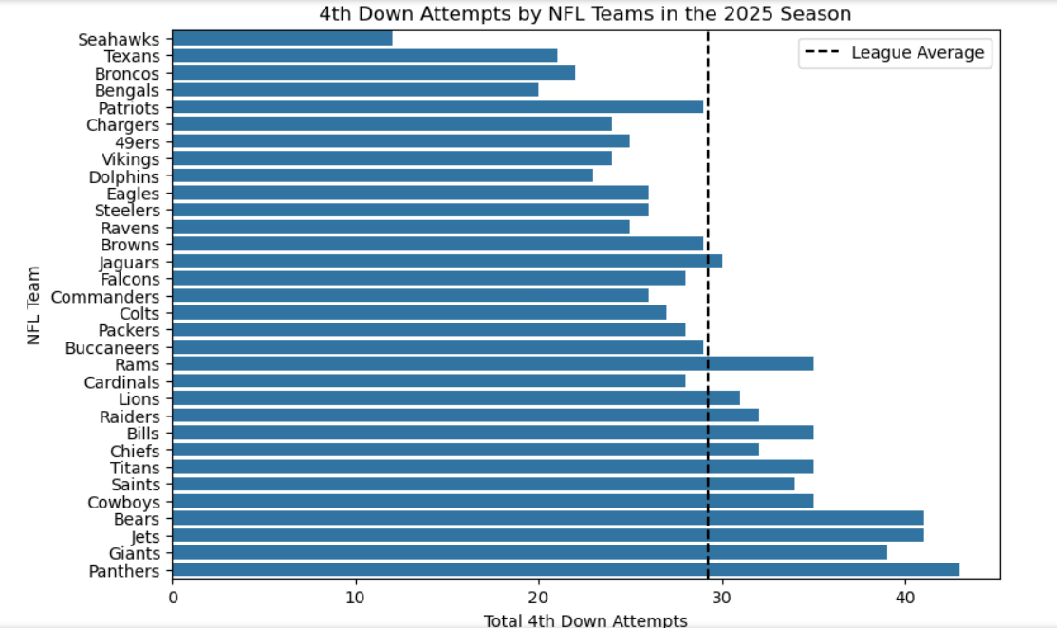
Results
Using the attempts per drive as my reference statistic, I found which teams had the highest averages over the past 24 seasons. I found that the Jaguars, Browns, Lions, Bears, and Giants have historically been the top 5 teams in the league when it comes to 4th down aggression. To see how teams compare historically, I created a function that takes a list of teams, and graphs this statistic over time, compared to the league average.
Total attempts made by each team in 2025

Slide 7
Conclusion
I learned that that NFL teams have become more aggressive and efficient at attempting the 4th down. However, this conclusion comes with some missing information.
The total number of 4th down attempts each season is consistently increasing. Additionally, the rate of 4th down attempts per game and the rate of 4th down attempts per drive are both increasing too by small amounts each season
Home and away teams historically have attempted the 4th down at similar rates, but the rates for both teams showed an increase this past season
Knowing that 4th down attempts are trending upwards, organizations can anticipate these plays before they even happen and prepare accordingly
In the future, I would like to take a more probability-based approach to determine if teams are becoming increasingly likely to attempt the 4th down.
Accounting for stronger offensive teams, “4th down decisions”, and high-risk scenarios
Using stronger statistical models

Slide 8
References
“Horizontal Bar Chart.” Horizontal Bar Chart - Matplotlib 3.10.8 Documentation, 2002–2012 John Hunter, Darren Dale, Eric Firing, Michael Droettboom and the Matplotlib development team; 2012–2025 The Matplotlib development team., matplotlib.org/stable/gallery/lines_bars_and_markers/barh.html. Accessed 20 Apr. 2026.
“Pandas.Dataframe.Reset_index.” Pandas.DataFrame.Reset_index - Pandas 3.0.2 Documentation, pandas via NumFOCUS, Inc. Hosted by OVHcloud., 2026, pandas.pydata.org/docs/reference/api/pandas.DataFrame.reset_index.html.
Waskom, Michael. “Seaborn.Barplot.” Seaborn.Barplot - Seaborn 0.13.2 Documentation, 2024, seaborn.pydata.org/generated/seaborn.barplot.html.

