Slide 1
Paper Reading Report · 114-2 Information Retrieval
PEFA: Parameter-Free Adapters
for Large-scale Embedding-based Retrieval Models
Authors
Wei-Cheng Chang, Jyun-Yu Jiang, Jiong Zhang, Mutasem Al-Darabsah, Choon Hui Teo, Cho-Jui Hsieh, Hsiang-Fu Yu, S. V. N. Vishwanathan
Affiliation
Amazon · UCLA
Venue
Reference
WSDM '24 · Mérida, Mexico
arXiv:2312.02429v2 · github.com/amzn/pecos
Presenter: 314581027 劉怡妏 | Date: 2026-05-19

Slide 2
Outline
2 / 15
Roadmap of this presentation
1
Motivation
2
Preliminaries
Why full-parameter fine-tuning is too expensive
Dense retrieval, ERMs, MIPS & ANN
3
PEFA Framework
4
PEFA-XL & PEFA-XS
Convex combination of ERM + non-parametric kNN
Two realizations with different trade-offs
5
Complexity Analysis
6
Document Retrieval
Index size, build time, inference latency
Experiments on NQ-320K & Trivia-QA
7
Product Search
8
Ablation & Discussion
Billion-scale industrial deployment
Hyper-parameters, related work, takeaways
PEFA · WSDM '24 · Paper Reading Report

Slide 3
1 · Motivation
3 / 15
Fine-tuning ERMs at industry scale is painful
Pain points of full-parameter fine-tuning
PEFA's promise
• Multi-stage pipeline — pre-train → 1st-stage FT (random/BM25 neg) → 2nd-stage FT (hard neg) → 3rd-stage distillation
• Compute cost — billions of (query, product) pairs → thousands of GPU hours
• Gradient access required — not feasible for black-box LLMs (GPT-3, etc.)
• Tail queries & labels — even SoTA bi-encoders struggle on long-tail
Traditional fine-tuning
• Backward pass + gradient updates
• GPU clusters, days to weeks
• Tied to white-box models
PEFA (this paper)
• No backward pass · no gradient
• CPU-side ANN index build (hours, not days)
• Works on pre-trained AND fine-tuned ERMs
• Applies to black-box LLM encoders
PEFA · WSDM '24 · Paper Reading Report

Slide 4
2 · Preliminaries
4 / 15
Dense text retrieval with bi-encoder ERMs
ERM scoring function
f_ERM(q, p; θ) = ⟨ E(q; θ), E(p; θ) ⟩
E(·; θ) : X → R^d · inner product / cosine similarity assumed (ℓ2-normalized)
Learning
Inference
• Training data: relevant pairs D = {(qᵢ, pᵢ)}
• Maximize log p_θ(p | q) (softmax over corpus)
• Partition function is intractable → negative sampling: random, BM25, hard mining, distillation
• All stages require gradient back-prop
• Maximum Inner Product Search (MIPS) over corpus P
• Exact MIPS is O(n) — infeasible for 100M+ corpora
• ANN libraries: HNSW, FAISS, ScaNN — sub-linear O(log n)
• Index build is cheap (CPU) vs FT (GPU clusters)
PEFA · WSDM '24 · Paper Reading Report

Slide 5
3 · PEFA Framework
5 / 15
Convex combination of ERM and non-parametric kNN
Core scoring function (applied only at inference)
f_PEFA(q̂, p_j) = λ · f_ERM(q̂, p_j) + (1 − λ) · f_kNN(q̂, p_j)
λ ∈ [0,1] : interpolation coefficient. ERM parameters θ remain unchanged.
Parameter-free
Black-box friendly
Orthogonal
No optimization over ERM weights.
Learning reduces to building an ANN index of key-value pairs.
Needs only forward embeddings.
Applies to GPT-3-class LLM encoders with no gradient access.
Complementary to pre-training, FT, and parameter-efficient methods (Adapter, LoRA, prefix-tuning).
PEFA · WSDM '24 · Paper Reading Report

Slide 6
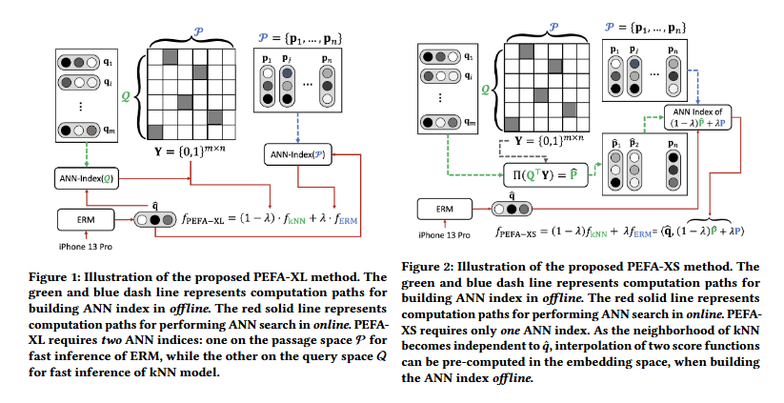
4a · PEFA-XL (extra large)
6 / 15
kNN over training queries — query-dependent neighborhood
Idea
Figure 1 of the paper · PEFA-XL
• Find top-k most similar training queries qᵢ ∈ Q to test query q̂
• Aggregate the relevant passages of those neighbors (Y_{i,j})
• Diagonal gate D_{i,i} = 1 if i ∈ NN(q̂, Q; k); else 0
PEFA-XL scoring (Eq. 6)
f_XL(q̂, p_j) = λ⟨q̂, p_j⟩ + (1−λ) · Σ_{i ∈ NN(q̂,Q;k)} ⟨q̂, qᵢ⟩ · Y_{i,j}
Normalization
D_{i,i} = 1/k so that f_kNN stays bounded by 1, calibrated against f_ERM (cosine in [−1, 1]).
Two ANN indices · TWO ANN searches at inference.
PEFA · WSDM '24 · Paper Reading Report

Slide 7
4b · PEFA-XS (extra small)
7 / 15
Query-independent kNN — fold into a single ANN index
Idea
Figure 2 of the paper · PEFA-XS
• Replace NN(q̂, Q; k) with I(p_j, Y) — queries relevant to passage p_j
• Neighborhood is now independent of test query q̂
• → interpolation can be pre-computed OFFLINE in embedding space
PEFA-XS scoring (Eq. 8)
f_XS(q̂, p_j) = ⟨ q̂, λ · p_j + (1−λ) · Π(Q^T Y_{:,j}) ⟩
Π(·) is ℓ2-normalization onto the unit sphere.
Why it matters
The interpolated passage embedding is built ONCE at offline indexing — inference cost is identical to the original ERM. Zero deployment overhead.
Single ANN index · ONE ANN search · zero extra latency.
PEFA · WSDM '24 · Paper Reading Report

Slide 8
5 · Complexity Analysis
8 / 15
Time & space at inference, using HNSW as the ANN backbone
Method | Build time | Index size | Inference time
ERM | O(n log n) | O(nd + |E_P|) | O(log n)
PEFA-XS | O(n log n) | O(nd + |E_P|) | O(log n)
PEFA-XL | O(n log n + m log m) | O(nd + |E_P| + md + |E_Q| + nnz(Y)) | O(log n + log m)
Key takeaways
• PEFA-XS has the SAME asymptotic cost as the ERM baseline — drop-in.
• PEFA-XL adds a second HNSW over the training-query space Q (size m), often comparable to or larger than n in e-commerce.
• Storing Y costs only O(nnz(Y)) — sparse, since Y ∈ {0, 1}^{m×n}.
• Index building runs on cheap CPU machines — orders of magnitude cheaper than GPU fine-tuning.
PEFA · WSDM '24 · Paper Reading Report

Slide 9
6a · Document Retrieval — NQ-320K
9 / 15
ERMs are fine-tuned; PEFA applied on top
Method | R@10 | R@100
BM-25 | 32.48 | 50.54
DSI (base) | 56.60 | —
SEAL (large) | 81.24 | 90.93
NCI (base) — prev. SoTA | 85.20 | 92.42
MPNet_base | 80.82 | 92.39
+ PEFA-XS | 86.67 | 94.53
+ PEFA-XL | 88.72 | 95.13
GTR_base | 79.74 | 90.91
+ PEFA-XS | 84.90 | 93.28
+ PEFA-XL | 88.71 | 94.36
Avg. gain PEFA-XS | +9.22 | +5.28
Avg. gain PEFA-XL | +11.82 | +5.72
Headline findings
• MPNet + PEFA-XL → 88.72 / 95.13 ⇒ new SoTA, beats NCI (85.20 / 92.42)
• GTR + PEFA-XL nearly ties (88.71)
• PEFA-XL > PEFA-XS on R@10; both >> baseline ERM
Why this matters
Sequence-to-sequence indexers (NCI, DSI, SEAL) need expensive decoder training. PEFA reaches SoTA on dense bi-encoders with no extra training — only an HNSW build.
PEFA · WSDM '24 · Paper Reading Report

Slide 10
6b · Trivia-QA + Hyper-parameter Ablation
10 / 15
Robustness on pre-trained-only ERMs · effect of λ and k
Trivia-QA — ERMs are pre-trained only (no FT)
Ablation on NQ-320K (R@100)
Method | R@20 | R@100
NCI (base, FT) | 94.45 | 96.94
Sent-BERT_distill | 51.94 | 68.50
+ PEFA-XS | 86.28 | 93.33
+ PEFA-XL | 83.76 | 91.83
GTR_base | 71.75 | 82.05
+ PEFA-XS | 83.81 | 91.02
+ PEFA-XL | 85.30 | 92.38
Avg. gain PEFA-XS | +18.67 | +13.61
Avg. gain PEFA-XL | +17.07 | +12.80
ERM / variant | λ=0.1 | λ=0.3 | λ=0.5 | λ=0.7 | λ=0.9
GTR PEFA-XS | 92.11 | 93.07 | 93.31 | 92.85 | 91.74
GTR PEFA-XL k=16 | 94.36 | 93.32 | 92.81 | 92.53 | 91.93
GTR PEFA-XL k=32 | 94.32 | 93.23 | 92.82 | 92.44 | 91.79
GTR PEFA-XL k=64 | 93.93 | 93.14 | 92.76 | 92.29 | 91.62
DPR PEFA-XS | 91.48 | 92.22 | 91.71 | 89.87 | 87.08
DPR PEFA-XL k=32 | 92.07 | 90.50 | 89.20 | 88.62 | 87.46
Take-aways
• PEFA-XS optimum ≈ λ = 0.3 – 0.5 ; PEFA-XL ≈ λ = 0.1
• k = 32 typically saturates
• λ = 1 reduces to the original ERM (sanity check)
PEFA · WSDM '24 · Paper Reading Report

Slide 11
7a · Product Search — Recall Gains
11 / 15
Three proprietary datasets · numbers = absolute gain over MPNet baseline
Method | 5M R@100 | 5M R@1000 | 15M R@100 | 15M R@1000 | 30M R@100 | 30M R@1000
MPNet_base | 0.00 | 0.00 | 0.00 | 0.00 | 0.00 | 0.00
+ PEFA-XS | 11.23 | 13.14 | 5.05 | 11.79 | 9.67 | 17.47
+ PEFA-XL | 22.83 | 12.31 | 23.48 | 21.56 | 27.22 | 18.96
GTR_base | 7.85 | 9.23 | 6.75 | 10.33 | 8.35 | 9.83
+ PEFA-XS | 17.32 | 19.55 | 16.83 | 25.00 | 18.49 | 24.38
+ PEFA-XL | 27.79 | 19.23 | 27.87 | 28.75 | 31.71 | 24.28
E5_base | 9.93 | 9.75 | 9.98 | 12.98 | 12.01 | 12.61
+ PEFA-XS | 19.23 | 19.18 | 17.21 | 27.78 | 20.11 | 26.08
+ PEFA-XL | 26.83 | 17.75 | 30.48 | 31.07 | 31.91 | 25.49
FT-ERM (full FT) | 21.32 | 20.87 | 21.74 | 30.04 | 18.49 | 24.11
+ PEFA-XS | 23.42 | 22.17 | 26.34 | 34.84 | 23.79 | 29.61
+ PEFA-XL | 29.32 | 22.87 | 36.54 | 37.24 | 32.99 | 30.01
Highlight
Even on top of a heavily fine-tuned FT-ERM, PEFA-XL adds +32.99 R@100 / +30.01 R@1000 on ProdSearch-30M — without touching ERM weights.
PEFA · WSDM '24 · Paper Reading Report

Slide 12
7b · Product Search — Deployment Cost
12 / 15
Index size (GiB) · Build time (hr) · Latency (ms/query, single thread)
Dataset | Method | Index disk (GiB) | Build time (hr) | Latency (ms/q)
ProdSearch-5M | FT-ERM | 13.1 | 0.3 | 0.82
ProdSearch-5M | + PEFA-XS | 13.1 | 0.2 | 0.67
ProdSearch-5M | + PEFA-XL | 32.2 | 0.7 | 2.15
ProdSearch-15M | FT-ERM | 28.6 | 0.6 | 0.91
ProdSearch-15M | + PEFA-XS | 28.6 | 0.5 | 0.94
ProdSearch-15M | + PEFA-XL | 100.7 | 1.9 | 1.94
ProdSearch-30M | FT-ERM | 51.9 | 0.9 | 0.77
ProdSearch-30M | + PEFA-XS | 51.9 | 1.0 | 0.71
ProdSearch-30M | + PEFA-XL | 287.7 | 4.7 | 1.99
PEFA-XS
• Same index size as FT-ERM
• Latency unchanged (sometimes faster)
• Drop-in into production pipeline
PEFA-XL
• ~3.6× index disk vs FT-ERM (30M)
• Latency ~2.4× (still < 2 ms/query)
• 4.7 h CPU build vs hundreds of GPU-hours for FT
• Practitioner picks the trade-off
PEFA · WSDM '24 · Paper Reading Report

Slide 13
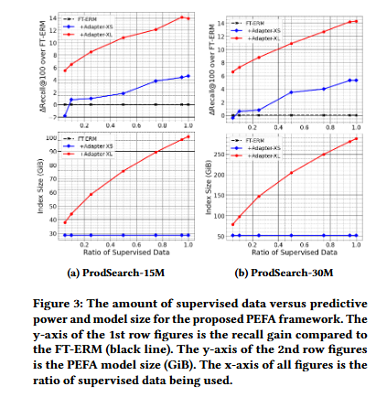
7c · Effect of Supervised Data
13 / 15
How much of Y do we actually need? (Section 5.4)
Figure 3 · ΔRecall@100 and index size vs. sampling ratio
Findings
• PEFA-XS reaches FT-ERM-level R@100 with only ~10% of pairs sampled from Y
• Index size of PEFA-XS does NOT grow with more supervised data
• PEFA-XL achieves large gains even with just 5% of Y
• Sampling ratios tested: {0.05, 0.10, 0.25, 0.50, 0.75, 0.95}
Cost trade-off
PEFA-XL index is ~1.4× larger than FT-ERM/PEFA-XS even at 5% sampling. Latency stays ~2× of FT-ERM across all dataset sizes. Practitioner picks Recall gain vs. infra cost.
PEFA · WSDM '24 · Paper Reading Report

Slide 14
8 · Related Work & Discussion
14 / 15
Where PEFA sits in the literature
kNN-LM
PIFA (XMC)
kNN component over vocabulary in language modeling. PEFA-XL is similar in spirit but operates on both passage AND query spaces; the latter is large and requires ANN, unlike a small vocab.
Positive Instance Feature Aggregation aggregates sparse tfidf features for clustering. PEFA-XS interpolates dense aggregated embeddings with the original passage embedding and indexes the result.
Parameter-efficient FT
Ethical aspects
Adapter / LoRA / prefix-tuning still need gradients and underperform on retrieval (Tam et al.). PEFA needs no gradient → applies to black-box LLM encoders; orthogonal to PEFT.
Interpretability: kNN reveals which training queries drove a retrieval result. Privacy: yearly-aggregated, anonymized search logs — no single-session traceability.
PEFA · WSDM '24 · Paper Reading Report

Slide 15
Conclusion & My Take
15 / 15
Summary, strengths, limitations
Paper conclusions
My critical take
• Parameter-free, gradient-free adapter framework for ERMs
• PEFA-XS: zero deployment overhead, modest gain
• PEFA-XL: bigger gain at ~2× latency and ~3.6× index
• Works on both pre-trained and fine-tuned ERMs
• NQ-320K: MPNet + PEFA-XL = 88.72 R@10 → new SoTA
• ProdSearch-30M: +5.3% / +14.5% R@100 over FT-ERM
• Strength · Reframes adaptation as ANN engineering — leverages mature CPU infra
• Strength · Inherently more interpretable than monolithic ERMs
• Limit · PEFA-XL needs label-side data Y at query time → not zero-shot
• Limit · Storage of Q + Y can dominate for very sparse Y
• Open · Combination with re-ranking; query-side augmentation; streaming Y updates
PEFA · WSDM '24 · Paper Reading Report

