Slide 1
Using Data to Fight Food Insecurity
Julia Hartnett & Megan Willis
Simmons University
Faculty Sponsor: Dr. Anthony Scotina

Slide 2
Food Insecurity in Urban and Non-Urban Communities
After conducting some exploratory data analysis, we decided to further investigate the differences in many attributes for Urban and Non-Urban census tracts
Poverty Rate
Vehicle Access
Low Income Population
Population Receiving SNAP Benefits
We decided to focus on comparing these features between Massachusetts census tracts and across regions of the United States

Slide 3
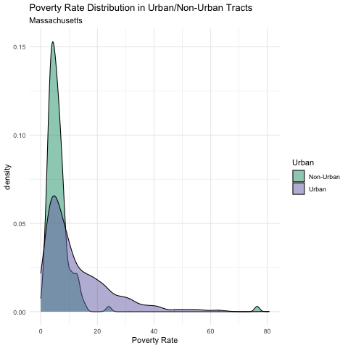
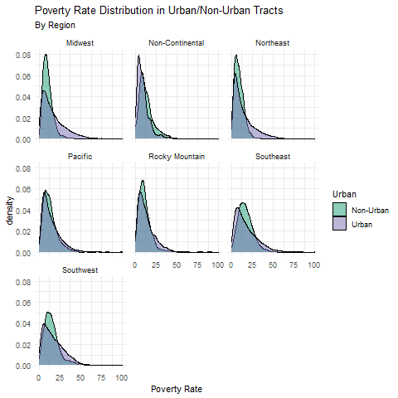
Poverty Rate

Slide 4
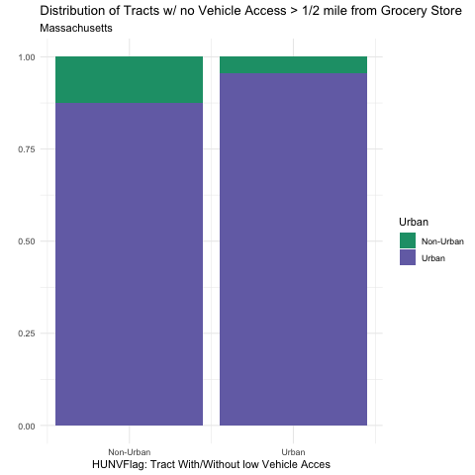
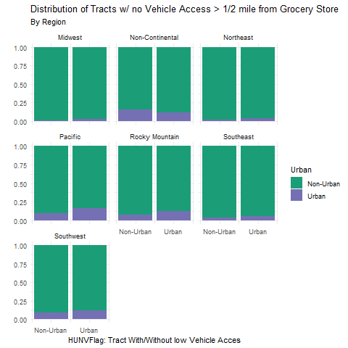
Vehicle Access

Slide 5
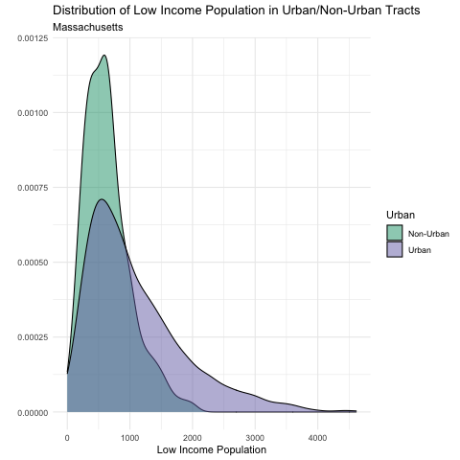
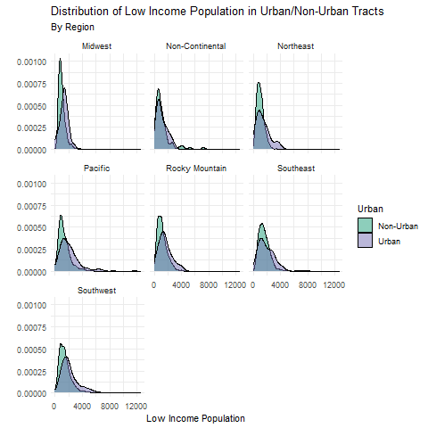
Low Income Population

Slide 6
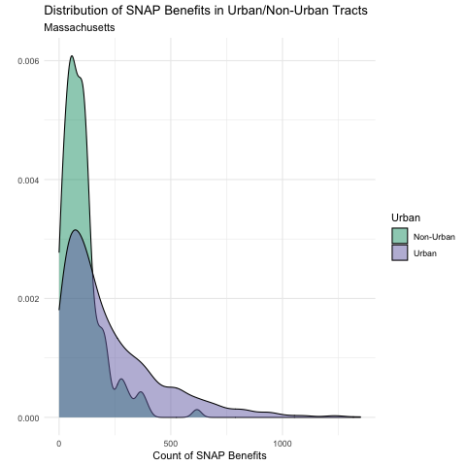
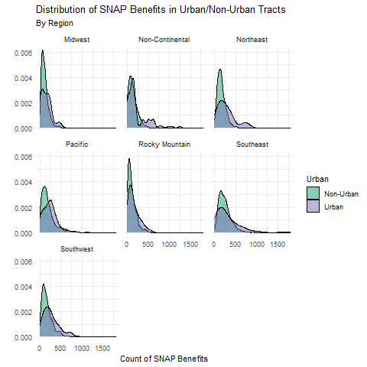
Population Receiving SNAP Benefits

Slide 7
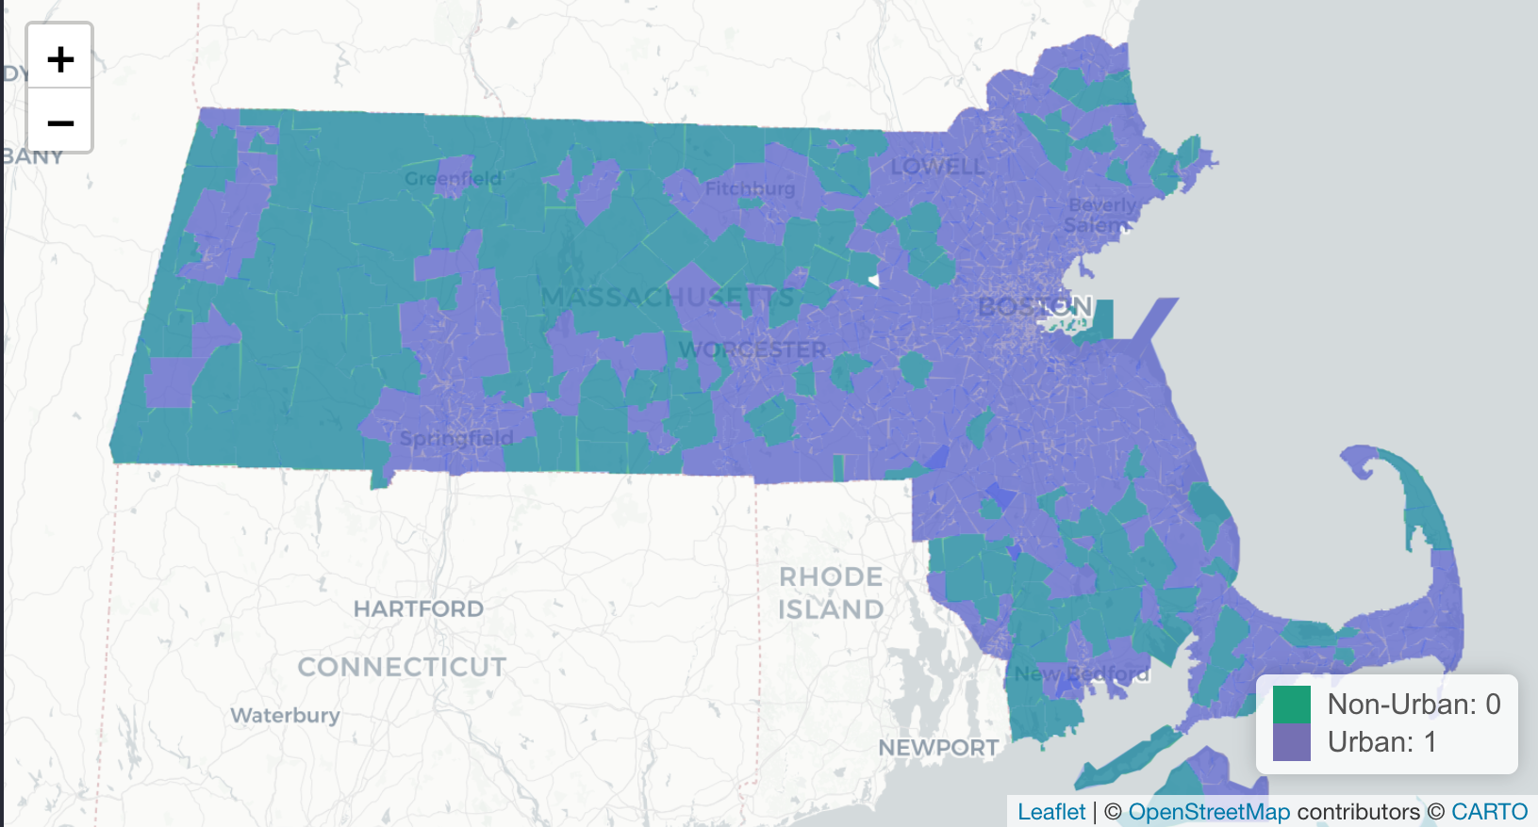
Urban and Non-Urban Census Tracts in Massachusetts
Link to interactive map of Massachusetts census tracts: https://rpubs.com/meganwillis/832592

Slide 8
Analysis
Poverty Rate: The density plot comparing poverty rate in urban and non-urban communities for MA shows that there is significantly more variability in Urban communities, with more Urban census tracts having a much higher poverty rate. The median poverty rate appears to be approximately the same across urban and non-urban areas. This trend is fairly consistent across the different regions, but the Urban communities in the Northeast and Midwest seem to have the most variability in poverty rate between urban and non-urban communities.
Vehicle Access: In Massachusetts, almost all households of the urban households do not have access to a vehicle. There is also a high proportion of non-urban households that do not have access to a vehicle. The majority of MA census tracts are considered Urban (1316 Urban, 151 Non-Urban), which could be affecting these values. The regions across the US have extremely different distribution of tracts with/without vehicle access than is seen in Massachusetts. All of the other regions have mostly households that do have access to a vehicle, and the proportions within each region do not vary much between and urban and non-urban communities.

Slide 9
Analysis
Low Income Population: In Massachusetts, the median value for low income population in urban communities is approximately equal to the median value for low income population in non-urban communities. The values for urban communities are much more variable, with a strong skew the the right. This trend appears to follow for most of the regions across the country. The northeast graph does appear to be slightly bimodal.
Population Receiving SNAP Benefits: In Massachusetts, the median amount of people receiving SNAP benefits appears to be approximately equal across urban and non-urban communities. There is much more variation in urban communities, as is shown by the heavy right skew. This trend seems to hold when looking at the distribution across the regions.

Slide 10
Conclusions
Urban communities seem to be more affected by some factors that could potentially increase food insecurity. This holds in both Massachusetts and in the regions across the United States.
In an effort to combat food insecurity in the US as a whole, our recommendations are focused on increasing accessibility within urban communities.
Potential improvements could include adding more grocery stores in urban communities and increasing options for transportation to grocery stores in urban communities.
Because urban communities have much higher counts for low income population than in non-urban communities, it is important that these transportation options be accessible and affordable, such as buses and subways at reduced prices.

