Slide 1
Voting Patterns Across Elections
Elections dating from 2004-2018
Maude Elovitz and Julia Hartnett
Simmons University
Faculty Sponsor: Dr. Anthony Scotina

Slide 2
Goals of the Project
Inspired by the controversies surrounding the most recent Presidential Election, we were interested in:
Method of voting by race
Method of voting by education
Method of voting counts overall through elections
Method of voting by age group
Method of voting according to swing states
We used the dataset about voting behaviors in the U.S. from the Census Bureau and Bureau of Labor Statistics, provided by the IPUMS organization and curated by ASA.

Slide 3
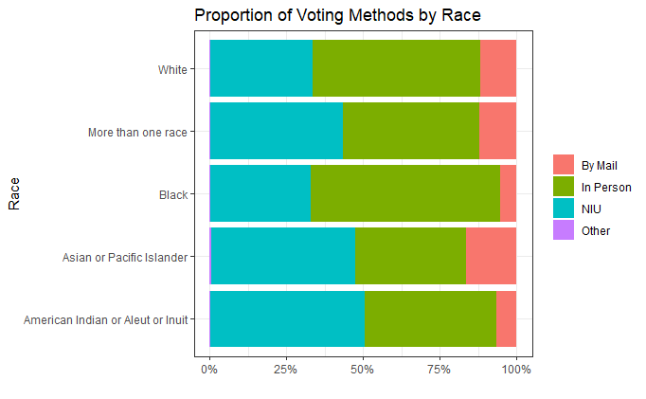
Exploring Method of Voting by Race
Black people and White people have the highest in-person voting proportions
American Indian and Inuit people have the highest NIU* proportions for method of voting
Asian or Pacific Islander have the highest vote by mail proportion across the races
*Not In Universe - Included in the dataset but did not vote

Slide 4
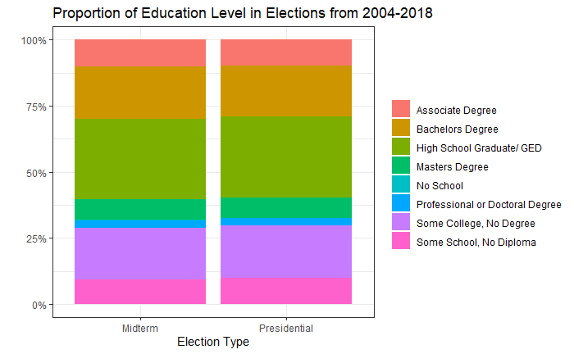
Exploring Voting Patterns within Election Types
The education level with the largest proportion of voters is High School Graduate/GED
The proportions are approximately equal between Midterm and Presidential Elections
We were expecting to see more voters of lower education levels in Presidential elections than Midterms!

Slide 5
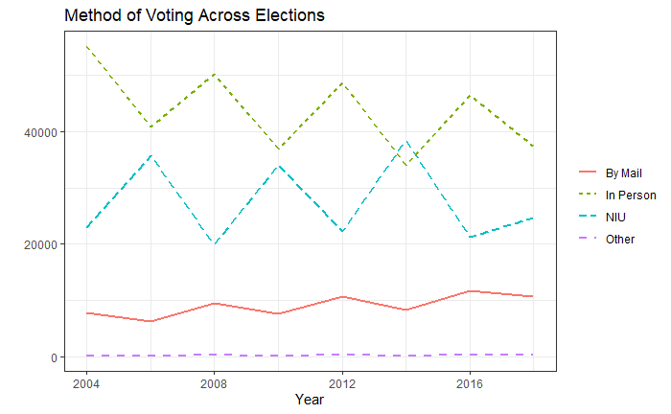
Method of Voting Counts Across Elections
The peaks in the line graph for each method of voting demonstrate higher voting counts in the presidential elections (‘04, ‘08, ‘12, ‘16)
2014 was the only election in which there were more NIU observations than in person voting
Vote by mail stayed consistently lower than both NIU and vote in person throughout all of the elections

Slide 6
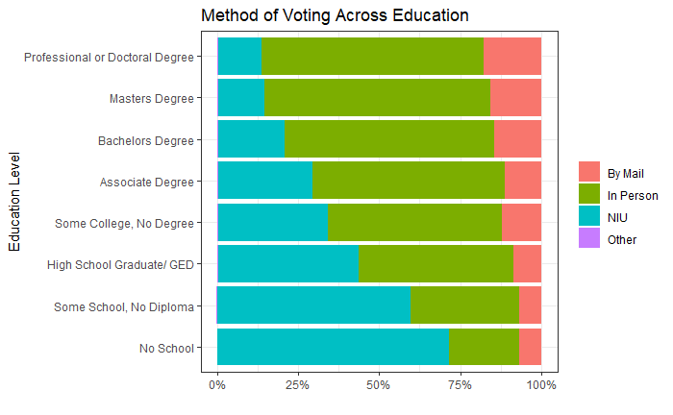
Exploring Method of Voting by Education Level
Using Full Data Set
As level of education increases, starting at No School, proportion of voters increases
Proportion of mail in voting also increases as level of education increases

Slide 7
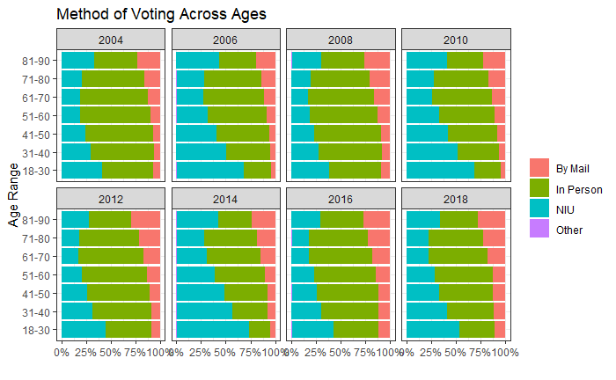
Exploring Method of Voting by Age Group
Displaying Percentages by Year
This graph uses the same data as the previous slide, yet breaks down the data by year
In ‘06, ‘10, ‘14’ and ‘18, we see the largest percentages of NIU’s for the youngest age group, most likely due to the election being a midterm, not presidential
During the years with presidential elections, we see larger percentages of in person voting across the age groups

Slide 8
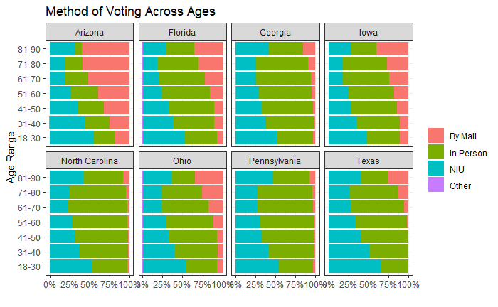
Exploring Method of Voting in Swing States
Displaying percentages by age group and swing states* of method of voting throughout 2004-2018
Most of the swing states have low proportions of Mail in voting
Mail in voting more popular among older age groups than younger age groups
Perhaps due to state restrictions on Mail in voting reasons
The youngest age group has the highest NIU proportion, demonstrating the issue that young voters are not as common as older voters
*Swing states being states in the 2020 Presidential Election that had the candidates within 5% of each other as of 11/3/2020, accoridng to https://projects.fivethirtyeight.com/2020-election-forecast/

Slide 9
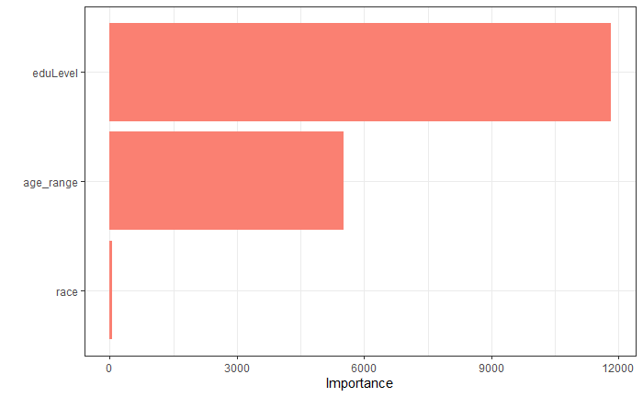
Predictive Model
Predicting Method of Voting according to Age Range, Education Level, and Race
We created a predictive model using decision trees in R
Our model was correct 60% of the time when predicting method of voting
Using an importance plot, we observed that eduLevel had the most influence on the model and race had essentially no influence on the model. Therefore, race can be excluded from the actual predictive model for added simplicity

Slide 10
Conclusion
Education level is a significant predictor to determine if people vote, and how people vote (mail in/in person)
Although mail in voting is not common, there is an association between voting by mail and education level and age range
With the preponderance of mail in voting in the 2020 presidential election, we are curious to see if these voting trends hold with education level and age range

Slide 11
Thanks
maude.elovitz@simmons.edu
julia.hartnett@simmons.edu
anthony.scotina@simmons.edu
Please keep this slide for attribution

