Slide 1


Project 1
by
Maja Gach
Mia Yin
Julia Heller

Slide 2
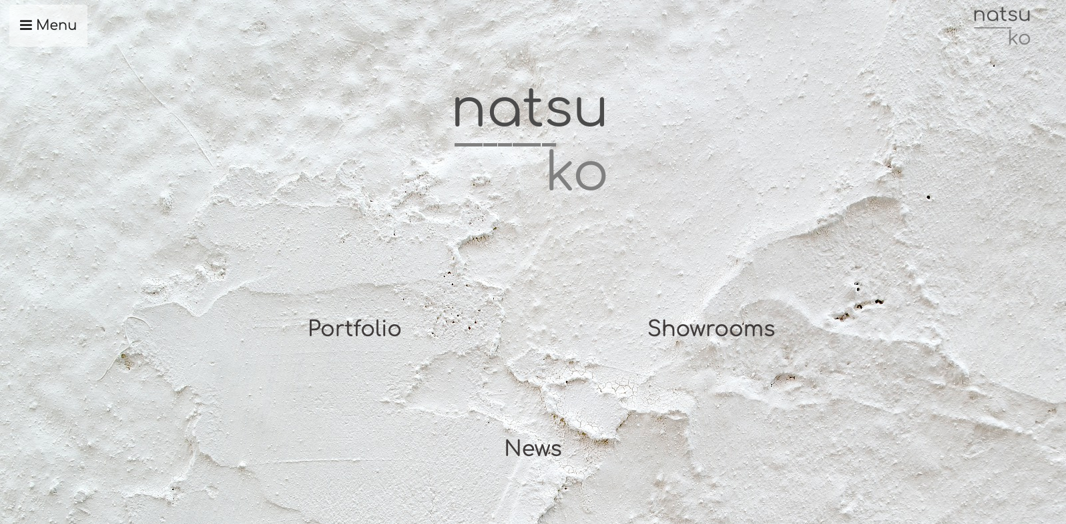
What?
website for a fictive interior design company
online representation of the brand

Slide 3
What?
structure:
HOME + NEWS, PORTFOLIO, SHOWROOMS, CONTACT
LINK

Slide 4
Why?
typical client project
clean and modern design
simple but functional

Slide 5
How?
deside on topic
brainstorm design
design mockup

Slide 6
How?
divide tasks between team
decide on using bootstrap
create and initialize GitHub repository

Slide 7
Live preview

