Slide 1
Fitness & Health Tracking Report
Strategic design improvements for Bellabeat’s Time
Julia Hong
March 2022
The following case study is a hypothetical scenario.

Slide 2
Background
In this scenario, I am a junior data analyst working for Bellabeat, a high-tech company that designs health tracking products for women.
This slide deck includes the high-level results of a data analyst project that I would present to stakeholders. It includes the ask, prepare, share, and act phases of the data analyst steps.
I used R to analyze and visualize the data..
Complete R documentation, including process and analyze phases, can be found on:
GitHub
Kaggle

Slide 3
Business Question
Based on trends in non-Bellabeat smart devices for tracking health data, what trends occur among consumers, and how can they be applied to the Bellabeat Time watch and the company's marketing strategy?

Slide 4
Key Stakeholders
Urška Sršen, one of the two founders of Bellabeat
Data analytics team at Bellabeat

Slide 5
About the Data
Fitbit Fitness Tracker Data was downloaded from Kaggle user Möbius:
Contains 18 CSV files
Activity, intensity, calories, steps, METS (metabolic equivalent of task), heartrate, weight, and sleep by time measures
Based on a crowdsourced survey of up to 33 Fitbit users, April – May 2016
Conducted by Amazon Mechanical Turk, originally published on Zenodo:
Furberg, R., Brinton, J., Keating, M., & Ortiz, A. (2016). Crowd-sourced Fitbit datasets 03.12.2016-05.12.2016. [Data set]. Zenodo. https://doi.org/10.5281/zenodo.53894.

Slide 6
Datasets relevant to activity and sleep
Original Name | Description
dailyActivity_merged.csv | Daily activity measures in wide format, by Id: total distance, total calories, minutes and distances by activity intensities (very, moderate/fair, light, sedentary activities)
hourlyIntensities_merged.csv | Total intensity and average intensity by activity hour (date and time) and Id
hourlyCalories_merged.csv | Total calories by activity hour and Id
hourlySteps_merged.csv | Total steps by activity hour and Id
sleepDay_merged.csv | By Id and sleep day (date and time): total minutes asleep, sleep records, minutes in bed
Furberg et al. 2016

Slide 7
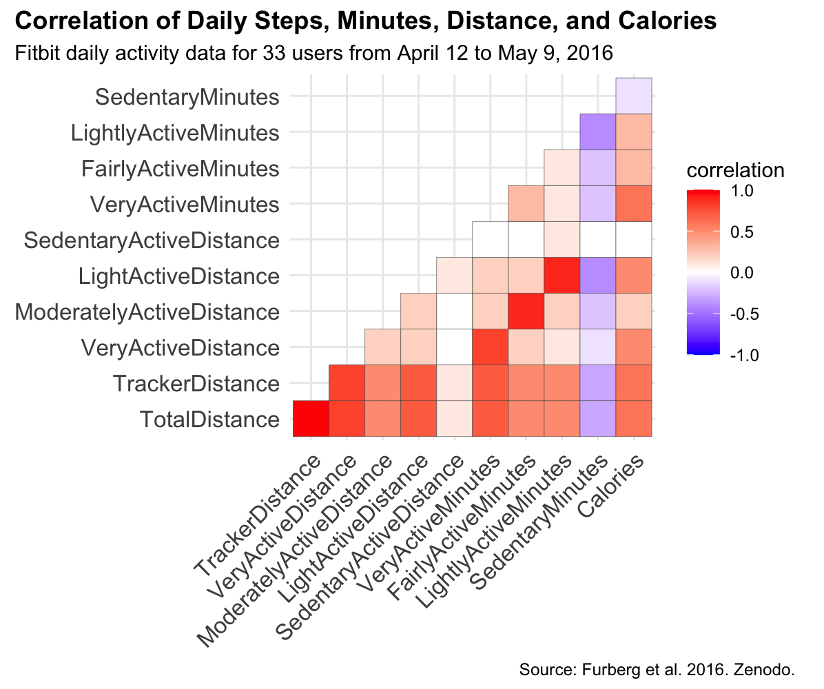
Daily Activity - an overview
Very, moderate/fair, light activity distances and minutes, calories: (+) correlated
Sedentary data: (–) correlated with activity measurements
Won’t be a focus in analysis

Slide 8
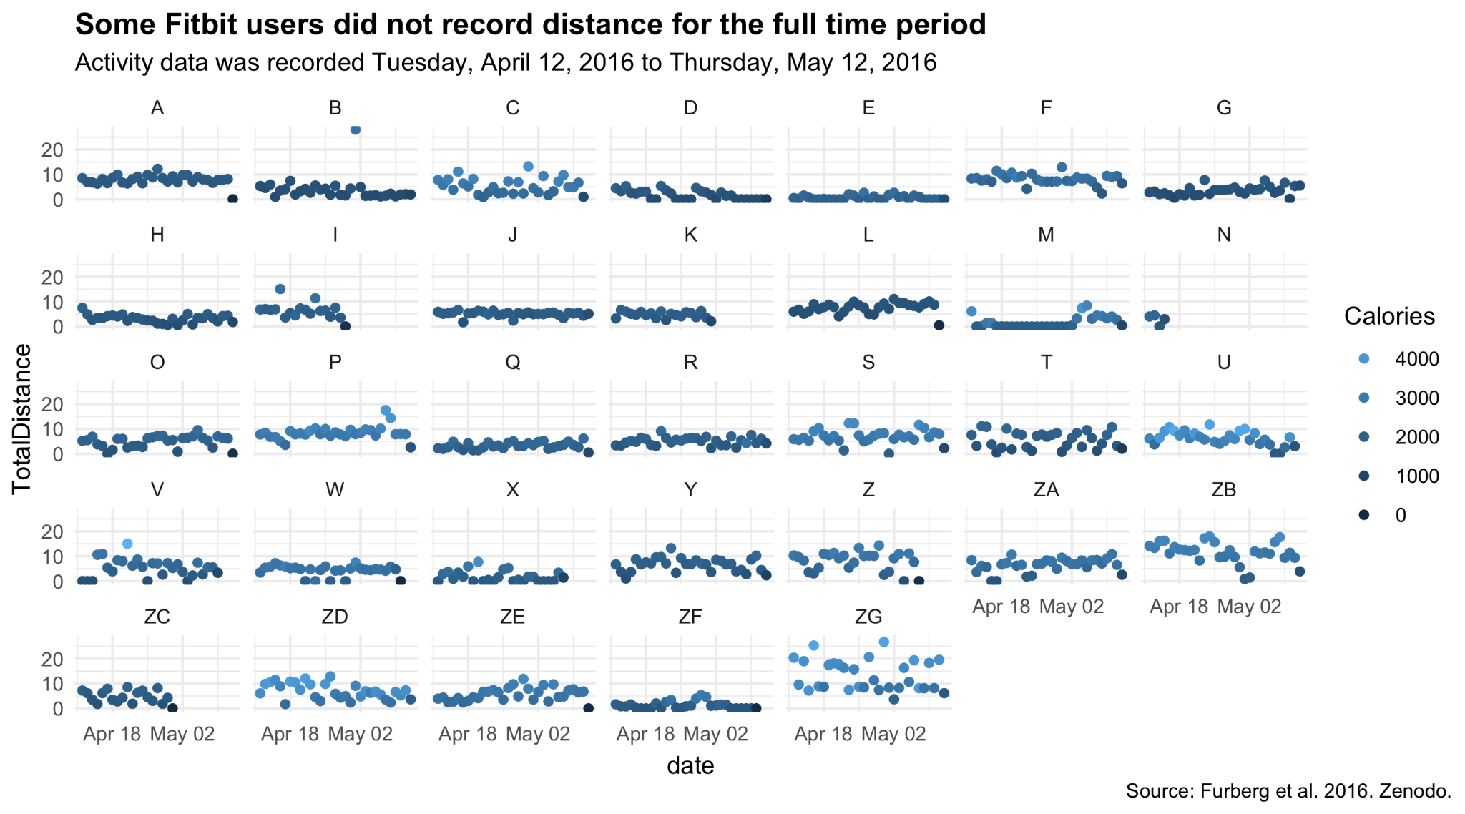
Daily Activity - an overview

Slide 9
Daily activity trends

Slide 10
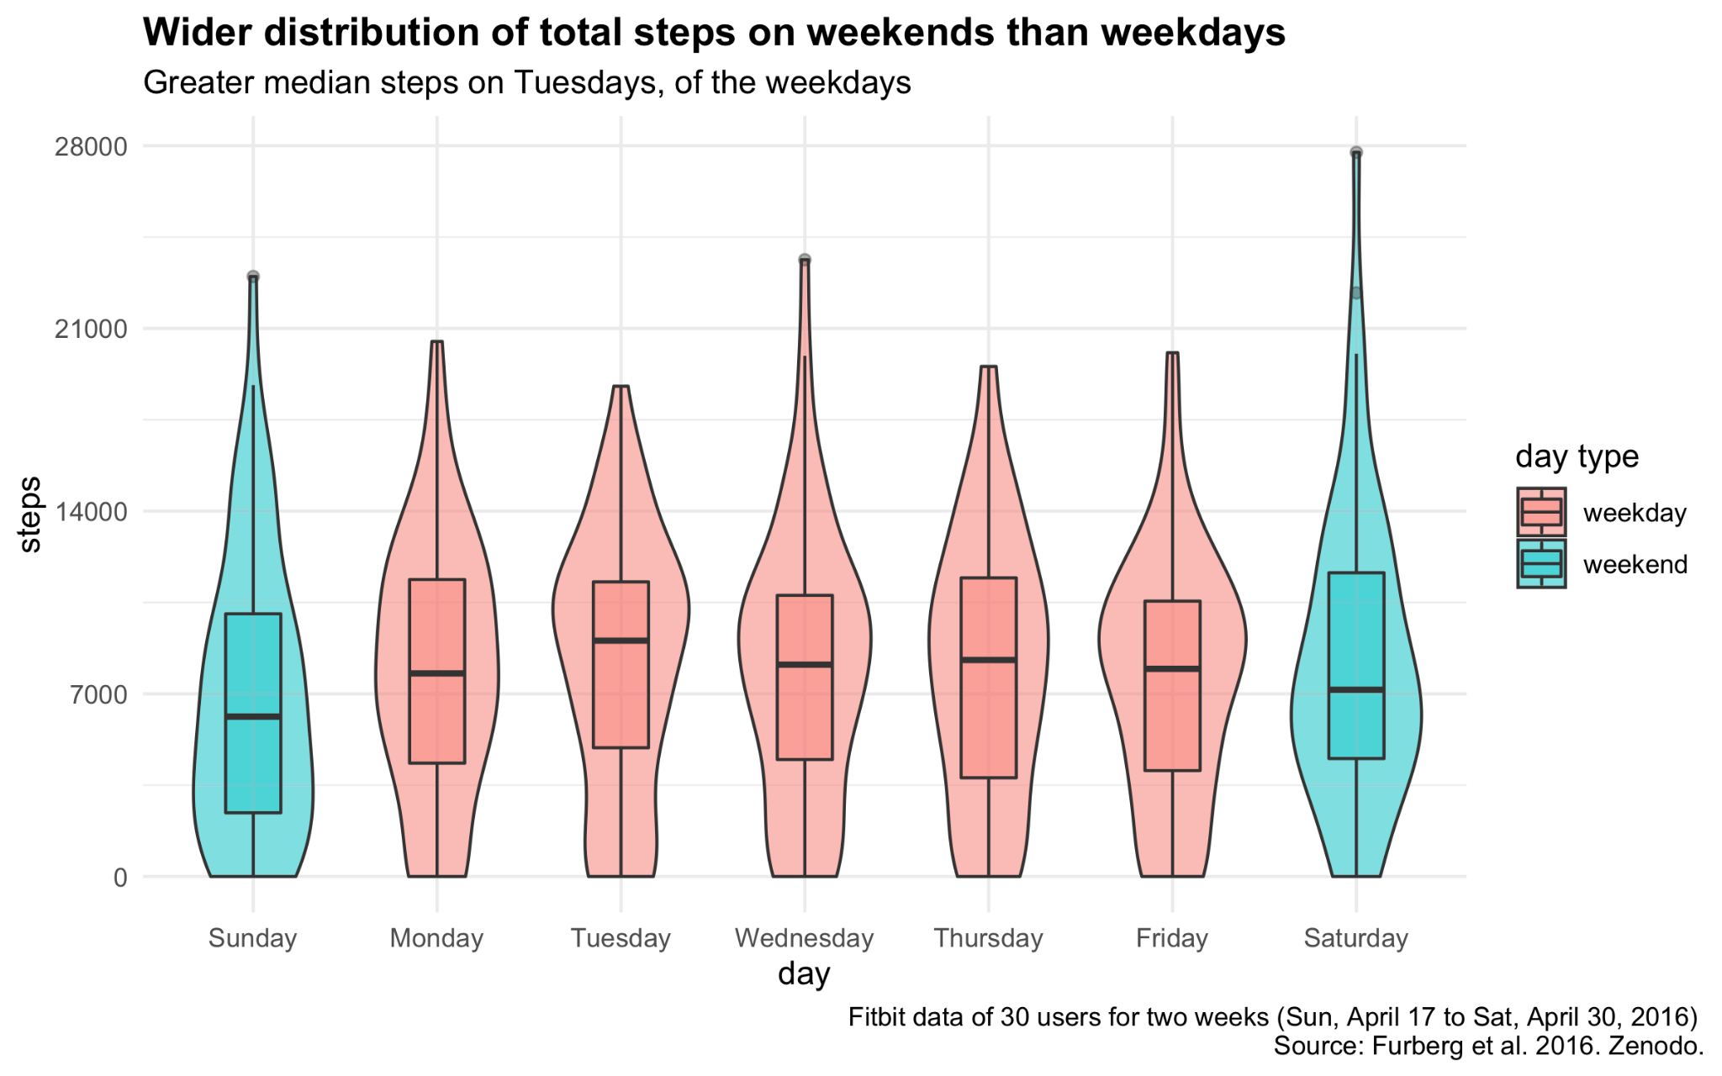

Slide 11
Healthy Recommendations for Weekly Activity
According to the National Health Interview Survey and the CDC, healthy targets for adults:
150+ min per week of light or moderate exercise
75+ min per week of very active exercise

Slide 12
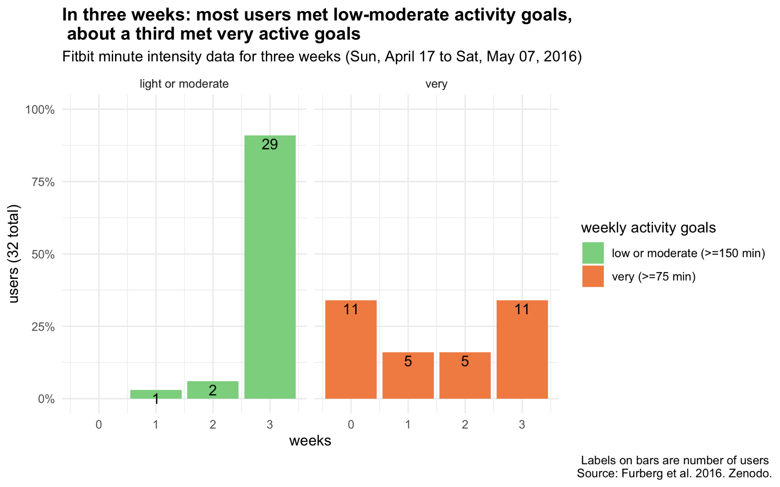

Slide 13
Grouped users by frequency of weekly activity targets
Determined type of exerciser by whether or not they met weekly targets for at least 2 of 3 weeks
Count (n = 32) | Group | Light or moderate | Very active
15 | Light or moderate (only) | 150+ min / wk for 2+ wks | < 75 min / wk for 2+ wks
16 | Light, moderate, or very | 150+ min / wk for 2+ wks | 75+ min / wk for 2+ wks
0 | Very active (only) | <150 min / wk for 2+ wks | 75+ min / wk for 2+ wks
1 | Not active | <150 min / wk for 2+ wks | < 75 min / wk for 2+ wks

Slide 14
Examined activity trends by type of exerciser

Slide 15
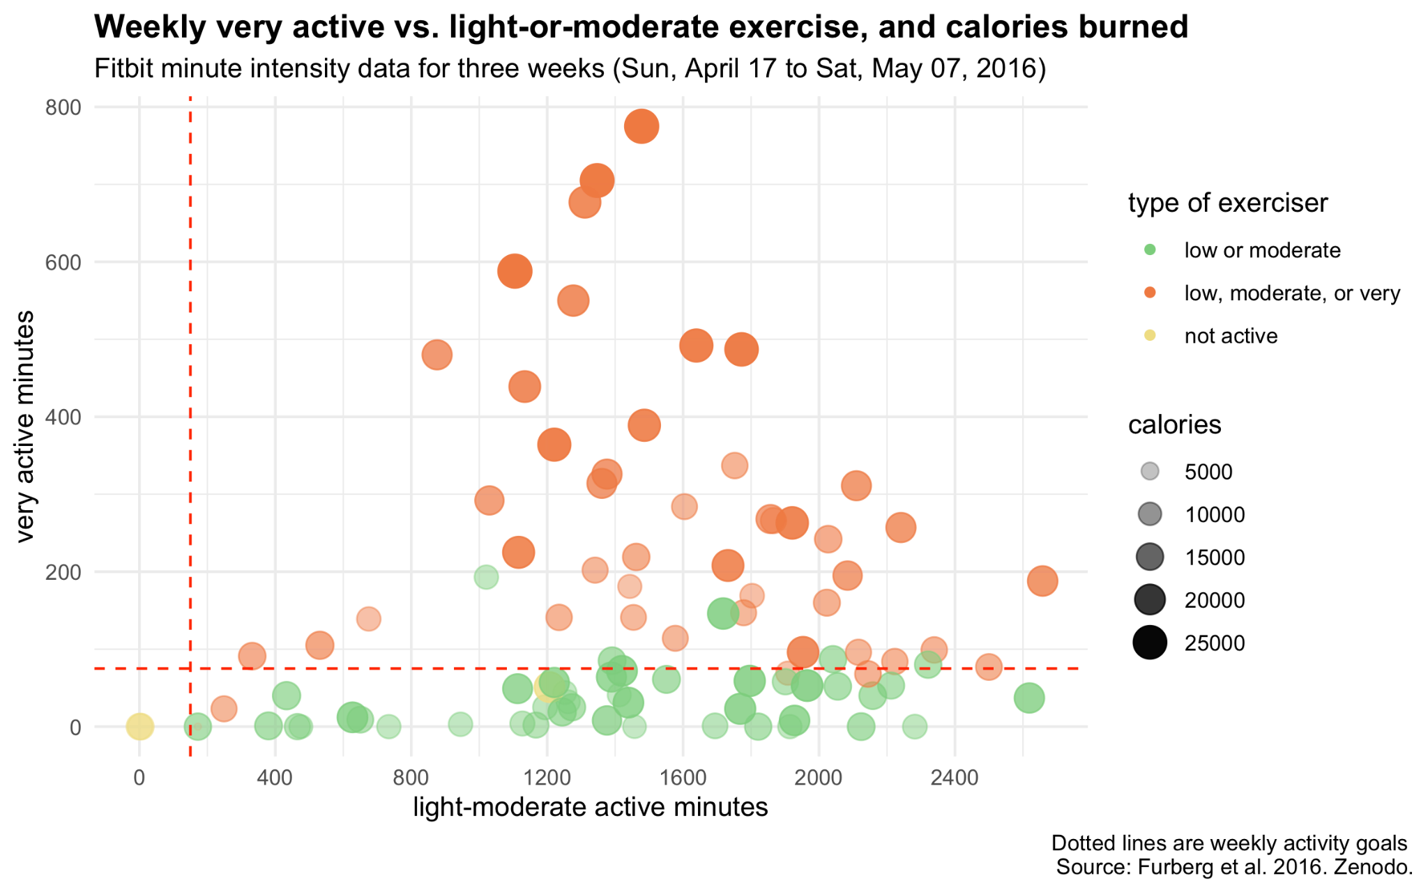

Slide 16
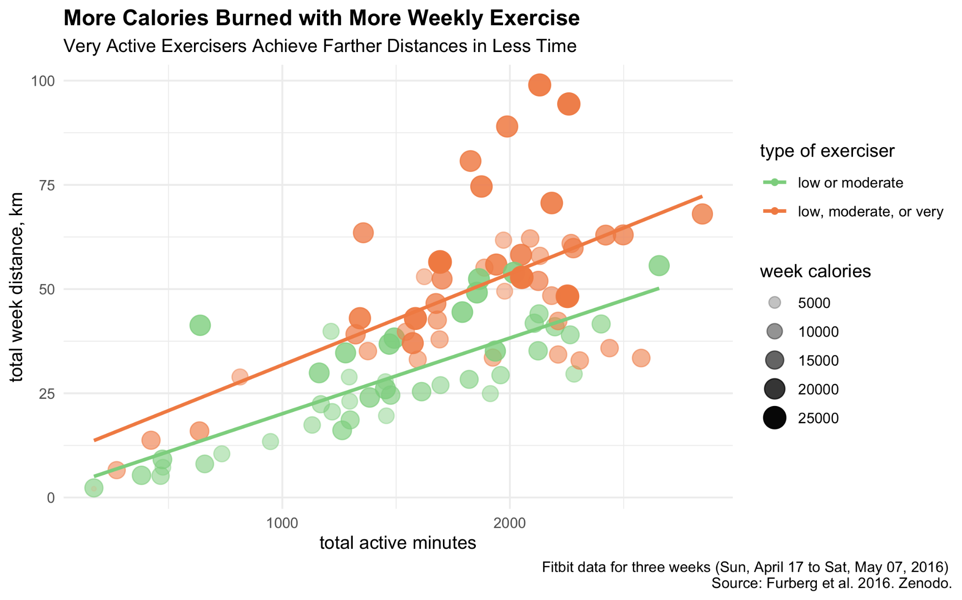

Slide 17
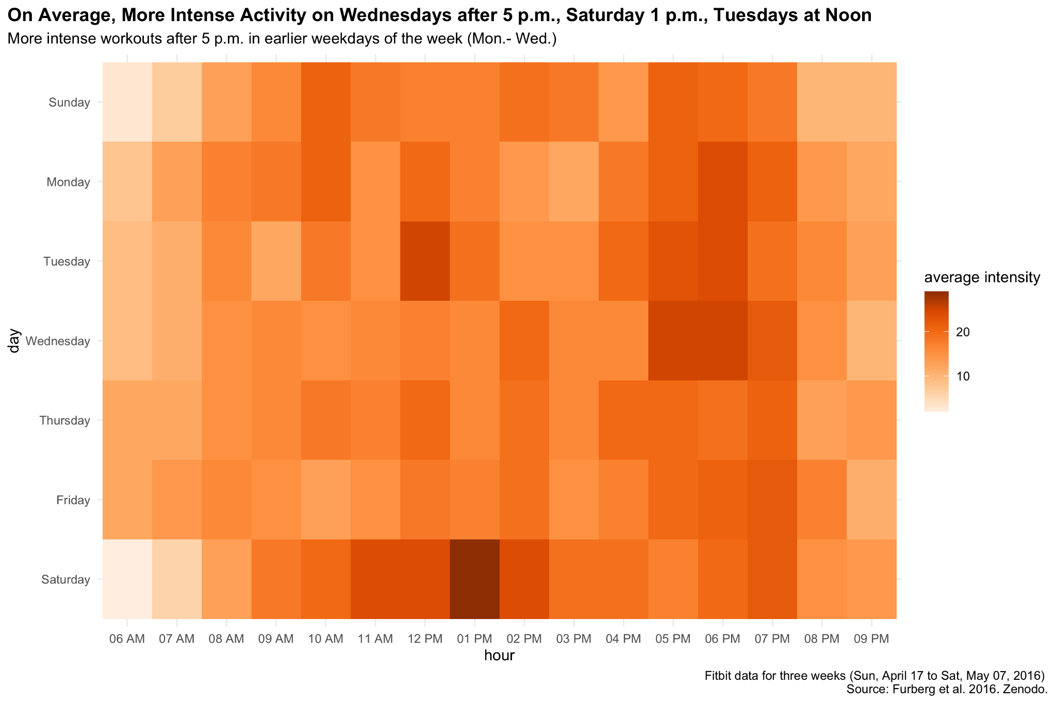

Slide 18
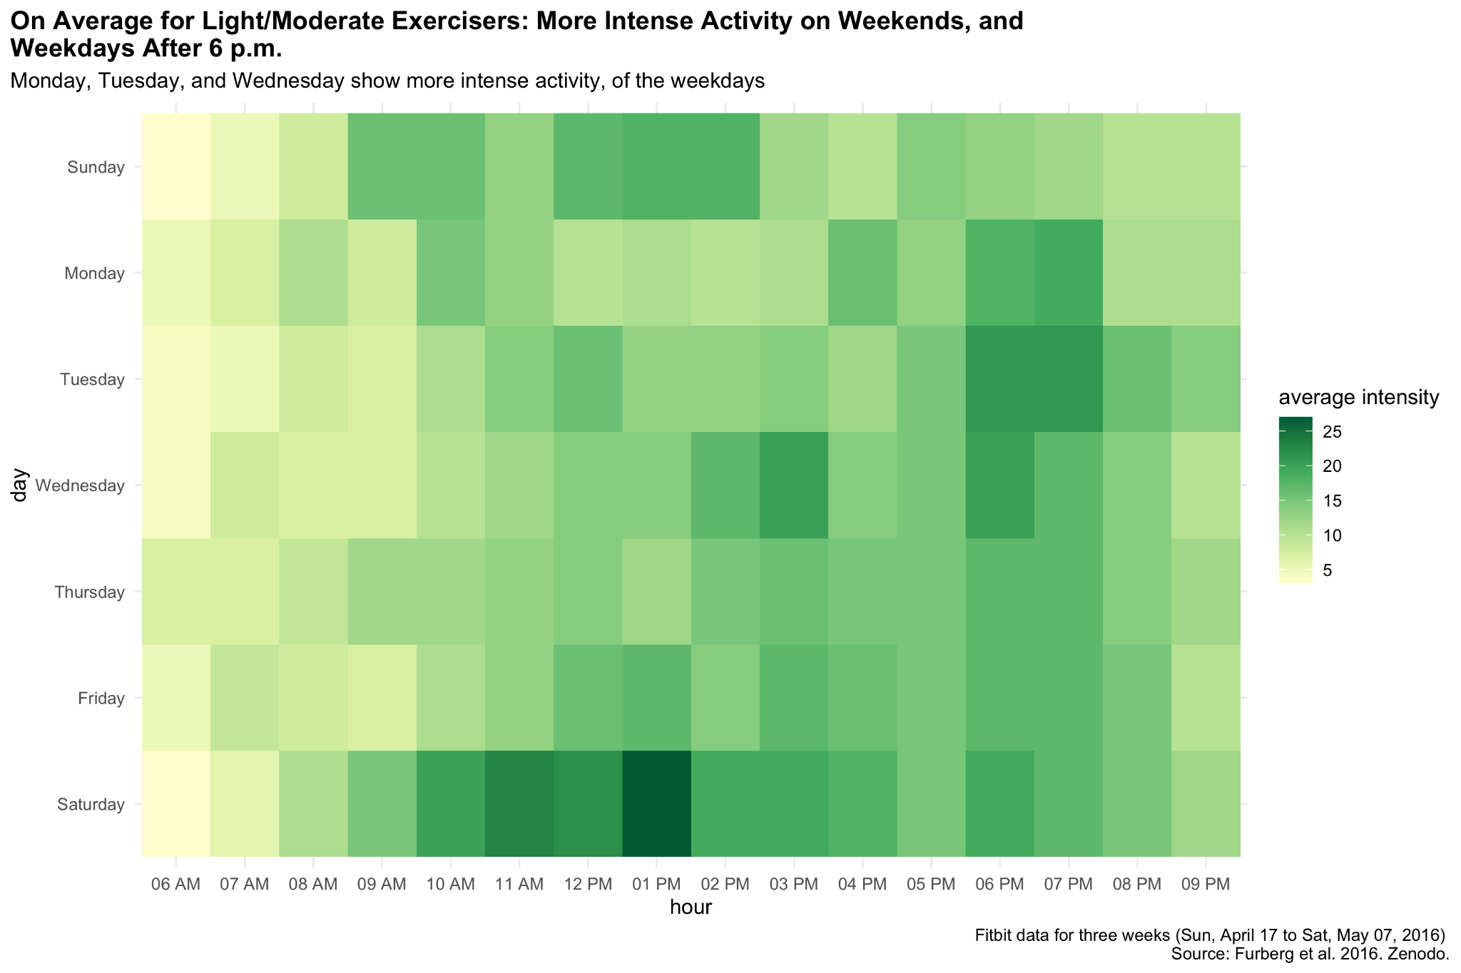

Slide 19
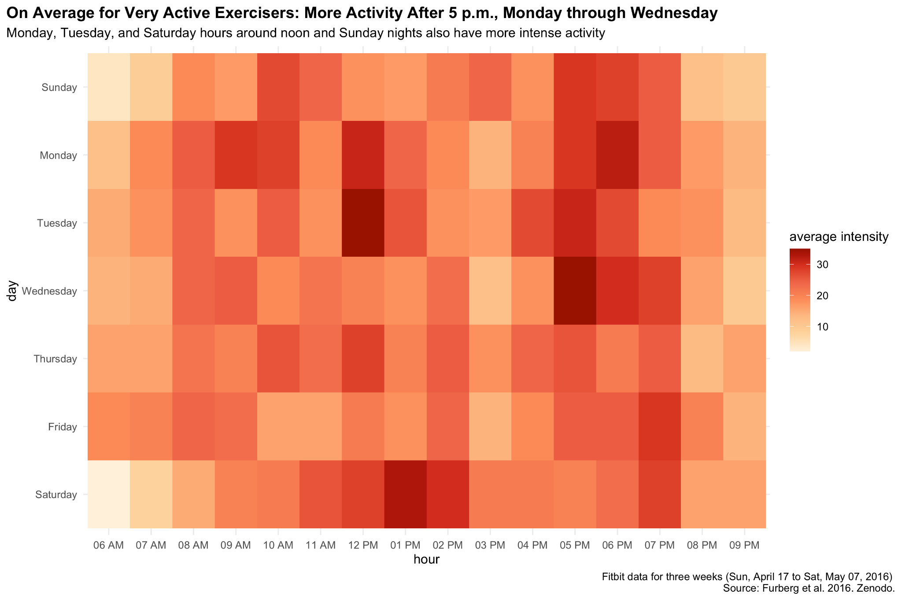

Slide 20
Activity tracking suggestions
Provide a questionnaire for users to determine the type of intensity workouts they plan on doing regularly and an option to set weekly exercise goals
Provide a weekly summary graph to show times of activity intensity per day and weekly totals per type of intensity (light/moderate and very active)
Include a reminder of optimal intensity exercise goals during the week and the difference of time needed to complete that weekly goal, based on exercise intensity time already spent
Give users the option to create hourly exercise schedules with reminder notifications
Suggest optimal exercise hours based on the type of exercise they intend on doing, as answered in their questionnaire

Slide 21
Sleep day trends

Slide 22
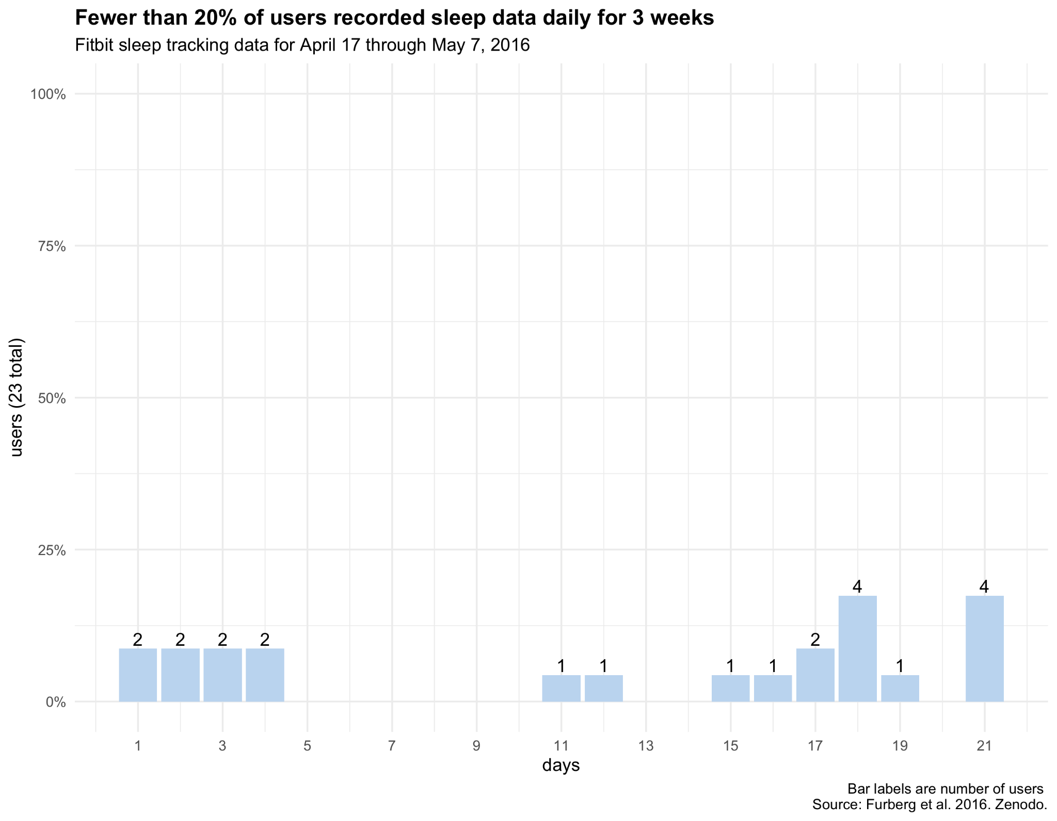
Sleep Day Data - an overview
Variable number of daily sleep records across Fitbit users in 21 days

Slide 23
Healthy sleep recommendations
According to a 2015 study, Watson et al, cited by the CDC, the healthy amount of sleep for an adult is 7 hours or more a night.
Since the sleep data is recorded in minutes, this converts to 420+ minutes a night.

Slide 24
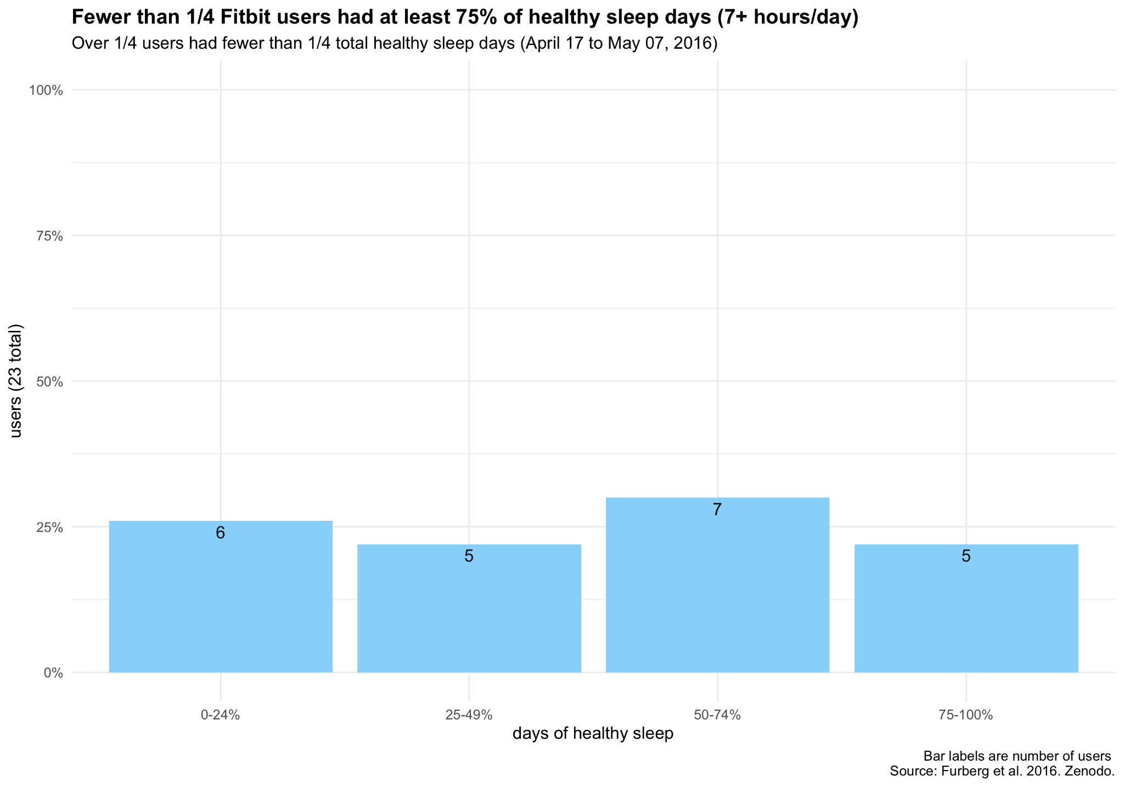

Slide 25
Sleep tracking questions
Are there ways to improve user consistency for wearing the tracker while sleeping?
How do we encourage users to sleep at least 7 hours per day?

Slide 26
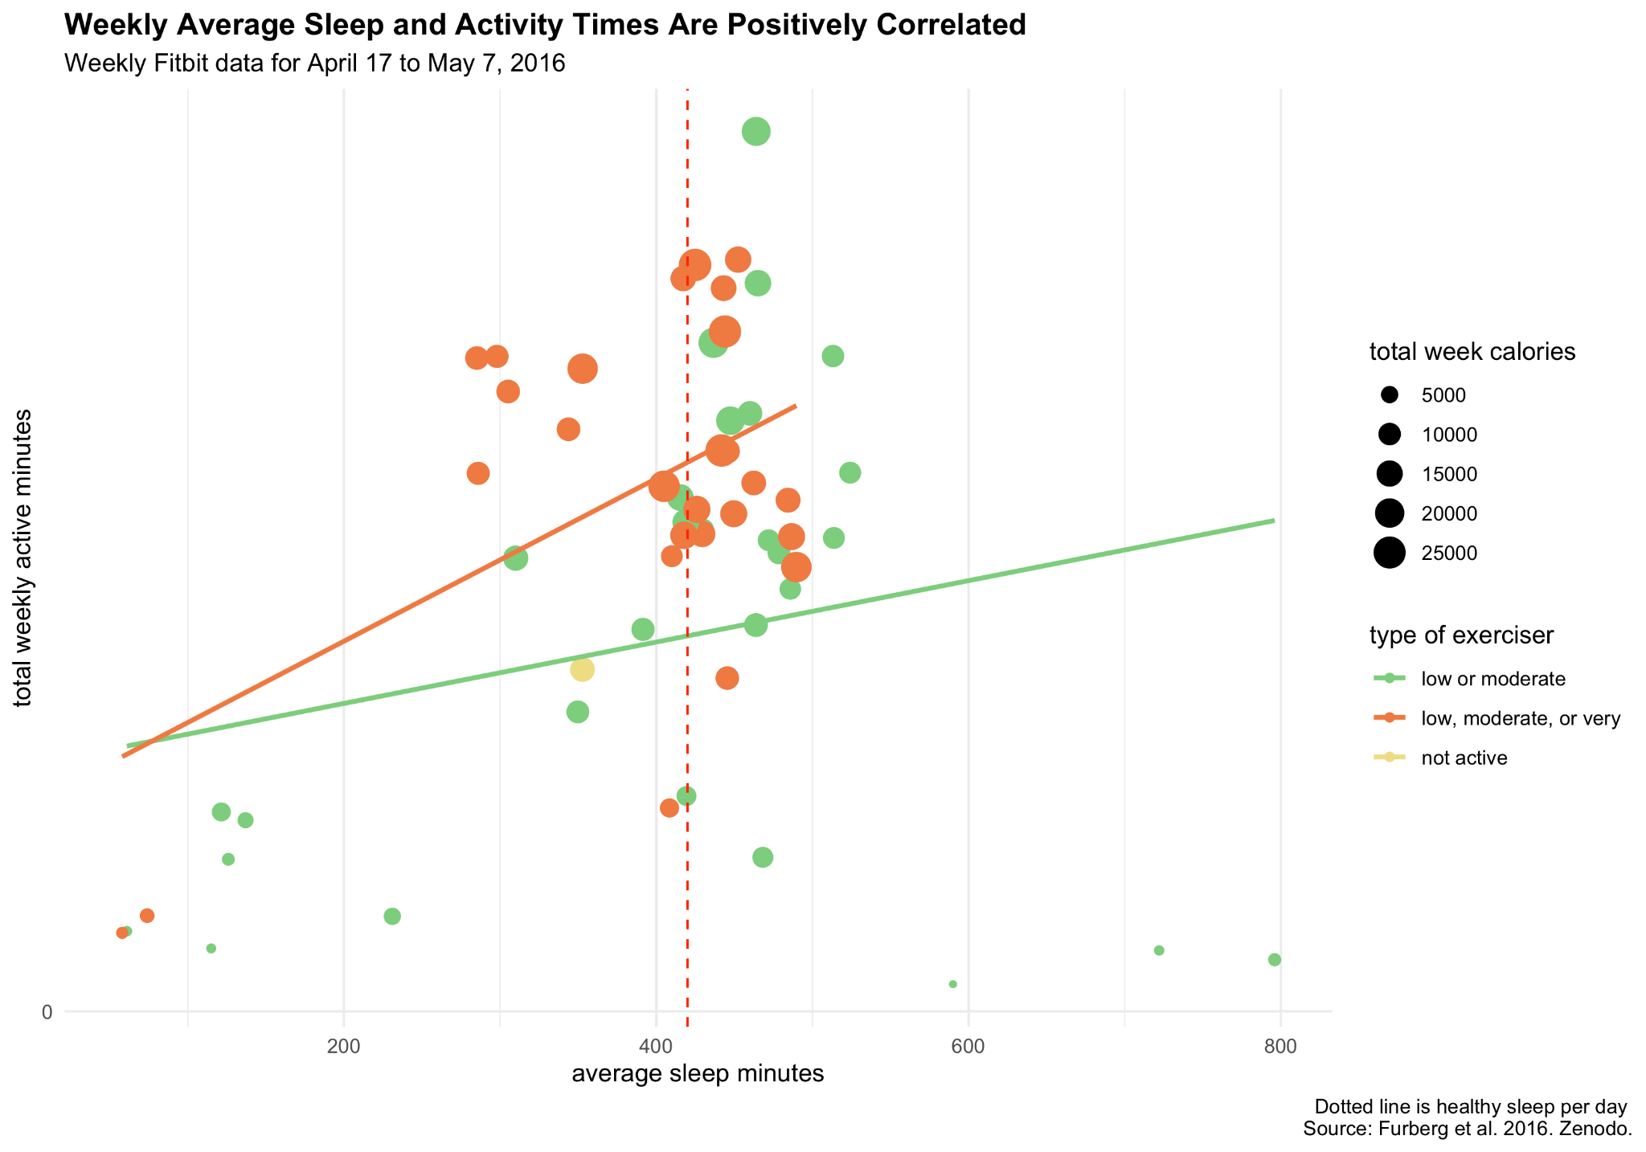

Slide 27
Sleep tracking suggestions
Create an optional sleeping tracking ring to act as a companion to the Time watch. The ring is a smaller wearable option that could encourage users to wear a tracking device daily when sleeping.
Provide the option of daily notifications to remind users to wear the watch while sleeping
Allow users to select optimal sleep and waking times and set reminders to go to bed by that certain time
Inform users of the benefits of healthy amounts of sleep, correlated with more weekly exercise

Slide 28
References
Furberg, R., Brinton, J., Keating, M., & Ortiz, A. (2016). Crowd-sourced Fitbit datasets 03.12.2016-05.12.2016. [Data set]. Zenodo. https://doi.org/10.5281/zenodo.53894. Retrieved from https://www.kaggle.com/arashnic/fitbit.
National Health Interview Survey (NHIS), Centers for Disease Control and Prevention (CDC) / National Center for Health Statistics (NCHS). (2022). Physical Activity. Retrieved from https://www.healthypeople.gov/2020/topics-objectives/topic/physical-activity/national-snapshot.
CDC. (2022) Physical Activity. Retrieved from https://www.cdc.gov/physicalactivity/basics/adults/index.htm.
Watson NF, Badr MS, Belenky G, et al. Recommended amount of sleep for a healthy adult: a joint consensus statement of the American Academy of Sleep Medicine and Sleep Research Society. Sleep. 2015;38(6):843–844. http://dx.doi.org/10.5665/sleep.4716.

