Slide 1
Applications of Gaussian Processes in Modelling Biological Collectives
Julia Klein, Master Thesis
Konstanz, 07.10.2021
Supervisors
Jun.-Prof. Dr. Tatjana Petrov
Dr. Matthias Rupp

Slide 2
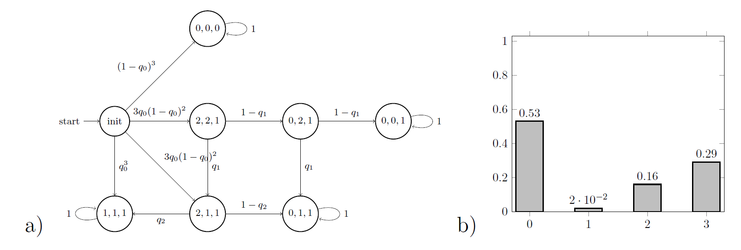
Background
Modelling Biological Collectives
Population Markov Chain to model stochastic behaviour of biological populations
Individual behaviours represented by parameters of Markov Chain
Problem: We can only observe the state of the whole population, but want to analyse individual decisions

Slide 3
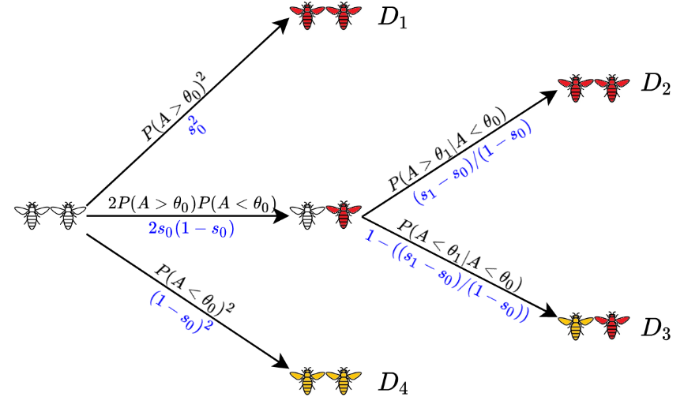
Background
Case Study: Social feedback in population of honeybees
Colony of bees is exposed to a threat: each bee may become aggressive, sting and die, or do nothing
Alarm pheromone P is released during stinging and increases aggressiveness of other bees
What is the mechanism that prevents the colony from becoming extinct? How is the individual bee influenced by the other bees?
N experiments with colony of n bees: outcome is number of stinging (dead) bees

Slide 4
Research Questions
#1 What is the fitness function of the bee colony used to optimize the collective behaviour?
→ Is there a pattern over colonies of different sizes, f.ex. 20% of the colony survives?
#2 Is the probability for a single bee to sting in a specific scenario the same in two colonies of different sizes?
→ Is the bee only physically affected by the amount of pheromone or also socially by its group members?

Slide 5
Motivation
Overall Goal
Learn parameters of local behaviours from data measurements and fitness of collective
Find method that is
model agnostic: applicable to different models with different assumptions
data-efficient: predictions when only sparse data is available
scalable: predictions for larger colony sizes, where stochastic models quickly become too difficult
Notes:
Model agnostic: also other case studies, f.ex. Consensus protocol

Slide 6
Gaussian Process
Gaussian Process Regression (GPR)
Non-parametric, Bayesian approach to describe, learn and optimize unknown functions
Kernel-based probabilistic model
Output provides quantification of uncertainty
Gaussian Process = generalization of multivariate Gaussian to infinite dimension to describe distribution over functions
f(x) ~ GP(m(x), k(x,x‘))
Kernel function k as similarity measure to define covariance matrix
Notes:
A GP is completely specified by a mean function m and a covariance function k of a real process f(x)
Kernel is real-valued function, describes shape of distribution and characteristics
Performs better than standard methods

Slide 7
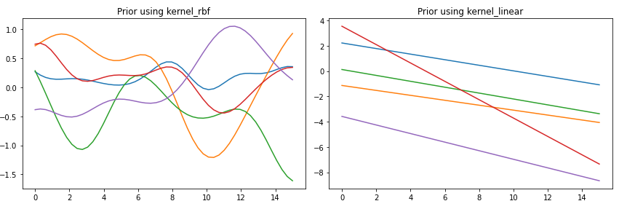
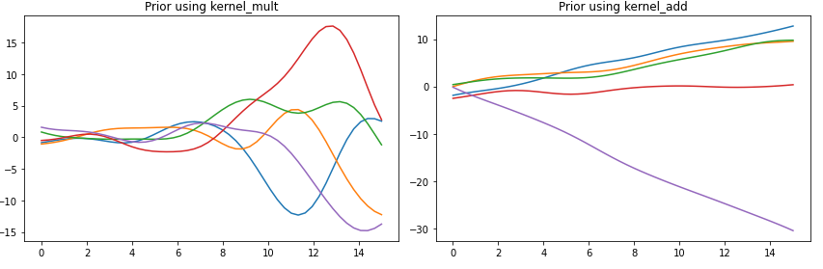
GPR Example
Define Prior
Apply Kernel function k to test points before observing data
Notes:
Evaluate Kernel on each pairwise combination of set of points
Generate random Gaussian vector (mean 0 and cov as described) to sample 5 functions from each Prior

Slide 8
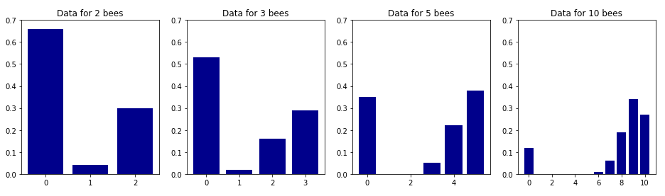




GPR Example
Observe data
Calculate mean number of stinging bees for each histogram
$$\overline{x}=0.64$$
$$\overline{x}=1.21$$
$$\overline{x}=2.93$$
$$\overline{x}=7.76$$
Notes:
Data from real experiments, collect in histogram

Slide 9


GPR Example
Derive Posterior
Joint distribution of training and test outputs:
Condition the joint Gaussian Priors on the observations to get posterior:
Evaluate mean and covariance and generate samples
Notes:
Training set X and f (= observations)
Given test set X* and training data X f, we want to predict function outputs f*

Slide 10
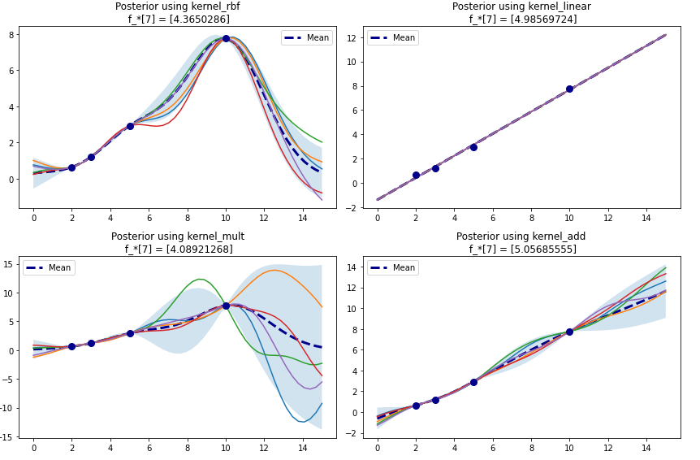
GPR Example
Derive Posterior
Notes:
Shaded area = 95% confidence region (as 2 std)
We didn‘t include any noise -> all functions go directly through training points

Slide 11
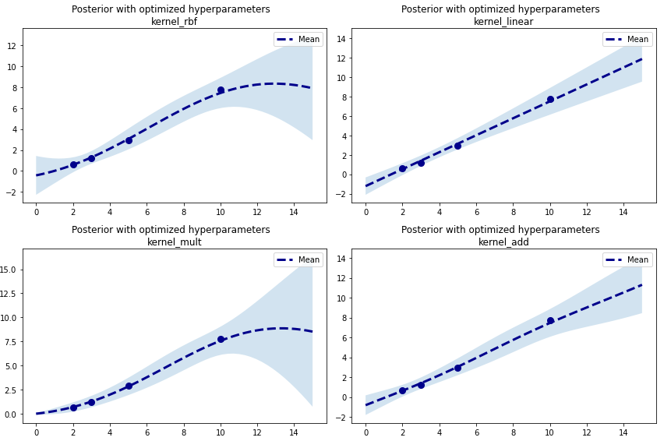
GPR Example
Assume noisy observations and optimize hyperparameters of kernel
Minimize negative log marginal likelihood
Notes:
Noise variance added to each observation (since we do not have perfect measurements)

Slide 12
GPR Example
Evaluation
Leave-one-out cross-validation to select kernel
Good for small sample size
Compute test error on held out point and average test errors
Here: linear kernel performs best
Overall goal: Learn parameters of local behaviours from data measurements and fitness of collective
First step to predicting the response of collective from data measurements
Notes:
Performs better than standard methods
We can predict the mean of the histograms, but what can we use that for? We first want to derive the fitness of the collective

Slide 13
Fitness function
What is the probability that at least 70% of bees survive?
Robustness of the system: property is preserved for changing population sizes
1) Find mean and variance prediction of histogram using GPR
Assume functional form of histogram (f.ex. normal)
Compute robustness using the predictions
2) Directly read probability of satisfying property from histogram
Find probability (robustness) using GPR
Notes:
Probably 1) assuming a functional form is not the best strategy

Slide 14
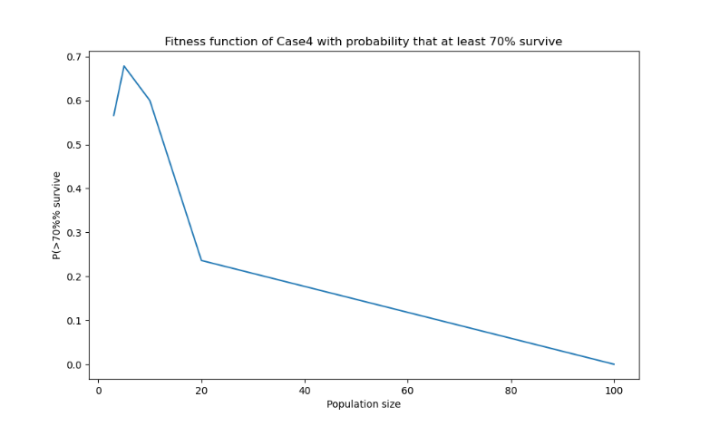
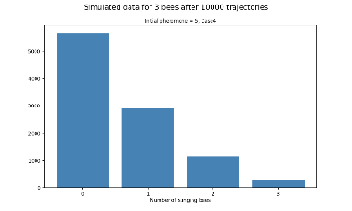
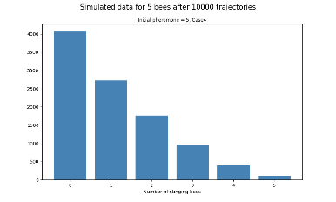
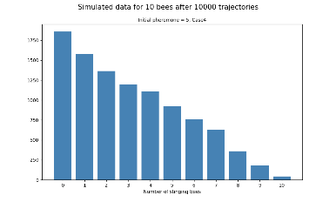
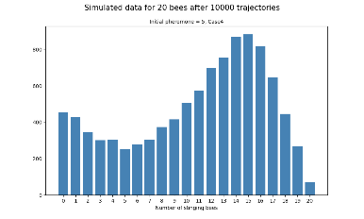
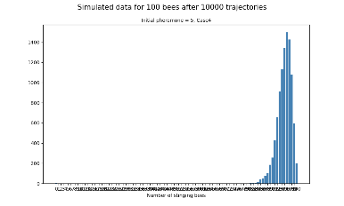
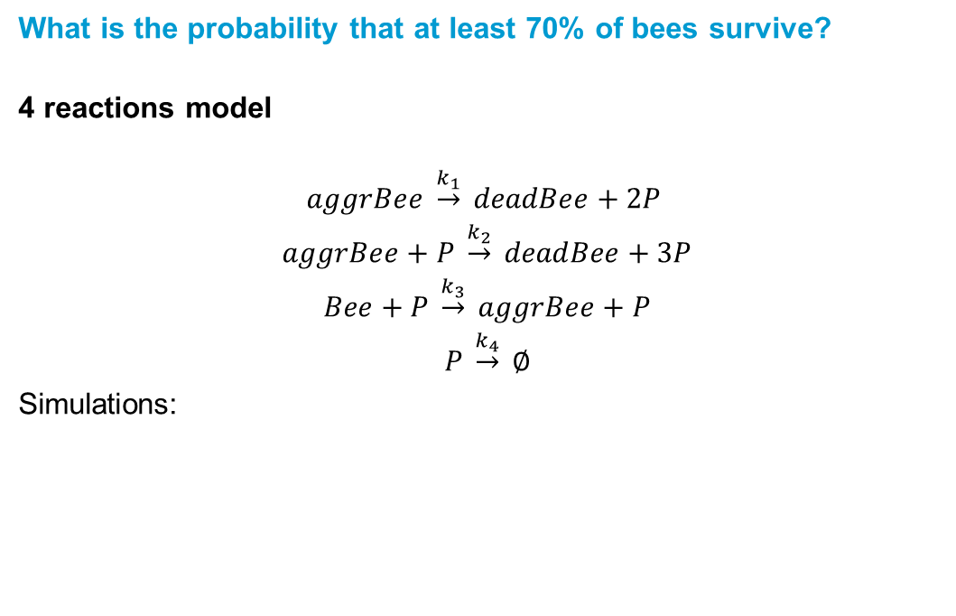
Fitness function
What is the probability that at least 70% of bees survive?
4 reactions model
$$aggrBee \underset{→}{k_{1}} deadBee+2P$$
$$aggrBee+P \underset{→}{k_{2}} deadBee+3P$$
$$Bee+P \underset{→}{k_{3}} aggrBee+P$$
$$P \underset{→}{k_{4}} ∅$$
Simulations:
[1]
3 bees
5 bees
10 bees
20 bees
100 bees
[1] Repin, D. and Petrov, T. (2021)
Notes:
Implemented by Denis Repin
Eventually all bees die → not reasonable! There is a mechanism that prevents the colony from becoming extinct
Fitness function decays, what do we need to do to make it more steady?

Slide 15
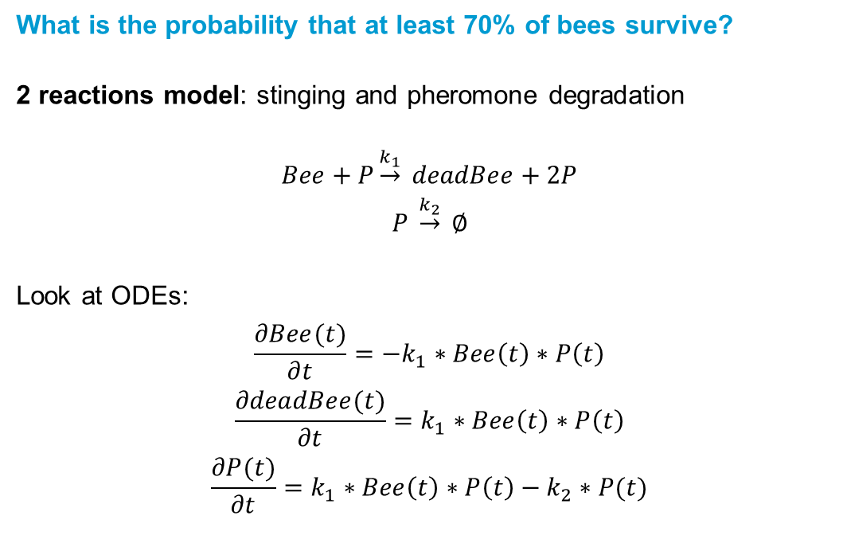
Fitness function
What is the probability that at least 70% of bees survive?
2 reactions model: stinging and pheromone degradation
$$Bee+P\underset{→}{k_{1}} deadBee+2P$$
$$P \underset{→}{k_{2}} ∅$$
Look at ODEs:
$$\frac{∂Bee(t)}{∂t}=−k_{1}∗Bee\left(t\right)∗P\left(t\right)$$
$$\frac{∂deadBee(t)}{∂t}=k_{1}∗Bee\left(t\right)∗P\left(t\right)$$
$$\frac{∂P(t)}{∂t}=k_{1}∗Bee\left(t\right)∗P\left(t\right)−k_{2}∗P(t)$$

Slide 16
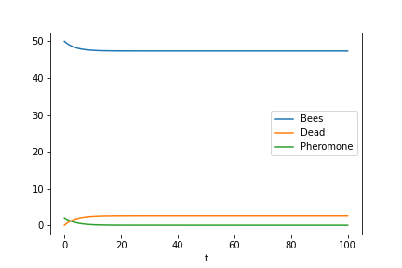
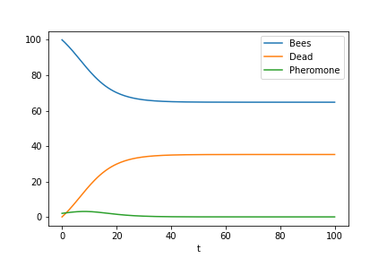
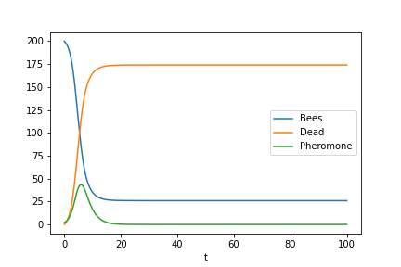
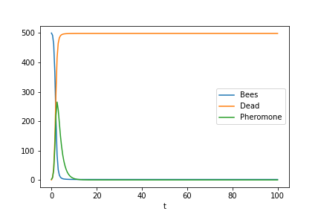
Fitness function
What is the probability that at least 70% of bees survive?
2 reactions model
Solution of ODEs
k₁=0.007, k₂=0.6
50 bees
100 bees
200 bees
500 bees

Slide 17
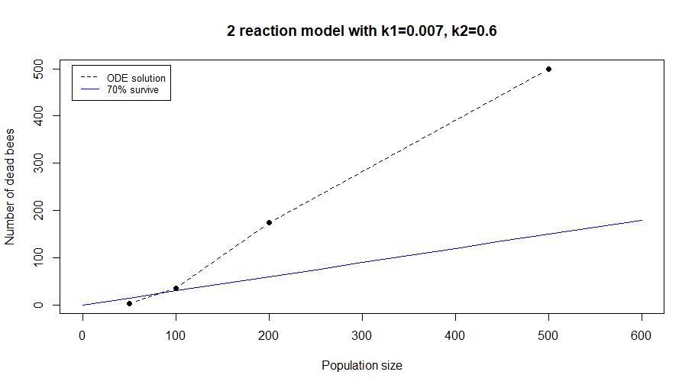
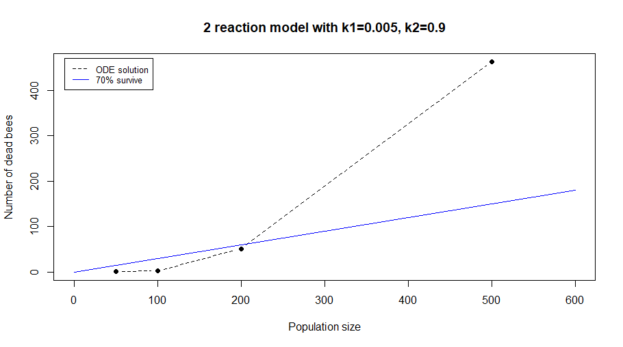
Fitness function
What is the probability that at least 70% of bees survive?

Slide 18
Discussion
Outlook
Predicting only the mean value of a histogram is not enough
Find plausible fitness function
Derive fitness function from histograms to learn about individual behaviours
Notes:
GPR is powerful method to make predictions and quantify uncertainty

