Slide 1
Applications of Gaussian Processes in Modelling Biological Collectives
Julia Klein, Master Thesis
Konstanz, 24.11.2021
Supervisors
Jun.-Prof. Dr. Tatjana Petrov
Dr. Matthias Rupp

Slide 2
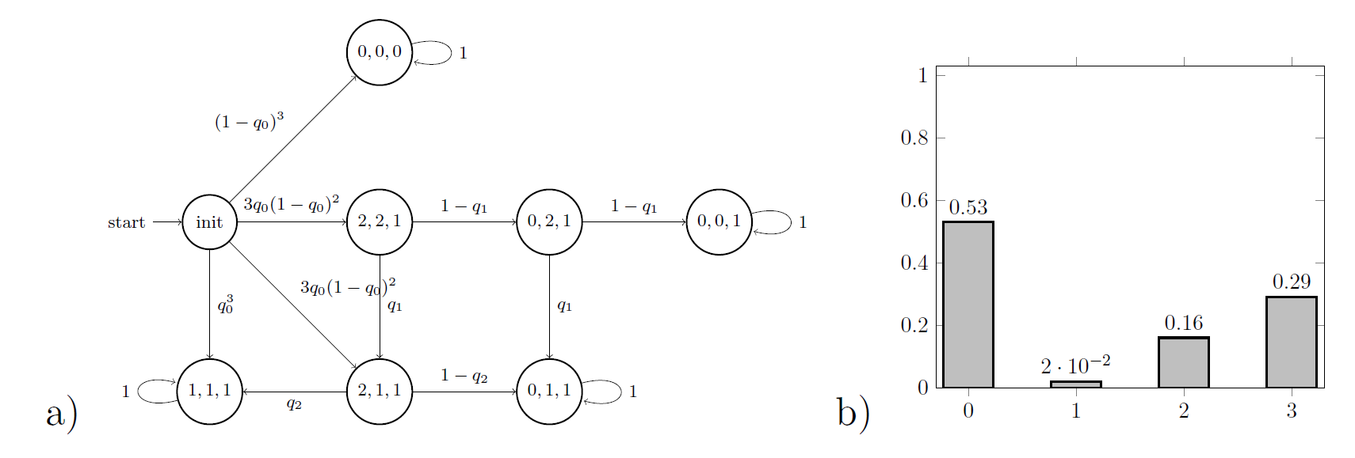
Background
Modelling Biological Collectives
Population Markov Chain to model stochastic behaviour of biological populations
Individual behaviours represented by parameters of Markov Chain
Problem: We can only observe the state of the whole population, but want to analyse individual decisions
Notes:
Steady-states of chain refer to final states of agents
Observe distribution of final states

Slide 3
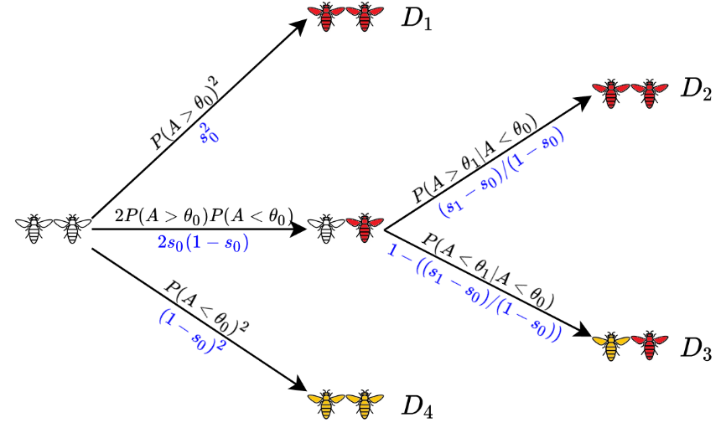
Background
Case Study: Social feedback in population of honeybees
Colony of bees is exposed to a threat: each bee may become aggressive, sting and die, or do nothing
Alarm pheromone P is released during stinging and increases aggressiveness of other bees
What is the mechanism that prevents the colony from becoming extinct? How is the individual bee influenced by the other bees?
N experiments with colony of n bees: outcome is number of stinging (dead) bees
Notes:
To explain in more detail what we do, I introduce one case study
But: aggressiveness doesn‘t increase endlessly, because then all bees would eventually die

Slide 4
Research Questions
#1 What is the fitness function of the bee colony used to optimize the collective behaviour?
→ Is there a pattern over colonies of different sizes, f.ex. 20% of the colony survives?
#2 Is the probability for a single bee to sting in a specific scenario the same in two colonies of different sizes?
→ Is the bee only physically affected by the amount of pheromone or also socially by its group members?
Notes:
Predict Collective response
Infer Individual behaviour

Slide 5
Motivation
Overall Goal
Learn parameters of local behaviours from data measurements and fitness of collective
Find method that is
model agnostic: applicable to different models with different assumptions
data-efficient: predictions when only sparse data is available
scalable: predictions for larger colony sizes, where stochastic models quickly become too difficult
Notes:
Model agnostic: also other case studies, f.ex. Consensus protocol
This sounds like Machine Learning

Slide 6
Gaussian Process
Gaussian Process Regression (GPR)
Non-parametric, Bayesian approach to describe, learn and optimize unknown functions
Kernel-based probabilistic model
Output provides quantification of uncertainty
Gaussian Process = generalization of multivariate Gaussian to infinite dimension to describe distribution over functions
f(x) ~ GP(m(x), k(x,x‘))
Kernel function k as similarity measure to define covariance matrix
Notes:
Non-parametric: without specifying underlying distribution
GP completely specified by mean function and covariance matrix of a real process f(x)
Kernel describes shape of distribution and characteristics; can also add and multiply different kernels -> flexible

Slide 7
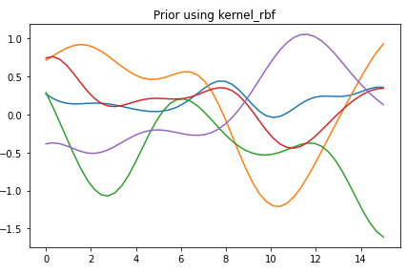
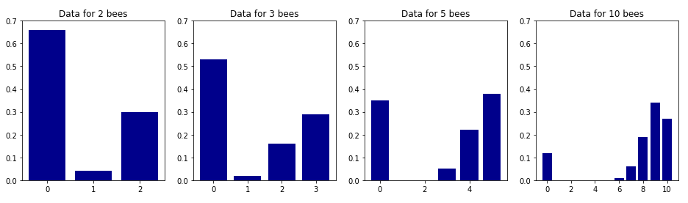




GPR Example
Define Prior
Apply Kernel function k to test points
Observe data
$$\overline{x}=0.64$$
$$\overline{x}=1.21$$
$$\overline{x}=2.93$$
$$\overline{x}=7.76$$
Notes:
Evaluate Kernel on each pairwise combination of set of points
RBF: sigma^2 exp(-||x-x*||^2 / 2l^2)
Generate random Gaussian vector (mean 0 and cov as described) to sample 5 functions from each Prior
Data: Calculate mean number of stinging bees for each histogram

Slide 8
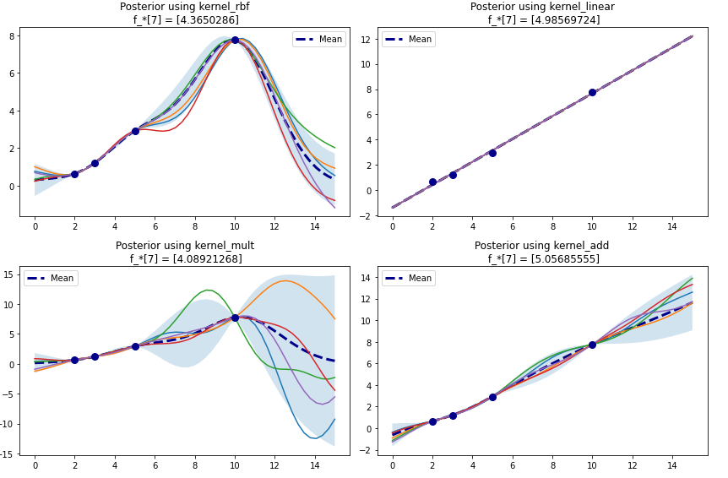


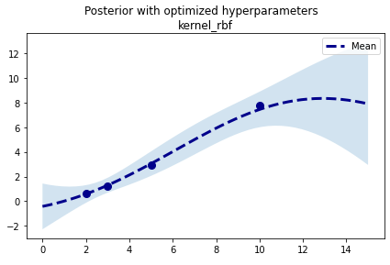
GPR Example
Derive Posterior
Joint distribution of training & test outputs:
Conditioning to get posterior:
Noisy observations, optimize hyperparameters of kernel:
minimze
Leave-one-out cross-validation to evaluate best kernel
Usage: predict mean & variance for other population sizes (assume functional form of histogram)
(Murphy 2012, Rasmussen 2003)
Notes:
Joint distribution of training and test outputs:
Training set X and f (= observations); Given test set X* and training data X f, we want to predict function outputs f*
Evaluate mean and covariance and generate samples
SHADED AREA: 95% confidence region (mean +- 2 std)
Minimze log marginal likelihood
COOV: Compute test error on held out point and average test errors
Good for small sample size
Usage: for this to be useful we would need to assume a functional form → first step to predicting collective response without need to do more experiments

Slide 9
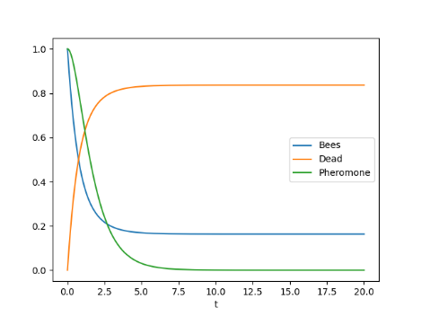
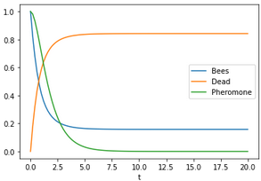
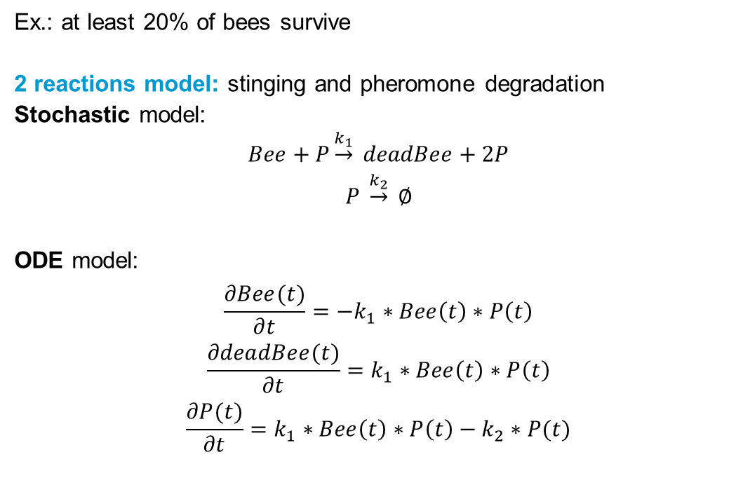
Fitness Function
Ex.: at least 20% of bees survive
2 reactions model: stinging and pheromone degradation
Stochastic model:
$$Bee+P\underset{→}{k_{1}} deadBee+2P$$
$$P \underset{→}{k_{2}} ∅$$
ODE model:
$$\frac{∂Bee(t)}{∂t}=−k_{1}∗Bee\left(t\right)∗P\left(t\right)$$
$$\frac{∂deadBee(t)}{∂t}=k_{1}∗Bee\left(t\right)∗P\left(t\right)$$
$$\frac{∂P(t)}{∂t}=k_{1}∗Bee\left(t\right)∗P\left(t\right)−k_{2}∗P(t)$$
k₁ = k₂ = 1
Population size = 1
(Repin 2020)
Alive Bees = 0.1578
Notes:
Fitness function is more abstract, qualitative
Example: assumption from expert knowledge
->here: how we could check this property for 1 population size (specific setting)

Slide 10
Fitness Function
Ex.: at least 20% of bees survive
3 possible approaches
Robustness: how robustly is property satisfied for varying population size? → Smoothed model checking (Bortolussi, 2014)
Design system (find parameters) such that it is robust under perturbation
Learn fitness function from data
Notes:
compute satisfaction probability for different population sizes with Gaussian Process Classification
If it satisfies fitness function robustly: good fit of model + fitness function
Quantitative argument for assumed fitness function & model
2) Engineering problem when you know or assume what‘s the fitness function
3) Ideal goal

Slide 11
Summary
Conclusions
GPR/GPC is powerful to make predictions & quantify uncertainty
Combining Formal Methods with Machine Learning seems promising
Given (steady-state) data and topology → predict collective response
Estimate individual parameters
Future goals
Learn fitness function from data
Given (time-series) data → learn topology & parameters
Notes:
Combining: flexibility of ML together with guarantees and a data-driven method to get reliable results with few data
More distant future

Slide 12
References
Kevin P. Murphy. Machine Learning: a probabilistic perspective. MIT press, 2012.
Carl Edward Rasmussen. Gaussian processes in machine learning. In Summer school on machine learning, Springer, 2003.
Denis Repin, Nhat-Huy Phung, and Tatjana Petrov. StochNetV2: A Tool for Automated Deep Abstractions for Stochastic Reaction Networks. 27-32. Springer, 2020.
Luca Bortolussi, Dimitrios Milios, and Guido Sanguinetti. Smoothed model checking for uncertain continuous-time Markov chains. Information and Computation, 247: 235-253, 2016.

Slide 15
Fitness function
What is the probability that at least 70% of bees survive?
Robustness: how does the system perform under perturbation (changing population size)?
1) Find mean and variance prediction of histogram using GPR
Assume functional form of histogram (f.ex. normal)
Compute robustness using the predictions
2) Directly read probability of satisfying property from histogram
Find probability (robustness) using GPR
Notes:
Probably 1) assuming a functional form is not the best strategy

Slide 16
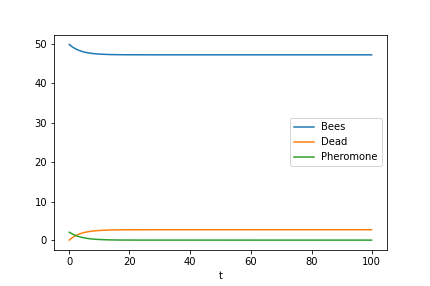
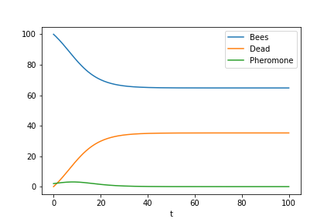
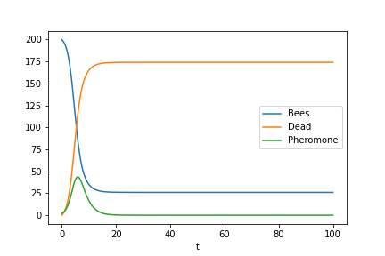
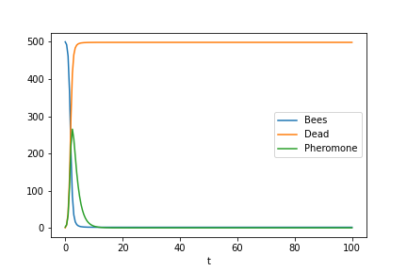
Fitness function
What is the probability that at least 70% of bees survive?
2 reactions model
Solution of ODEs
k₁=0.007, k₂=0.6
50 bees
100 bees
200 bees
500 bees

Slide 17
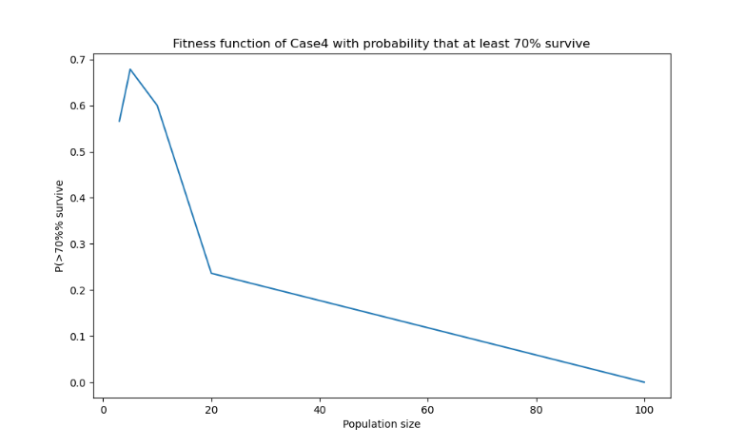
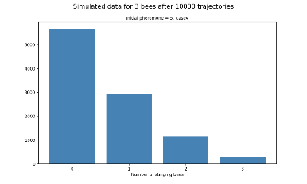
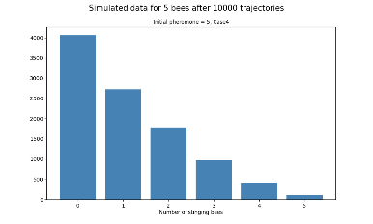
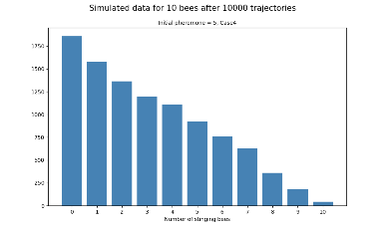
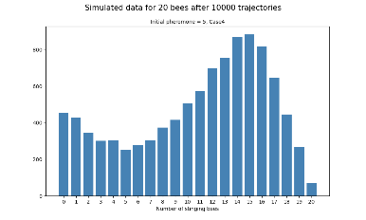
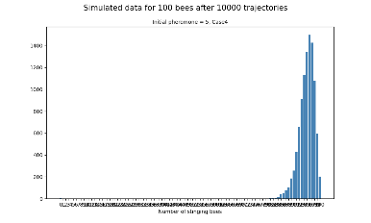
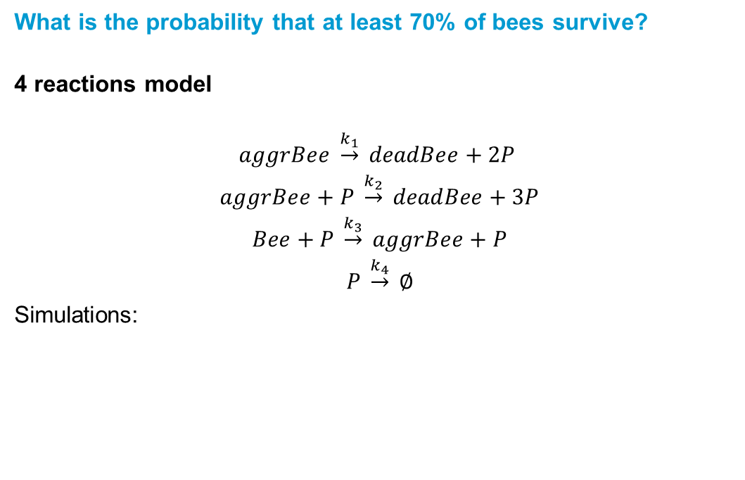
Fitness function
What is the probability that at least 70% of bees survive?
4 reactions model
$$aggrBee \underset{→}{k_{1}} deadBee+2P$$
$$aggrBee+P \underset{→}{k_{2}} deadBee+3P$$
$$Bee+P \underset{→}{k_{3}} aggrBee+P$$
$$P \underset{→}{k_{4}} ∅$$
Simulations:
[1]
3 bees
5 bees
10 bees
20 bees
100 bees
[1] Repin, D. and Petrov, T. (2021)
Notes:
Implemented by Denis Repin
Eventually all bees die → not reasonable! There is a mechanism that prevents the colony from becoming extinct
Fitness function decays, what do we need to do to make it more steady?

Slide 18
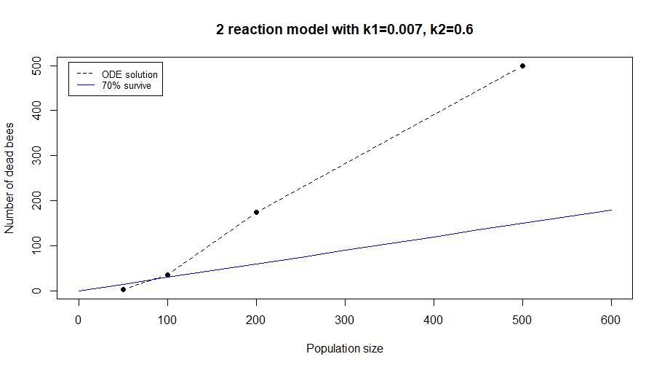
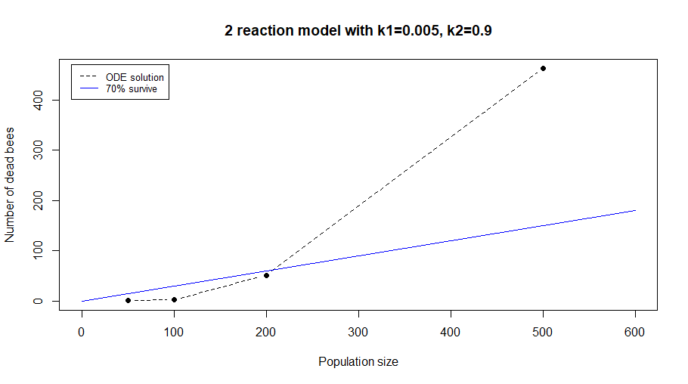
Fitness function
What is the probability that at least 70% of bees survive?

