Slide 1
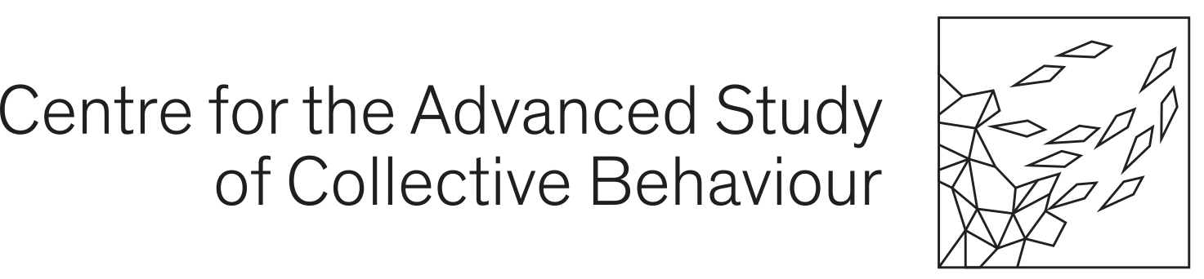

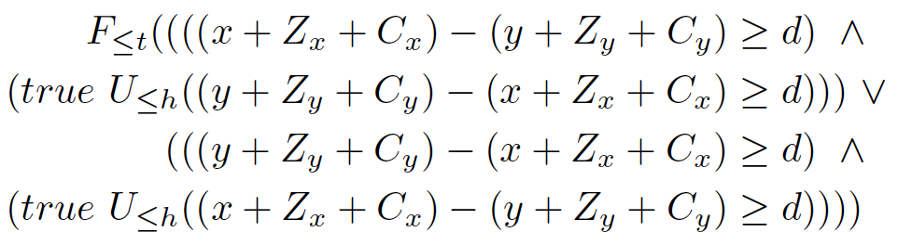
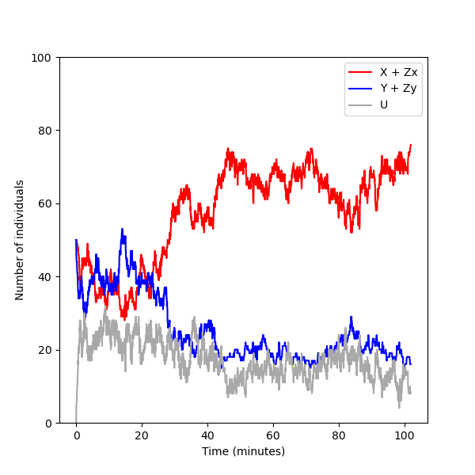
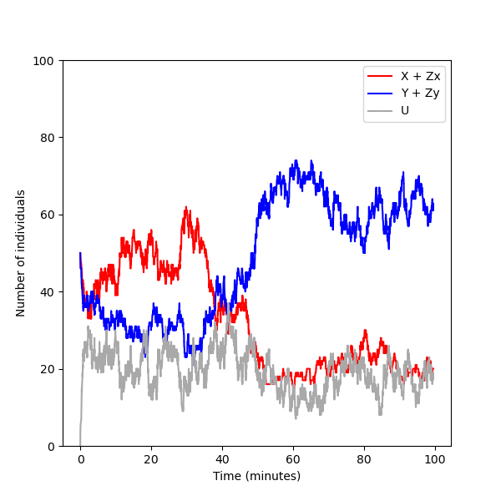
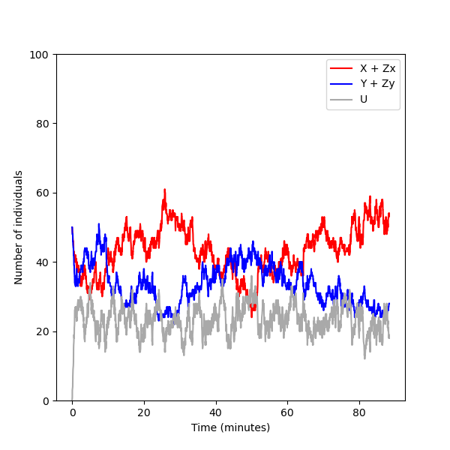
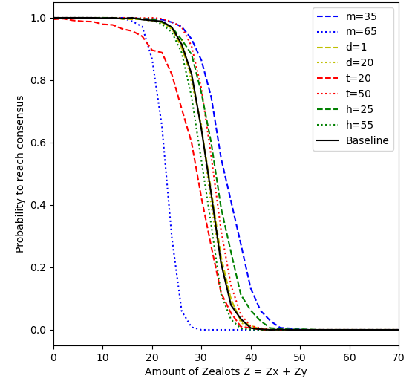
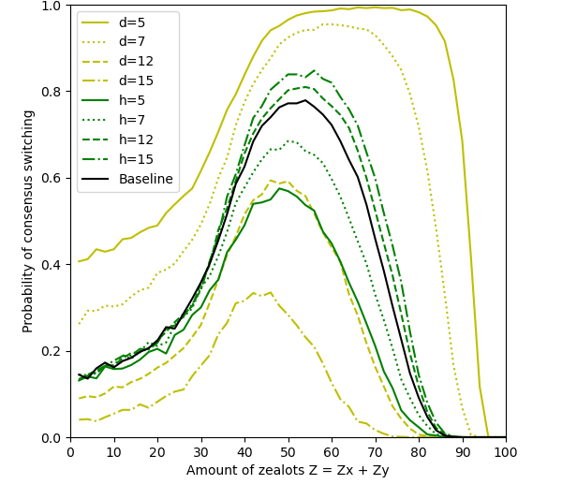
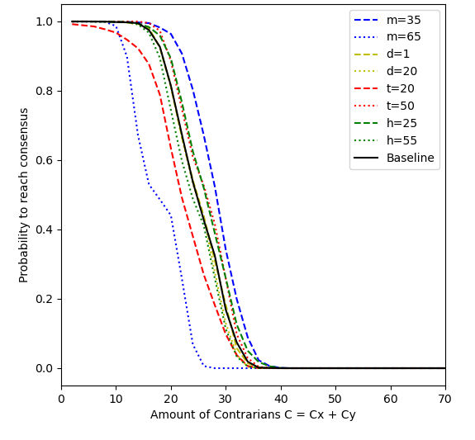
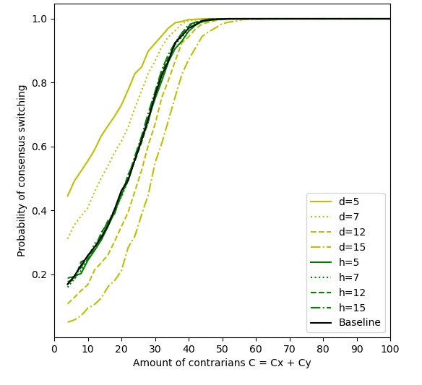
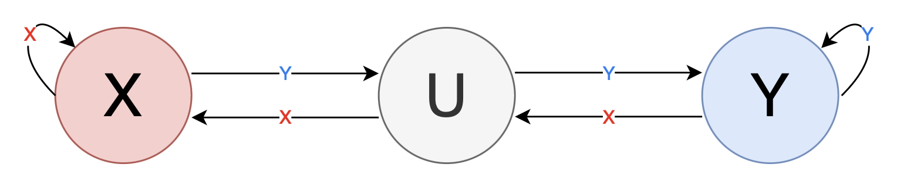
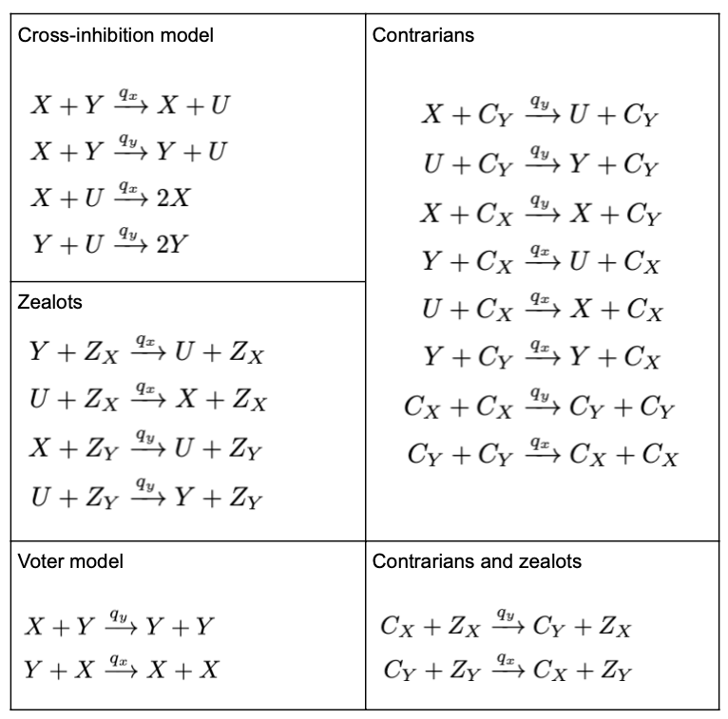
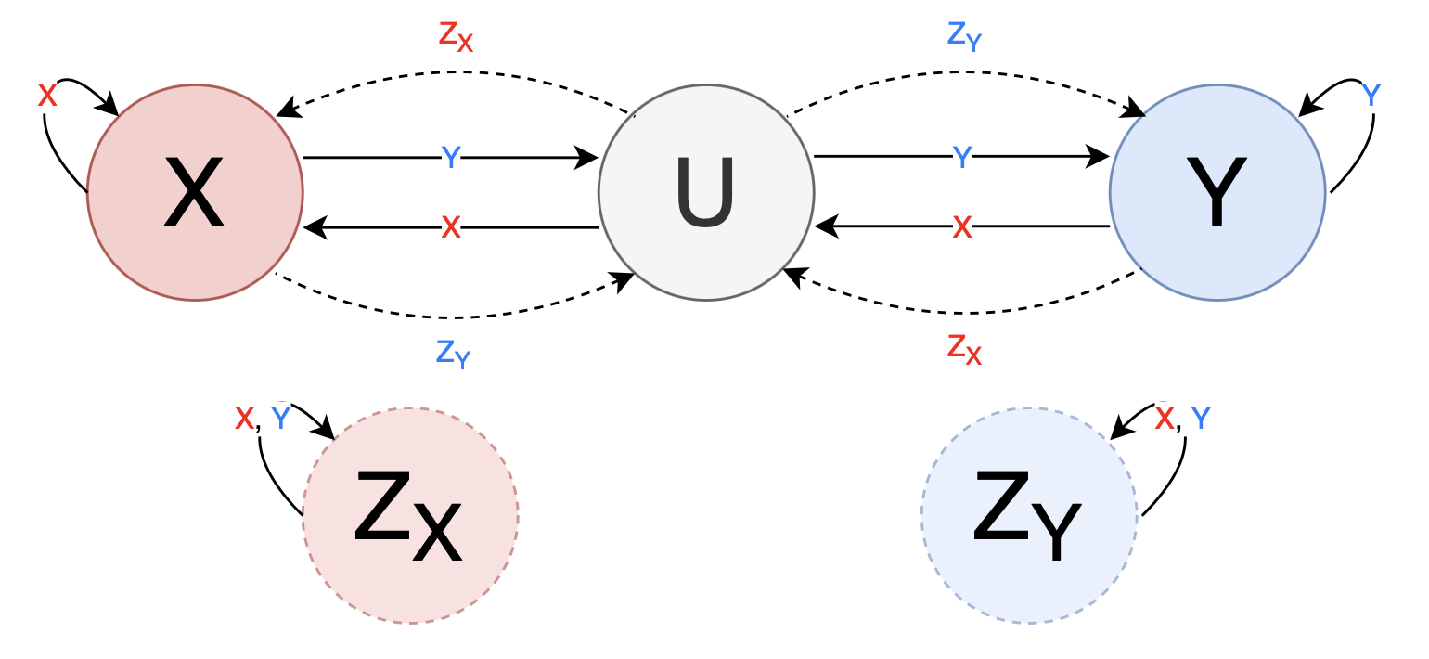
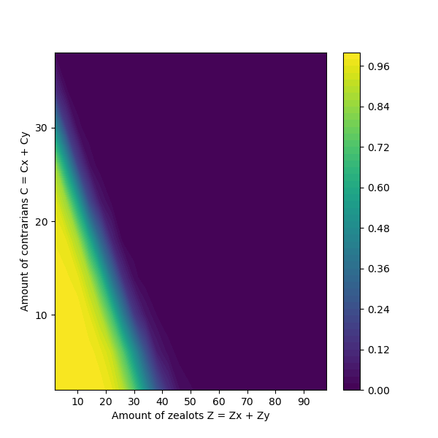
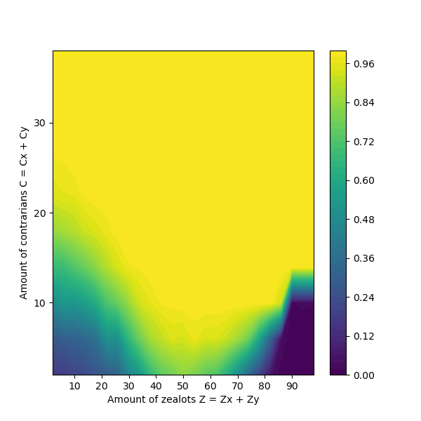
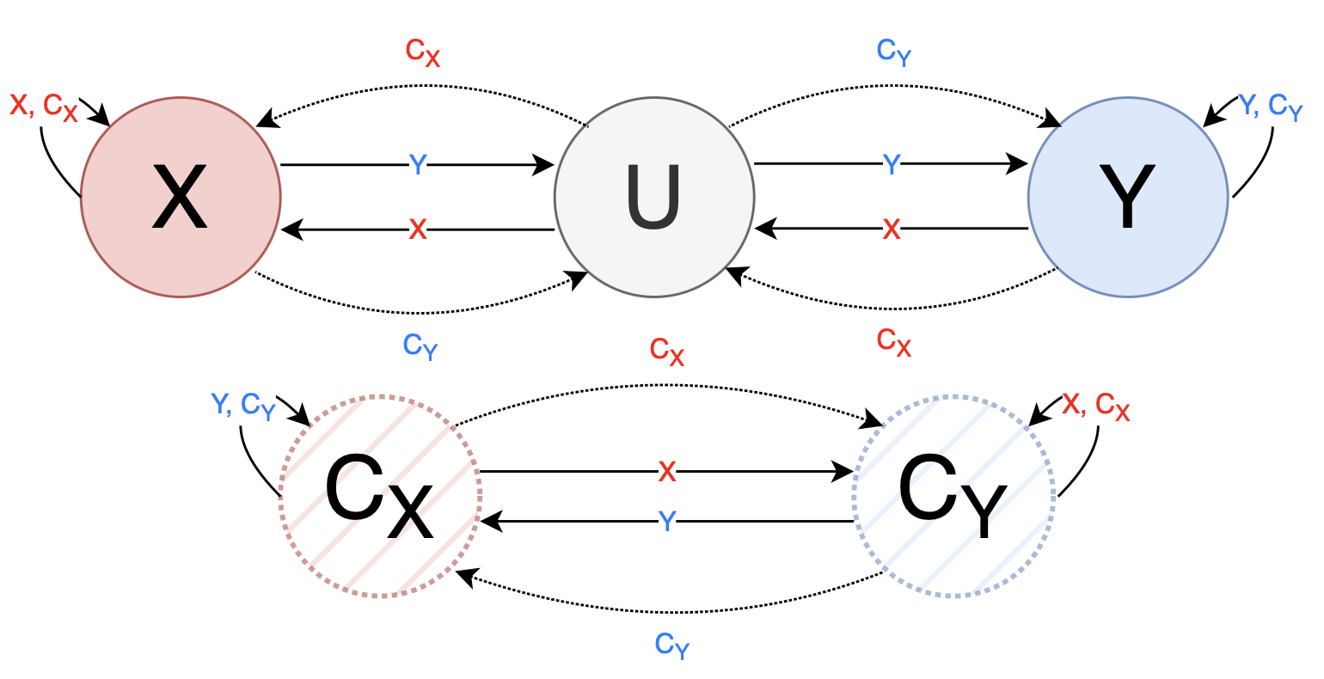
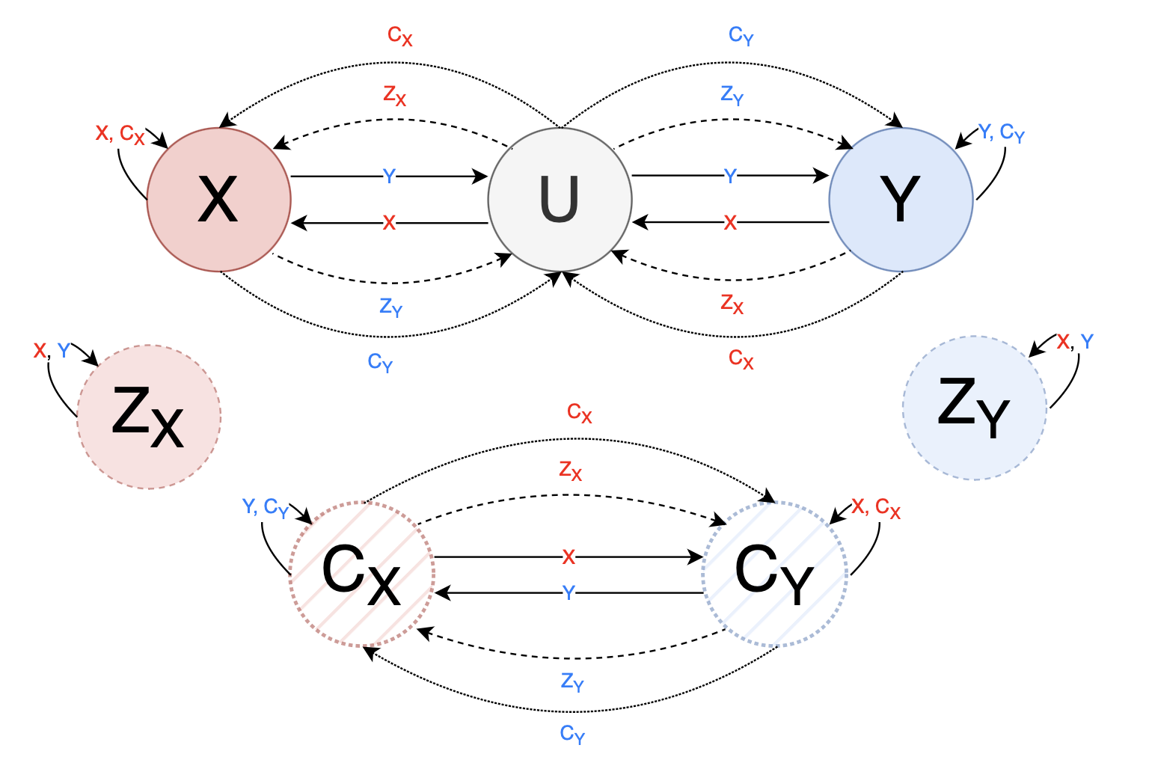
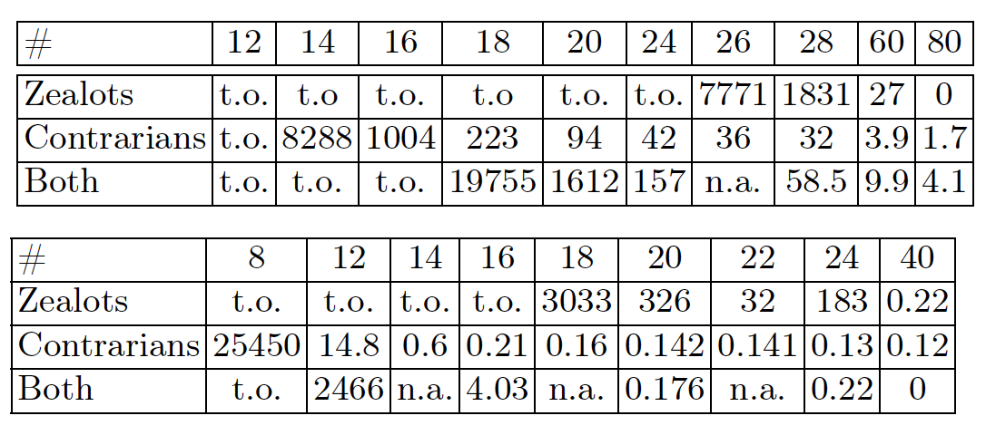
x
Exploring Consensus Robustness in Swarms
with Disruptive Individuals
Julia Klein^{1,2}, Tatjana Petrov^{2,3,4}
¹University of Konstanz ²Centre for the Advanced Study of Collective Behaviour, University of Konstanz ³University of Trieste ⁴Max Planck Institute of Animal Behaviour, Radolfzell
julia.klein@uni-konstanz.de
Abstract
Analysis
Consensus in collective systems essential for coordinated behaviour
Strongly opinionated minorities can disrupt opinion dynamics
Approach: investigate robustness of consensus-reaching among stubborn individuals (zealots) and contrarians
Statistical model checking to formally quantify robustness under perturbations of amount of disruptive individuals
Investigate robustness landscape for combinations of different disruptive agents
Goal: guide design and control of swarm robotics systems with focus on resilience to disruptive agents
Statistical model checking of properties in Bounded Linear Temporal Logic
Definition of consensus:
Majority: more than m% of population commits to same decision
Distance: significant difference of at least d between majority & those favouring opposite decision
Reaching time: consensus is reached within r minutes
Holding time: group maintains consensus for at least h minutes
Baseline: m=50, d=10, r=35, h=40
Stable consensus (1a) in BLTL:
Switching consensus (1b) in BLTL:
Monte Carlo algorithm to estimate satisfaction probability
Background
Underlying model of decision-making: cross-inhibition model with ‘undecided’ state between switching opinion (2a)
Including zealots: never change their opinion (2b)
Including contrarians: counter opinion of individual they interact with (2c)
Including both zealots and contrarians (2d)
Scenario:
2 equivalent options X and Y
Group of N=100 individuals
Initial state: equally split between X and Y, varying amount of disruptive individuals
Results
Robustness of consensus in presence of zealots
Robustness of consensus in presence of contrarians
Robustness of consensus in presence of both zealots & contrarians
Expected time to reach and hold majority
Disruptive individuals can change opinion dynamics
Robust up to certain #zealots/#conrrarians, then phase transition
Zealots are less harmful than conrtrarians
Future work: more complex scenarios with more parameters, decision difficulty, number of options, spatial correlation, influence of group size
(1a)
(1b)
(1c)
Models
(2a)
(2b)
(2c)
(2d)
References
[1] Reina, A., Zakir, R., De Masi, G., Ferrante, E.: Cross-inhibition leads to group consensus despite the presence of strongly opinionated minorities and asocial behaviour. Communications Physics 6(1), 236 (2023)
This work was funded by the Deutsche Forschungsgemeinschaft (DFG, German Research Foundation) under Germany’s Excellence Strategy – EXC 2117 – 422037984.

