Slide 1




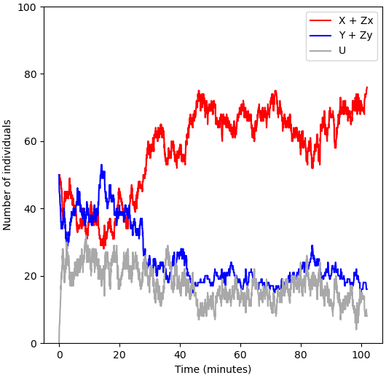
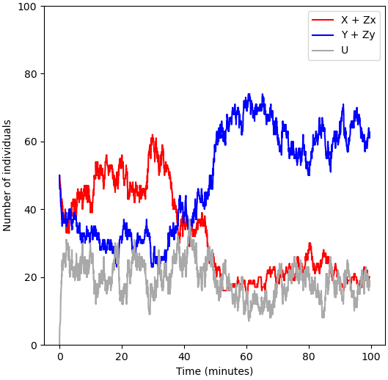
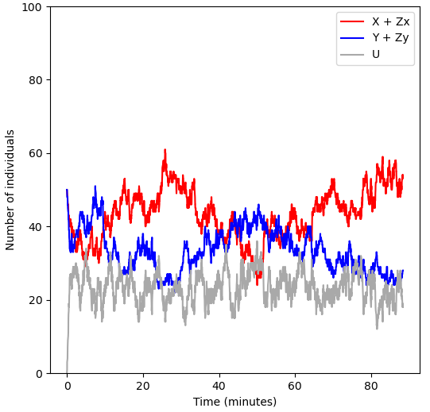
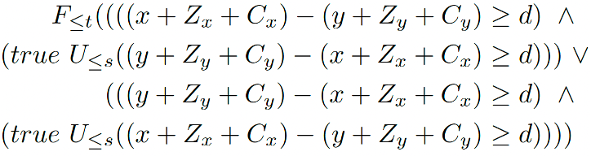
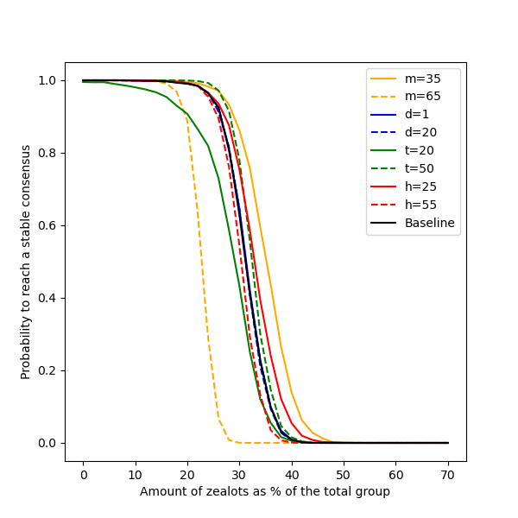
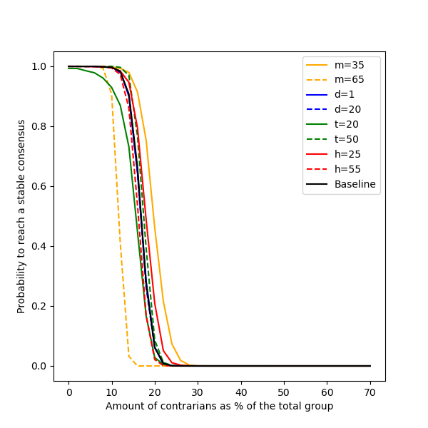
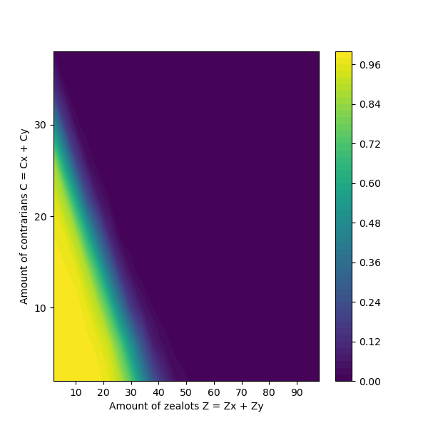
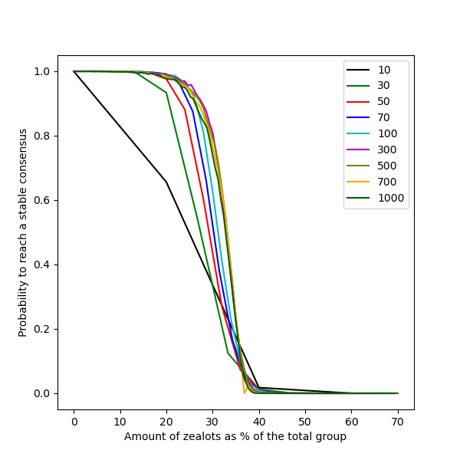
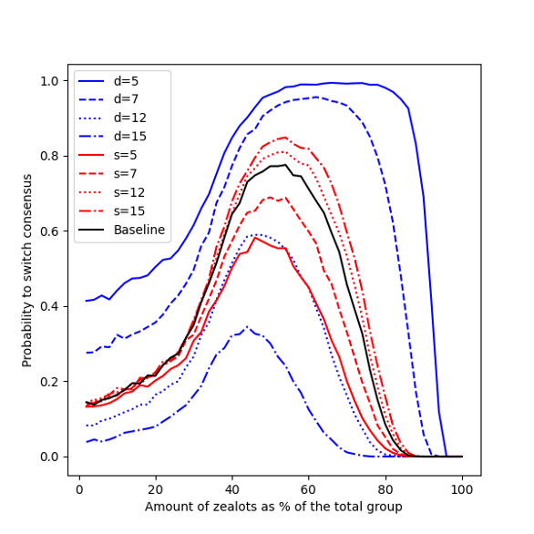
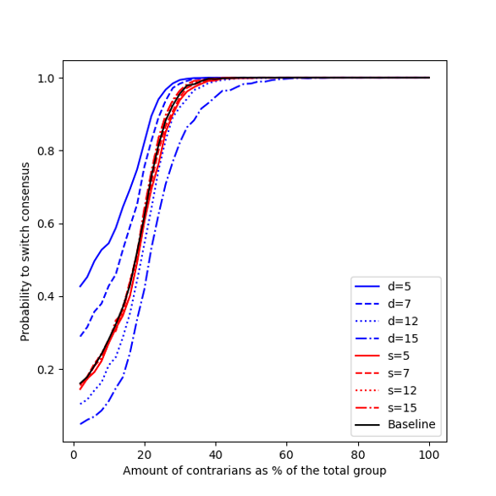
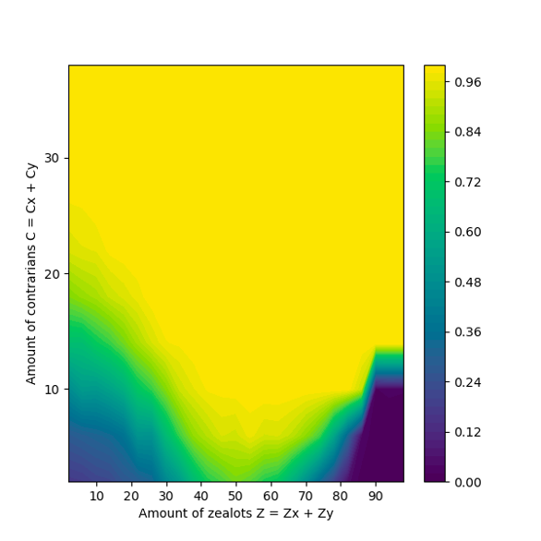
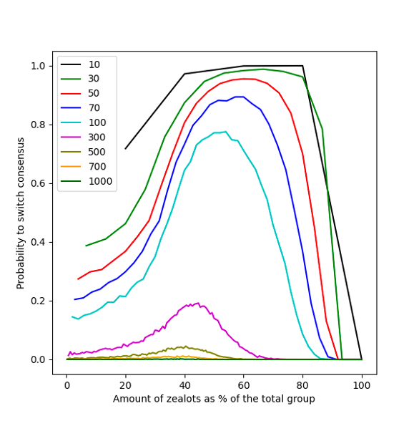
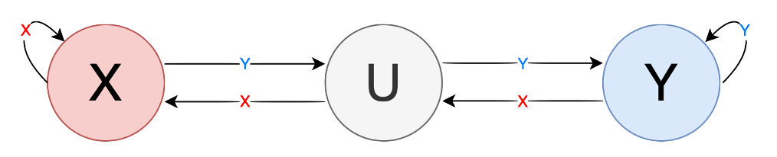
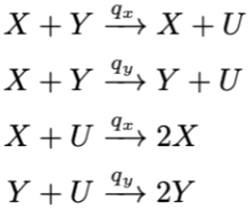
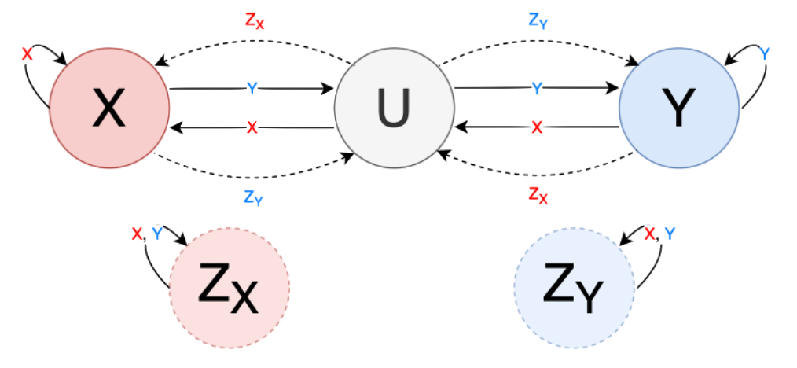
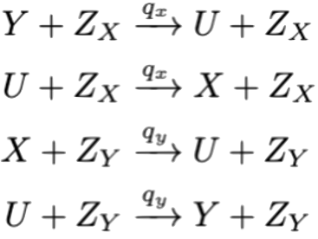
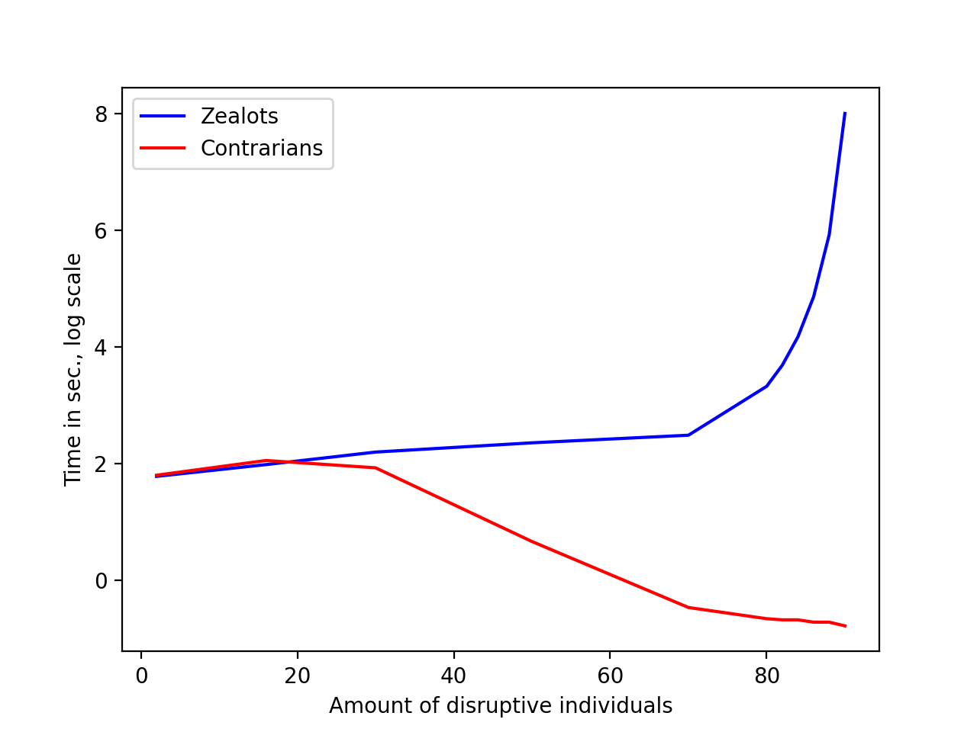
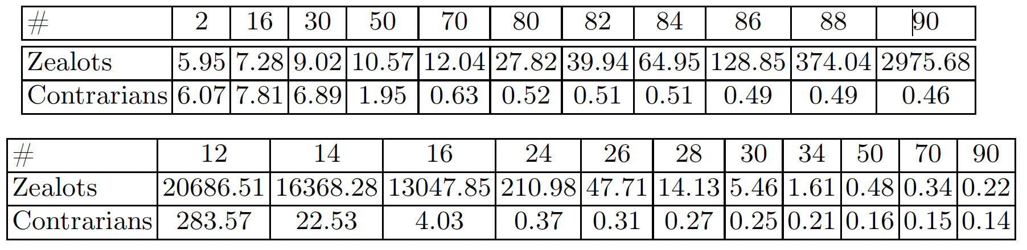
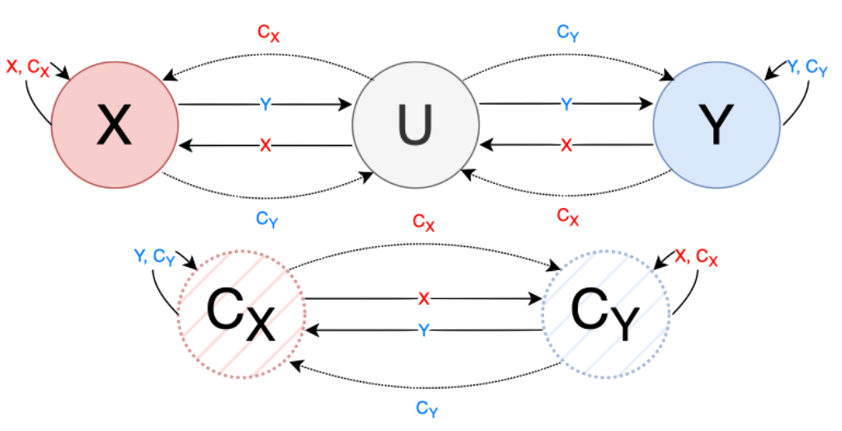
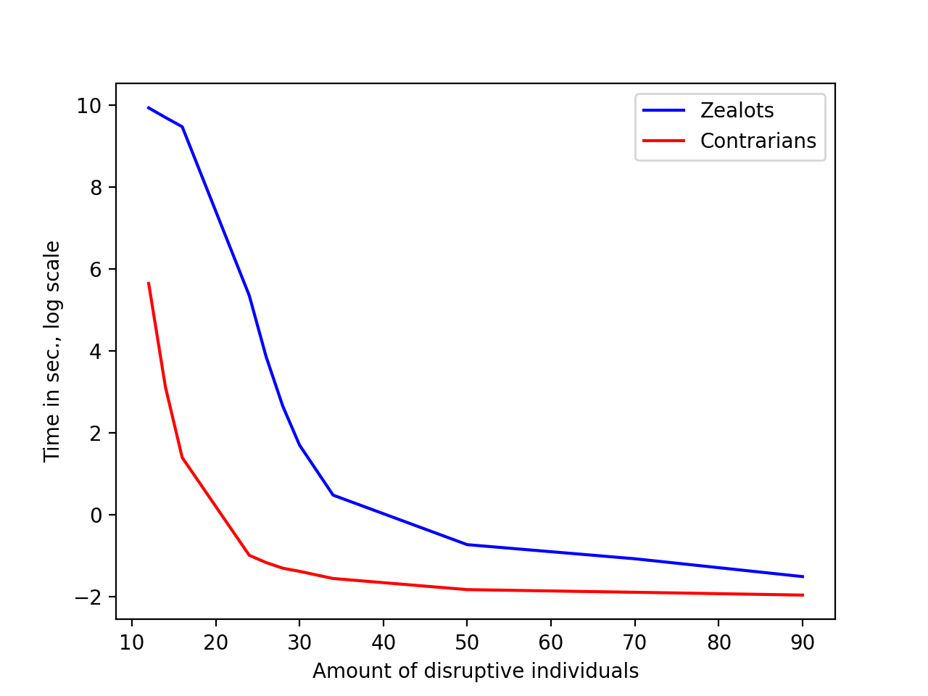
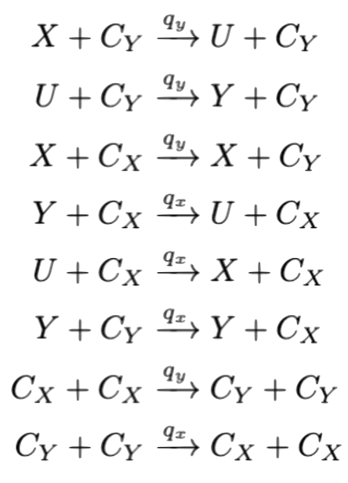
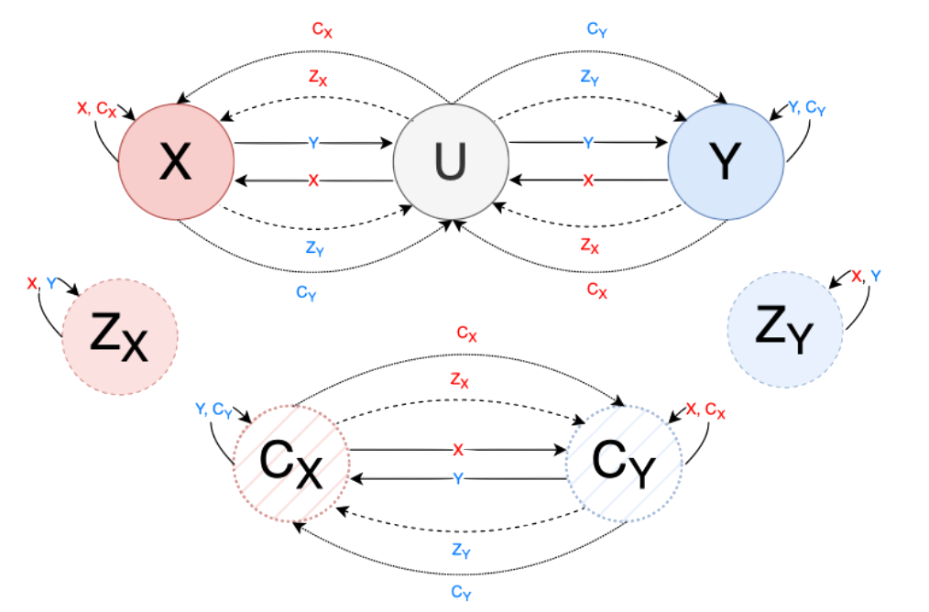
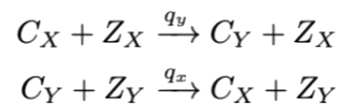
x
Exploring Consensus Robustness in Swarms
with Disruptive Individuals
Julia Klein^{1,2}, Alberto d’Onofrio³, Tatjana Petrov^{2,3,4}
¹University of Konstanz ²Centre for the Advanced Study of Collective Behaviour, University of Konstanz ³University of Trieste ⁴Max Planck Institute of Animal Behaviour, Radolfzell
julia.klein@uni-konstanz.de
Motivation
Analysis
Consensus in collective systems essential for coordinated behaviour
Cross-inhibition model (2a) as underlying model of decision-making is more robust than classic voter model due to ‘undecided’ state between switching opinion [1]
Introducing stubborn individuals…
Zealots: never change their own opinion (2b)
Contrarians: counter opinion of individual they interact with (2c)
…can disrupt opinion dynamics!
Observation of 3 different group dynamics:
Research Questions
Robustness: Quantify how the amount of disruptive individuals affects consensus reaching
Combined effect: Quantify how the combination of zealots & contrarians affects consensus reaching
Group size effect: Quantify how the group size affects consensus reaching
Approach:
Investigated scenario: group of N individuals has to decide between two equivalent options X and Y
Swarm state evolves as a continuous-time Markov chain (see reaction systems 2e-h)
Apply model checking tools (PRISM and PlasmaLab) to explore research questions wrt. different group dynamics
Formally describe observed scenarios in Bounded Linear Temporal Logic
Definition of consensus with five parameters: at least majority m% of population commits to same decision, difference of at least d between both groups, consensus is reached within reaching time t, consensus is maintained for at least holding time h, switch to other opinion happens within switching time s
Baseline: m=50, d=10, t=35, h=40, s=10
Stable consensus (1a) in BLTL:
Switching consensus (1b) in BLTL:
Statistical model checking to estimate satisfaction probability and quantify robustness under perturbations of the amount of disruptive individuals
(1a) stable consensus
(1b) switching consensus
(1c) no consensus
Results
Robustness of reaching a stable consensus (1a)
Robustness of switching consensus (1b)
Expected times
Robustness – Zealots
Robustness – Contrarians
Combined effect
Group size effect
Models
Robustness – Zealots
Robustness – Contrarians
Combined effect
Group size effect
(2a)
Cross-Inhibition model
(2e)
(2b)
Zealots
…to reach consensus
(2f)
…to hold consensus
(2c)
Contrarians
(2g)
Conclusion
(2d)
Disruptive individuals can change opinion dynamics
Precise, quantitative analysis of robustness
Stable consensus: robust up to certain #zealots/#contrarians, then rapid phase transition; zealots are less harmful for reaching consensus
Switching consensus: only range of zealots for which switching occurs with high probability; contrarians promote switching dynamics
Future work: formal analysis of group-size effect, variations of current scenario (e.g. non-symmetric decision quality), control theory
Both Zealots & Contrarians
(2h)
References
[1] Reina, A., Zakir, R., De Masi, G., Ferrante, E.: Cross-inhibition leads to group consensus despite the presence of strongly opinionated minorities and asocial behaviour. Communications Physics 6(1), 236 (2023)
This work was funded by the Deutsche Forschungsgemeinschaft (DFG, German Research Foundation) under Germany’s Excellence Strategy – EXC 2117 – 422037984.

