Slide 1
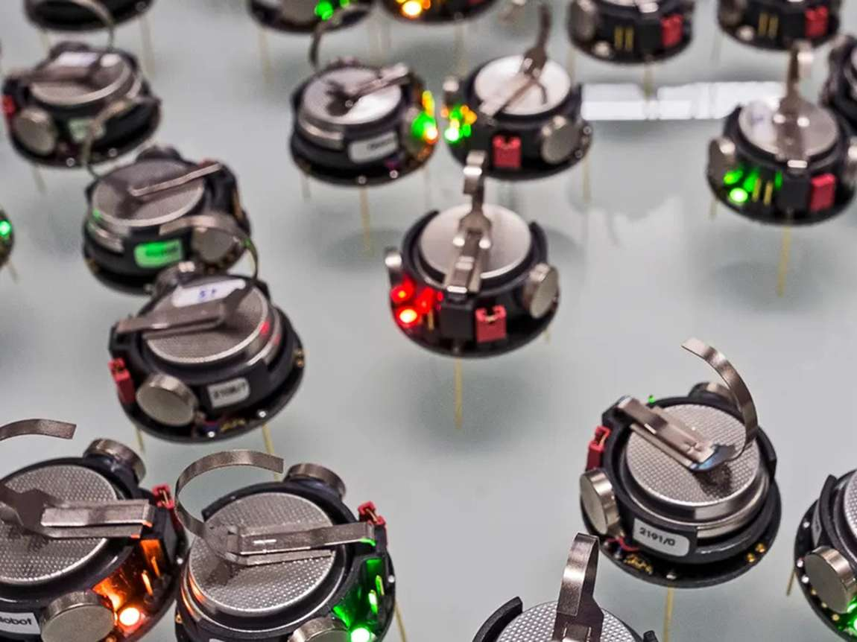

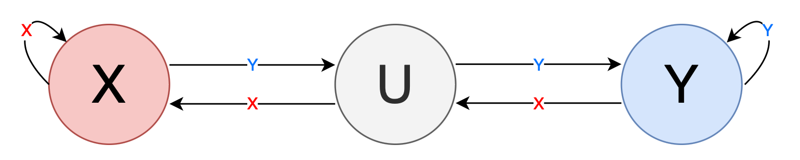
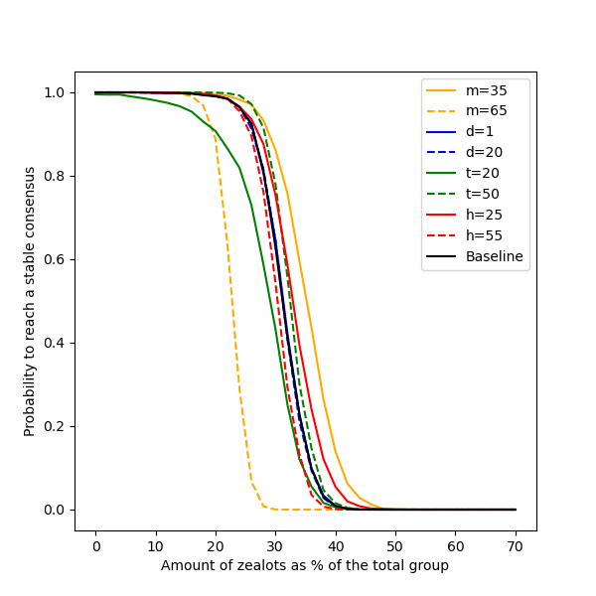
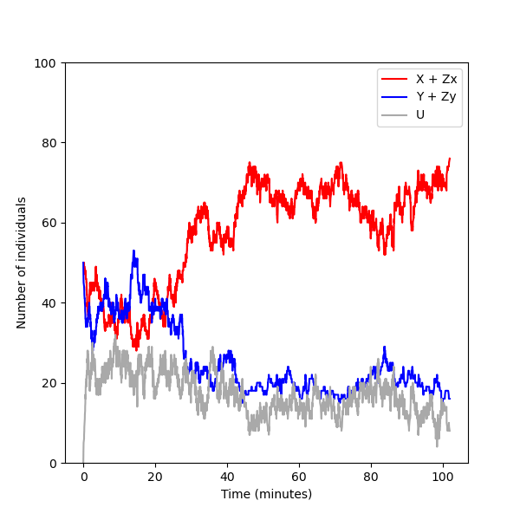
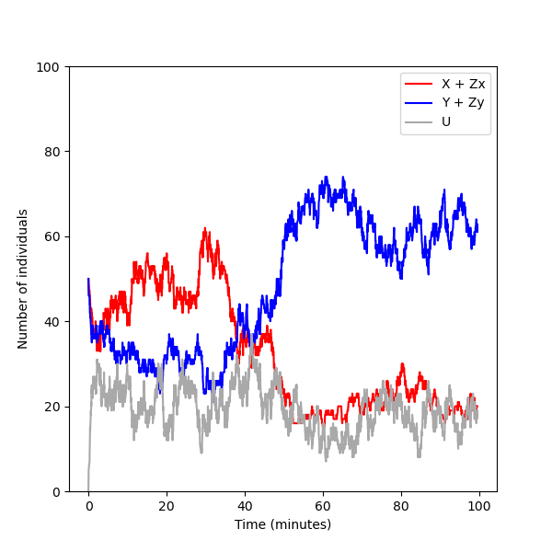
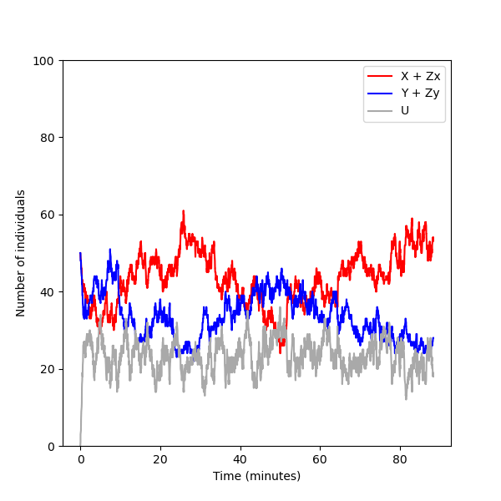
Exploring Consensus Robustness in Swarms with Disruptive Individuals Julia Klein, Tatjana Petrov, Alberto d’Onofrio
Cross-inhibition model for decision-making is more stable than classic voter model [1]
X
What happens in presence of disruptive individuals?
Y
Quantify the robustness of reaching consensus wrt. the amount of disruptive individuals
Introducing stubborn individuals can disrupt opinion dynamics!
Formally describe consensus in BLTL and use statistical model checking tools to precisely analyse scenarios
[1] Reina et al. Cross-inhibition leads to group consensus despite the presence of strongly opinionated minorities and asocial behaviour. (2023)

