Slide 1
YouTube Advertising Strategy
Julia Lu

Slide 2
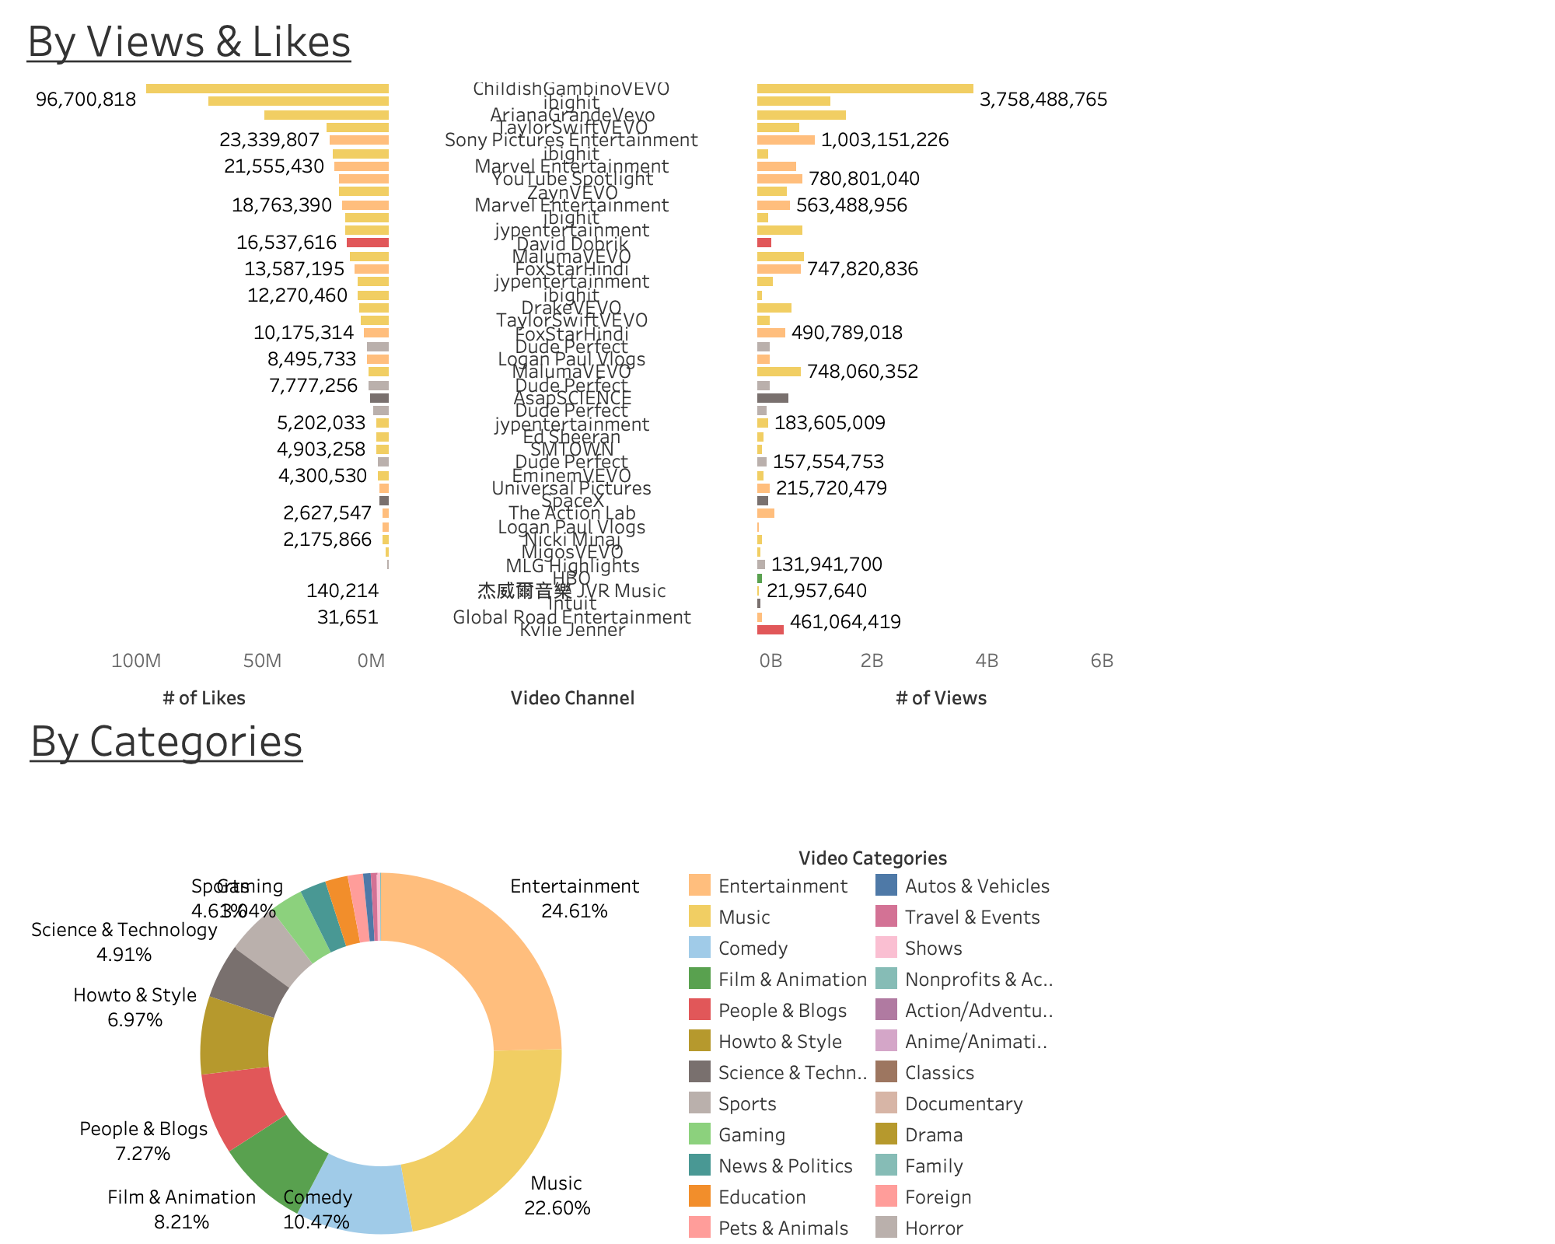
Popularity & Genre
In general, Entertainment and Music videos are the most popular genres on YouTube with high audience engagement. They incorporate the vast majority of most viewed and most liked videos.
Comedy, Film & Animation, People & Blogs are also popular genres among videos with 1M views.
Exceptional Sports, People & Blogs, and Science & Technology videos are likely to be viewed by a lot of people as well.
*For the graph above, videos are filtered to have over 10,000,000 views and are sorted based on # of views. For publicity benefits, we are more interested in the general content of the viral videos rather than its exact title, so channel titles are used for each video.
*For the chart below, videos are filtered to have over 1,000,000 views and are sorted based on # of views.

Slide 3
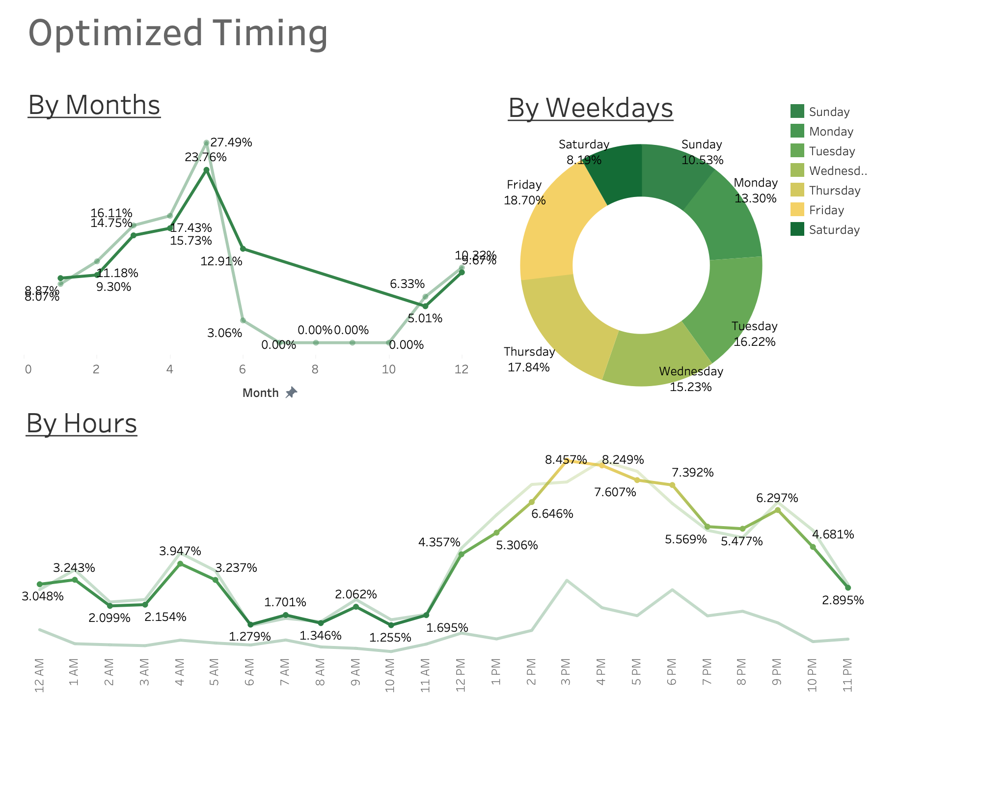
Video views peak at Summer/Q2 both for publish time and trending time
On a daily advertising basis, 3 pm – 6 pm would be the golden advertising time while during 12 pm – 10 pm videos still receive considerable attention; the pattern is particularly strong for weekdays
Publish time
Trending time
Weekdays
Overall
Weekend
*All percentages are calculated based on the total number of “popular videos” on YouTube.
Popular videos are defined by either over 1,000,000 views or 500,000 likes

