Slide 1
YouTube Advertising Strategy
Julia Lu

Slide 2
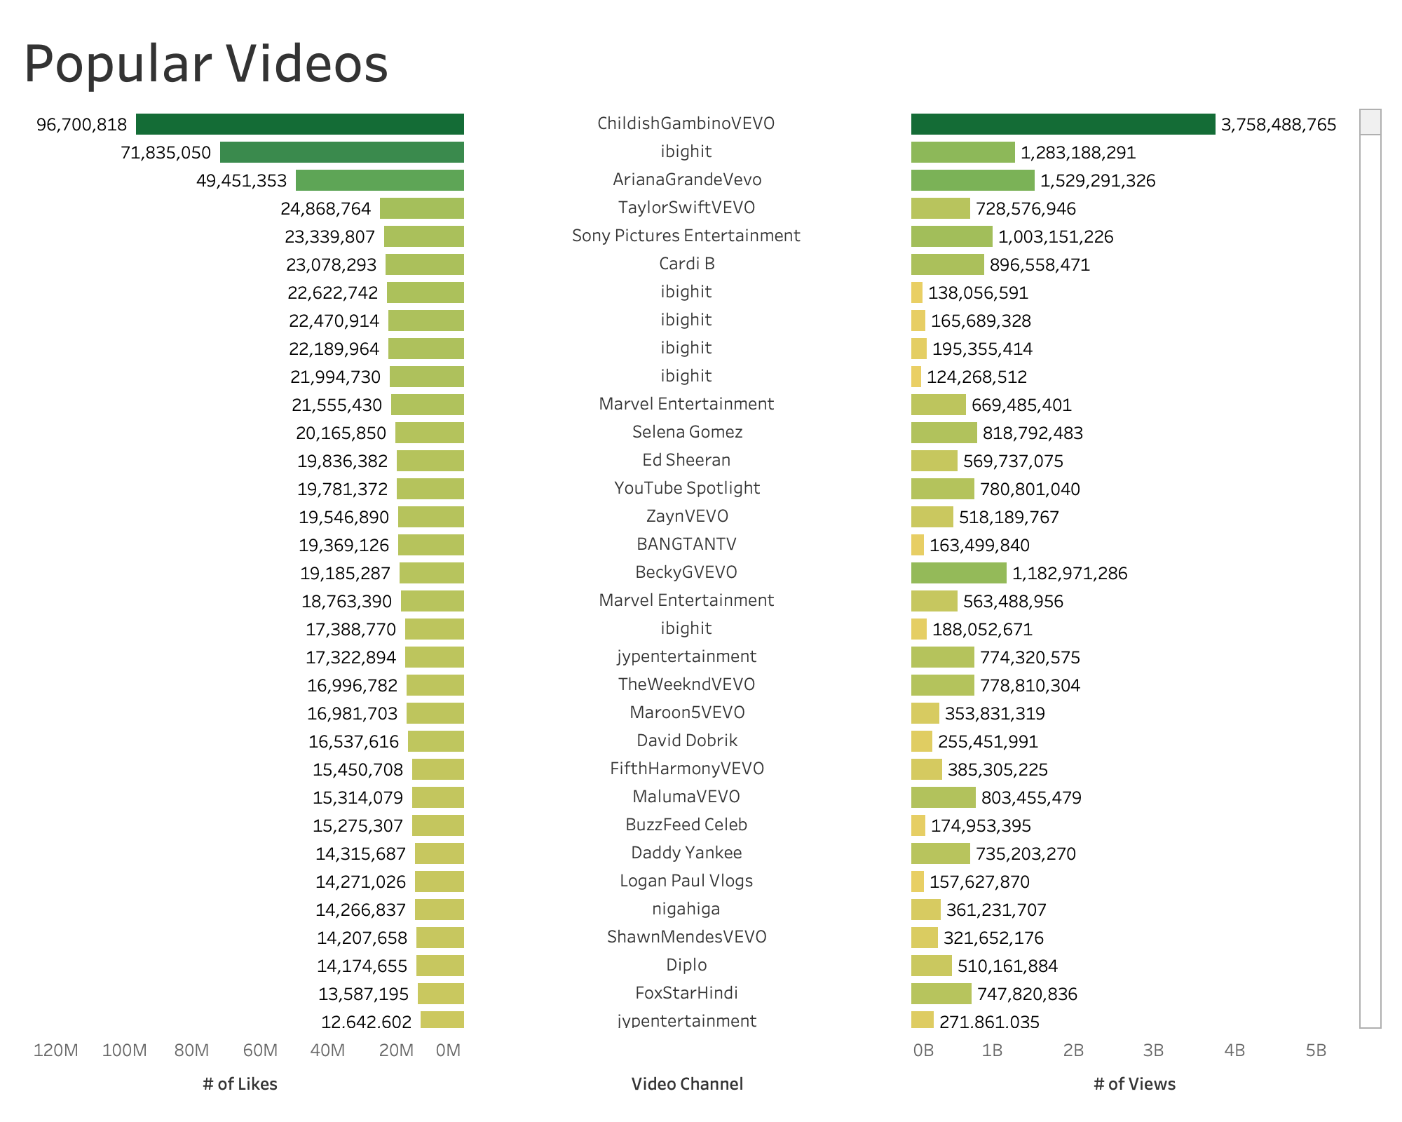

Slide 3
