Slide 1
Russia & Ukraine Conflict vs Stocks Prices
Zoe Garbus, Julia Luo, Vivian Chen
Notes:
Vivian

Slide 2
01
Background
02
Introduction
TABLE OF CONTENTS
03
Methods
04
Results
Problem statement & importance
Description of the data
Techniques and strategies used
Summary, interpretation of results, and limitations
Notes:
Vivian

Slide 3
01
Problem Statement
The problem statement:
Address how Russia’s invasion of Ukraine affects the stock prices of companies that pulled out of the Russian economy
+
Determine which industry is the most impacted by this conflict
Notes:
Vivian

Slide 4
Why is this important?
War doesn’t only affect the countries directly involved
Has a huge impact on the economy - globalization
Affects the lives of everyday citizens around the world:
Rising gas prices
Stockholders’ perspective:
Influencing decision to buy or hold stocks from certain companies/industries
The immediate barrage of economic sanctions placed on Russia by countries and global companies alike
Notes:
Vivian

Slide 5
02
Introduction
How we collected the data
Notes:
Zoe

Slide 6
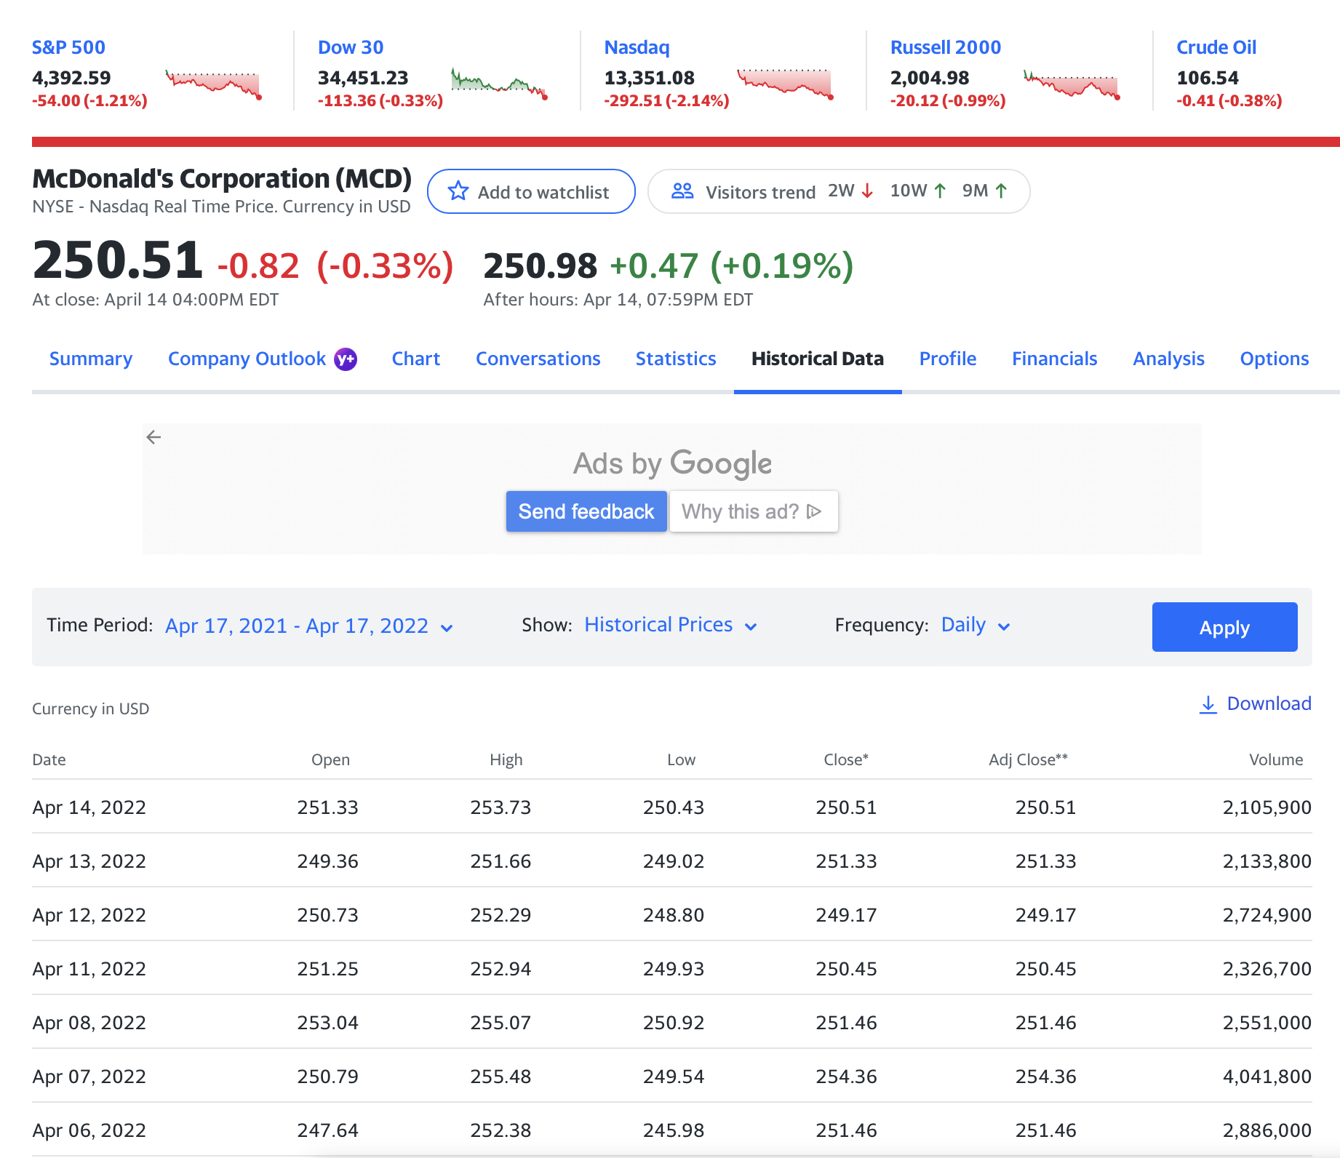
Background of our Dataset Source
The primary dataset that we used was Yahoo Finance
Documentation of all public companies and institutions’ stock market information
accurate and verified information that is utilized and is a primary source for businesses
Notes:
Zoe
We collected each of our data sets from Yahoo finance. A little bit of background about this source is that it includes documentation of all public companies and institution’s stock market information. It is accurate and verified information that is utilized as a primary source for business purposes which allows it to constitute as a record.

Slide 7
What we used from the data source
We collected our data from public stock market records for each company we were going to be observing
Stock information from the beginning of 2022 up until April 12th, 2022
Analyzed the data far back enough for more accurate comparison
Notes:
Zoe
For all 9 companies that we observed, we took the stock records from each beginning in January 2022 all the way up until April 12th. We wanted to make sure that we observed the companies stocks far back enough so that we could assume a baseline of what the companies stocks normally looked like before going through a serious event such as the conflict in Ukraine that would cause any sort of changes that were not typical to the company. This way we could see when the real change occurred and what fluctuations were abnormal.

Slide 8
03
Methods
Our techniques and overall strategies to conduct our analysis
Notes:
Zoe

Slide 9
Techniques
Data Visualization
Built-in Python Functions
Arithmetic operators
List Comprehension
Line & Bar graph
Max( ) & Min( )
Difference & Average
Slicing
Notes:
Zoe
There are 4 main techniques that we used throughout our project. The first and most prominent being data visualization. We communicated all of our results through various forms of data visualizations which you will see when we talk about the results. We used the built-in Python functions such as max and min to find any significant data points that would be worth identifying. We used arithmetic operators when finding the difference in company prices and similarly we found the averages. The last technique we used is list comprehension. We turned our data into the form of a list and from their we had iterate over the list and use methods like slicing to focus in on the specific information we wanted to see which were the dates and the closing stock prices.

Slide 10
04
Results
Notes:
Zoe

Slide 11
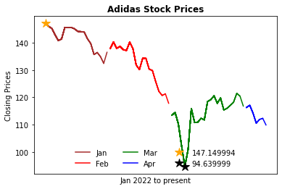
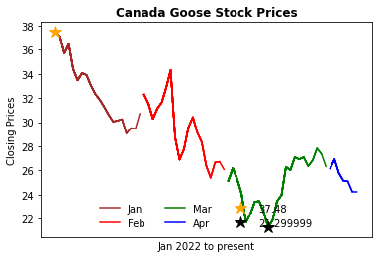
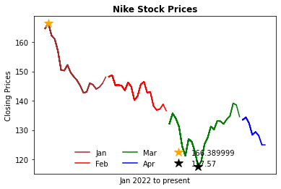
Retail Industry
Adidas
Canada Goose
Nike
Suspended operations & its partnership with the Russian Football Union
Suspended sales due to difficult operating environment
Suspended operations due to supply chain disruption
Notes:
Pulled out March 1, 2, 3 respectively
All these companies made the decision to pull out of Russia in light of the challenging operating environment and evolving sanctions against Russia
Adidas said it would suspend operations in Russia until further notice but continue to pay its employees there. Last week, Adidas suspended its partnership with the Russian Football Union following Moscow’s invasion of Ukraine.
Nike had indicated on its Russian website that it was suspending operations because it could not guarantee delivery. Three days after the war started, FedEx and UPS suspended shipments to Russia and Ukraine.

Slide 12
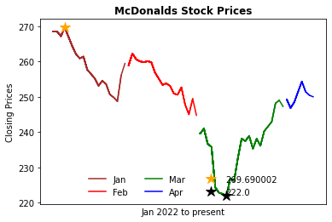
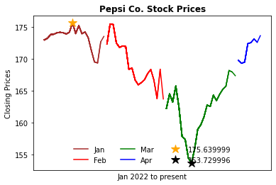
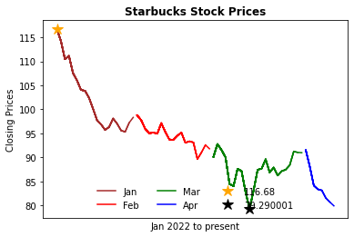
Food Industry
McDonalds
Pepsi
Starbucks
First major chain food company to stop operations
Continued to produce baby food products and diary in a “humanitarian” effort
March 8th
Notes:
In the food industry all the companies highlighted pulled out on the same date, March 8th. As you can see the month of march, shown in green, was when the companies faced the largest decline in closing stock prices. This is where each company hit its minimum price. The main reason that these companies pulled out of Russia was because it was the morally correct thing to do. They were clearly not benefiting from this move but it made sense to follow suit with what other companies were doing. McDonalds was one of the first major chain food companies to suspend its operations in Russia and temporarily close all of its stores. Pepsi was unique, they stopped selling soda but continued to produce baby food products and dairy in what they called a “humanitarian” effort. Even though they continued to produce some goods they still faced a big decline in closing prices. Starbucks had the least notable effect due to the fact that they are not very dependant on the business they conduct in Russia.

Slide 13
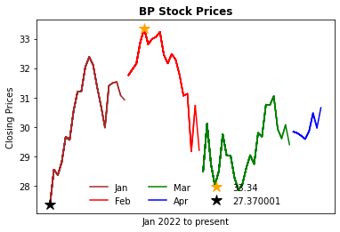
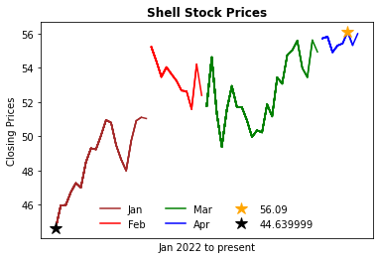
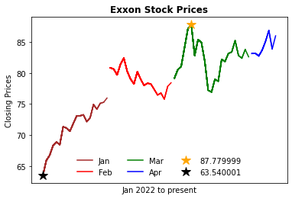
Oil Industry
BP
Shell
Exxon Mobil
(feb 28th)
The first major oil company to pull out
(march 8th)
Null values in data beginning of february
(march 1st)
Exxon’s Russian business not as large as those of other oil giants
Notes:
So I analyzed three of the largest companies in the oil industry, BP, shell, and exxon mobil.
BP was the first to pull business out of Russia, on february 28th. As you can see, their stock prices dropped drastically around that time and the most out of all three companies. This might be because they pulled out early and that led other companies to follow in BP’s footsteps. Unfortunately for BP, that meant that they took most of the initial damage.
Shell pulled out later, on March 8th. Their stock prices followed a similar trend, but recovery seems much better. There is also a large gap/jump between the months of january and february because our data had null values at the beginning of february, that is to say that there was no data available for those days.
Exxon mobil pulled out on march 1st, and their drop was also relatively low and they quickly recovered as well. Exxon’s russian business is relatively small in the context of their wider enterprise, meaning they don’t invest as much in Russia as they do in other parts of the world. So pulling out of russia or abandoning its russian assets would not have as much impact in comparison to BP for example.
Overall, each company’s price dropped after they pulled out of Russia, but it started rising again quickly after.

Slide 14
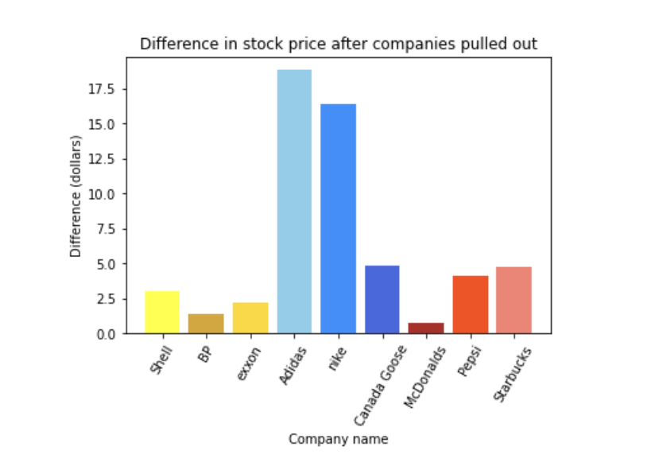
Retail stores are the most affected
Notes:
This bar graph shows the difference between the stock price on the day the company pulled out and the lowest price on the day following that date. I wanted to see how much they were hit after they pulled out.
On the x axis, I labeled each bar with the name of the company, and the y axis is the price drop.
As you can see the retail industry was the most affected by the pull out by far.

Slide 15
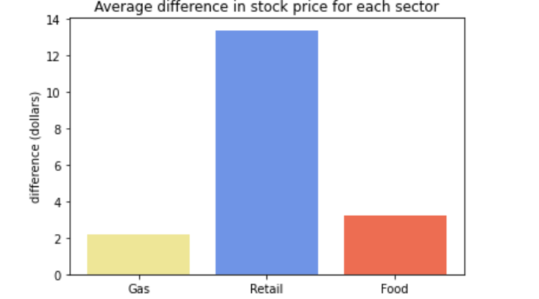
Average Differences by Industry
Notes:
This graph shows the overall average difference of the companies in each industry so that we can answer our problem statement: which industry was most affected by the Russia and Ukraine conflict. While we did analyze some of the largest companies in each industry, we only have three companies for each industry which wont give us the most accurate representation.
julia

Slide 16
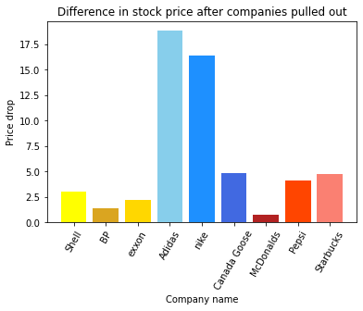
Reasons for Differences
Retail
Food
Oil
Most affected
Earlier pull out date compared to other companies we used
FedEx and UPS suspended shipments to Russia and Ukraine
Normal goods
Not greatly affected
Companies looked at are not greatly dependant business conducted in Russia
Late pull out date
Oil plays a huge role in the global economy
Stock prices didn’t decrease that much overall
Benefited / didn’t affect the companies; more negative impact on the public
Notes:
Oil plays a huge role in the Russian economy and therefore global economies.
So, it was pretty surprising to see that their stock prices didn’t decrease by that much overall. even after they fell, they quickly increased again
However, this might be because the companies had to increase their prices for gas due to losing their source of Russian oil. This would have probably not affected or even benefited the companies but negatively impacted the public because of the extreme rise of gas prices.

Slide 17
THANKS!
Do you have any questions?

