Slide 1
Automated Usable Functional Verification of Object-Oriented Programs
Doctoral Examination
Julian Tschannen

Slide 2
Motivation and Goals
Help developers write correct software
Great challenge in today’s software development
Full functional program verification
Target realistic object-oriented programming language
Capable of verifying challenging examples
Automated tool support
Support for verification novices as well as verification experts
IDE integration
Verification as standard part of software development
Automated and unobtrusive interface
Flexible architecture integrating diverse tools
Notes:
The underlying motivation for this dissertation is to help developers write correct software, which leads to two more points I want to elaborate on.
First, we aim for full functional program verification. Our target is to verify a realistic object-oriented programming language equipped with contracts powerful enough to specify functional properties. Our goal is to verify challenging examples that are idiomatic for object-oriented programs. The tools should be automated as much as possible to reduce the burden on the developer, but still usable for verification novices and verification experts alike.
The second point is, that we want our tools integrated in an IDE in order to make verification a standard part of software development. Developers should be able to use all verification tools through an automated and unobtrusive interface. Also, since the range of verification tools can be very diverse, the architecture of the IDE integration needs to be flexible enough to accommodate this.

Slide 3
Contributions
Methodology for auto-active verification
Two-step verification [VSTTE’13]
Polymorphic calls and Eiffel exception handling [LASER’12]
AutoProof: an auto-active verifier for Eiffel
Integrated in the Eiffel Verification Environment (EVE)
Supports advanced methodologies
Two-step verification and polymorphic calls
Semantic collaboration [co-author, FM’14]
Verification of function objects [co-author, TOOLS’10]
Evaluated on benchmark and challenge problems [STTT’14]
Design of an integrated verification environment [SEFM’11]
Scoring system for verification tools
Prototype implementation in EVE combining three tools
Notes:
This thesis makes the following contributions:
Several methodologies for auto-active verification. Two-step verification is used to improve the feedback of failed verification attempts, as we will see in detail later. The methodology for polymorphic calls utilizes information of the dynamic type of objects to use strengthened or weakened contracts, and we have developed a translation for Eiffel’s exception handling mechanism.
The main outcome of this dissertation is AutoProof, an auto-active verifier for Eiffel. AutoProof is integrated in EVE, the Eiffel Verification Environment, and supports much of the Eiffel language as input. It has support for advanced verification methodologies such as semantic collaboration to express frame properties or a methodology to verify function objects. AutoProof has been evaluated on benchmark and challenge problems from recent verification competitions.
The last contribution is the design of an integrated verification environment and a scoring system to integrate diverse verification tools. We have developed a prototype implementation of the scoring system in the verification assistant tool in EVE. The prototype system integrates three tools: AutoProof, AutoTest – an automatic testing tool based on random testing –, and the Eiffel Inspector – a lightweight code checker.
In this presentation I will first show the scoring system of the verification assistant, and then show in more detail AutoProof and two-step verification.

Slide 4
Tool Integration for Scoring System
High-level combination of verification tools
Allows integrating diverse tools
No dependency on specific tool
Tools run automatically and in background
User
Verification Assistant
AutoProof
Blackboard
data pool
AutoTest
Eiffel Inspector

Slide 5
Verification Assistant Scoring System
Quantitative estimate of correctness in interval [-1, 1]
Score and weight per tool
Score represents estimate of correctness
Weights represent applicability of result to routine
Combined score for routines and classes
Weighted average of individual scores
-1
0
1
Evidence of incorrectness
Evidence of correctness

Slide 6
Scores and Weights for Proofs
Weight for AutoProof (sound, incomplete)
1: sound verification possible
(0, 1): potential sources of unsoundness (e.g. floating point arithmetic)
0: no verification possible (unsupported code)
Failed proof for
complete tool
Timeout
Successful proof for sound tool
-1
0
1
Failed proof for
incomplete tool
Successful proof for unsound tool

Slide 7
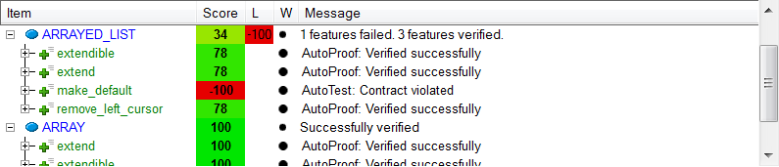
Verification Assistant Interface
Shows overview of program’s correctness
Single unobtrusive interface
Immediate visual feedback
Example output of the Verification Assistant

Slide 8

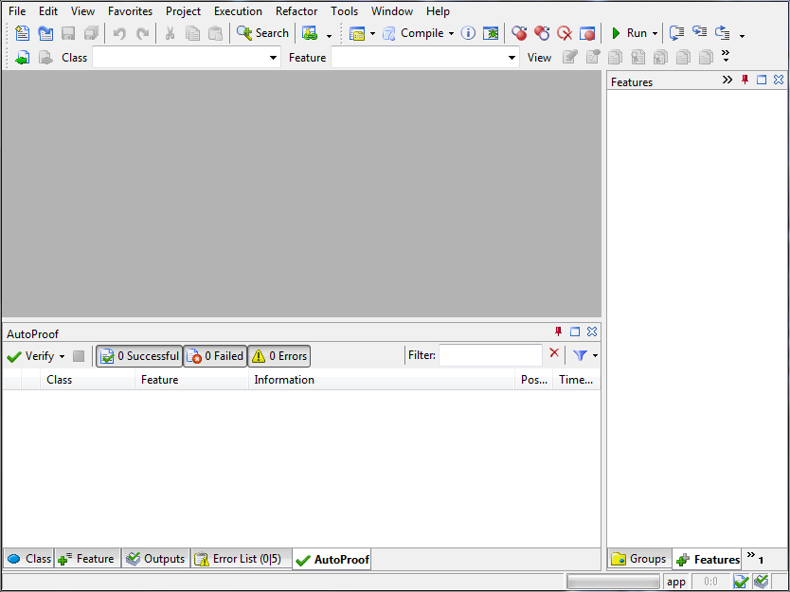
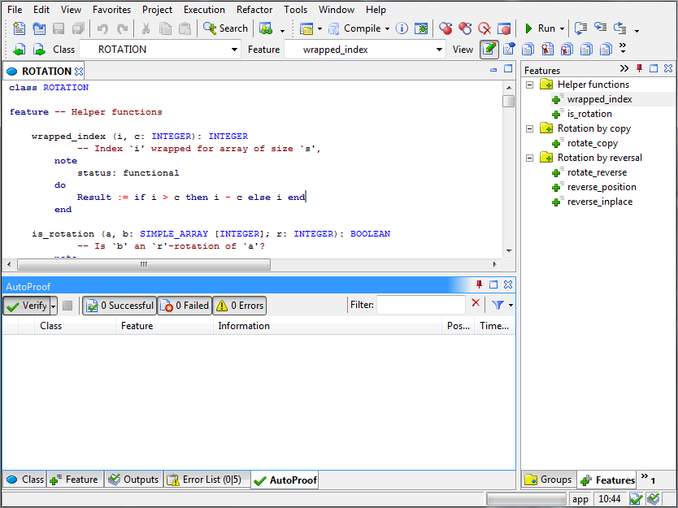
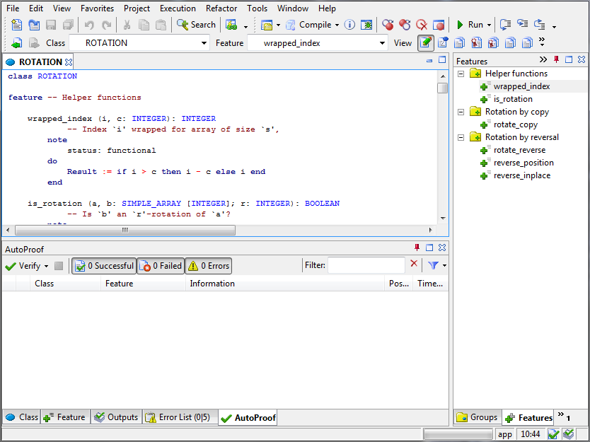
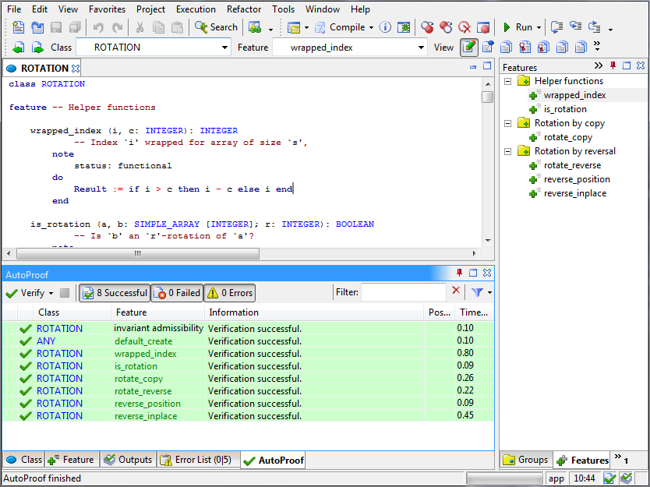


Auto-active Verification with AutoProof
Eiffel program
Eiffel results
Boogie results
Boogie file
verification
conditions
valid/invalid
Notes:
AutoProof is an auto-active verifier for Eiffel using Boogie and Z3 (both from Microsoft Research) as a verification backend.
The verification workflow of AutoProof is as follows:
The programmer writes his contract-equipped Eiffel program in EVE and clicks the Verify button of AutoProof.
AutoProof then takes the compiled Eiffel program and creates a Boogie representation of it.
The Boogie file is given to the Boogie verifier who generates verification conditions that are discharged by Z3.
Z3 reports its result to Boogie who reports to AutoProof.
AutoProof traces the Boogie results back to the Eiffel code.
Finally, the Eiffel results are then displayed to the user in the EVE user interface.

Slide 9
Flexible Implementation and Translation
Extension points
Three types: Calls, Nested Expressions, Across Expressions
Example: across handlers for INTERVAL (80 LOC) and MML_SET (40 LOC)
Code annotations
Direct mapping to Boogie types or Boogie functions
Include Boogie theory files
Example: MML_SEQUENCE maps to custom Boogie Seq type
across a..b as i all f (i) end
forall i: int · a ≤ i ≤ b ⇒ f(i)
across set as i all f (i) end
forall i: int · i∈set ⇒ f(i)
note
maps_to: "Seq"
theory: "sequence.bpl"
class MML_SEQUENCE [G]
Notes:
AutoProof has a flexible implementation and also a flexible translation to Boogie.
The implementation offers three extension points, that allow overriding of the default translation for specific code elements.
The three extension points are calls, nested expressions and across expressions.
The call extension points can be used to override the default translation of arbitrary routine calls.
Nested expressions are more general, allowing to override arbitrary nested expressions.
The third extensions point are across expressions. These are important for verification, as they are used to specify quantified expressions and thus quantified contracts. For each type that should be used in an across expression a handler needs to be defined for the type specific translation to Boogie. The implementation of these handlers are quite concise, for example the INTERVAL across handler is implemented in 80 lines of code, and the handler for MML sets only needs 40 lines of code. These handlers are then responsible to translate across expressions as the ones shown here to an efficient Boogie encoding.
The second way AutoProof can be easily extended is through code annotations. These allow to define direct mappings of Eiffel types and Eiffel routines to Boogie types and Boogie functions. For this, one can specify Boogie files that are added to the background theory whenever an entity of a specific type is used. The example that you see here shows how the MML sequence class is specified as using a custom Boogie type specified in a custom Boogie file. With this flexible approach the AutoProof translation can be augmented with custom theories without any need to adapt AutoProof itself.

Slide 10
Evaluation of AutoProof for Experts and Novices
Verified Software Repository
25 Examples from verification benchmarks and verification challenges
Moderate specification overhead: 1.7 spec tokens per code token
Responsive performance: on average <1s verification time per routine
Software Verification Course
Course project with 9 teams of up to 3 people
Verification of full functional correctness for quicksort and bucket sort
Full verification by 2 teams, very good results by 5 teams
Notes:
TODO: EVALUATION SLIDE BENCHMARKS AND TEACHING

Slide 11
Two-step Verification
Improve feedback of failed verifications
Try to find out if specification is to blame
Make two verification attempts
1. attempt: modular verification
2. attempt: use inlining and unrolling (ignoring specs)
Second attempt only necessary if first fails
Combine result of both attempts
1. attempt successful: report successful verification
2. attempt successful: suggest change to specification
Both attempts failed: report failure
Notes:
We will now look at two-step verification in more detail. Two-step verification can be used to improve the error reporting of failed verifications.
For this, we make two verification attempts: the first verification attempt uses regular modular verification. In the second verification attempt we use inlining for routine calls and unrolling for loops, effectively ignoring the provided specifications inside the routine. The second step is only necessary if the verification in the modular case failed.
In the reporting to the user we can then combine the results of both verification steps. If the first step was already successful, we report successful verification. If the first step failed but the second step was successful, we can conclude that the implementation of the routine can be considered correct, but the specification of called routines or loops inside the routine needs to be adapted for the proof to go through. When both steps fail we report regular failure of the verification.

Slide 12
Two-step Verification Example: Modular step
class PLAYER
feature
pos: INTEGER
play (d1, d2: DIE)
do
d1.roll
d2.roll
pos := pos + d1.val + d2.val
ensure
old pos + 2 <= pos
pos <= old pos + 12
end
end
class DIE
feature
val: INTEGER
r: V_RANDOM
roll
do
r.forth
val := r.in (1, 6)
end
end
Postcondition
may be violated
Notes:
The example here shows an excerpt of two classes from a board game implementation, specifically the “play” procedure of the player class and the “roll” procedure of the die class. Let’s first look at the roll procedure of the die. This procedure uses a random number generated of EiffelBase2 – a fully verified data structure library – to set the value of the die to a random number between 1 and 6. Both the die and the random number generator use command-query separation, therefore the die uses the procedure “forth” to advance the random number generator to its next value, and then uses a function that returns the next random number restricted to the interval from 1 to 6, and stores it in the “value” attribute for use by its clients. The “play” procedure of the player takes two dice it receives from the game, rolls those two dice, and then adds their values to its board position. It also has a postcondition expressing this behavior, asserting that the position is increased by some value between 2 and 12.
If you run AutoProof on this code, the result will be a possible postcondition violation. The reason is that the “roll” procedure does not have a postcondition at all, therefore modular verification will not be able to deduce anything from the two calls to “roll”. Using two-step verification, we will do a second verification attempt, however, using inlining.

Slide 13
Two-step Verification Example: Inlined step
class PLAYER
feature
pos: INTEGER
play (d1, d2: DIE)
do
d1.roll
d2.roll
pos := pos + d1.val + d2.val
ensure
old pos + 2 <= pos
pos <= old pos + 12
end
end
class PLAYER
feature
pos: INTEGER
play (d1, d2: DIE)
do
d1.r.forth
d1.val := d1.r.in (1, 6)
d2.r.forth
d2.val := d2.r.in (1, 6)
pos := pos + d1.val + d2.val
ensure
old pos + 2 <= pos
pos <= old pos + 12
end
end
class DIE
feature
val: INTEGER
r: V_RANDOM
roll
do
r.forth
val := r.in (1, 6)
end
end
✓
Verification successful after inlining
class V_RANDOM
in (min, max): INTEGER
ensure
min <= Result <= max
end
You might need to strengthen the postcondition of called routines
Notes:
In the second step we redo all failed verification attempts while inlining the procedure calls. So the code to be verified will look like this. We do the two instructions of the “roll” procedure directly in the “play” procedure of the player. As I mentioned before, the random number generator is from a fully specified data structure library, therefore the function that returns the random number restricted to an interval has a postcondition that specifies this behavior. When AutoProof now verifies the “play” routine, it relies on the implementation of the “roll” procedure and directly on the specifications of the random number generator. Using this, AutoProof can successfully verify the “play” routine. Since this is the second step of a two-step verification, we do report the successful verification with a qualification that inlining was performed to obtain this result. In addition, we can also suggest that a strengthening of the postcondition of the called routines might help to verify the “play” routine modularly.

Slide 14
Two-step Verification Example: Fixed version
class PLAYER
feature
pos: INTEGER
play (d1, d2: DIE)
do
d1.roll
d2.roll
pos := pos + d1.val + d2.val
ensure
old pos + 2 <= pos
pos <= old pos + 12
end
end
class DIE
feature
val: INTEGER
r: V_RANDOM
roll
do
r.forth
val := r.in (1, 6)
ensure
1 <= val <= 6
end
end
✓
✓
Verification successful
Notes:
Following the suggestion we can strengthen the postcondition of the “roll” procedure, giving the expected specification that the value of a die roll is between 1 and 6. Then, using this postcondition AutoProof can verify the “play” procedure successfully with modular verification. Since we changed the “roll” procedure, we should re-verify it as well. The new postcondition follows directly from the specification of the random number generator, therefore AutoProof is also able to verify it successfully.

Slide 15
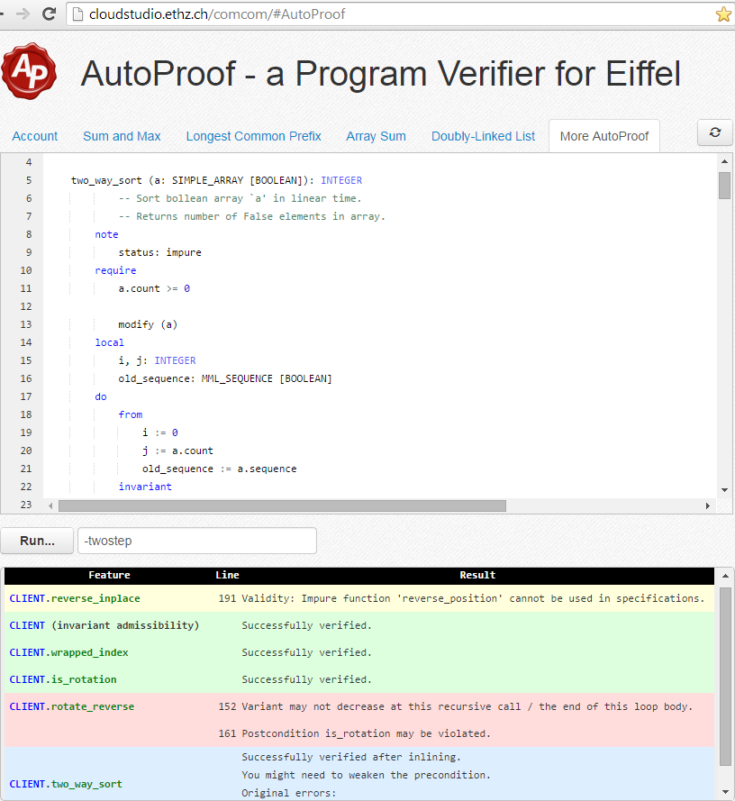
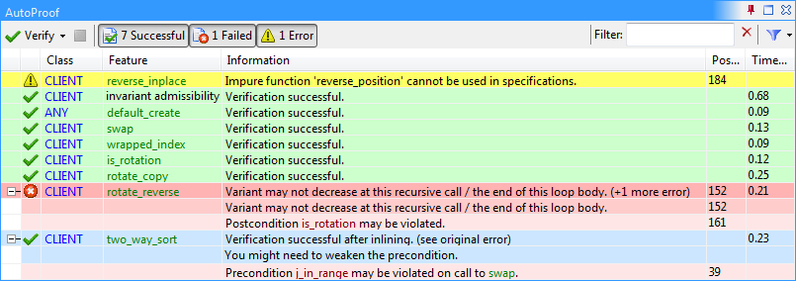
Demo: AutoProof with Two-step Verification
Notes:
Verify whole example (no two-step verification)
Explain
Board game with different squares: GAME, BOARD, SQUARE
Player take turns throwing two dice: PLAYER, DIE
Usage of verified EiffelBase2
Discuss verification error of PLAYER.play
Use two-step verification for PLAYER.play
Discuss annotations:
Remove “modify_field” of PLAYER.move
Remove “status: creator” of PLAYER.make
Show Code Repo and linked queue
Very few annotations necessary for implementing a linked queue
Relies on a more difficult data structure library that needs more annotations

Slide 16
Conclusions
AutoProof: State-of-the-art auto-active verifier
Supports much of Eiffel, enhanced with custom annotations
For novices: two-step verification, implicit contracts, inlining, unrolling
For experts: semantic collaboration, agents, polymorphic calls
Evaluated on verification benchmarks and competitions
Extendable architecture and translation
Integrated Verification Environment
Scoring system to highlight program’s state of correctness
Prototype implementation integrating diverse tools: AutoProof, AutoTest, Eiffel Inspector
Notes:
We have presented AutoProof, a state-of-the-art auto-active verifier for Eiffel. AutoProof supports much of the full-fledged object-oriented programming language Eiffel and adds custom annotations for a richer specification language. AutoProof supports various verification methodologies that cater to both verification novices and verification experts. With two-step verification, implicit contracts, inlining and unrolling, AutoProof tries to improve error reporting and reduce the annotation overhead. With semantic collaboration, verification of agents, and polymorphic calls, AutoProof offers powerful methodologies to verify idiomatic object-oriented programs. We have evaluated AutoProof on a suite of verification benchmarks and verification competitions which attest AutoProofs competitiveness among similar verification tools. AutoProof is implemented in an extendable way and offers facilities for a flexible extension of the Boogie translation.
To integrate verification tools in a single IDE, we have developed a scoring system highlighting the state of correctness of programs. The system works by having each tool assign a score and a weight to routines and using weighted averages to calculate a single score per routine and class. A prototype implementation of the system integrates three diverse tools – AutoProof, AutoTest, and the Eiffel Inspector – showing the feasibility of the integration.

Slide 17


Slide 19
Coverage and Techniques
Language support
Supports most statements and expressions of Eiffel
Custom annotations for richer specifications
Library support
Limited support for EiffelBase with some replacements
Supports MML and large subset of EiffelBase2
Verification techniques
Semantic collaboration
Polymorphic calls
Agent verification
Two-step verification

Slide 20
AutoProof Verified Software Repository
25 Examples from verification benchmarks and challenges
10 algorithmic: search, sorting, and other array algorithms
7 on complex invariants and framing
8 on data structures and related topics
Included patterns: iterator, observer, composite, strategy, command
Moderate specification overhead
In average 1.7 spec tokens per code token
Responsive performance
In average <1 second verification time per routine

Slide 21
Tool Integration in EVE
High-level combination of verification tools
Allows integrating diverse tools
No dependency on specific tool
Show overview of a program’s correctness
Single unobtrusive interface
Automatic and in background
Example output of the Verification Assistant

Slide 22
Scores and Weights for Tests
Weight for AutoTest
1: by default
100: fault detected
Failing test case
No tests
Passing test case
Passing test case
Passing test case
-1
0
1

Slide 23
Scores and Weights for Code Checker
Weight for Eiffel Inspector
0: no error or warning rules violated
1: only warning rules violated
100: some error rules violated
Error rule violated
Warning rule violated
Warning rule violated
Warning rule violated
-1
0
1
No warnings or errors

