Slide 1



LandGen project goal:
Understand the connectivity of pollinators in urbanized landscapes
What we need:
2 specimen of 4 insect species per km² over 400 km² around Luxembourg City and the southwest of Luxembourg
How you can help:
Net and store them in small tubes with 95% ethanol

Slide 2
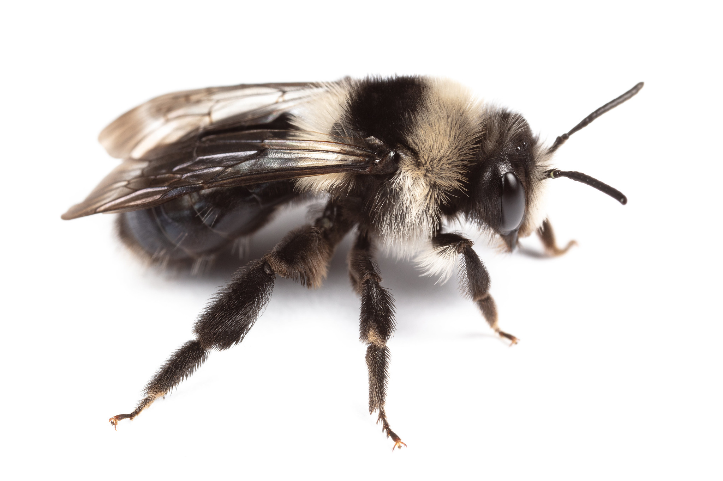
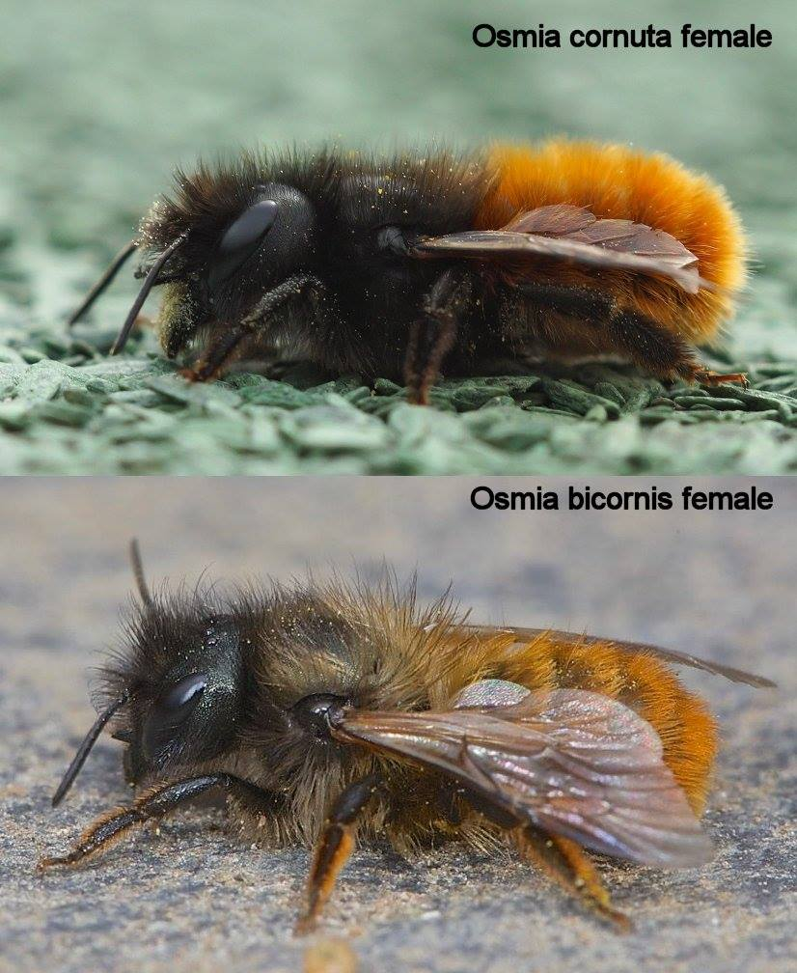
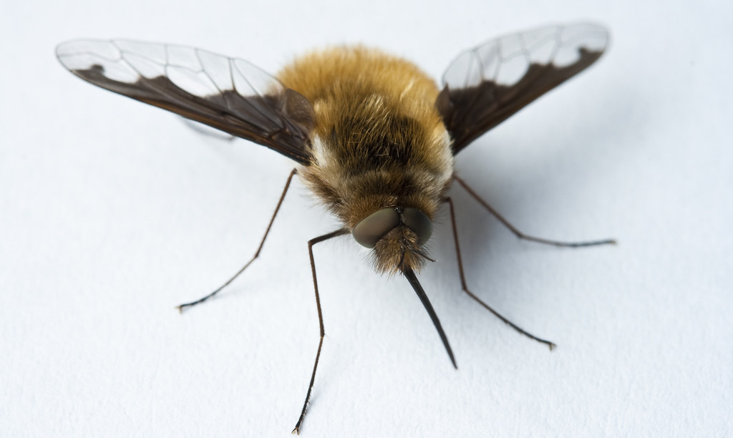
Andrena cineraria female
Nicolas J. Vereecken
Bombylius major
Anders Illum
http://bwars.com/

Slide 3
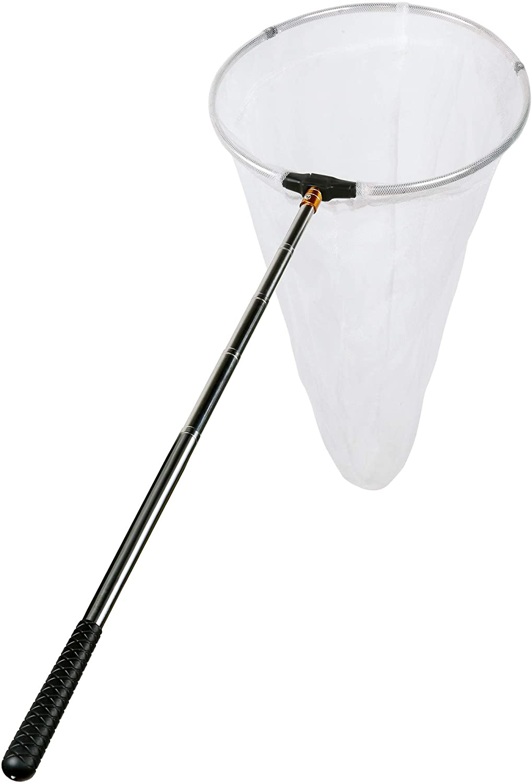
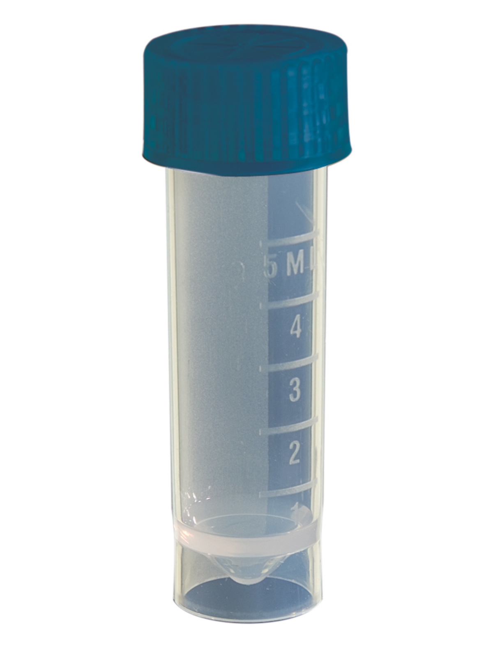

Catching them:
Bee flies can be found hovering close to Andrena ground nests
Insect hotels are an easy way to find the Osmia species
We provide training on how to ID, net and process them
We only catch females for the bee species
Good to know:
We can bring samples or we can pick them up
Reports/articles will acknowledge your help
We provide an interactive map to organize
We can provide you with material
You will be able to “book” spots
We have a permit

