Slide 1





Trading with Twitter Data, The Beta
Michael De Paula, Julian Martinez, Lawrence Cummings, Takeshi Nagai, Kevin Walsh

Slide 2
Motivation & Summary
Goal: find if we can use Twitter data to predict stock price movements of 5 corps
Method:
1. Collect Tweets of a company’s official account for sentiment analysis (Twint)
failed keyword search by a company name due to the huge amount of data
2. Apply Sklearn classification models with
X feature: sentiment only
y value: trading signals
Accuracy score were around 50%. Not perform well
3. Compare performances in regression and classification analyses b/w 2 models
(1) X feature: former stock prices only
(2) X features: former stock prices and sentiment scores
Conclusion:
1. Sentiment could improve performances of regression and classification models
2. But still uncertain how reliable it is

Slide 3
Model Summary
Sentiment Analysis - Sentiment Intensity Analyzer from nltk
Prediction models:
Regression (2 models)
Neural Network comprising only Dense layers
LSTM Model
(2) Classification (7 models)
Neural Network comprising only Dense layers
LSTM Model
Decision Tree Classifier
Logistic Regression
Random Forest Classifier
Support Vector Classifier (Kernel: Radical Basis Function)
XG Boost Classifier

Slide 4
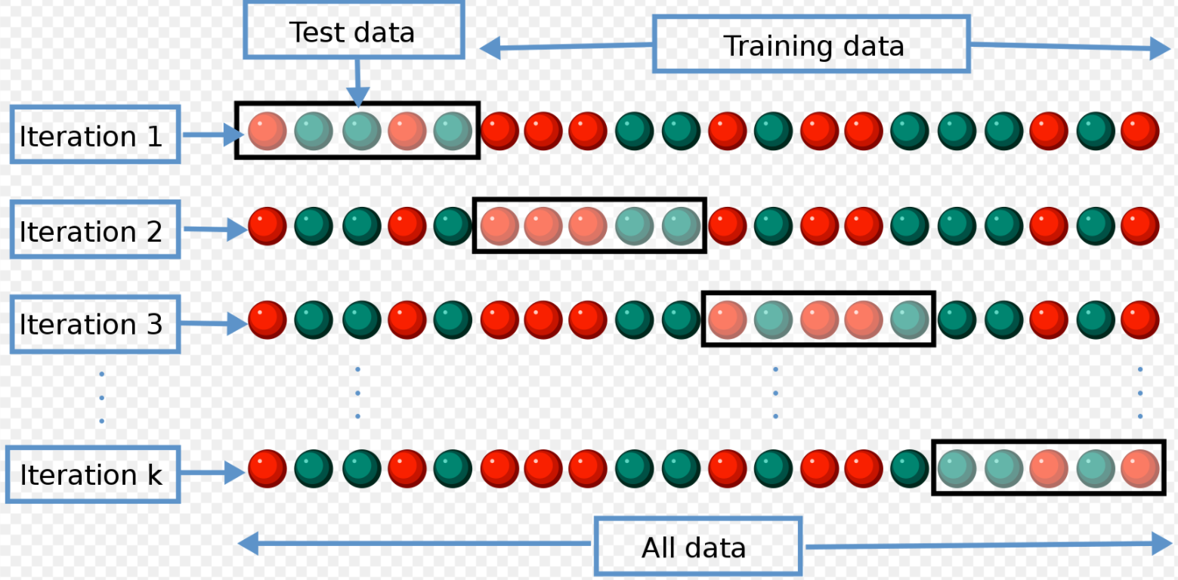
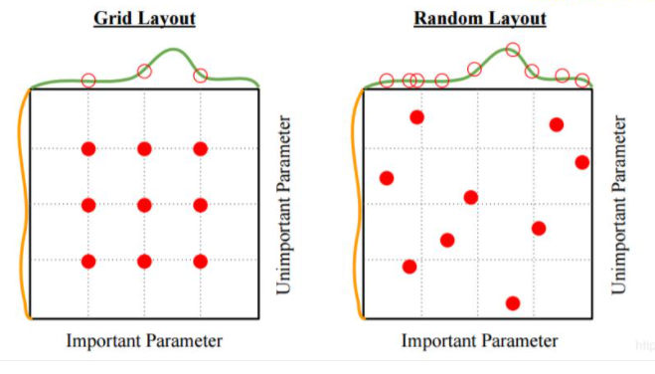
Model Refining
1. Cross Validation (from Sklearn)
To reduce bias and randomness, rotate sets of train and test data
2. Grid Search (from Sklearn)
To optimize parameters, exhaust all combinations of parameters specified manually
Source: https://en.wikipedia.org/wiki/Cross-validation_(statistics) / https://www.programmersought.com/article/2318546785/

Slide 5
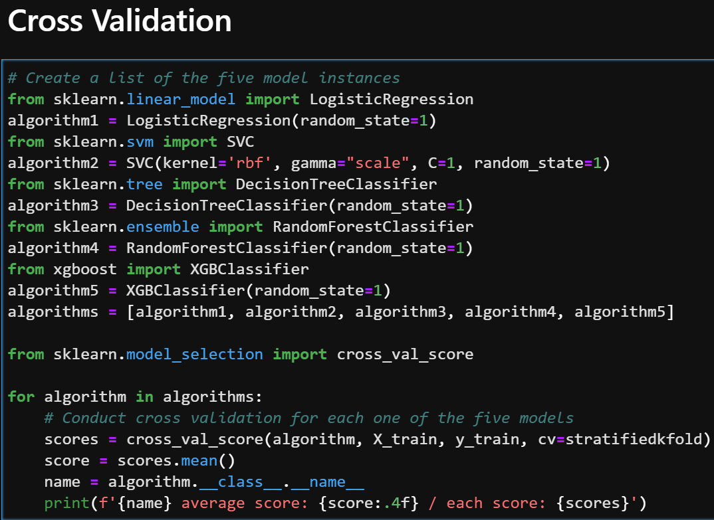
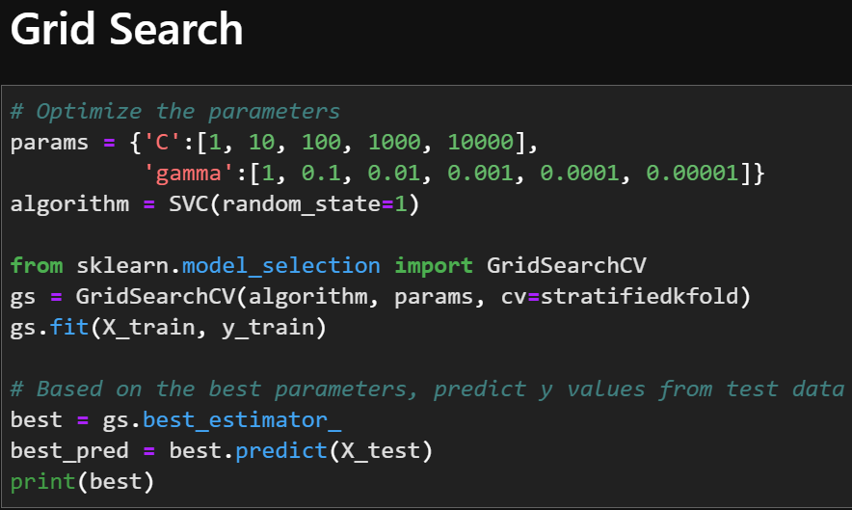
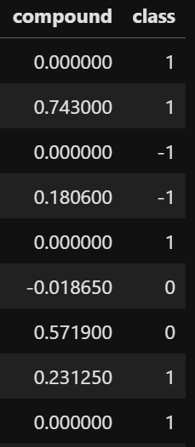
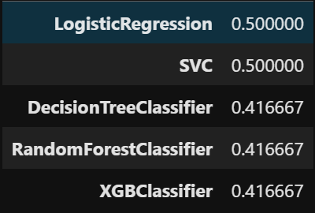
Initial Model : 1 X feature: Sentiment
y value: Trading signals
Apply 5 models
Not perform well
based on accuracy scores

Slide 6
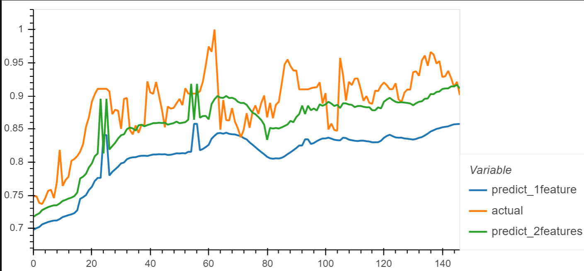
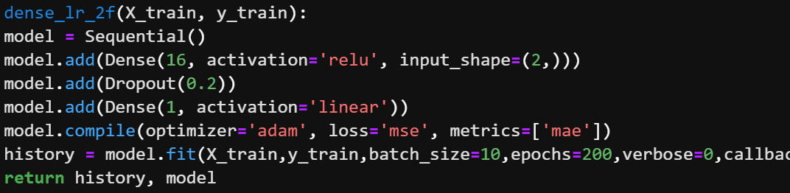
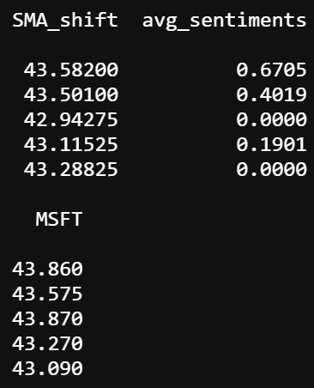
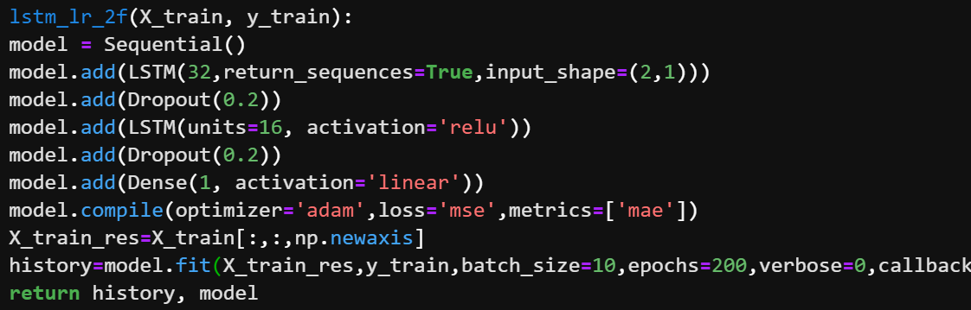
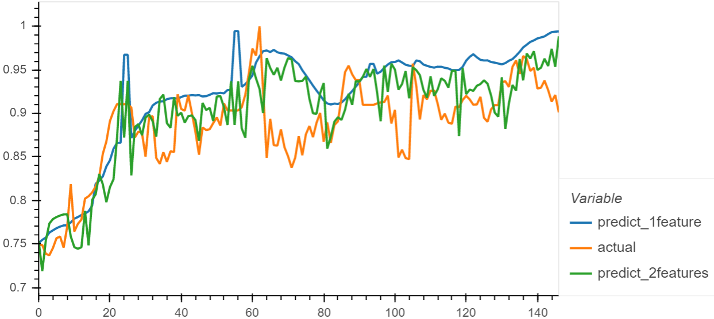
Next Model : 2 X features: Past Stock Price & Sentiment
y value: Stock Price (Regression)
or Trading signals (Classification)
1. Regression
ex) MSFT
(1) Dense NN
Orange: y_test. Actual price movements →
1 feature: moving average only ↓
Apply 2 models
↑Green (with sentiment) closer to orange
↓than blue (without sentiment) in both models
2 features: moving average + sentiment →
(2) LSTM
↑ 2 X features
(moving avg + sentiment)
← y value

Slide 7
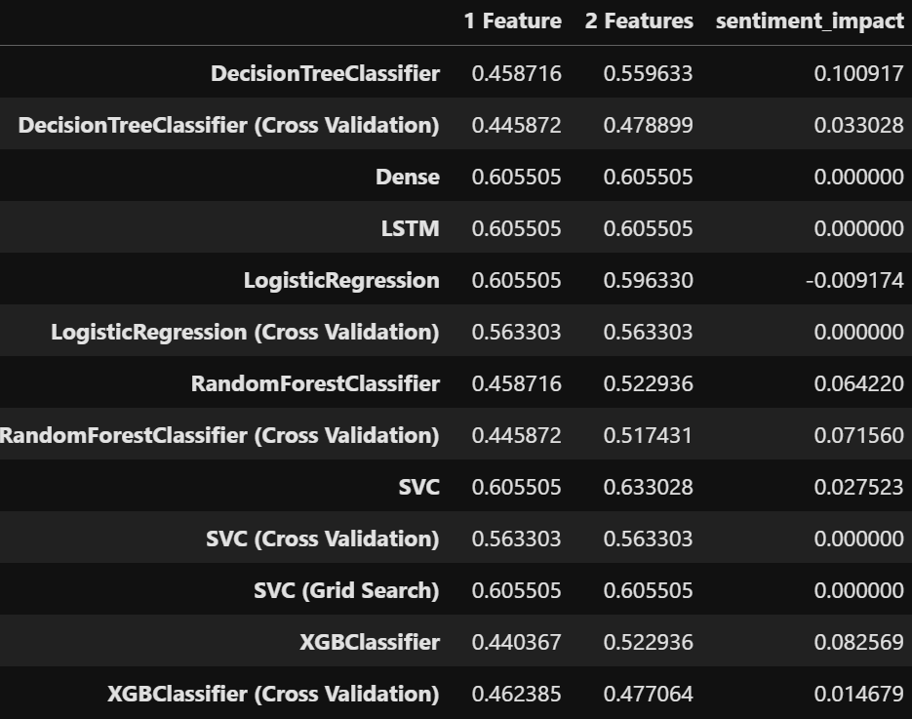
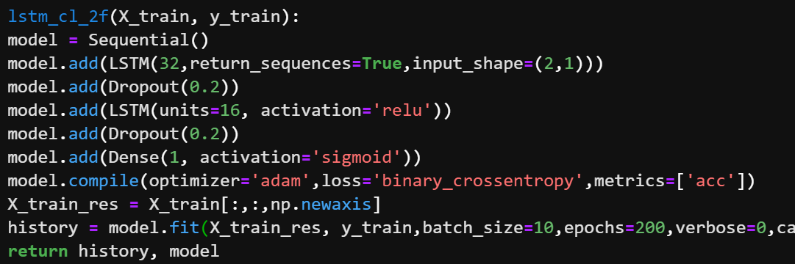
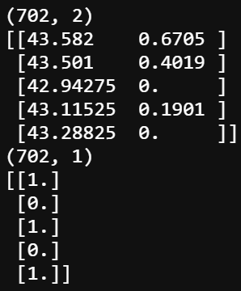
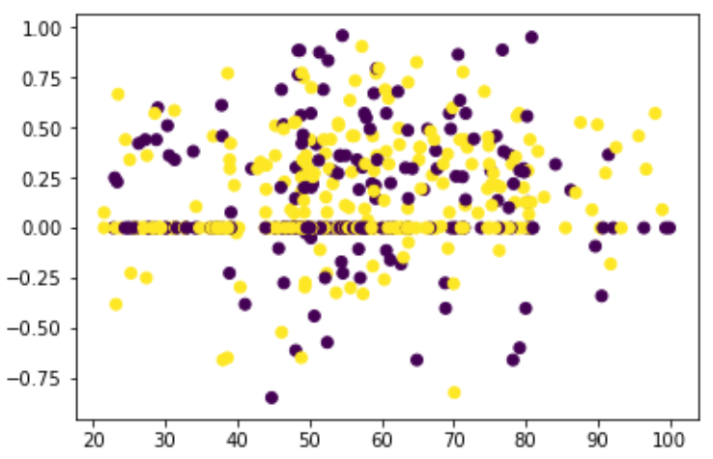
Next Model : 2 X features: Past Stock Price & Sentiment
y value: Stock Price (Linear Regression)
or Trading signals (Classification)
Contd’
Accuracy score improvements due to sentiments ↓
2. Classification
1. activation: linear → sigmoid
2. loss: mean square error → binary_crossentropy
3. metrics: mean absolute error → accuracy
3 changes to convert into a classification model
ex) Sony
Apply 7 models
and calculate how much sentiments improve accuracy scores
↑ 2 X features
(moving avg + sentiment)
← y class value

Slide 8
Obstacles Faced
Data Collection - Finding a cost free API.
Low accuracy scores through multiple models.
Time Constraints- Advanced machine learning models take lots of time to develop.
Getting Additional Data for our models.
Computing Power - Amount of time it takes to pull data(2-3 hours for 10 years of tweets)

Slide 9
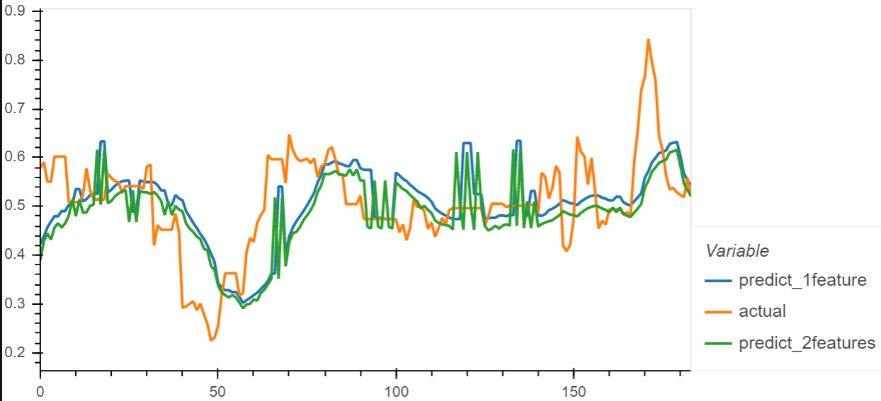
Conclusions and Predictions
Hard to predict stock prices solely based on tweet sentiments.
Combined with stock prices, tweet sentiments could improve a regression model performance as in MSFT. However, tweet sentiments didn’t make a meaningful difference for the other 4 corps.
3. Tweet sentiments also could improve a classification model performance as in Sony. However, the accuracy score is at most around 60%.
4. Although we faced some examples that tweets refined a regression/classification model, in many cases it was not clear if tweets could be used in general to predict stock prices.
Pfizer
LSTM

Slide 10
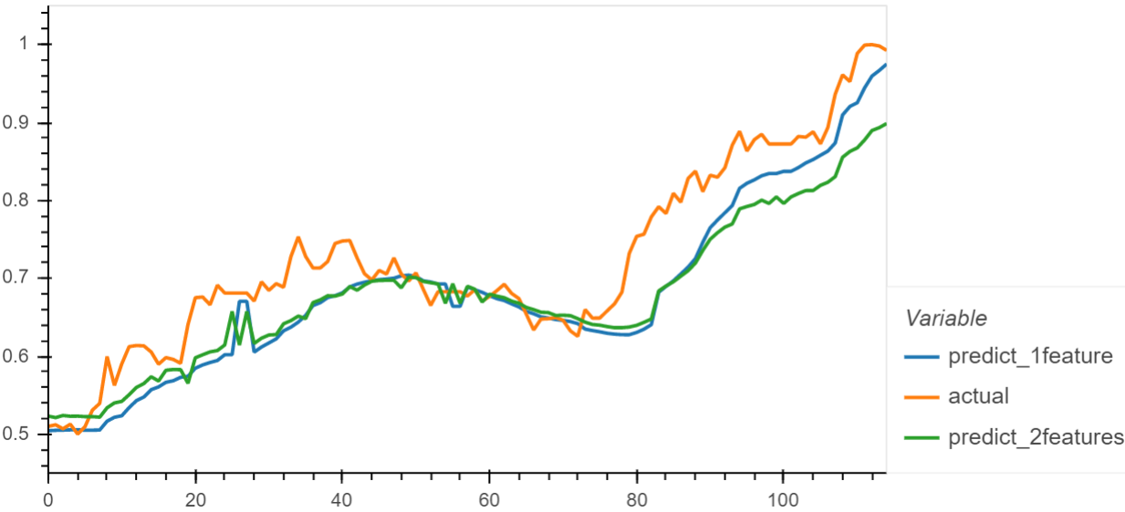
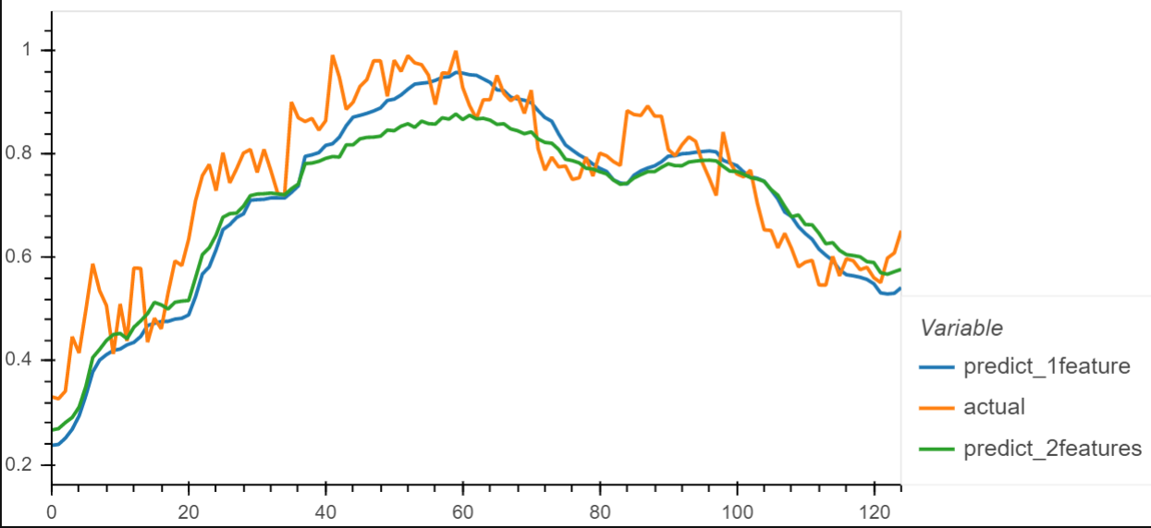
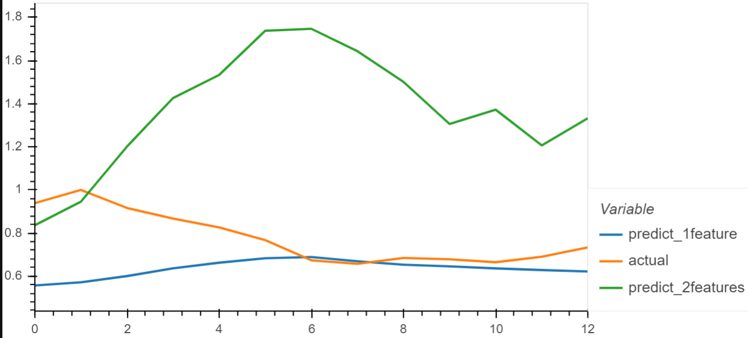
Predictions of LSTM Models
unlike MSFT, the 2 features models do not improve the performance so much
Sony
LSTM
Pfizer LSTM
Regeneron
LSTM
Moderna
LSTM

Slide 11
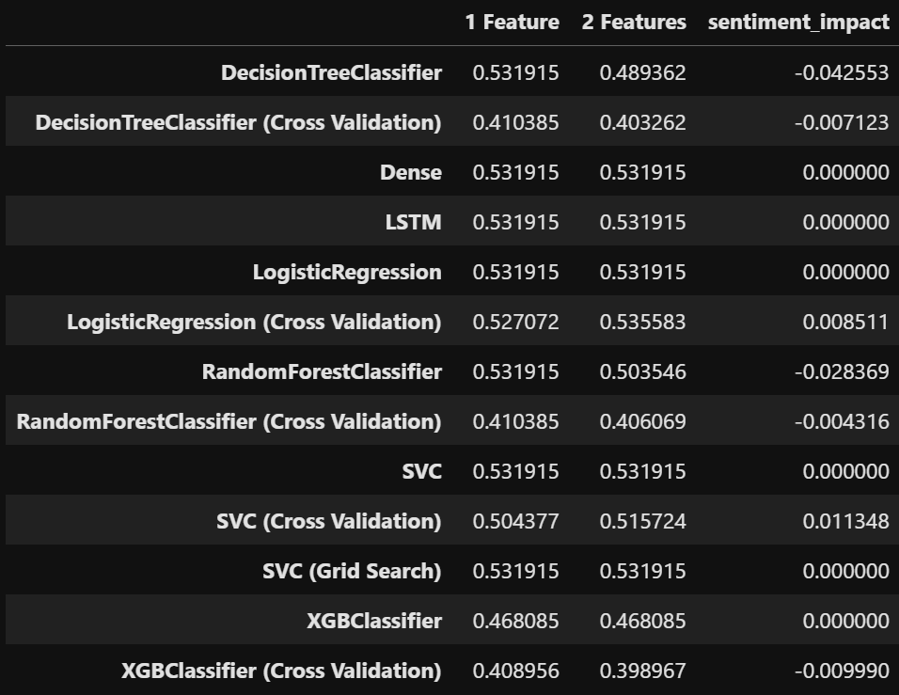
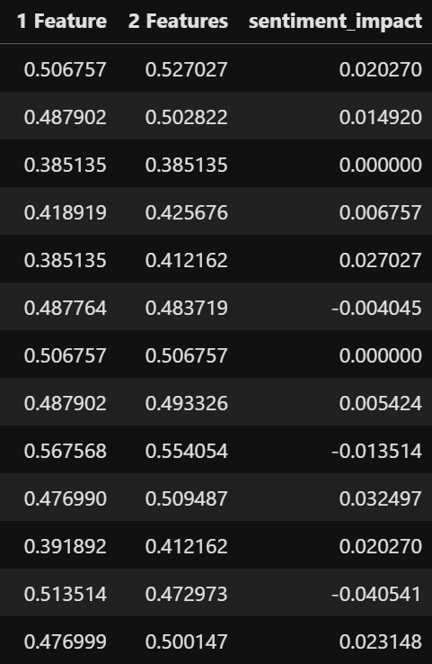
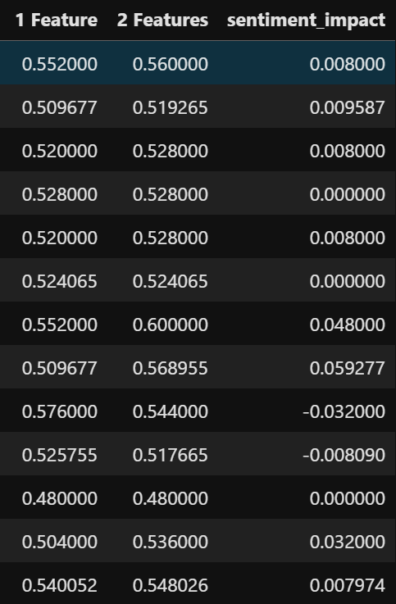
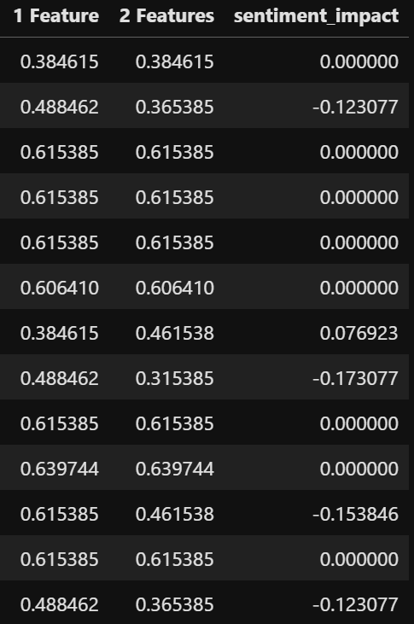
Accuracy Scores of Classification Models and the Effect of Sentiment Scores
unlike Sony, the sentiment scores do not improve accuracy scores so much in any model
MSFT
Pfizer
Regeneron
Moderna

Slide 12
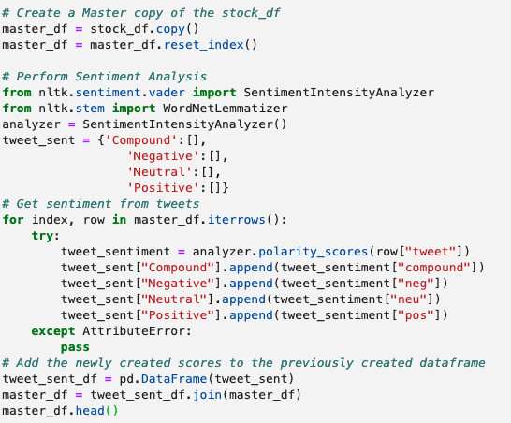
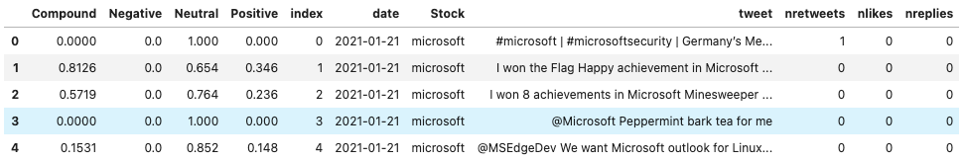
Sentiment Analysis
After using twint to gather raw Twitter Data, we could then perform sentiment analysis using nltk

Slide 13
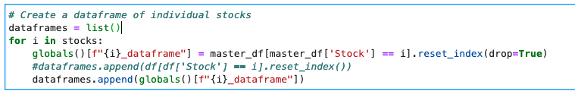
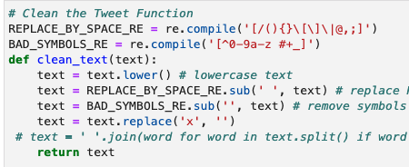
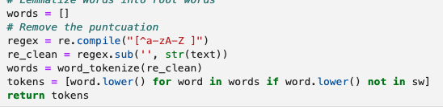

Sentiment Analysis - Data Filtering and Text Cleaning
After running the initial sentiment analysis, we found it helpful to split the master dataframe by stock

Slide 14

Sentiment Analysis and For Loops
Using globals() and for loops made the visualization process seamless

Slide 15
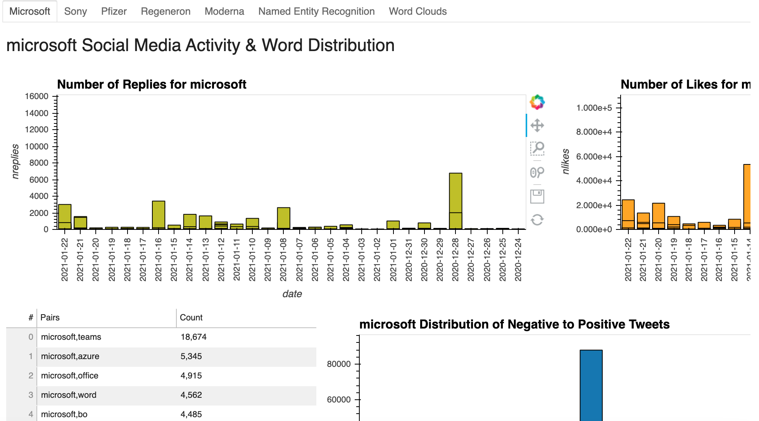
Sentiment Analysis - Dashboard

Slide 16
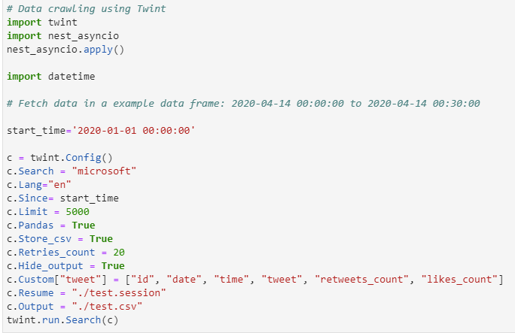
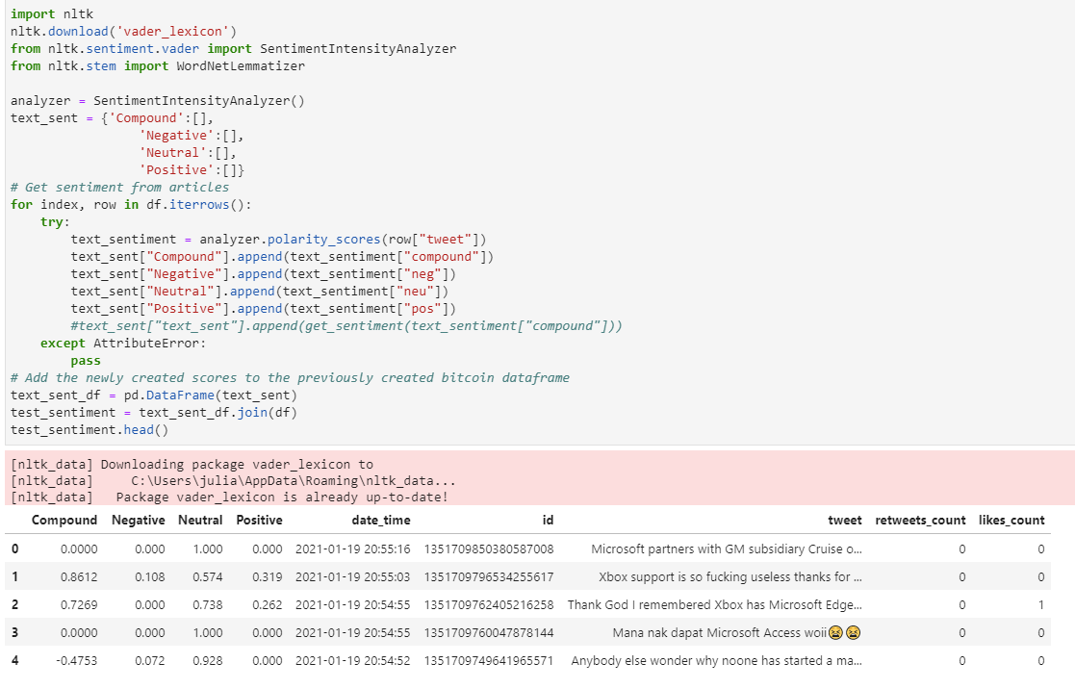
Twitter Data Pull/Cleanup:
Used Twint import to call in twitter data:
Twint provides unlimited tweets
Customization of required data with Search parameters
Storage capabilities directly to CSV
Provides User ID, Data, Time and “like” counts
Does not require Twitter API access
Code required to pull data using twint:

Slide 17
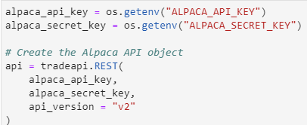
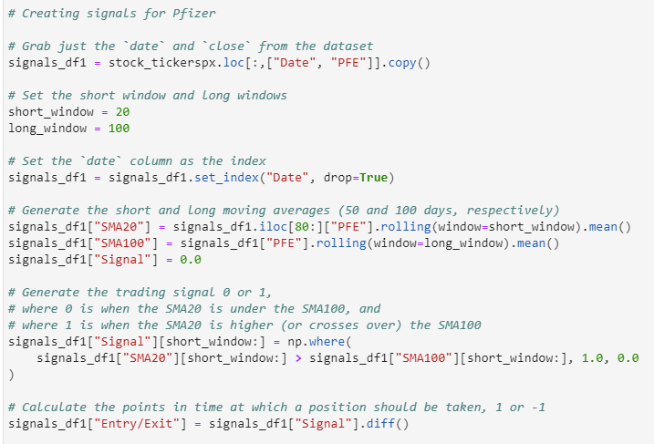
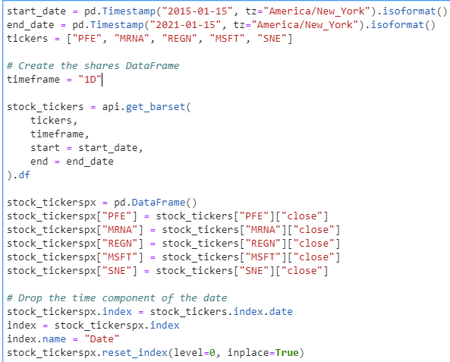
Pulling stock data, cleanup and prep:
Used Alpaca API to pull 6 years of stock data for Pfizer, Moderna, Regeneron, Microsoft and Sony.
Only retained closing prices from the Alpaca data in order to prep for creation of signals and bollinger band.

