Slide 1
RBM Recommender System

Slide 2
RBMs and Collaborative Filtering
Based on the paper by Salakhutdinov et al https://www.cs.toronto.edu/~rsalakhu/papers/rbmcf.pdf
This presentation will synthesize the information presented in this paper and only outline the methods used in the program found here: https://github.com/julianClayton/Recommender-RBM
This presentation assumes that the reader knows how RBMs work

Slide 3
Structure
An RBM is created for each individual user
The unrated movies for a user are removed for each RBM
The RBM is trained on each single user and the weights and biases are saved.
At the end of the training ALL the weights and biases from ALL the RBMS are averaged. The averaged weights and biases are used to provide recommendations.

Slide 4
Formatting Input/Rating.
The movie are rated on a scale from 1-5
For each user, each movie rating is converted to a one-hot vector. The softmax function is then applied to the vector to get probabilities.
This is how the data is formatted before being fed into the network.
Diagram on following slide

Slide 5
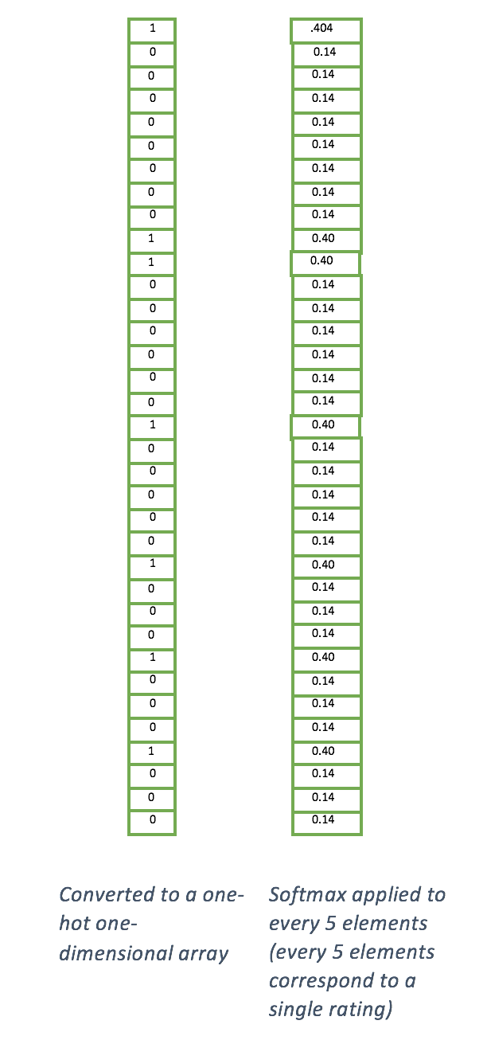
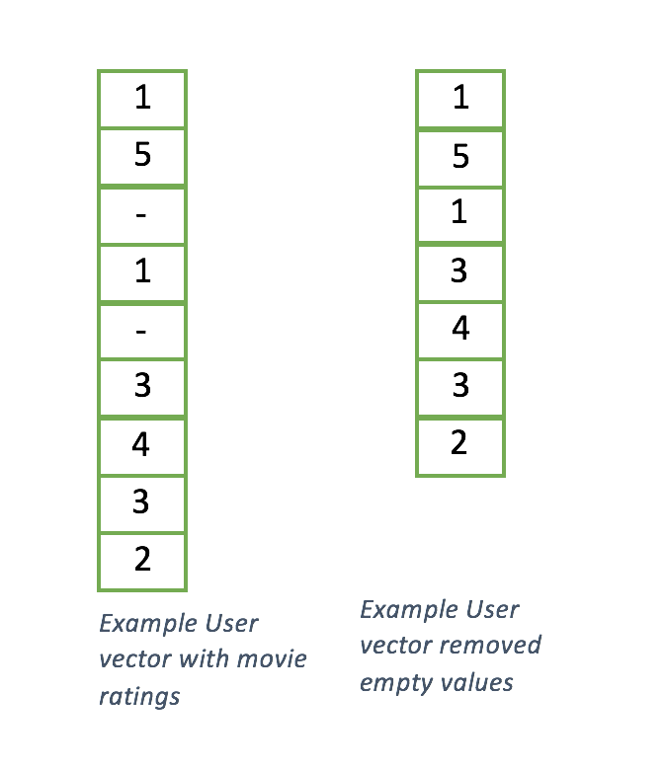

Input

Slide 6

Feed forward
Let the input (visible layer) be V
Let the hidden biases be BH
Let the visible biases be BV
Let the hidden layer be H
To feed forward in the RBM we want the probability that H[i] = 1 given visible inputs V
Thus we have:

Slide 7

Feed Backward
After sampling the hidden layer as instructed in the previous slide we sample the visible layer, given hidden layer h
In doing this we will calculate the probabilities that any element in V will be a will be a 1 given H.
Thus the denominator is the sum of all the probabilities and the numerator is the probability
For K ratings and individual rating k

Slide 8
Training
As said above, train by creating an RBM for each user, and running it for a set amount of iterations or until the difference between the cost of each iteration reaches a certain threshold.
The cost function used in the code is a simple Root Mean Squared Error (RMSE) function.

Slide 9
Recommendations
After training, all the weights and biases are averaged and saved.
To recommend we sample the probability that movie q rated 1, 2, 3,4 or 5 then get the expected value of these probabilities.
In the code this means that for a single user we set movie q to rating 1,2,3,4,5. For each of these ratings we sample from the RBM using the methods from slides 6 and 7. Then the probability for each rating are saved to an array, the soft-max function is applied then we get the expected value for that array.

