Slide 1
RBM Recommender System

Slide 2
RBMs and Collaborative Filtering
Based on the paper by Salakhutdinov et al https://www.cs.toronto.edu/~rsalakhu/papers/rbmcf.pdf
This presentation will synthesize the information presented in this paper and only outline the methods used in the program found here: https://github.com/julianClayton/Recommender-RBM
This presentation assumes that the reader knows how RBMs work

Slide 3
Structure
An RBM is created for each individual user
The unrated movies for a user are removed for each RBM
The RBM is trained on each single user and the weights and biases are saved.
At the end of the training ALL the weights and biases from ALL the RBMS are averaged. The averaged weights and biases are used to provide recommendations.

Slide 4
Formatting Input/Rating.
The movie are rated on a scale from 1-5
For each user, each movie rating is converted to a one-hot vector. The softmax function is then applied to the vector to get probabilities.
This is how the data is formatted before being fed into the network.
Diagram on following slide

Slide 5
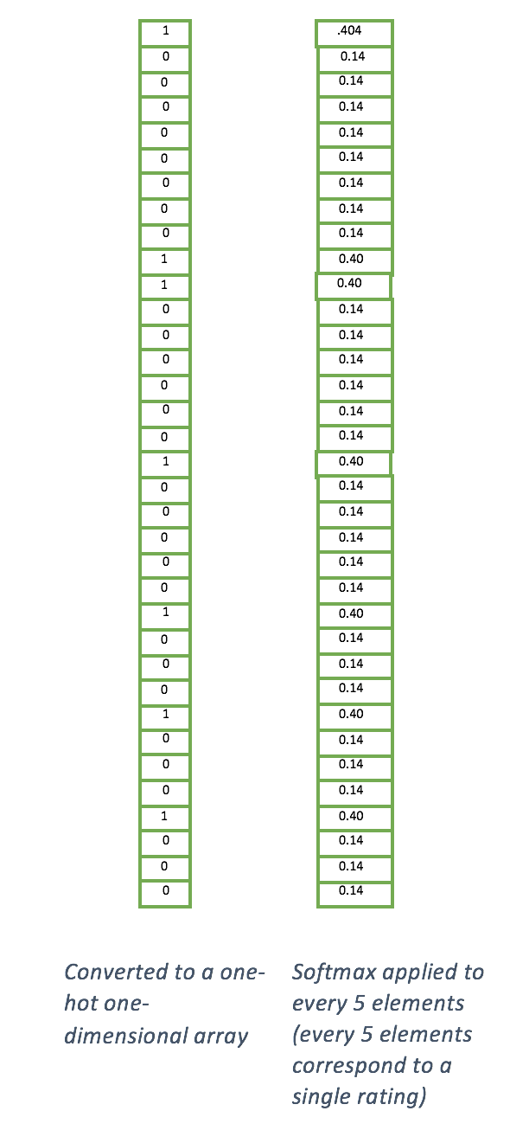
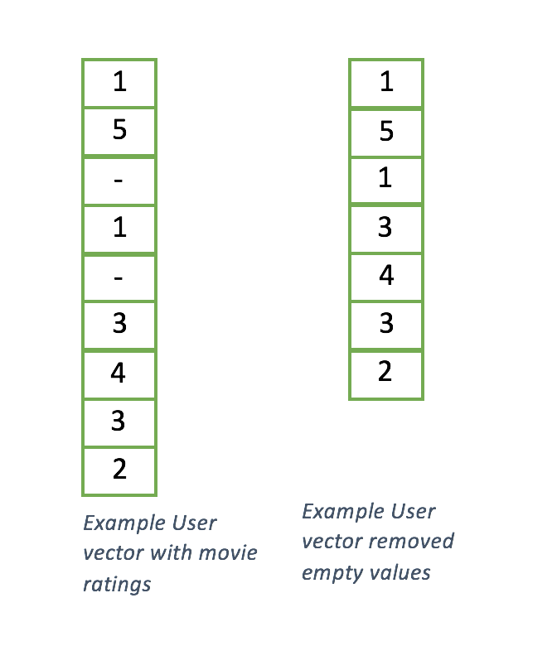

Input

Slide 6

Feed forward
Let the input (visible layer) be V
Let the hidden biases be BH
Let the visible biases be BV
Let the hidden layer be H
To feed forward in the RBM we want the probability that H[i] = 1 given visible inputs V
Thus we have:

Slide 7

Feed Backward
After sampling the hidden layer as instructed in the previous slide we sample the visible layer, given hidden layer h
In doing this we will calculate the probabilities that any element in V will be a will be a 1 given H.
Thus the denominator is the sum of all the probabilities and the numerator is the probability
For K ratings and individual rating k

Slide 8
Training
As said above, train by creating an RBM for each user, and running it for a set amount of iterations or until the difference between the cost of each iteration reaches a certain threshold.
The cost function used in the code is a simple Root Mean Squared Error (RMSE) function.

Slide 9
Recommendations
After training, all the weights and biases are averaged and saved.
To recommend we sample the probability that movie q rated 1, 2, 3,4 or 5 then get the expected value of these probabilities.
In the code this means that for a single user we set movie q to rating 1,2,3,4,5. For each of these ratings we create a new RBM and sample from it using the weights that we saved.
For each of these ratings we sample from the RBM using the methods from slides 6 and 7. Then the probability for each rating is saved to an array, the soft-max function is applied then we get the expected value for that array.

Slide 10
Example
Given user vector [0,0,0,1,0,1,0,0,0,0,1,0,0,0,0]
Add the movie that we want to predict: [0,0,0,1,0,1,0,0,0,0,1,0,0,0,0,1,0,0,0,]. This would compute the probability that the red movie is rated 1.
Now sample from the RBM; Let’s say that we get the following probabilities returned:
[0.22,0.13,0.12,0.4,0.13,0.13,0.11,0.21,0.4,0.05,0.41,0.05,0.05,0.19,0.3,0.54,0.1,0.11,0.05,0.2].
Therefore the probability that the rating=1 is 13% which is quite low

Slide 11
Example Continued….
Put the 13% into a list to be used after: [0.13, tbd, tbd, tbd,tbd]
Do the same process to all other ratings
In the end we will have something like this: [0.13, 0.8, 0.5, 0.2,0.1]
Apply soft-max to this list: [0.15516083, 0.30322108, 0.2246317 , 0.16641126, 0.15057513]
Get the expected value:
0.15 * 1 + 0.3 * 2 + 0.22 * 3 + 0.17*4 + 0.15*5 = 2.84

Slide 12
Running the program
The program is run from the Recommender.py class
To train:
if __name__ == "__main__":
recommender = Recommender()
Training can take a VERY long time so it is not recommended to do this unless you have several hours at your disposal.
However all the weights and biases of a full training session are saved under the data subdirectory so that they can be loaded to provide recommendationss

Slide 13
Recommendations
In the Recommender class:
if __name__ == "__main__":
recommender = Recommender()
recommender.recommend(40, 346)
This will provide a prediction user 40, movie 346.

Slide 14
Issues with the RBM Recommender
Takes a very long time to train and is very computationally expensive.
According to the paper by Salakhutdinov et al. provides 6% more accurate recommendations than standard SVD techniques. Is it worth it?
What mighthappen if we add another RBM layer? Longer computation? How much more accuracy?

