Slide 1





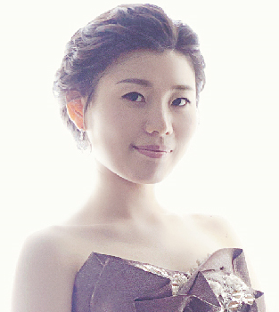
Ecole Music Sydney Team Information
Suite 2 Betty Cuthbert Avenue, Ermington NSW 2115
(02) 8606 1765 (02) 8677 4327
info@ecolemusicsydney.com
ecolemusicsydney.com
Juliana Seo
(Piano | Theory | Accompaniment)
Head of School, Ecole Music Sydney
Education
École Normale de Musique de Paris, France - Diplôme Supérieur d’Enseignement (Post Grad. Education Diploma) - Diplôme Supérieur d’Exécution (Post Grad. Solo Performing Diploma)
Hanover Univ. of Music, Drama and Media, Germany (Master of Music)
Ewha Womans University, S. Korea (Bachelor of Music)
Sun Hwa Arts Highschool, S. Korea
Experience
Head of School, Ecole Music Sydney / Int’l pianist
A member of French Music Research Society
Adjunct faculty, Chugye Univ. for the Arts - College of Music, S Korea
Music teacher, Sun Hwa Arts Highschool, S. Korea
Int'l Competition Award
1st Prize of Young Musicians Int’l Competition “Citta di Barletta” in Italy
1st Prize of Concorso Int’l di Ececuzione Musicale ‘Valeria Martina’ “Citta di Massafra” in Italy
2nd Prize of Concours Int’l de Piano ‘Madelene de Valmalte’ in Paris, France
3rd Prize of Grand Prix Int’l et Rencontre Jeunes Talents Monrond-les-Bains in France

Slide 2
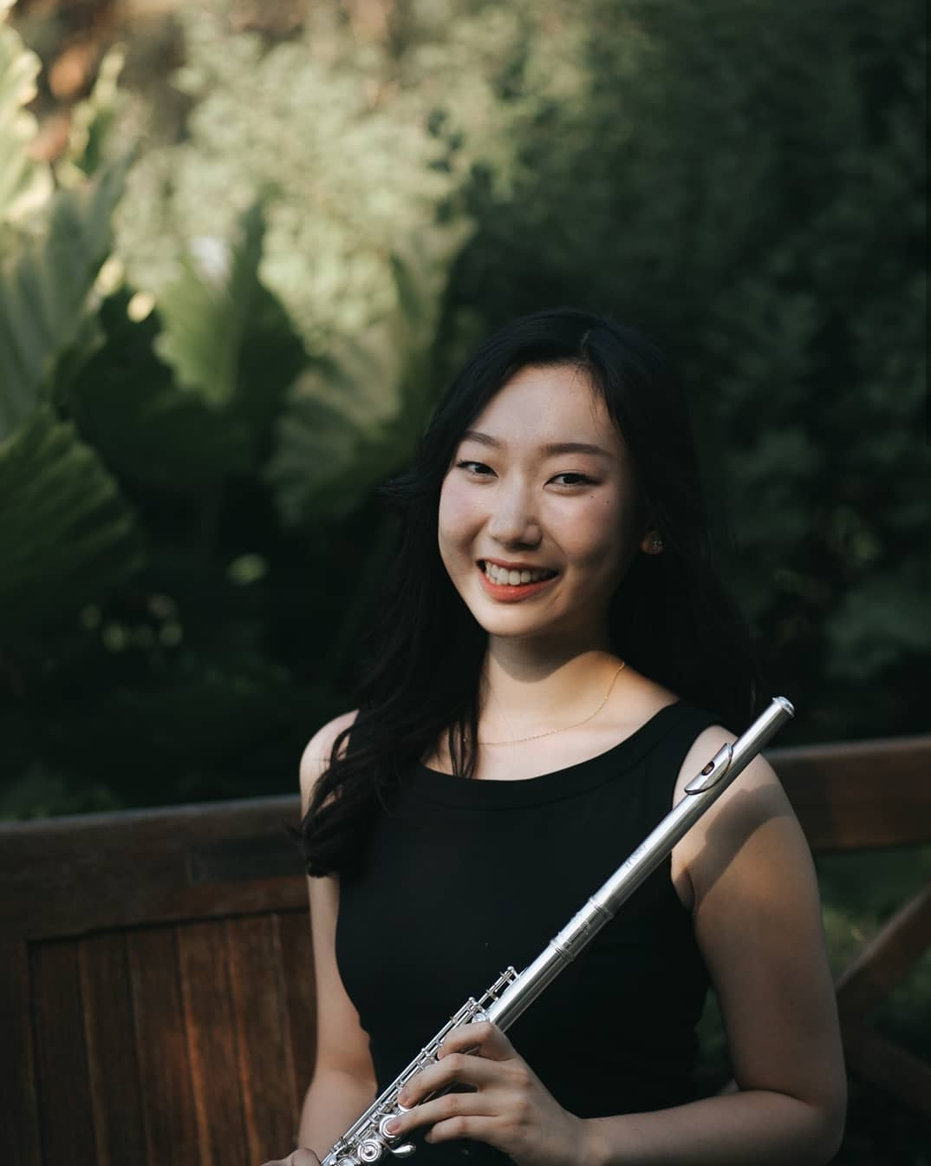
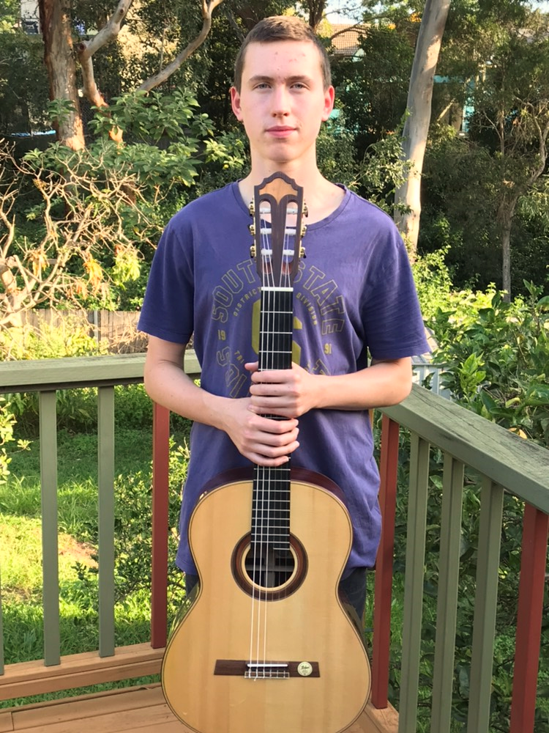
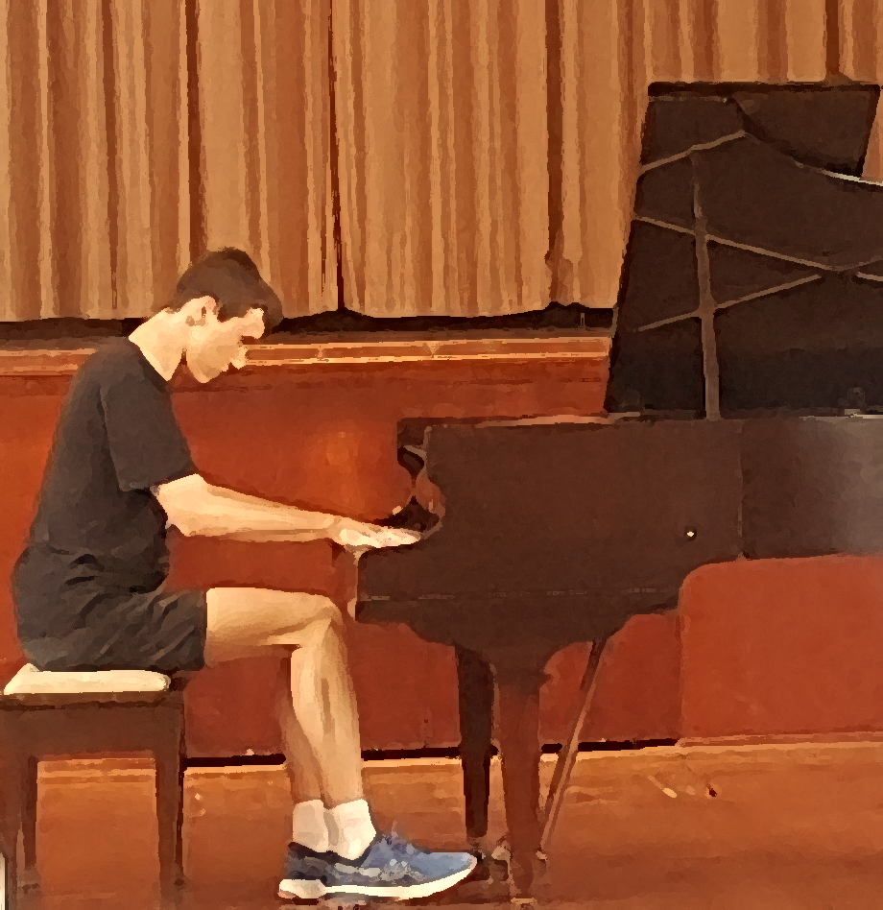
Ecole Music Sydney Team Information
Suite 2 Betty Cuthbert Avenue, Ermington NSW 2115
(02) 8606 1765 (02) 8677 4327
info@ecolemusicsydney.com
ecolemusicsydney.com
Joanne Kim
(Flute | Theory)
Flute teacher, Ecole Music Sydney
Education
University of New South Wales (UNSW) - Bachelor of Music (Honours) / Bachelor of Education (Secondary) / AMUS
Experience
Music teacher at Macarthur Girls High School, Holroyd High School, etc
Music tutor at North Bridge Public School, Windworks Woodwind Specialist, etc
Music ensemble member, the Arts Unit and UNSW Wind Symphony Orchestra
Others
1st in the HSC Music II, HSC Encore Nomination, and 1st Prizes of local competitions
Jeremiah Hodgson
(Classical Guitar | Theory)
Classic Guitar teacher, Ecole Music Sydney
Education
Sydney Conservatorium of Music (Bachelor of Music)
Others
Completed Grade 8 AMEB exam for classical guitar
Albert Hodgson
(Piano | Theory)
Piano teacher, Ecole Music Sydney
Education
Sydney Conservatorium of Music (Bachelor of Music)
Others
Completed Grade 8 AMEB exam for piano

