Slide 1

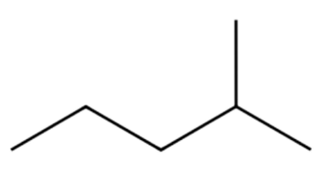
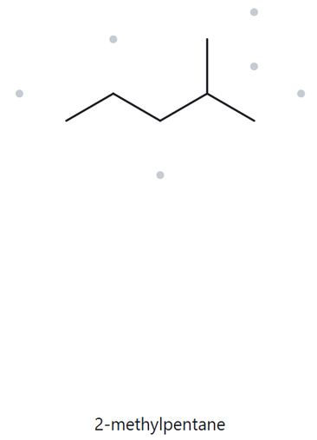


STRUCTURE → NAME
A01 | Foundation · Molecular formula: C₆H₁₄
1) Numbered Parent
2) Naming Trail
Parent: Longest continuous chain = 5 carbon atoms → pentane.
Numbering: Left → right gives the methyl substituent at 4; Right → left gives the methyl substituent at 2; First point of difference: 2 < 4, so number from right → left.
2
5
4
3
1
Substituent: One methyl group (–CH₃) attached to 2 → 2-methyl.
3) My Name
4) The Alkane Check
2-methylpentane
Match
VERIFICATION STRIP
longest chain confirmed
lowest locants
alphabetical order
punctuation
formula counted

Slide 2
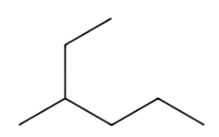
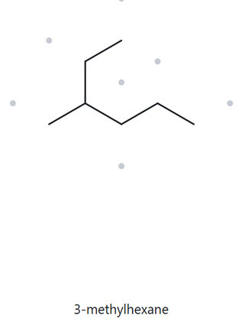
STRUCTURE → NAME
A02 | Foundation · Molecular formula: C₇H₁₆
1) Numbered Parent
2) Naming Trail
1
Parent: Longest continuous chain = 6 carbon atoms → hexane.
2
Numbering: Upper end → right end gives 3; Right end → upper end gives 4; First point of difference: 3 < 4, so number from the upper end.
3
4
5
Substituent: One methyl group attached to C3 → 3-methyl.
6
3) My Name
4) The Alkane Check
3-methylhexane
Match
VERIFICATION STRIP
longest chain confirmed
lowest locants
alphabetical order
punctuation
formula counted

Slide 3
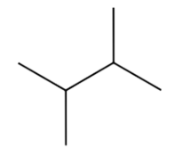
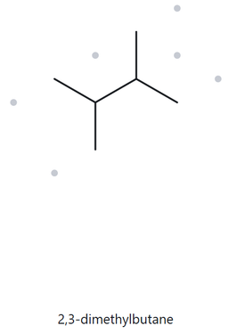
STRUCTURE → NAME
A03 | Foundation · Molecular formula: C₆H₁₄
1) Numbered Parent
2) Naming Trail
Parent: Longest continuous chain = 4 carbon atoms → butane.
Numbering: Left → right gives methyl groups at 2 and 3; Right → left also gives methyl groups at 2 and 3; Both directions give the same locants.
3
2
4
Substituent: Two methyl groups attached to 2 and 3 → 2,3-dimethyl.
1
3) My Name
4) The Alkane Check
2,3-dimethylbutane
Match
VERIFICATION STRIP
longest chain confirmed
lowest locants
alphabetical order
punctuation
formula counted

Slide 4
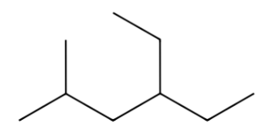
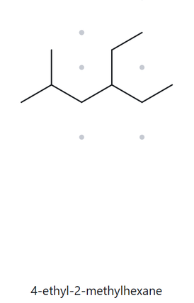
STRUCTURE → NAME
A04 | Developing · Molecular formula: C₉H₂₀
1) Numbered Parent
2) Naming Trail
Parent: Longest continuous chain = 6 carbon atoms → hexane. There are multiple 6-carbon paths, but they give the same substituents when numbered correctly.
Numbering: Left → right gives substituents at 2 and 4; Right → left gives substituents at 3 and 5; First point of difference: 2 < 3, so number from the left.
2
3
4
5
6
Substituent: Methyl group at 2; Ethyl group at 4; Arrange substituents alphabetically: ethyl before methyl.
1
3) My Name
4) The Alkane Check
4-ethyl-2-methylhexane
Match
VERIFICATION STRIP
longest chain confirmed
lowest locants
alphabetical order
punctuation
formula counted

Slide 5
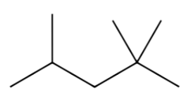
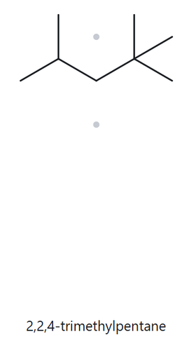
STRUCTURE → NAME
A05 | Developing · Molecular formula: C₈H₁₈
1) Numbered Parent
2) Naming Trail
Parent: Longest continuous chain = 5 carbon atoms → pentane.
Numbering: Left → right gives methyl groups at 2, 4, and 4; Right → left gives methyl groups at 2, 2, and 4; First point of difference: 2,2,4 is lower than 2,4,4, so number from the right.
4
3
2
1
Substituent: Three methyl groups attached to 2, 2, and 4 → 2,2,4-trimethyl.
5
3) My Name
4) The Alkane Check
2,2,4-trimethylpentane
Match
VERIFICATION STRIP
longest chain confirmed
lowest locants
alphabetical order
punctuation
formula counted

Slide 6
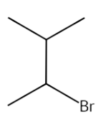
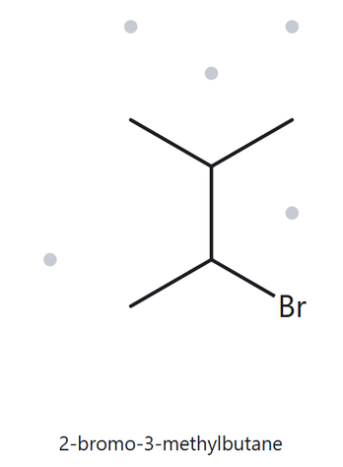
STRUCTURE → NAME
A06 | Developing · Molecular formula: C₅H₁₁Br
1) Numbered Parent
2) Naming Trail
4
Parent: Longest continuous chain = 4 carbon atoms → butane.
3
Numbering: Starting from the upper-left end gives methyl at 2 and bromo at 3; Starting from the lower-left end gives bromo at 2 and methyl at 3; Both directions give the locant set 2,3; First point of difference (alphabetical tie-break): bromo comes before methyl, so bromo receives the lower number.
2
1
Substituent: Bromo (–Br) on 2; Methyl (–CH₃) on 3.
3) My Name
4) The Alkane Check
2-bromo-3-methylbutane
Match
VERIFICATION STRIP
longest chain confirmed
lowest locants
alphabetical order
punctuation
formula counted

Slide 7
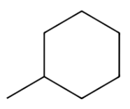
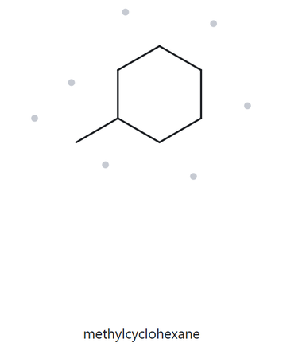
STRUCTURE → NAME
A07 | Developing · Molecular formula: C₇H₁₄
1) Numbered Parent
2) Naming Trail
3
Parent: Six-membered carbon ring = cyclohexane.
2
4
Numbering: Start at the ring carbon attached to the methyl group (1); Continue clockwise or counterclockwise; Since there is only one substituent, either direction gives the same numbering.
1
5
6
Substituent: One methyl group (–CH₃) attached to 1 → 1-methyl.
3) My Name
4) The Alkane Check
methylcyclohexane
Note: The locant 1 is unnecessary because there is only one substituent on the ring.
Match
VERIFICATION STRIP
longest chain confirmed
lowest locants
alphabetical order
punctuation
formula counted

Slide 8
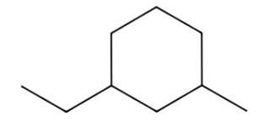
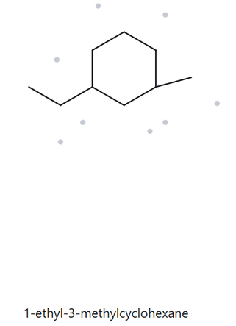
STRUCTURE → NAME
A08 | Challenge · Molecular formula: C₉H₁₈
1) Numbered Parent
2) Naming Trail
Parent: Longest parent structure = six-carbon ring → cyclohexane. The ring is the parent because it contains more carbon atoms than either attached side chain.
4
5
6
Numbering: Start at the ring carbon attached to the ethyl group; Number toward the methyl group to obtain the lowest locants; Clockwise: ethyl at 1 and methyl at 3; Counterclockwise: ethyl at 1 and methyl at 5; First point of difference: 3 < 5, so choose the first direction.
1
3
Substituent: Ethyl group (–CH₂CH₃) on 1; Methyl group (–CH₃) on 3; Arrange alphabetically: ethyl before methyl.
2
3) My Name
4) The Alkane Check
1-ethyl-3-methylcyclohexane
Match
VERIFICATION STRIP
longest chain confirmed
lowest locants
alphabetical order
punctuation
formula counted

Slide 9
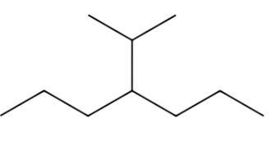
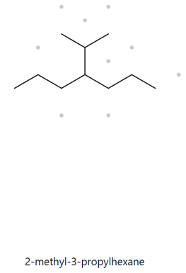

STRUCTURE → NAME
A09 | Challenge · Molecular formula: C₁₀H₂₂
1) Numbered Parent
2) Naming Trail
Parent: Longest continuous chain = 7 carbon atoms → heptane.
Numbering: Left → right gives the substituent at 4; Right → left also gives the substituent at 4; Both directions give the same locant, so either direction is acceptable.
Substituent: One propan-2-yl (isopropyl) group attached to 4. The branch contains: 1 central carbon attached to the parent chain and 2 methyl groups attached to that central carbon.
2
4
6
1
3
5
7
3) My Name
4) The Alkane Check
The correct name is 4-(propan-2-yl)heptane. The Alkane's mistake was selecting a six-carbon parent chain instead of the longest available seven-carbon chain. According to the IUPAC rule, the longest continuous carbon chain must be selected as the parent before identifying substituents. Therefore, 4-(propan-2-yl)heptane is correct.
4-(propan-2-yl)heptane
Commonly written as:
4-isopropylheptane
Mismatch
VERIFICATION STRIP
longest chain confirmed
lowest locants
alphabetical order
punctuation
formula counted

Slide 10
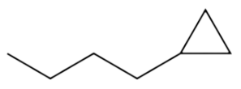
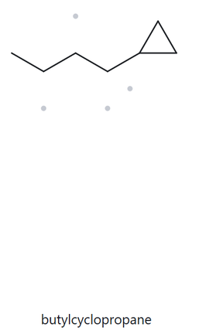
STRUCTURE → NAME
A10 | Challenge · Molecular formula: C₇H₁₄
1) Numbered Parent
2) Naming Trail
Parent: Longest acyclic chain = 4 carbon atoms → butane. The chain is chosen as the parent because it contains more carbon atoms than the cyclopropane ring (4 vs. 3).
Numbering: Left → right gives the cyclopropyl substituent at 4; Right → left gives the cyclopropyl substituent at 1; Choose right → left because 1 is lower than 4.
4
2
3
1
Substituent: One cyclopropyl group attached to 1 → 1-cyclopropyl.
3) My Name
4) The Alkane Check
Both 1-cyclopropylbutane and butylcyclopropane refer to the same structure, but they differ in their choice of parent structure and naming. The correct IUPAC name is 1-cyclopropylbutane because the longest acyclic chain contains four carbon atoms, while the cyclopropane ring contains only three. According to the parent structure selection rule, the acyclic chain is chosen as the parent when it contains more carbon atoms than the ring; thus, butane is the parent and cyclopropyl is the substituent
1-cyclopropylbutane
Mismatch
VERIFICATION STRIP
longest chain confirmed
lowest locants
alphabetical order
punctuation
formula counted

Slide 11
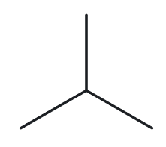
NAME → STRUCTURE
B01 | Foundation · Given Name: 2-methylpropane
1) Name Decoded
2) Bond-Line Structure
Parent: Propane → a 3-carbon chain.
Substituent: Methyl on 2.
Expected Formula: 3 + 1 = 4 C; acyclic alkane → C₄H₁₀.
3) Formula Check
4) Back-Check
Counted from the drawing: C₄H₁₀
Acyclic alkane: CₙH₂ₙ+₂ = C₄H₂(₄)+₂ = C₄H₁₀ ✓
Same as the given name
VERIFICATION STRIP
parent length matches
substituent positions matched
formula agrees
back-check recorded

Slide 12
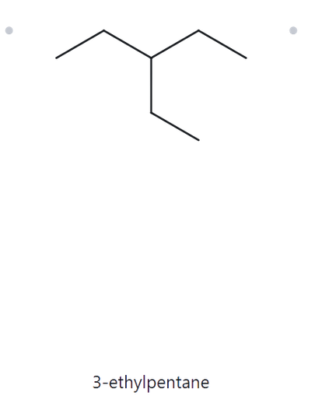
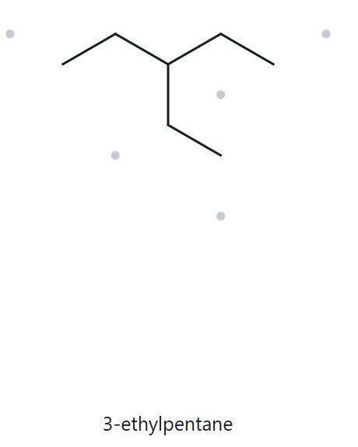
NAME → STRUCTURE
B02 | Foundation · Given Name: 3-ethylpentane
1) Name Decoded
2) Bond-Line Structure
Parent: Pentane → a 5-carbon chain.
Substituent: Ethyl on 3.
Expected Formula: 5 + 2 = 7 C; acyclic alkane → C₇H₁₆.
3) Formula Check
4) Back-Check
Counted from the drawing: C₇H₁₆
Acyclic alkane: CₙH₂ₙ+₂ = C₇H₂(₇)+₂ = C₄H₁₆ ✓
Same as the given name
VERIFICATION STRIP
parent length matches
substituent positions matched
formula agrees
back-check recorded

Slide 13
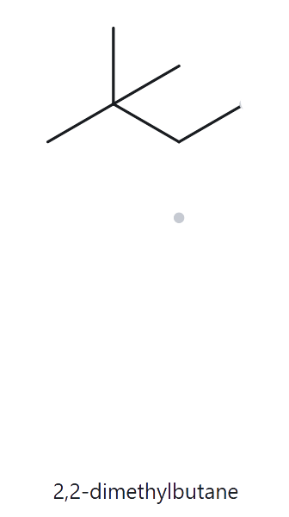
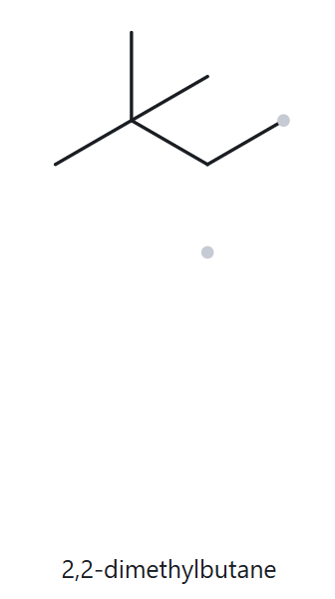
NAME → STRUCTURE
B03 | Foundation · Given Name: 2,2-dimethylbutane
1) Name Decoded
2) Bond-Line Structure
Parent: Butane → a 4-carbon chain.
Substituent: Two methyl groups on 2
Expected Formula: 4 + 2 = 6 C; acyclic alkane → C₆H₁₄.
3) Formula Check
4) Back-Check
Counted from the drawing: C₆H₁₄
Acyclic alkane: CₙH₂ₙ+₂ = C₆H₂(₆)+₂ = C₆H₁₄ ✓
Same as the given name
VERIFICATION STRIP
parent length matches
substituent positions matched
formula agrees
back-check recorded

Slide 14
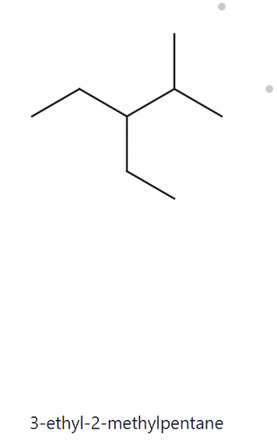
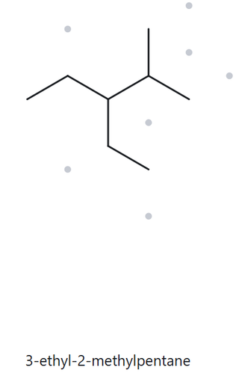
NAME → STRUCTURE
B04 | Developing · Given Name: 3-ethyl-2-methylpentane
1) Name Decoded
2) Bond-Line Structure
Parent: Pentane → a 5-carbon chain.
Substituent: Ethyl on 3; methyl on 2.
Expected Formula: 5 + 2 + 1 = 8 C; acyclic alkane → C₈H₁₈.
3) Formula Check
4) Back-Check
Counted from the drawing: C₈H₁₈
Acyclic alkane: CₙH₂ₙ+₂ = C₈H₂(₈)+₂ = C₈H₁₈ ✓
Same as the given name
VERIFICATION STRIP
parent length matches
substituent positions matched
formula agrees
back-check recorded

Slide 15
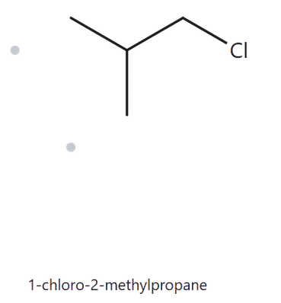
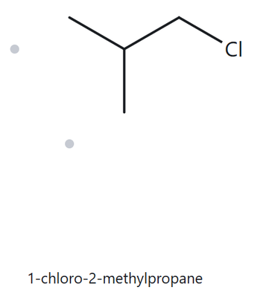
NAME → STRUCTURE
B05 | Developing · Given Name: 1-chloro-2-methylpropane
1) Name Decoded
2) Bond-Line Structure
Parent: Propane → a 3-carbon chain.
Substituent: Chloro on 1; methyl on 2.
Expected Formula: 3 + 1 = 4 C; acyclic alkane → C₄H₁₀; one H replaced by Cl → C₄H₉Cl.
3) Formula Check
4) Back-Check
Counted from the drawing: C₄H₉Cl
Acyclic alkane: CₙH₂ₙ+₂ = C₄H₂(₄)+₂ = C₄H₁₀
One hydrogen is replaced by chlorine: C₄H₉Cl ✓
Same as the given name
VERIFICATION STRIP
parent length matches
substituent positions matched
formula agrees
back-check recorded

Slide 16
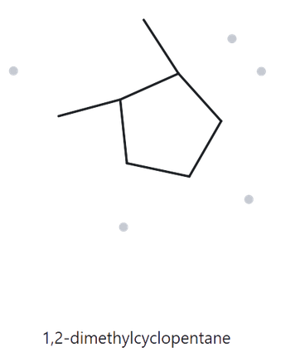
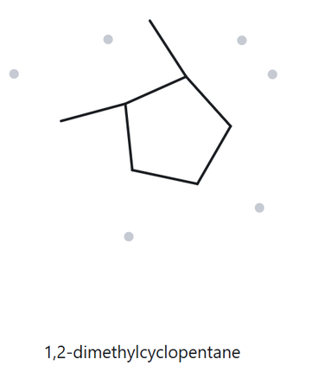
NAME → STRUCTURE
B06 | Developing · Given Name: 1,2-dimethylcyclopentane
1) Name Decoded
2) Bond-Line Structure
Parent: Cyclopentane → a 5-carbon ring
Substituent: Methyl on 1; methyl on 2
Expected Formula: 5 + 1 + 1 = 7 C; one ring → C₇H₁₄; two methyl substitutions replace two H atoms with two CH₃ groups, giving C₇H₁₄.
3) Formula Check
4) Back-Check
Counted from the drawing: C₇H₁₄
Cycloalkane with one ring: CₙH₂ₙ = C₇H₂(₇) = C₇H₁₄ ✓
Same as the given name
VERIFICATION STRIP
parent length matches
substituent positions matched
formula agrees
back-check recorded

Slide 17
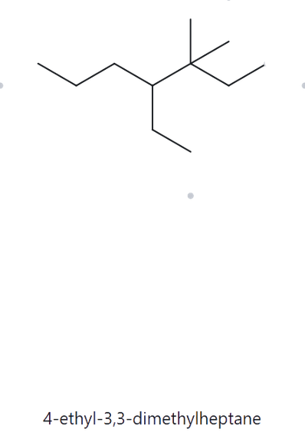
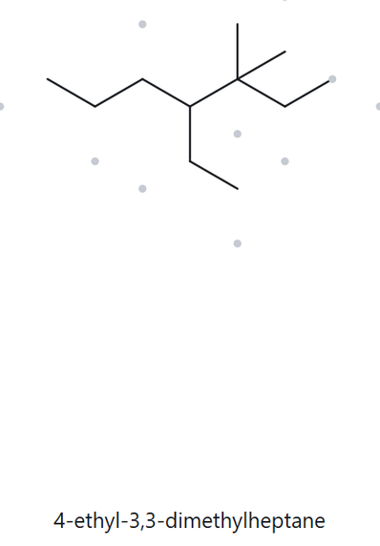
NAME → STRUCTURE
B07 | Developing · Given Name: 4-ethyl-3,3-dimethylheptane
1) Name Decoded
2) Bond-Line Structure
Parent: Heptane → a 7-carbon chain.
Substituent: Ethyl on 4; two methyl groups on 3.
Expected Formula: 7 + 2 + 1 + 1 = 11 C; acyclic alkane → C₁₁H₂₄.
3) Formula Check
4) Back-Check
Counted from the drawing: C₁₁H₂₄
Acyclic alkane: CₙH₂ₙ+₂ = C₁₁H₂(₁₁)+₂ = C₁₁H₂₄ ✓
Same as the given name
VERIFICATION STRIP
parent length matches
substituent positions matched
formula agrees
back-check recorded

Slide 18
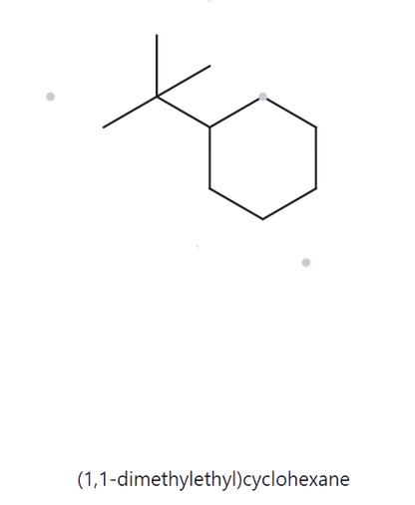
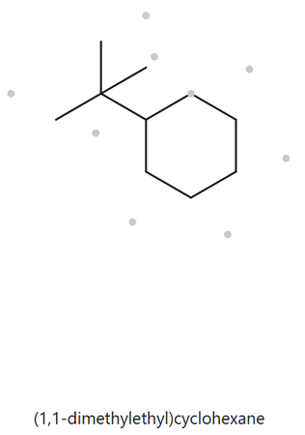
NAME → STRUCTURE
B08 | Challenge · Given Name: tert-butylcyclohexane
1) Name Decoded
2) Bond-Line Structure
Parent: Cyclohexane → a 6-carbon ring.
Substituent: tert-Butyl on C1 → a branched substituent containing 4 carbon atoms (one central carbon bonded to three methyl groups).
Expected Formula: 6 + 4 = 10 C; one ring → C₁₀H₂₀.
3) Formula Check
4) Back-Check
Counted from the drawing: C₁₀H₂₀
Same as the given name
Cycloalkane with one ring: CₙH₂ₙ = C₁₀H₂(₁₀) = C₁₀H₂₀ ✓
Note: The tert-butylcyclohexane and (1,1-dimethylethyl)cyclohexane are the exact same compound because they describe the identical six-carbon ring with a four-carbon branch using two different official naming systems. While "tert-butyl" is the widely accepted common shorthand nickname for this specific four-carbon branch, "(1,1-dimethylethyl)" is its systematic IUPAC blueprint name that breaks down the branch step-by-step as a two-carbon chain (ethyl) with two one-carbon branches (1,1-dimethyl) attached to it.
VERIFICATION STRIP
parent length matches
substituent positions matched
formula agrees
back-check recorded

Slide 19
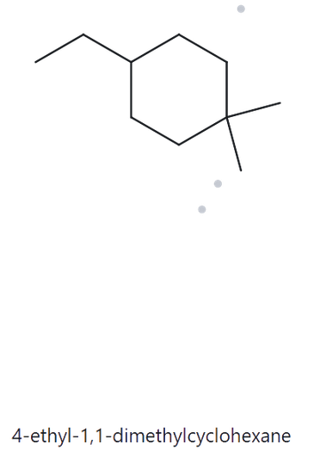
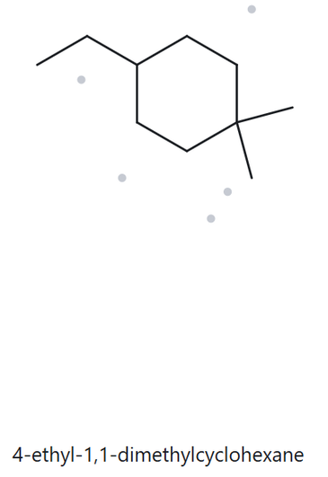
NAME → STRUCTURE
B09 | Challenge · Given Name: 3-ethyl-1,1-dimethylcyclohexane
1) Name Decoded
2) Bond-Line Structure
Parent: Cyclohexane → a 6-carbon ring.
Substituent: Ethyl on 3; two methyl groups on 1.
Expected Formula: 6 + 2 + 1 + 1 = 10 C; one ring → C₁₀H₂₀.
3) Formula Check
4) Back-Check
Counted from the drawing: C₁₀H₂₀
Cycloalkane with one ring: CₙH₂ₙ = C₁₀H₂(₁₀) = C₁₀H₂₀ ✓
Same as the given name
VERIFICATION STRIP
parent length matches
substituent positions matched
formula agrees
back-check recorded

Slide 20
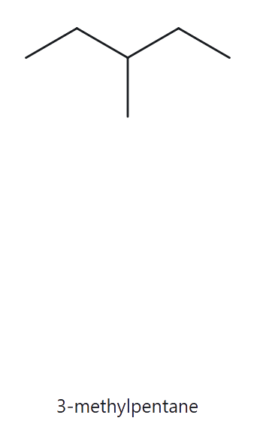
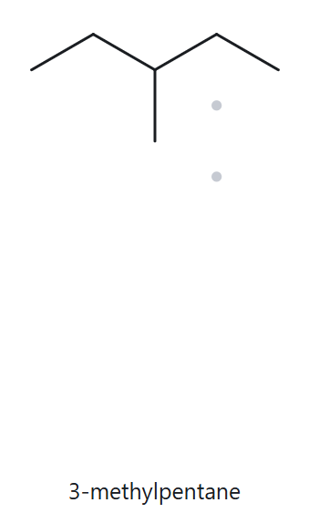
NAME → STRUCTURE
B10 | Challenge · Given Name: 2-ethylbutane (incorrect name)
The correct IUPAC name is 3-methylpentane, not 2-ethylbutane, because the longest continuous carbon chain contains five carbon atoms, making pentane the parent chain.
1) Name Decoded
2) Bond-Line Structure
Parent:
Substituent:
Expected Formula:
3) Formula Check
4) Back-Check
Counted from the drawing: C₈H₁₈
Acyclic alkane: CₙH₂ₙ+₂ = C₈H₂(₈)+₂ = C₈H₁₈ ✓
Same as the resolved name
VERIFICATION STRIP
parent length matches
substituent positions matched
formula agrees
back-check recorded

