Slide 1
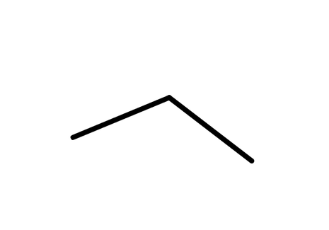

CARD 01 - PROPANE
C₃H₈
1. Molecular Formula
2. Lewis Structure
H
H
H
C₃H₈
—
—
—
H —
C — C — C
— H
—
—
—
H
H
H
3. Condensed Structural Formula
4. Bond-Line Formula
CH₃CH₂CH₃
VERIFICATION STRIP
atom count verified
valence checked
bond order checked
same connectivity confirmed

Slide 2
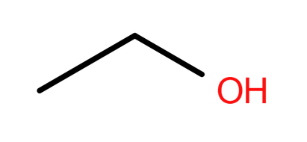
CARD 02 - ETHANOL
C₂H₆O
1. Molecular Formula
2. Lewis Structure
H
H
C₂H₆O
—
—
.
.
H —
C — C — O — H
.
.
—
—
H
H
3. Condensed Structural Formula
4. Bond-Line Formula
CH₃CH₂OH
VERIFICATION STRIP
atom count verified
valence checked
bond order checked
same connectivity confirmed

Slide 3
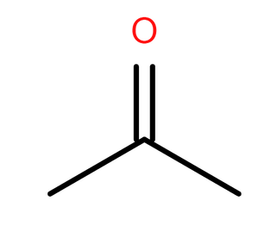
CARD 03 - ACETONE (PROPAN-2-ONE)
C₃H₆O
1. Molecular Formula
2. Lewis Structure
H
O
H
—
—
C₃H₆O
—
—
H —
C — C — C
— H
—
—
H
H
3. Condensed Structural Formula
4. Bond-Line Formula
CH₃COCH₃
VERIFICATION STRIP
atom count verified
valence checked
bond order checked
same connectivity confirmed

Slide 4
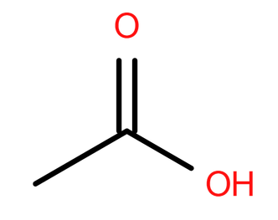
CARD 04 - ACETIC ACID (ETHANOIC ACID)
C₂H₄O₂
1. Molecular Formula
H —
2. Lewis Structure
H
—
—
H
C₂H₄O₂
.
.
—
O
—
.
.
.
C — C — O — H
.
.
.
3. Condensed Structural Formula
4. Bond-Line Formula
CH₃COOH
VERIFICATION STRIP
atom count verified
valence checked
bond order checked
same connectivity confirmed

Slide 5
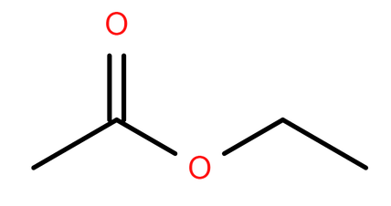
CARD 05 - ETHYL ACETATE (ETHYL ETHANOATE)
C₄H₈O₂
1. Molecular Formula
2. Lewis Structure
H
.
O
.
H
H
.
.
C₄H₈O₂
—
—
—
.
.
—
—
H —
C — C — O — C — C — H
.
.
—
—
—
H
H
H
3. Condensed Structural Formula
4. Bond-Line Formula
CH₃COOCH₂CH₃
VERIFICATION STRIP
atom count verified
valence checked
bond order checked
same connectivity confirmed

Slide 6
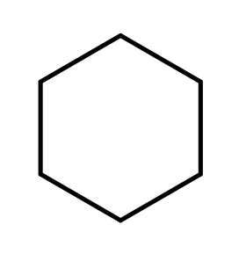
CARD 06 - CYCLOHEXANE
C₆H₁₂
1. Molecular Formula
2. Lewis Structure
H
H
H
—
—
H
C₆H₁₂
—
—
C
—
—
H
—
C
C
—
H
—
—
H
—
C
C
—
H
—
—
C
—
—
H
—
—
H
H
H
3. Condensed Structural Formula
4. Bond-Line Formula
CH₂CH₂CH₂CH₂CH₂CH₂
VERIFICATION STRIP
atom count verified
valence checked
bond order checked
same connectivity confirmed

Slide 7
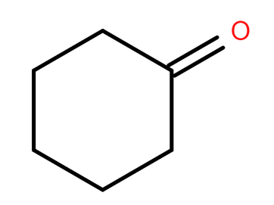
CARD 07 - CYCLOHEXANONE
C₆H₁₀O
1. Molecular Formula
2. Lewis Structure
H
H
H
—
—
C₆H₁₀O
—
—
C
—
—
C
C
—
O
H
—
—
—
H
—
C
C
—
H
—
—
C
—
—
H
—
—
H
H
H
3. Condensed Structural Formula
4. Bond-Line Formula
(CH₂)₅CO
VERIFICATION STRIP
atom count verified
valence checked
bond order checked
same connectivity confirmed

Slide 8
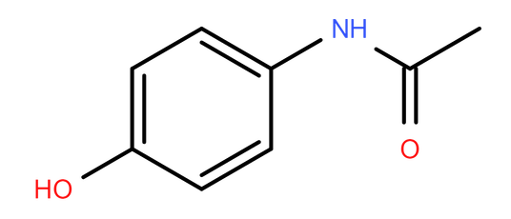
CARD 08 - ACETAMINOPHEN (PARACETAMOL)
C₈H₉NO₂
1. Molecular Formula
2. Lewis Structure
H
H
—
—
C₈H₉NO₂
C — C
H
—
—
—
. .
—
. .
. .
—
H
O —
C
C
— N
—
—
—
—
—
—
C
— C
— H
H
C — C
—
—
—
—
. .
—
H
H
O
H
. .
3. Condensed Structural Formula
4. Bond-Line Formula
HOC₆H₄NHCOCH₃
VERIFICATION STRIP
atom count verified
valence checked
bond order checked
same connectivity confirmed

Slide 9
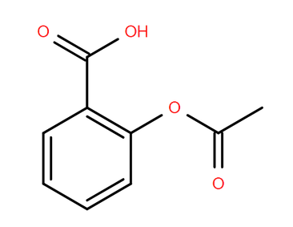
CARD 09 - ASPIRIN (ACETYLSALICYLIC ACID)
C₉H₈O₄
1. Molecular Formula
2. Lewis Structure
H
. .
—
. .
O
. .
O
—
—
. .
C₉H₈O₄
—
C
H
—
. .
—
—
H
H
C
—
—
O
—
—
C
—
—
. .
C
—
C
C
—
—
H
—
—
—
—
C
—
C
O
. .
H
—
—
C
—
—
. .
—
H
H
3. Condensed Structural Formula
4. Bond-Line Formula
CH₃COOC₆H₄COOH
VERIFICATION STRIP
atom count verified
valence checked
bond order checked
same connectivity confirmed

Slide 10
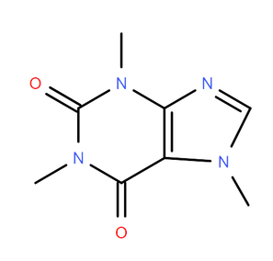
CARD 10 - CAFFEINE
C₈H₁₀N₄O₂
1. Molecular Formula
2. Lewis Structure
. .
. .
H
H
O
—
—
—
C
—
. .
—
—
C₈H₁₀N₄O₂
H
C
—
N
H
—
—
—
—
C
—
N
H
—
. .
C
—
. .
—
—
N
H
C
C
—
—
—
—
—
O
—
—
C
. .
. .
N
—
—
—
. .
H
—
C
—
H
H
—
3. Condensed Structural Formula
4. Bond-Line Formula
H
SMILES Notation
CN1C=NC2=C1C(=O)N(C(=O)N2C)C
Note: Caffeine does not have a conventional condensed structural formula because it is a complex, bicylci heterocyclic organic compound.
VERIFICATION STRIP
atom count verified
valence checked
bond order checked
same connectivity confirmed

