Slide 1

Bias incidents
Juliana Rosa
05/04/2021
Data 205- Capstone in Data Science

Slide 2
Datasets overview
Bias Incidents dataset:
Source: dataMontgomery.
Variables of interest: incident date, bias code, offense, case status, victim count, and suspect count.
Hate Crimes dataset:
Source: Kaggle.
Variables of interest: year, state, bias code, offense, victim count, offender count, and offender race.

Slide 3
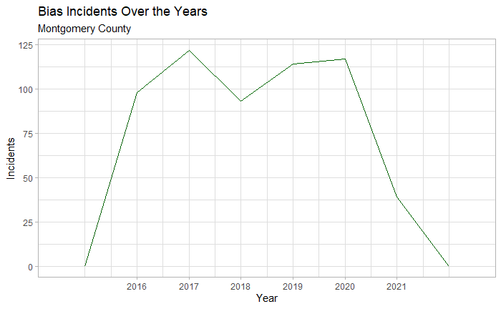
Year of the incident
Source: dataMontgomery

Slide 4
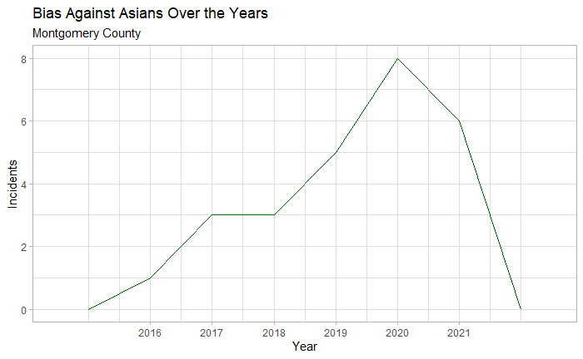
Year of the incident
Filter:
Anti-Asian
Source: dataMontgomery

Slide 5
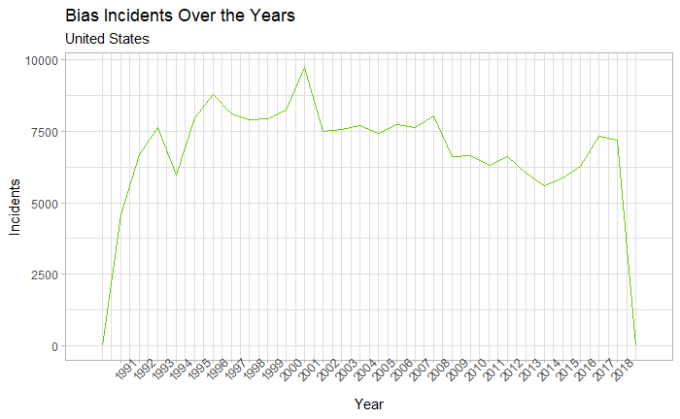
Year of the incident
Source: Kaggle

Slide 6
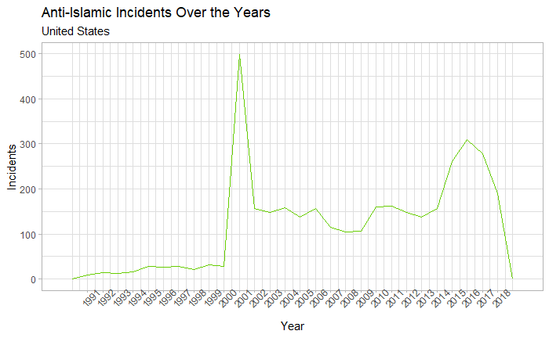
Year of the incident
Filter:
Anti-Islamic
Source: Kaggle

Slide 7
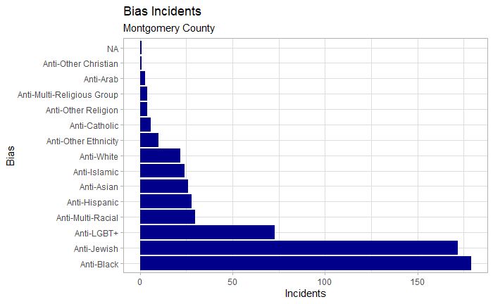
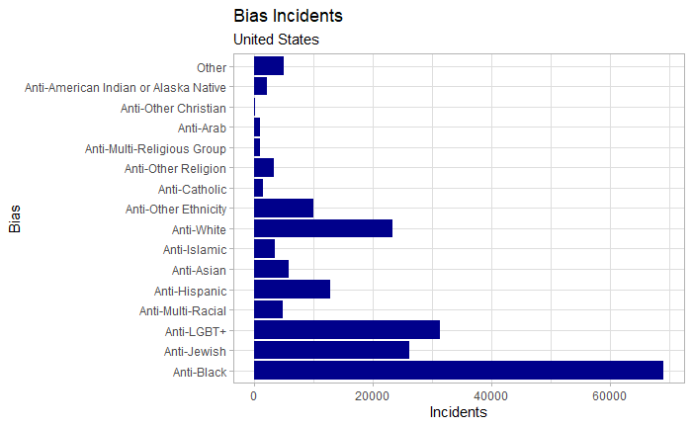
Bias code of the incident
Source: dataMontgomery
Source: Kaggle

Slide 8
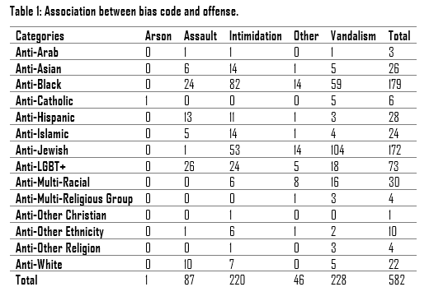
Bias code vs offense
Montgomery
County
Source: dataMontgomery

Slide 9
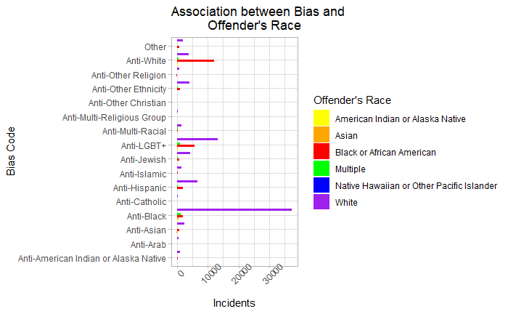
Bias code vs offender’s race
United States
89,302 Missing Values
Source: Kaggle

Slide 10
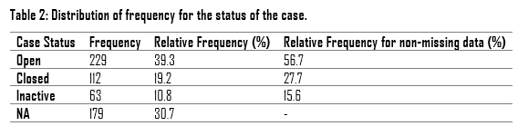
Case status
Montgomery
County
Source: dataMontgomery

Slide 11
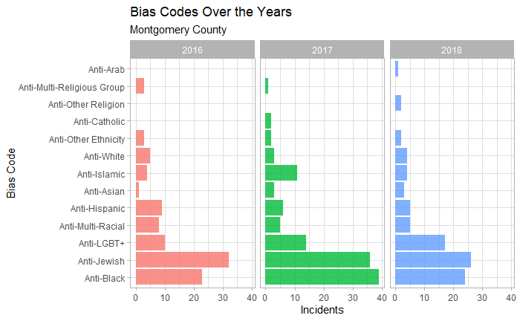
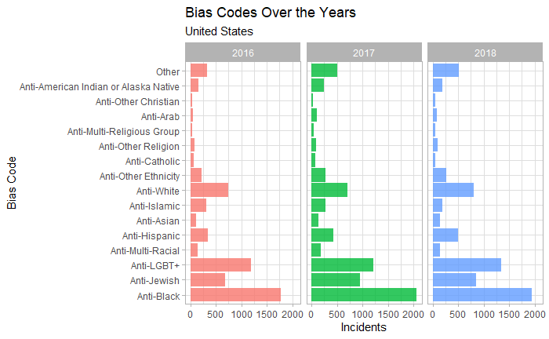
Year vs bias code
Source: dataMontgomery
Source: Kaggle

Slide 12
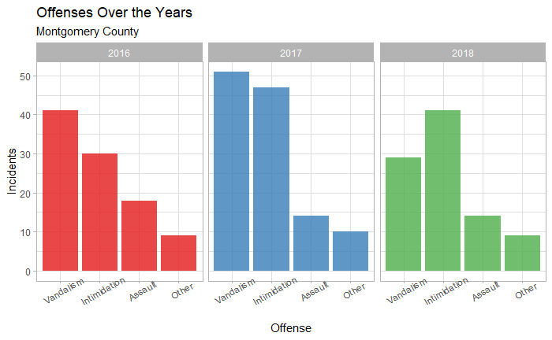
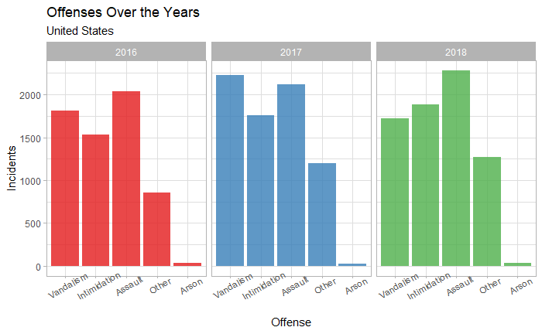
Year vs offense
Source: dataMontgomery
Source: Kaggle

Slide 13
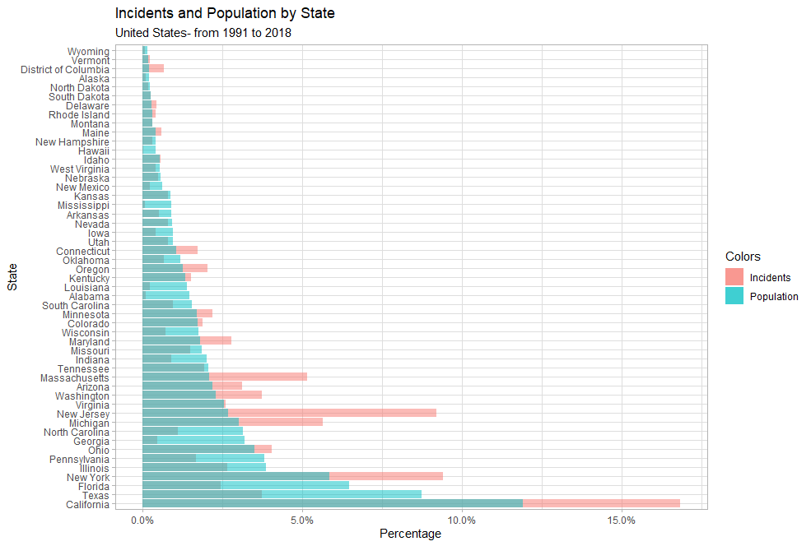
states
Source: Kaggle

Slide 14
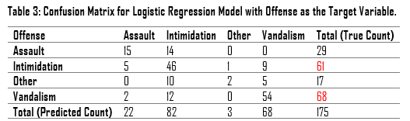
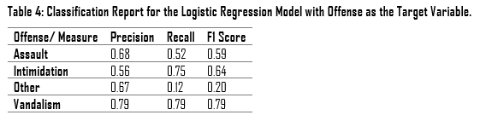
Predicting offenses
Montgomery
County
Source: dataMontgomery

Slide 15
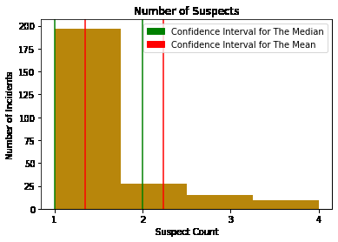
Number of suspects
Montgomery
County
Source: dataMontgomery

Slide 16
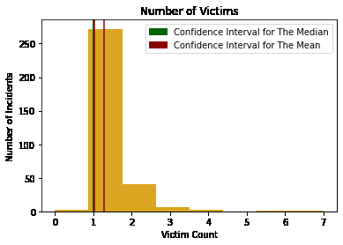
Number of victims
Montgomery
County
Source: dataMontgomery

Slide 17
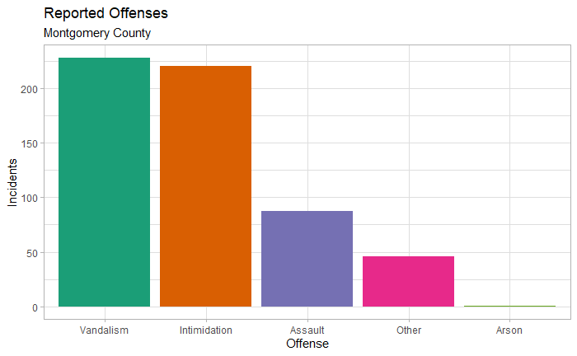
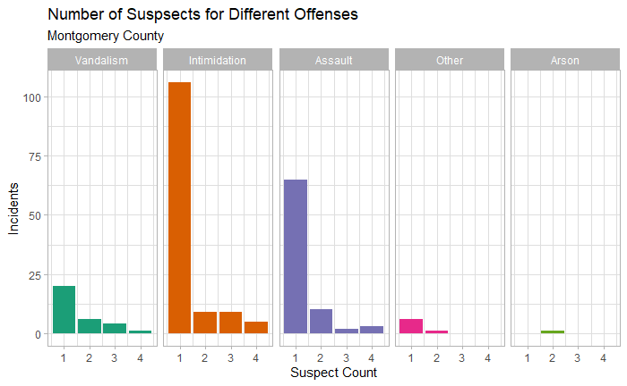
recommendations
For dataMontgomery: collect more information on the incidents’ locations and add it to the dataset.
Source: dataMontgomery

Slide 18


recommendations
Spread information about support services for hate crime victims (Maryland’s helpline, Victim Assistance and Sexual Assault Program- VASAP, local Office of Victim Services, etc.) through fliers in Black neighborhoods, pride centers, and synagogues or through social media groups/ pages that are usually accessed by African American, Jews, and people from the LGBT+ community (since they are the most frequent victims of hate crimes).

Slide 19
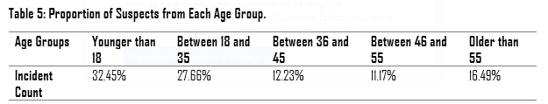
recommendations
Focus awareness campaigns on middle/ high school students, offering mini-courses about diversity.
Source: dataMontgomery

Slide 20

acknowledgments
Prof. Iapalucci;
Prof. Saidi;
Prof. Mohamed;
Victoria Lewis;
Montgomery College staff.

