Slide 1

Colors:
Background Default:
#00172b
Accent:
#2ab9d2
Background Light:
#002646
Font:
Montserrat: https://fonts.google.com/specimen/Montserrat
Logo:

Slide 2



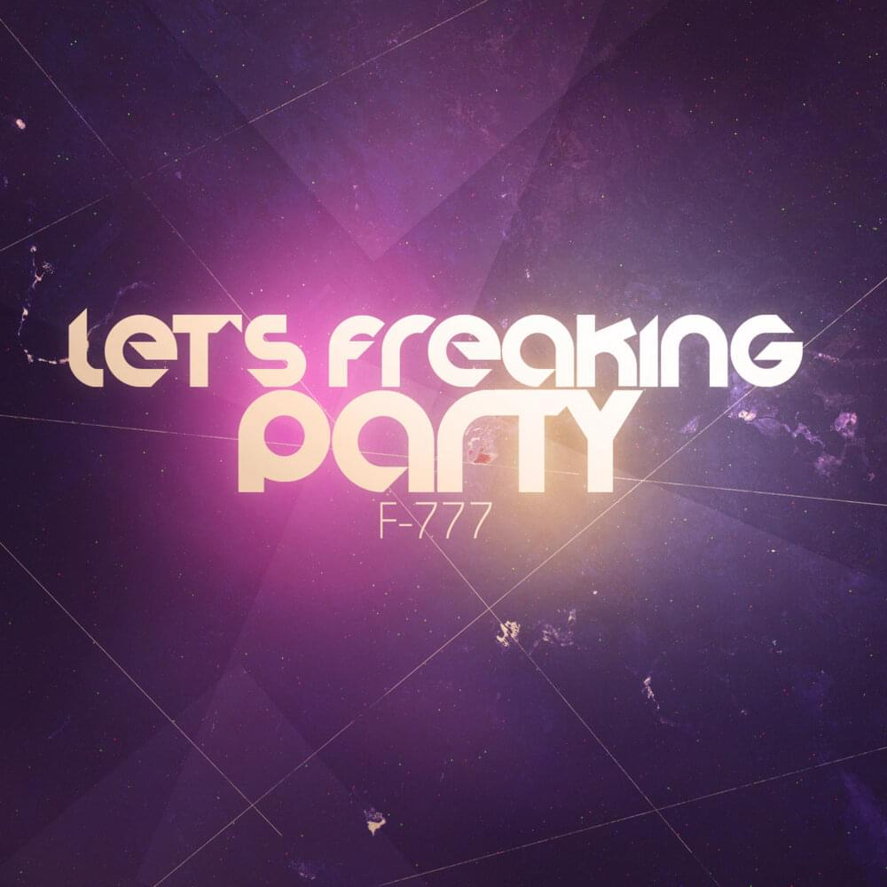




Search for something …
Recently played
F-777
Sonic Blaster

Slide 3
Search for something …
About this project

Slide 4
Search for something …
Library

Slide 5
Search for something …
Playlists

Slide 6
Search for something …
Browse

Slide 7
Search for something …
Download

