Slide 1

Colors:
Background Default:
#00172b
Accent:
#2ab9d2
Background Light:
#002646
Font:
Montserrat: https://fonts.google.com/specimen/Montserrat
Logo:

Slide 2
Desktop

Slide 3








Search for something …
Login
Welcome to SonicWave!
Login
Register
Notes:
Welcome page if not logged in

Slide 4

Search for something …
Logout
Recently played
F-777
3:02
F-777
3:02
F-777
3:02
F-777
3:02
F-777
3:02
F-777
3:02
F-777
3:02
Sonic Blaster
Sonic Blaster
Sonic Blaster
Sonic Blaster
Sonic Blaster
Sonic Blaster
Sonic Blaster
Playlists
8 Songs
28:18
8 Songs
28:18
8 Songs
28:18
8 Songs
28:18
8 Songs
28:18
8 Songs
28:18
8 Songs
28:18
Let’s freaking party
Let’s freaking party
Let’s freaking party
Let’s freaking party
Let’s freaking party
Let’s freaking party
Let’s freaking party
Artists
Notes:
Home page with multiple categories of songs listed

Slide 5
Search for something …
Logout
About this project
This is a private project made by me something something
GitHub
Frontend: https://github.com/julianamschwand/SonicWave Backend:
https://github.com/julianamschwand/SonicWaveBackend
Notes:
About page for project info

Slide 6





Search for something …
Logout
Library
Search for something …
Sonic Blaster
F-777
2014
3:02
Sonic Blaster
F-777
2014
3:02
Sonic Blaster
F-777
2014
3:02
Sonic Blaster
F-777
2014
3:02
Sonic Blaster
F-777
2014
3:02
Sonic Blaster
F-777
2014
3:02
Notes:
Library with all downloaded songs

Slide 7


Search for something …
Logout
Edit song
Title:
Title …
Genre:
Genre …
Release year:
Release year …
Artist:
Save
F-777
Cancel
Artist …
Notes:
Edit song page to edit song metadata

Slide 8
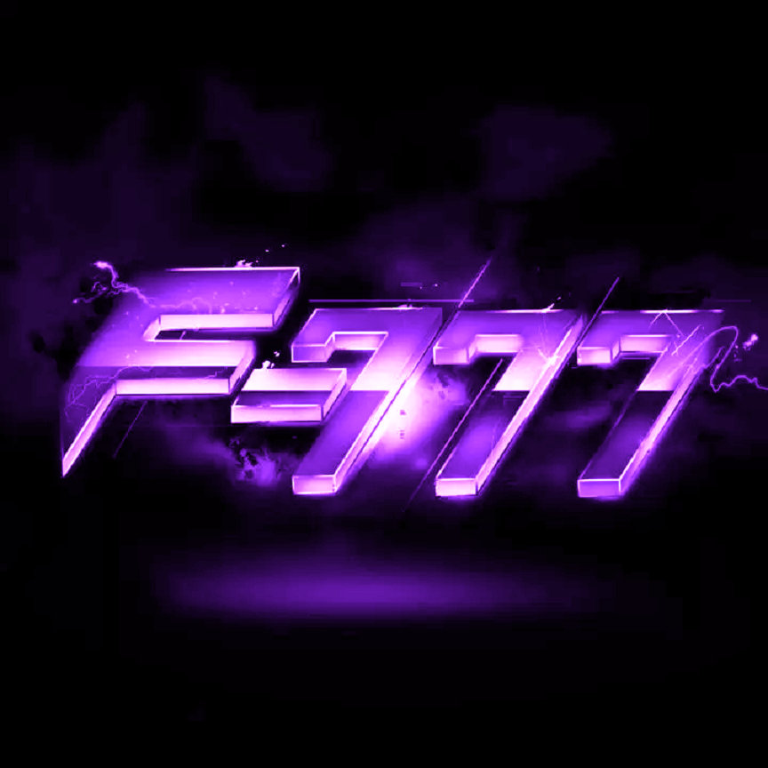
§
Search for something …
Logout
Edit artist
Name:
Name …
Description:
Description …
Save
Cancel
Notes:
Edit song page to edit song metadata

Slide 9

Search for something …
Logout
Playlists
8 Songs
28:18
8 Songs
28:18
8 Songs
28:18
8 Songs
28:18
8 Songs
28:18
8 Songs
28:18
8 Songs
28:18
Let’s freaking party
Let’s freaking party
Let’s freaking party
Let’s freaking party
Let’s freaking party
Let’s freaking party
Let’s freaking party
8 Songs
28:18
8 Songs
28:18
8 Songs
28:18
8 Songs
28:18
8 Songs
28:18
8 Songs
28:18
8 Songs
28:18
Let’s freaking party
Let’s freaking party
Let’s freaking party
Let’s freaking party
Let’s freaking party
Let’s freaking party
Let’s freaking party
Notes:
Playlist page to display all created playlists

Slide 10

Search for something …
Logout
Add playlist
Name:
Name …
Description:
Description …
Upload Image
Save
Cancel
Notes:
Playlist page to display all created playlists

Slide 11


Search for something …
Logout
Back
+
8 Songs
28 min 18 s
Let’s freaking party
By F-777
Sonic Blaster
F-777
2014
3:02
Sonic Blaster
F-777
2014
3:02
Sonic Blaster
F-777
2014
3:02
Sonic Blaster
F-777
2014
3:02
Notes:
Playlist page to display all created playlists

Slide 12




Search for something …
Logout
8 Songs
28 min 18 s
Let’s freaking party
By F-777
Sonic Blaster
F-777
2014
3:02
Sonic Blaster
F-777
2014
3:02
Sonic Blaster
F-777
2014
3:02
Sonic Blaster
F-777
2014
3:02
0:00
3:02
Sonic Blaster
Sonic Blaster
F-777
3:02
Notes:
Playlist page to display all created playlists

Slide 13
Search for something …
Logout
Browse
Search for something …
Sonic Blaster
F-777
2014
3:02
Sonic Blaster
F-777
2014
3:02
Sonic Blaster
F-777
2014
3:02
Sonic Blaster
F-777
2014
3:02
Sonic Blaster
F-777
2014
3:02
Sonic Blaster
F-777
2014
3:02
Notes:
Browse page to browse songs with the official soundcloud API

Slide 14
Search for something …
Logout
Download
Enter Song- or Playlist-URL
URL …
Notes:
Dowload page to download songs by URL with yt-dpl / spotDL

Slide 15
Sonic Bla
Logout
Songs
Download
Playlists
Artists
Notes:
Search dropdown

Slide 16





Search for something …
Logout
Register requests
User management
GenericUser123 wants to register
GenericUser123
user
GenericUser123 wants to register
SpecialUser123
admin
GenericUser123 wants to register
GenericUser123
user
GenericUser123 wants to register
Notes:
Admin panel to accept / deny registration requests and manage users

Slide 17
Mobile

Slide 18
Login
Welcome to SonicWave!
Login
Register
Notes:
Welcome page if not logged in

Slide 19
Logout
Recently played
F-777
3:02
F-777
3:02
F-777
3:02
Sonic Blaster
Sonic Blaster
Sonic Blaster
Playlists
8 Songs
28:18
8 Songs
28:18
8 Songs
28:18
Let’s freaking party
Let’s freaking party
Let’s freaking party
Artists
Notes:
Welcome page if not logged in

Slide 20

Logout
Library
Search for something …
Sonic Blaster
3:02
F-777
Sonic Blaster
3:02
F-777
Sonic Blaster
3:02
F-777
Sonic Blaster
3:02
F-777
Sonic Blaster
3:02
F-777
Sonic Blaster
3:02
F-777
Sonic Blaster
3:02
F-777
Sonic Blaster
3:02
F-777
Notes:
Welcome page if not logged in

Slide 21
Logout
Playlists
8 Songs
28:18
8 Songs
28:18
Let’s freaking party
Let’s freaking party
8 Songs
28:18
8 Songs
28:18
Let’s freaking party
Let’s freaking party
Notes:
Welcome page if not logged in

Slide 22
Logout
8 Songs
28:18
Let’s freaking party
By F-777
Sonic Blaster
3:02
F-777
Sonic Blaster
3:02
F-777
Sonic Blaster
3:02
F-777
Sonic Blaster
3:02
F-777
Sonic Blaster
3:02
F-777
Notes:
Welcome page if not logged in

Slide 23
Logout
8 Songs
28:18
Let’s freaking party
By F-777
Sonic Blaster
3:02
F-777
Sonic Blaster
3:02
F-777
Sonic Blaster
3:02
F-777
Sonic Blaster
3:02
F-777
Sonic Blaster
3:02
F-777
Sonic Blaster
F-777
Notes:
Welcome page if not logged in

Slide 24


from Let’s freaking party
Sonic Blaster
0:00
3:02
Notes:
Welcome page if not logged in

Slide 25
Logout
Search
Search for something …
Songs
F-777
3:02
F-777
3:02
Sonic Blaster
Playlists
8 Songs
28:18
8 Songs
28:18
Let’s freaking party
Let’s freaking party
Artists
Notes:
Welcome page if not logged in

Slide 26
Logout
Browse
Search for something …
Sonic Blaster
3:02
F-777
Sonic Blaster
3:02
F-777
Sonic Blaster
3:02
F-777
Sonic Blaster
3:02
F-777
Sonic Blaster
3:02
F-777
Sonic Blaster
3:02
F-777
Sonic Blaster
3:02
F-777
Sonic Blaster
3:02
F-777
Notes:
Welcome page if not logged in

Slide 27
Logout
Enter Song- or Playlist-URL
URL …
Notes:
Welcome page if not logged in

